Slide 1
Evaluation of AI algorithms for biomedical research and sex and gender biases in AI
Block 4: Project Design and Implementation of Best Practices
Carolina Belver Aguilar, BSC
30/01/26
© 2026 Barcelona Supercomputing Center - Centro Nacional de Supercomputación.
Author: Carolina Belver Aguilar. Material licensed under CC BY-NC-4.0.

Slide 2
Why do we need to change our perspective?
© 2026 BSC-CNS. Licensed under CC BY-NC-4.0
Why do we need to change our perspective?
For a long time, biomedical research was “gender-blind”, assuming that results from male subjects applied to everyone.
This lack of diversity leads to less accurate science and potential risks for patient safety.
We must move towards “gender-aware” research to ensure high-quality and inclusive results.

Slide 3
How do we achieve excellence in research?
© 2025 BSC-CNS. Licensed under CC BY-NC-4.0
Integrating sex and gender is not an “extra” step; it is a fundamental part of scientific excellence.
We will use the Hipatia toolkit as our roadmap to evaluate every stage of our projects.
This approach improves the reproducibility of our data and the social relevance of our findings.

Slide 4
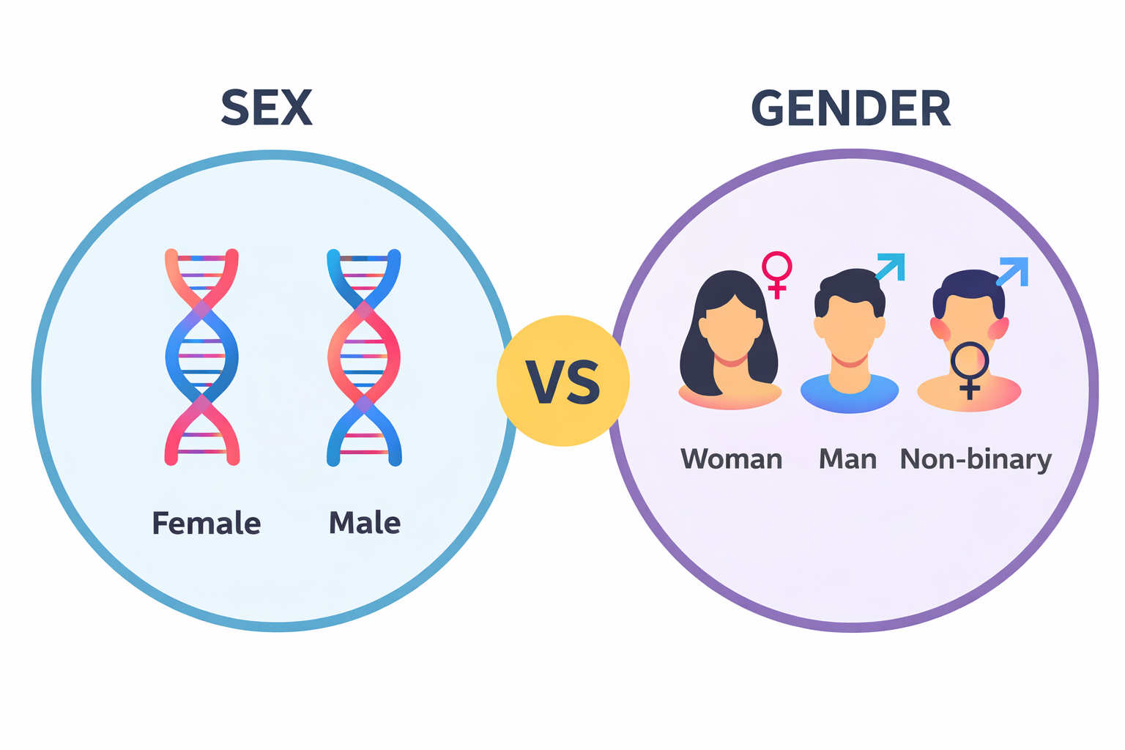
Key concept: Sex as a biological variable
© 2025 BSC-CNS. Licensed under CC BY-NC-4.0
Sex refers to biological characteristics, such as chromosomes, hormones and anatomy.
It is an important variable in basic research, involving cells, tissues and animal models.
In bioinformatics and AI, sex is a primary variable that influences how we process genomic data.

Slide 5
Key concept: Gender as a social construct
© 2025 BSC-CNS. Licensed under CC BY-NC-4.0
Gender refers to the social roles, behaviours and identities that society considers appropriate for men and women.
Gender influences how people access healthcare, their exposure to risks, and their lifestyle.
To understand a patient’s health completely, we must look at how biological sex and social gender interact.

Slide 6
Beyond sex and gender: Intersectionality
© 2025 BSC-CNS. Licensed under CC BY-NC-4.0
People are not defined by a single category; multiple factors like age, ethnicity and geography overlap.
Analysing only “women” or “men” as uniform groups can hide important differences in health outcomes.
To achieve true precision, we must consider how these different social and biological layers interact.

Slide 7
The risk of overlooking diversity
© 2025 BSC-CNS. Licensed under CC BY-NC-4.0
Excluding females from early-stage research has created a “knowledge gap” in medicine.
This lack of data often leads to incorrect diagnoses or less effective treatments for women.
If we train algorithms using biased historical data, the AI will repeat and amplify these same “blind spots”.

Slide 8
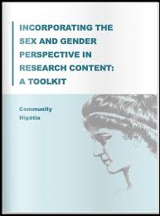
The Legal Framework
© 2025 BSC-CNS. Licensed under CC BY-NC-4.0
Public institutions like AQuAS require the integration of the sex and gender perspective in all health research.
Following these guidelines is not optional; it is a marker of scientific quality and ethics.
Projects that include a sex and gender dimension are more likely to meet international funding requirements (e.g., Horizon Europe).

Slide 9
The Hipatia toolkit
© 2025 BSC-CNS. Licensed under CC BY-NC-4.0
It is a systematic checklist developed to guide researchers through every phase of their project.
It helps identify where sex and gender are relevant and how to address them specifically.
The toolkit follows the natural “life cycle” of a research project, from the first idea to the final report.
hipatia-toolkit-checklist-fillable-aquas2024.pdf

Slide 10
© 2026 BSC-CNS. Licensed under CC BY-NC-4.0
The Hipatia Process

Slide 11
Phases of a research project
© 2025 BSC-CNS. Licensed under CC BY-NC-4.0
Phase 1: The idea
Phase 2: The methodology
Phase 3: Data analysis
Phase 4: Reporting

Slide 12
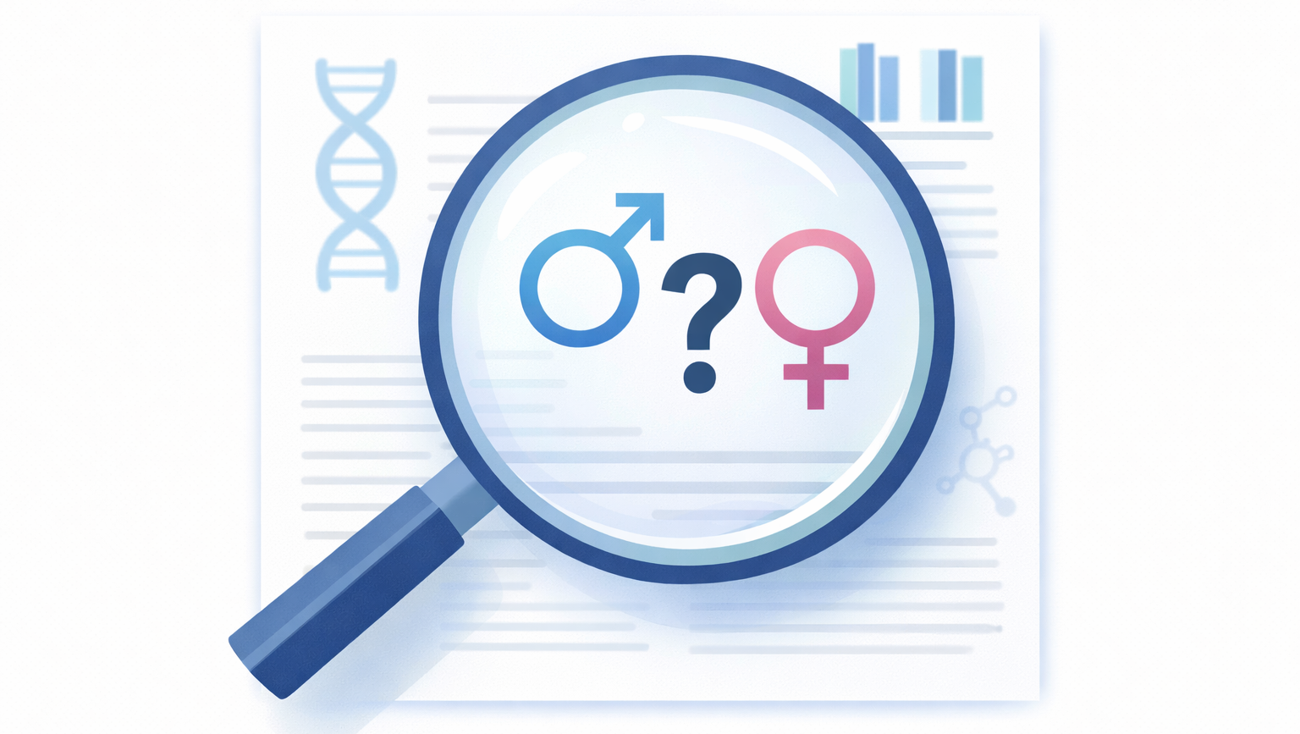
Phase 1 - The research idea
© 2025 BSC-CNS. Licensed under CC BY-NC-4.0
Asking the right questions.
Initial reflection: Does the health problem you are studying affect men, women and non-binary people differently?
Literature Gap: When reviewing previous studies, check if thy reported sex-disaggregated data or ignored it.
Your project should aim to fill these gaps by including diverse perspectives from the very beginning.

Slide 13
Phase 1 - The research idea
© 2025 BSC-CNS. Licensed under CC BY-NC-4.0
Defining the hypothesis.
Your research hypothesis should explicitly state if you expect different biological or social outcomes.
Defining these variables at the start prevents biased interpretations during the analysis phase.
Identify if ignoring sex or gender could lead to a “false negative” or an incorrect conclusion in your study.

Slide 14
Phase 1 - The research idea
© 2025 BSC-CNS. Licensed under CC BY-NC-4.0
Justification of the sample.
In the Hipatia framework, diversity is the default; exclusion is the exception that must be explained.
If you study only one sex (e.g., ovarian cancer), you must justify why this is scientifically required.
You cannot exclude a sex or gender simply because it “complicates” the data or the recruitment process.

Slide 15
Phase 1 - The research idea
© 2025 BSC-CNS. Licensed under CC BY-NC-4.0
Setting objectives.
Ensure your project goals mention the analysis of sex and gender as a scientific priority.
Explain how your results will be more applicable to the whole population by including these variables.
Remember that including the gender dimension is a key criterion for high-quality scientific evaluation.

Slide 16
Phase 2 - Methodology
© 2025 BSC-CNS. Licensed under CC BY-NC-4.0
Who is part of the study?
The Hipatia toolkit requires that the sample reflects the diversity of the people affected by the health issue.
Aim for a balanced number of males and females to ensure enough statistical power for both.
Plan specific actions to reach groups that are usually underrepresented in medical research.

Slide 17
Phase 2 - Methodology
© 2025 BSC-CNS. Licensed under CC BY-NC-4.0
Biological diversity in the lab
Cell Lines: Verify and document the chromosomal sex (XX or XY) of the cells used in your experiments.
Animal models: Use both male and female animals to capture biological variability that might be masked otherwise.
Documenting these choices is essential for other scientists to reproduce your results.

Slide 18
Phase 2 - Methodology
© 2025 BSC-CNS. Licensed under CC BY-NC-4.0
Data collection
Ensure that surveys, interviews and forms are designed to capture both biological sex and gender identity.
Use clear and validated categories to avoid ambiguity when different researchers collect the data.
In clinical settings, consider how the environment might influence the answers of different gender groups.

Slide 19
Phase 2 - Methodology
© 2025 BSC-CNS. Licensed under CC BY-NC-4.0
Preparing for disaggregated data
You must plan to analyse data for males and females separately (sex-disaggregated analysis) from the start.
Do not plan to “correct” or “adjust” for sex as if it were a problem; treat it as a primary variable of interest.

Slide 20
Phase 3 - Data analysis
© 2025 BSC-CNS. Licensed under CC BY-NC-4.0
Looking for differences and similarities
Conduct specific tests to see if the treatment or biological marker behaves differently in men and women.
A “neutral” average can hide the fact that a drug works well for one group but is toxic for another.
If the sample size allows, analyse how sex interacts with other variables like age or ethnicity.

Slide 21
Phase 3 - Data analysis
© 2025 BSC-CNS. Licensed under CC BY-NC-4.0
Interpreting results
If you find a difference, investigate if it is due to biological factors (sex) or social behaviours (gender).
Be careful not to use gender stereotypes to explain your results without scientific evidence.
If no differences are found, report it. Knowing that a treatment is equally effective for everyone is a very valuable scientific finding.

Slide 22
Phase 4 - Reporting and dissemination
© 2025 BSC-CNS. Licensed under CC BY-NC-4.0
Transparency in science
Always state the sex of the subjects in the title or abstract.
Use graph and tables that clearly show the results for each sex, even if they are similar.
SAGER guidelines: Follow the “Sex and Gender Equity in Research” standards when preparing your manuscript for publication.

Slide 23
Closing the Hipatia Loop: Self-evaluation
© 2025 BSC-CNS. Licensed under CC BY-NC-4.0
Use the toolkit to review if you have fulfilled all the sex and gender-dimension criteria.
Identify which areas were the most challenging to include for future project designs.
Share your process to help other teams in your institution follow these best practices.

Slide 24
© 2026 BSC-CNS. Licensed under CC BY-NC-4.0
Impact & AI Examples

Slide 25

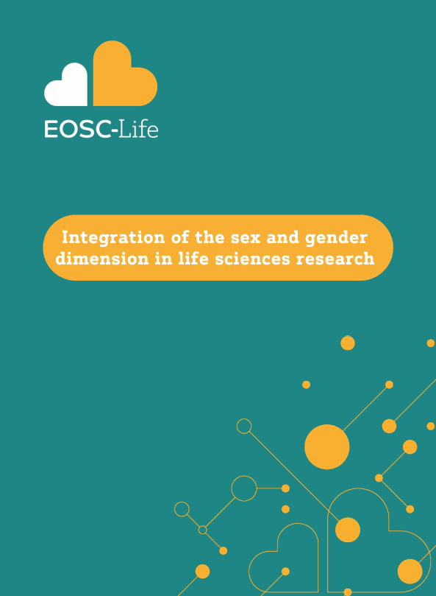

The handbook
© 2025 BSC-CNS. Licensed under CC BY-NC-4.0

Slide 26
Cardiovascular disease
© 2025 BSC-CNS. Licensed under CC BY-NC-4.0
“Canadian investigators collected gender-relevant variables through a questionnaire and developed a methodology to generate a composite measure of gender, the gender score. This score predicted the recurrence of cardiovascular events and showed that individuals with characteristics traditionally ascribed to women had worse outcomes, highlighting the importance of including gender and sex in studies.“

Slide 27
Gene expression
© 2025 BSC-CNS. Licensed under CC BY-NC-4.0
“Sex-biased regulatory network structures have been described in healthy tissue as well as in diseased individuals. Even though most transcription factors (TFs) are not differentially expressed between males and females, many have sex-biased regulatory targeting patterns. For example, genes associated with Parkinson’s disease and Alzheimer’s disease are targeted by different sets of TFs in each sex”.

Slide 28
Adverse drug reactions (ADR)
© 2025 BSC-CNS. Licensed under CC BY-NC-4.0
“Pharmaceutical research, closely related to drug development, is a sub-field of biomedicine where the inclusion of the sex and gender perspective is urgent. Most of the treatments we have are the outcome of pre-clinical and clinical trials with a specific drug. For this, lack of gender diversity within these trials has resulted in suboptimal healthcare for minorities and females, which has been reported since 1986 (Geller et al., 2018). It is not acceptable to employ Caucasian male-tailored drug treatments, given the fact that the drug dynamics are quite different between males and females (Zucker & Prendergast, 2020). This is due to many factors, but the most relevant one is argued to be the historically disproportionate use of male animal models in clinical trials (Zucker & Beery, 2010): A survey of 2000 animal studies published in 2010 found that 80% of studies had male bias (Ravindran et al., 2020). “

Slide 29
Related pain
© 2025 BSC-CNS. Licensed under CC BY-NC-4.0
A patient has sex characteristics that affect how they feel pain, but the patient is also influenced by gender norms in the culture they live in, and this may influence how that patient feels and expresses pain. Gender norms, for example, may influence a person’s willingness to report pain. In many cultures, men are expected to be strong and resolute, which means that men may be less willing to express pain than women. This varies by ethnicity and other social factors. Physician gender stereotypes may also influence their choice of treatments for men and women. Clinicians often perceive women’s pain to be psychological, and women may receive more non specific diagnoses, wait longer for treatment, and receive more antidepressants and fewer painkillers than men. Consequently, the treatment a patient receives depends in part on the patient’s gender and on the physician’s gender assumptions. To my knowledge, this has not been studied in nonbinary patients. (Source: Schiebinger, L. (2022). Sex, gender, and intersectional puzzles in health and biomedicine https://doi.org/10.1016/j.medj.2022.04.003 ).

Slide 30
© 2026 BSC-CNS. Licensed under CC BY-NC-4.0
Best practices

Slide 31
The new standard for best practices
© 2025 BSC-CNS. Licensed under CC BY-NC-4.0
Use sex-disaggregated data from the beginning.
Perform subgroup analysis to ensure the algorithm works for everyone, not just the “average”.
Transparently report if the dataset was balanced of if it has limitations regarding sex and gender.

Slide 32
Ethics in data
© 2025 BSC-CNS. Licensed under CC BY-NC-4.0
Data is never "neutral."
It is not just about what the data says, but how it was collected and who was excluded in the process.
The social science perspective ensures that the AI's "conclusions" don't turn into harmful social stereotypes.

Slide 33
Correcting historical neglect
© 2025 BSC-CNS. Licensed under CC BY-NC-4.0
For decades, "chest pain" was coded based on male physiology. AI models trained on this data "learned" that women's symptoms were atypical.
By using the Hipatia Toolkit, researchers identified this gap and retrained models using sex-stratified data.
This isn't just "better ethics"; it's a software update that significantly reduces the false-negative rate for female patients.

Slide 34
Algorithmic accountability
© 2025 BSC-CNS. Licensed under CC BY-NC-4.0
If an AI diagnostic tool fails a specific gender group, we need to be able to audit "why.“
Researchers must document the sex and gender composition of their training datasets in their final reports and explain how sex variables were handled during feature engineering.

Slide 35

Diversity in the technical teams
© 2025 BSC-CNS. Licensed under CC BY-NC-4.0
Even the most objective engineer has biases. If a team is homogeneous, they are more likely to overlook biases.
Diversity in teams leads to more diverse questions during the "Idea Phase," preventing biases before the first line of code is written.
Institutions should promote balanced teams not just for "fairness," but to improve the quality of the research.

Slide 36
Diversity in peer review and evaluation
© 2025 BSC-CNS. Licensed under CC BY-NC-4.0
AQuAS emphasizes that committees evaluating AI projects must have gender-balanced representation.
We tend to value research that resembles our own experience.
Diverse committees are better at spotting if a project has ignored the sex and gender dimension.

Slide 37
© 2026 BSC-CNS. Licensed under CC BY-NC-4.0
A practical guideline

Slide 38
The “fairness” checklist – design phase
© 2025 BSC-CNS. Licensed under CC BY-NC-4.0
Use the Hipatia Toolkit to identify if previous models in your field have a "male-only" bias.
Decide at the start of the code architecture that you will evaluate performance for "Male," "Female," and, where possible, "Non-binary.“
If your software is sex-specific (e.g., prostate cancer), document the technical reason to meet AQuAS standards.

Slide 39
The “fairness” checklist – data engineering
© 2025 BSC-CNS. Licensed under CC BY-NC-4.0
Ensure the "Sex" variable is not lost during data cleaning or normalization.
When splitting data into Training, Validation, and Test sets, ensure each "fold" maintains a representative sex ratio.
Work with a social scientist to identify if variables like "zip code" or "insurance type" are acting as hidden gender proxies.

Slide 40
The “fairness” checklist – evaluation
© 2025 BSC-CNS. Licensed under CC BY-NC-4.0
Do not settle for "Global Accuracy." Calculate the Error Rate, Precision, and Recall separately for each sex.
Create "Confusion Matrices" for both groups to see if the AI fails differently (e.g., more False Negatives in women).
If you remove 10% of the female data, does the model collapse? This tests the robustness of your diversity.

Slide 41
Communicating results (reporting)
© 2025 BSC-CNS. Licensed under CC BY-NC-4.0
The SAGER Guidelines: Follow these international standards for "Sex and Gender Equity in Research" when writing your README or paper.
If your dataset was biased and you couldn't fix it, say so. Transparency is a key value in the AQuAS framework.
Use "Disaggregated Data Visualizations." Avoid merging everyone into a single "average" line in your charts.

Slide 42
Humanizing the output
© 2025 BSC-CNS. Licensed under CC BY-NC-4.0
Ensure the final report doesn't use language that reinforces gender stereotypes.
Explain why a difference might exist (biology vs. social).
Act as the "Human-in-the-loop" to ensure the AI's recommendations are socially responsible and safe.

Slide 43
Building a legacy
© 2025 BSC-CNS. Licensed under CC BY-NC-4.0
Document your "Gender-Aware" workflow so it can be reused as a template by other engineering teams.
Senior engineers should mentor juniors on how to detect and mitigate these biases early.
Set up a schedule to re-evaluate your AI models every 6 months to ensure they haven't developed "bias drift."

Slide 44
© 2026 BSC-CNS. Licensed under CC BY-NC-4.0
Conclusion

Slide 45
The economic case for equity
© 2025 BSC-CNS. Licensed under CC BY-NC-4.0
"Gender-blind" research leads to failed clinical trials and retracted software. Equity is more cost-effective in the long run.
Diverse and inclusive research environments are more attractive to top-tier international scientists and engineers.
Most modern funding bodies (like Horizon Europe) now require a "Gender Equality Plan" (GEP) to award grants.

Slide 46
The future of biomedical AI
© 2025 BSC-CNS. Licensed under CC BY-NC-4.0
True innovation only happens when we stop designing for a "universal default" and start designing for everyone.
Sex and gender integration is the new gold standard for scientific and technical quality.
Your next project starts with a choice: will it be "blind" or will it be "aware"?

Slide 47
Thanks!
Questions?
© 2025 Barcelona Supercomputing Center - Centro Nacional de Supercomputación. Author: (XXXX).
Material licensed under CC BY-NC-4.0.

