Slide 1
Quantifying Sex Data with LLMs
Systematic Extraction from Biomedical Literature
Olivier Philippe* BSC
““fellowship within the “Generación D” initiative, Red.es, Ministerio para la Transformación Digital y de la Función Pública, for talent attraction (C005/24-ED CV1). Funded by the European Union NextGenerationEU funds, through PRTR”
27/01/2026
© 2025 Barcelona Supercomputing Center - Centro Nacional de Supercomputación.
Author: (Olivier Philippe). Material licensed under CC BY-NC-4.0.
Notes:
Not "Sex and Gender Bias in AI"
But: How AI Can Help Detect Sex and Gender Bias in Literature

Slide 2
Why This Matters
Sex and gender play a decisive role in health outcomes:
Women live longer than men but spend more years in poor health
Cardiovascular disease, autoimmune disorders, chronic pain → under-studied in women
Delayed diagnoses and pain bias remain common
EU has made gender mainstreaming a pillar of research policy (Horizon Europe, EU4Health)

Slide 3
Research literature is no longer just for humans to read
© 2025 BSC-CNS. Licensed under CC BY-NC-4.0
Model | Company | Training includes scientific papers
GPT-4 | OpenAI | Undisclosed mix
Claude | Anthropic | Undisclosed mix
LLaMA 3 | Meta | 15T tokens incl. arXiv ¹
Gemini | Google | "Keen focus on scientific papers" ²
DeepSeek | DeepSeek | 8.1T multi-source corpus ³
Mistral | Mistral AI | Yes (Biomistral)⁴
Meta AI Blog: https://ai.meta.com/blog/meta-llama-3/
Wikipedia/Google PaLM: https://en.wikipedia.org/wiki/PaLM
Shao, Z., Dai, D., Guo, D., Liu (Benjamin Liu), B., Wang, Z., & Xin, H. (2024). DeepSeek-V2: A Strong, Economical, and Efficient Mixture-of-Experts Language Model. ArXiv, abs/2405.04434.
Labrak, Y., Bazoge, A., Morin, E., Gourraud, P. A., Rouvier, M., & Dufour, R. (2024). Biomistral: A collection of open-source pretrained large language models for medical domains. arXiv preprint arXiv:2402.10373.

Slide 4
Bias in Research
© 2025 BSC-CNS. Licensed under CC BY-NC-4.0

Slide 5
Sex Bias in Clinical Trials
© 2025 BSC-CNS. Licensed under CC BY-NC-4.0
Evidence
Statistic
Median women enrolment
41% ¹
Phase I trials
Only 30.6% women ²
Cardiovascular trials
Only 30% women ³
Trials exclusively male
34.1% ²
Daitch, V., Turjeman, A., Poran, I. et al. Underrepresentation of women in randomized controlled trials: a systematic review and meta-analysis. Trials 23, 1038 (2022). https://doi.org/10.1186/s13063-022-07004-2
Merone, L., Tsey, K., Russell, D., & Nagle, C. (2022). Sex Inequalities in Medical Research: A Systematic Scoping Review of the Literature. Women's health reports (New Rochelle, N.Y.), 3(1), 49–59. https://doi.org/10.1089/whr.2021.0083
Tobb, K., Kocher, M., & Bullock-Palmer, R. P. (2022). Underrepresentation of women in cardiovascular trials- it is time to shatter this glass ceiling. American heart journal plus : cardiology research and practice, 13, 100109. https://doi.org/10.1016/j.ahjo.2022.100109

Slide 6
Historical Context
© 2025 BSC-CNS. Licensed under CC BY-NC-4.0
1977
FDA banned women of childbearing potential from Phase I/II trials ¹
1993
NIH Revitalization Act lifted the ban²
Today
Despite EU mandates, it remains difficult to monitor how consistently sex-disaggregated data are collected and reported in scientific publications.
Institute of Medicine (US) Committee on the Ethical and Legal Issues Relating to the Inclusion of Women in Clinical Studies; Mastroianni AC, Faden R, Federman D, editors. Women and Health Research: Ethical and Legal Issues of Including Women in Clinical Studies: Volume 2: Workshop and Commissioned Papers. Washington (DC): National Academies Press (US); 1999. Health Consequences of Exclusion or Underrepresentation of Women in Clinical Studies (I) Available from: https://www.ncbi.nlm.nih.gov/books/NBK236583/
NIH Revitalization Act of 1993, Pub. L. No. 103-43, 107 Stat. 122 (1993).

Slide 7
Real-World Consequences: ADRs
© 2025 BSC-CNS. Licensed under CC BY-NC-4.0
Adverse Drug Reactions
  Women face 1.5-1.7x higher risk of ADRs ¹
  1997-2000: 8 of 10 FDA drug withdrawals posed higher risk to women ²
The Zolpidem Case (2013)
  First drug with sex-specific dosing ³
  Women: 50% higher plasma levels, 35% lower clearance
  Disparity missed for 21 years
Cardiovascular
  Women are 2x more likely to be misdiagnosed after a heart attack ⁴
  Only 22% of PCPs feel prepared to assess CVD in women ⁵
Pain
  Women receive 25% less opioids for identical procedures ⁶
  Nurses given identical patient (pain rated 9/10):
    Male patient → rated 80/100
    Female patient → rated 72/100⁷
Women wait 30 minutes longer in emergency departments
Zucker, I., & Prendergast, B. J. (2020). Sex differences in pharmacokinetics predict adverse drug reactions in women. Biology of sex differences, 11(1), 32. https://doi.org/10.1186/s13293-020-00308-5
Watson, S., Caster, O., Rochon, P. A., & den Ruijter, H. (2019). Reported adverse drug reactions in women and men: Aggregated evidence from globally collected individual case reports during half a century. eClinicalMedicine, 17. https://doi.org/10.1016/j.eclinm.2019.10.001
https://www.fda.gov/drugs/drug-safety-and-availability/fda-drug-safety-communication-fda-approves-new-label-changes-and-dosing-zolpidem-products-and
Jianhua Wu, Chris P Gale, Marlous Hall, Tatendashe B Dondo, Elizabeth Metcalfe, Ged Oliver, Phil D Batin, Harry Hemingway, Adam Timmis, Robert M West, Editor’s Choice - Impact of initial hospital diagnosis on mortality for acute myocardial infarction: A national cohort study, European Heart Journal. Acute Cardiovascular Care, Volume 7, Issue 2, 1 March 2018, Pages 139–148, https://doi.org/10.1177/2048872616661693
Johnson, H. M., Gorre, C. E., Friedrich-Karnik, A., & Gulati, M. (2021). Addressing the Bias in Cardiovascular Care: Missed & Delayed Diagnosis of Cardiovascular Disease in Women. American journal of preventive cardiology, 8, 100299. https://doi.org/10.1016/j.ajpc.2021.100299
Zhang, L., Losin, E. A. R., Ashar, Y. K., Koban, L., & Wager, T. D. (2021). Gender Biases in Estimation of Others’ Pain. The Journal of Pain, 22(9), 1048–1059. https://doi.org/10.1016/j.jpain.2021.03.001
M. Guzikevits, T. Gordon-Hecker, D. Rekhtman, S. Salameh, S. Israel, M. Shayo, D. Gozal, A. Perry, A. Gileles-Hillel, & S. Choshen-Hillel, Sex bias in pain management decisions, Proc. Natl. Acad. Sci. U.S.A. 121 (33) e2401331121, https://doi.org/10.1073/pnas.2401331121 (2024).

Slide 8
How This Affects LLM End-Tasks
© 2025 BSC-CNS. Licensed under CC BY-NC-4.0
If the literature says...
The LLM may...
"Typical MI = crushing chest pain"
Miss female presentations
Drug X "safe" (tested on men)
Recommend without warnings
Women's pain often "psychosomatic"
Suggest psychology over tests
LLMs don't know what they don't know.
Absence of data becomes confident silence.

Slide 9
Our Approach: LLM4SexQuant
© 2025 BSC-CNS. Licensed under CC BY-NC-4.0

Slide 10
LLM4SexQuant: Overview
© 2025 BSC-CNS. Licensed under CC BY-NC-4.0
Goal: Using LLMs to reliably extract the distribution of female and male participants from scientific articles stored in Pubmed
Collaboration: BSC (Olivier, Philippe, Beatriz Urda) & Joint Research Center (Victoria Isabel Ruiz Serra, Paula Fortuna)
Data collection:
Getting the list of the pmcid from PubMed
Query their annotations_api to see if the article has the following species: [human, humans, man, homo sapiens, h. sapiens, homo_sapiens]
Check if the article is Open-access
Download the xml, preprocess the xml into raw text (historical reason) and store every section into a db
Using the method section to perform the analysis
1M articles stored and preprocessed
Notes:
**Sex:** Biological attributes (chromosomes, hormones, reproductive anatomy)
- Typically recorded as female/male
- Affects disease risk, pharmacokinetics, outcomes
**Gender:** Socially shaped roles, norms, identities
- Influences health-seeking behaviour, care roles, exposures
- E.g., women overrepresented in nursing → higher needle-stick injury risk
**Being explicit about which one improves inference and reduces error.**

Slide 11
Methods: Corpus Construction
© 2025 BSC-CNS. Licensed under CC BY-NC-4.0
Difficulties
Information is often buried in:
  Methods prose
  Footnotes
  Supplementary text
  Tables (hard to parse)
100 biomedical research texts
Inclusion criteria:
  Human participants or human-derived samples
  Methods section present
  Range of study designs and medical subfields
Exclusions:
  Purely in-vitro/in-silico/animal studies
  Editorials, reviews, clinical trial letters, news

Slide 12
Methods: Annotation Process
© 2025 BSC-CNS. Licensed under CC BY-NC-4.0
Evolution of the Annotation Process
  The Challenge of Labelling
  Why annotation is hard:
    Scientific text is ambiguous
    "participants" vs "samples" vs "subjects"
    Numbers scattered across **methods, results, tables, supplements**
    Requires domain expertise to interpret correctly
    Evolving standards required multiple iterations
    Edge cases

Slide 13
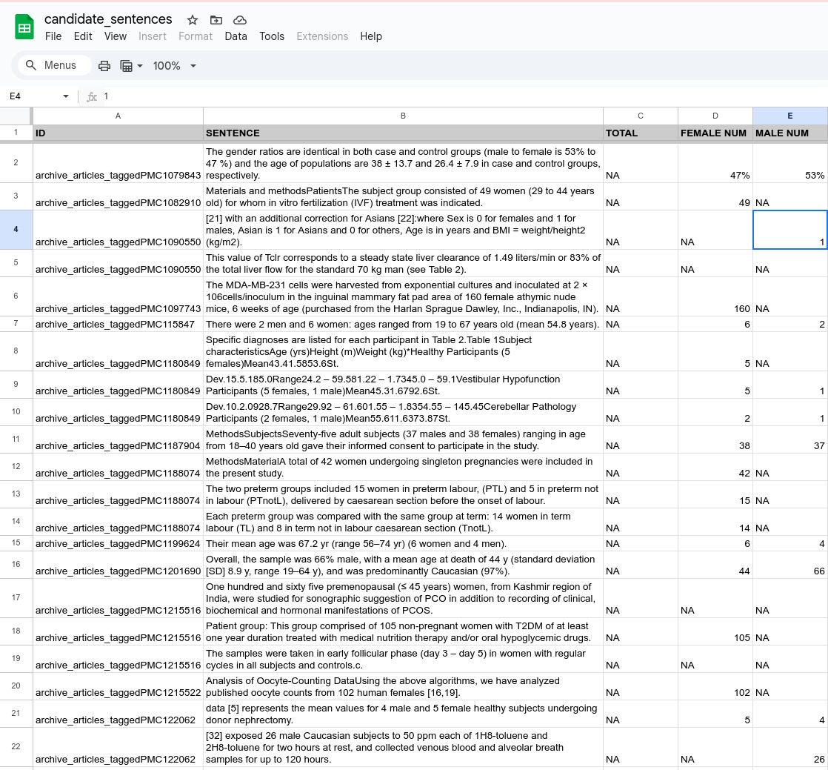
Phase 1: BERT + Simple Spreadsheet (2022)
© 2025 BSC-CNS. Licensed under CC BY-NC-4.0
Google Sheets
BERT identifies candidate sentences
  Manual extraction to spreadsheet
  Simple numeric columns
Train model on 2000 sentences
Limitations:
  No context beyond sentence
  Ambiguous cases hard to resolve
  No structured reasoning

Slide 14
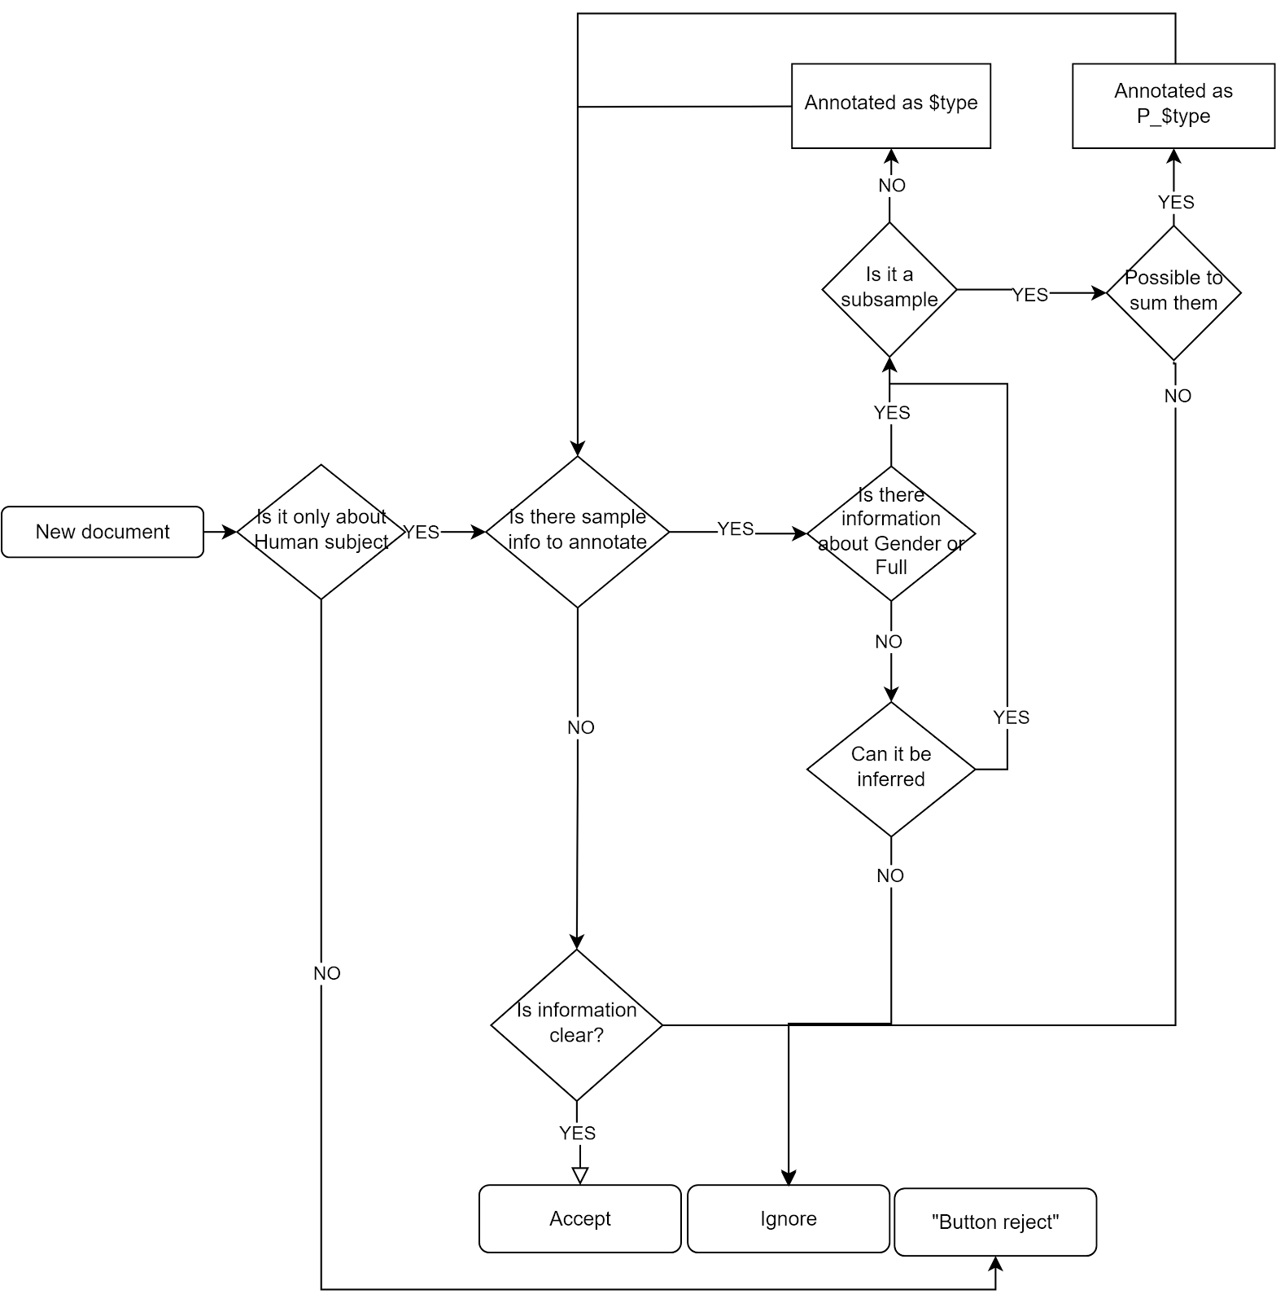
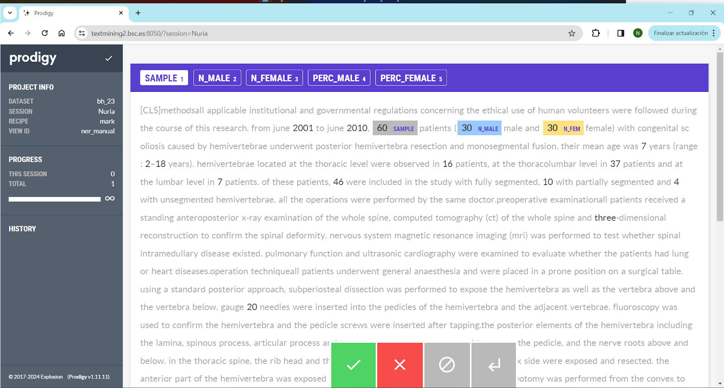
Phase 2: Prodigy
© 2025 BSC-CNS. Licensed under CC BY-NC-4.0
Active learning approach
  Binary accept/reject interface
  Faster annotation cycles
Limitations:
  Limited multi-label support
  Hard to capture nuance
  No structured relationships

Slide 15
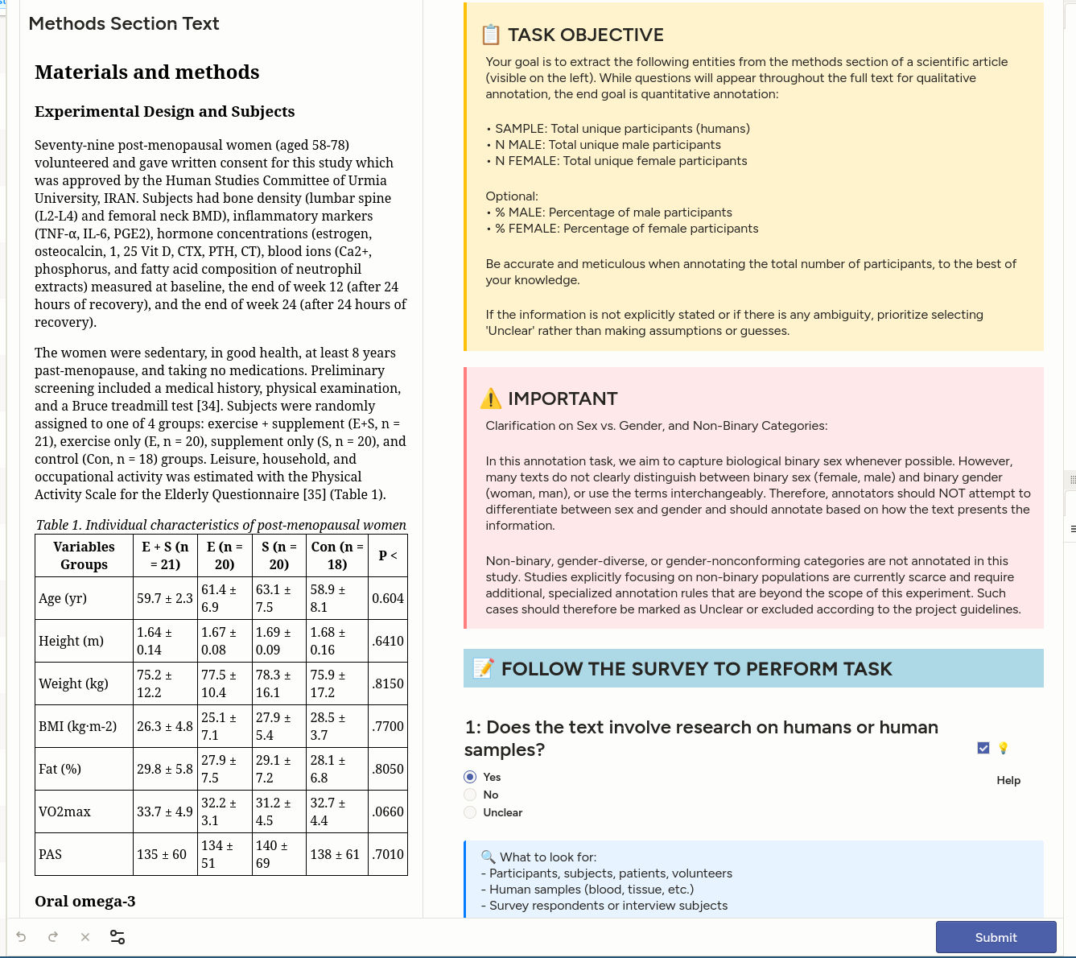
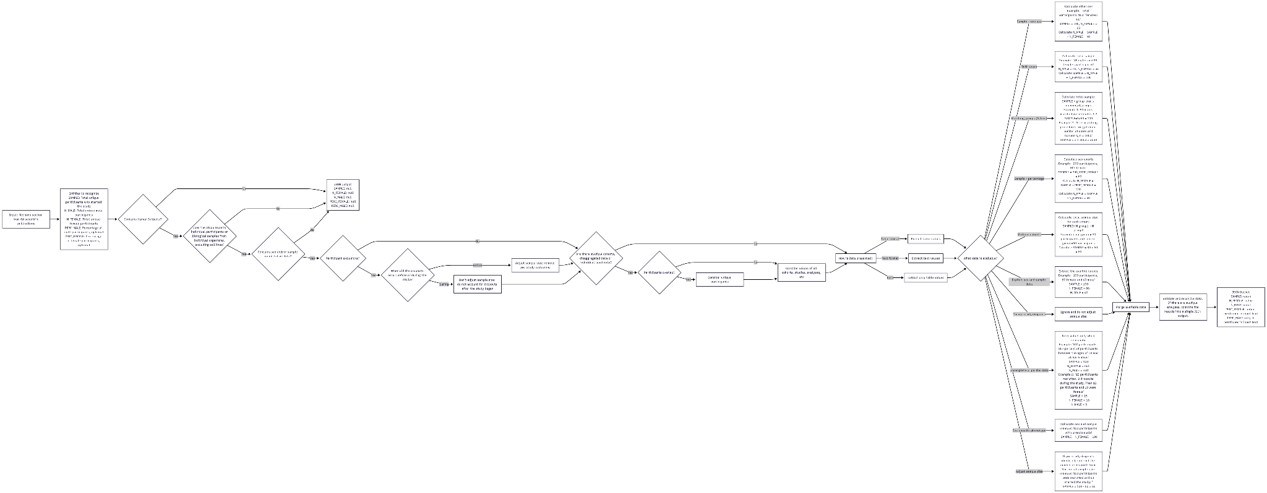
Phase 3: Developing the logic

Slide 16
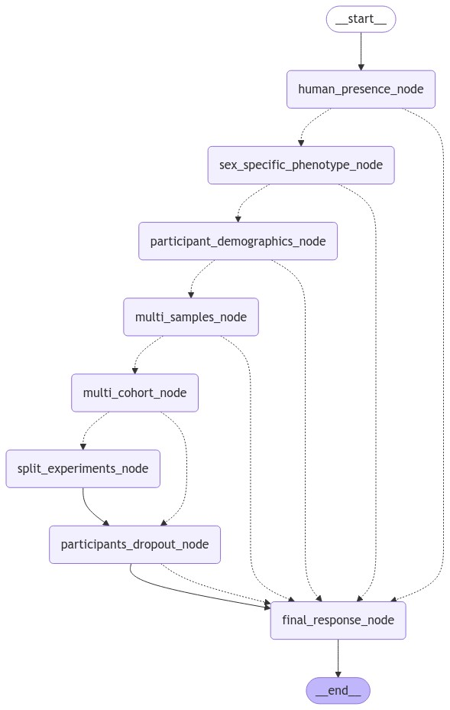
Prompting Strategy
© 2025 BSC-CNS. Licensed under CC BY-NC-4.0
Strategy | Description
Zero-shot | Simple extraction instruction
NER-style | Named entity recognition format
Graph-based | Structured relationship extraction
Chain-of-Thought (CoT) | Step-by-step reasoning
Agent Based Workflow | Replicate Annotation flow

Slide 17
Prompting Strategy: Direct Prompting
Chain-of-Thought (CoT)
© 2025 BSC-CNS. Licensed under CC BY-NC-4.0
Extract numerical data about human participants from the given scientific text. Focus on these entities:
SAMPLE: Total number of unique participants
N_MALE: Total unique male participants
N_FEMALE: Total unique female participants
PERC_MALE: Percentage of male participants
PERC_FEMALE: Percentage of female participants
General constraints:
Do not count non-human samples
Cells or tissue samples from human subjects are valid for inclusion only if they come from different individuals. This must be clearly stated in the study.
Assign "null" for unclear, undetermined, absent, or unreasonably inferred values.
Extract information from tables if they include demographic information, such as age and sex.
Infer sex based on context for sex-related conditions (e.g., prostate cancer = male, ovarian cancer = female).
Provide one output for all studies, not per individual study.
Rules for arithmetic operations:
Use the largest initial number of participants when filtering is mentioned, regardless of whether they all completed the study or not
Account for overlapping participants across subsets.
Round numbers to the nearest whole number, unless the original data is given in decimal form. In that case, keep the decimal places as they are
Rules to calculate implicit numeric information:
If SAMPLE and number or percentages of one of the sexes is available, infer the number of the other sex
If only a percentage is given, but not the actual count, calculate the count using the given percentage.
If the inference is too speculative or uncertain, assign "null" to the value.
Output format:
{
"SAMPLE": <number|null>,
"N_MALE": <number|null>,
"N_FEMALE": <number|null>,
"PERC_MALE": <number|null>,
"PERC_FEMALE": <number|null>
}
{EXAMPLES}
Do not add any other text or explanation. Ensure the output is valid JSON as it will be parsed using `json.loads()` in Python and it should be in the schema as for example {"N_MALE":0,"N_FEMALE":0,"SAMPLE":0}. The study:
Focus on the following section: {{ section_header }} of the document: {{ section_content }}

Slide 18
Prompting Strategy: Agent
© 2025 BSC-CNS. Licensed under CC BY-NC-4.0
The article discusses experiments involving individual human subjects.
Your task is to determine the presence of information about the number of participants and whether it is disaggregated by sex or gender in the section.
Focus on the following section: {{ section_header }} of the document: {{ section_content }}
Respond with:
- 'True': If the document contains information to know if some participants are males or females or if the information about the gender is given. Even if only one gender or sex can be inferred, answer True
- 'False': If the document does not contain information about the sex or the gender of the participants.
Here are two illustrative examples to guide you in the task:
Example 1:
- Text: The study included 50 participants, comprising 30 females and 20 males, aged between 20 and 35 years.
- Response: True
Example 2:
- Text: "This research involved a cohort of individuals who participated in various cognitive tests."
- Response: False
Your task is to determine if the article involves a study on human subjects.
Focus on the following section: {{ section_header }} of the document: {{ section_content }}
Respond with:
- 'True': If the document explicitly mentions human subjects.
- 'False': If the document does not mention human subjects or lacks enough information for a clear decision.
The article discusses experiments involving individual human subjects.
Your task is to determine if the study involves sex-specific phenotypes only.
Focus on the following section: {{ section_header }} of the document: {{ section_content }}
Respond with:
- 'True': If the document contains sex specific phenotype.
- 'False': If the document does not contain sex specific phenotype.
Here are two illustrative examples to guide you in the task:
Example 1:
- Text: The study explored the genetic markers associated with breast cancer. Researchers identified hormonal influences unique participants physiology that contribute to the development and progression of the disease.
- Response: True
Example 2:
- Text: The research examined cognitive decline patterns in Alzheimer's disease across various age groups.
- Response: False
Your task is to determine if the article mentions samples from same individuals or if there are several participants.
Analyse the following section: {{ section_header }} of the document:
{{ section_content }}
Answer as follows:
- 'True': If the report involves more than one human subject or participant.
- 'False': If it does not involve several humans or subjects, multiple lines of tissues, cells, etc., or if there's insufficient information.

Slide 19
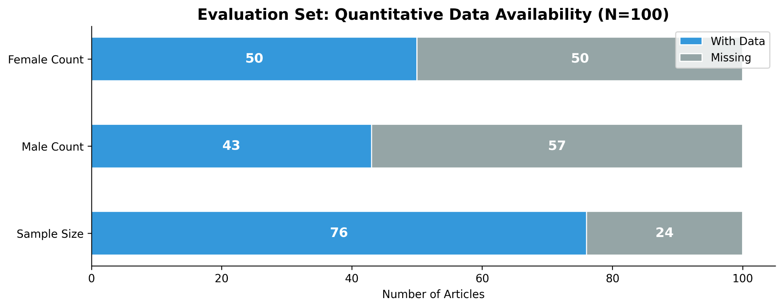
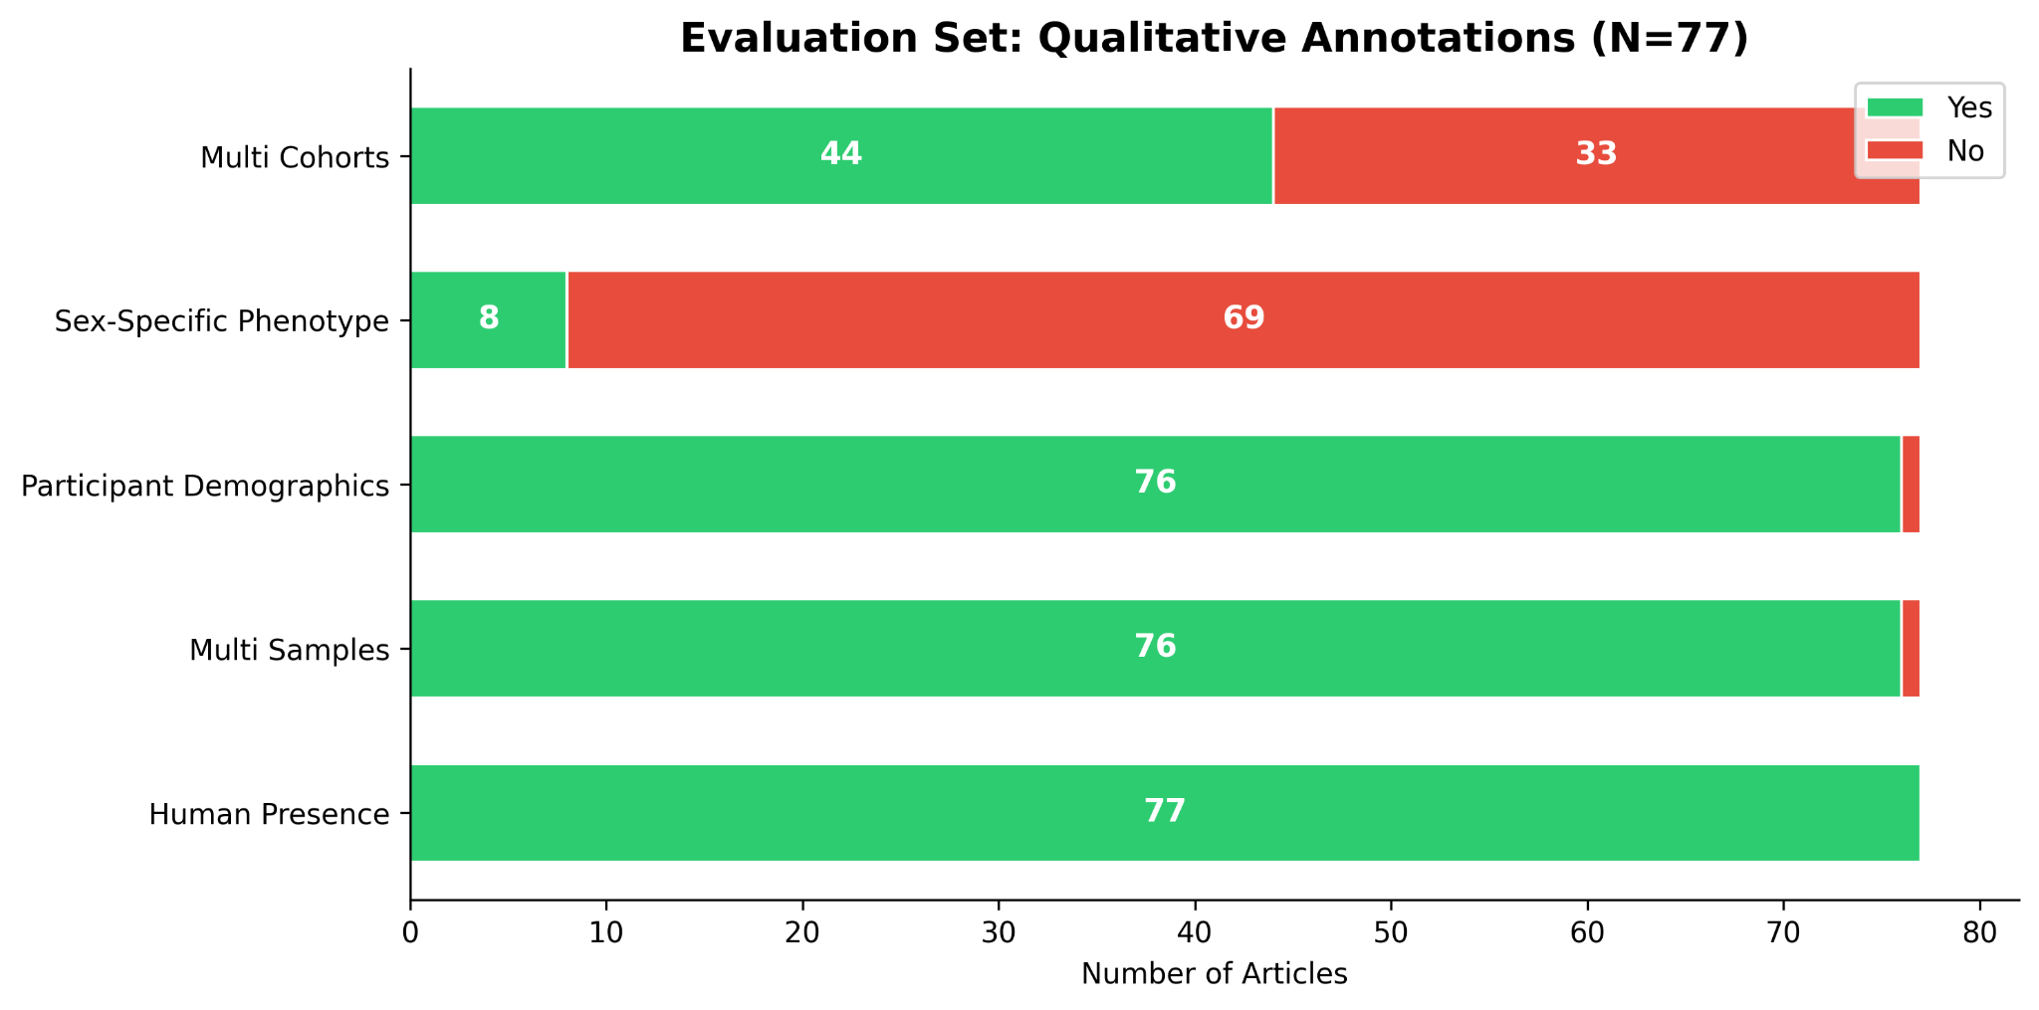
Annotation Results
© 2025 BSC-CNS. Licensed under CC BY-NC-4.0

Slide 20
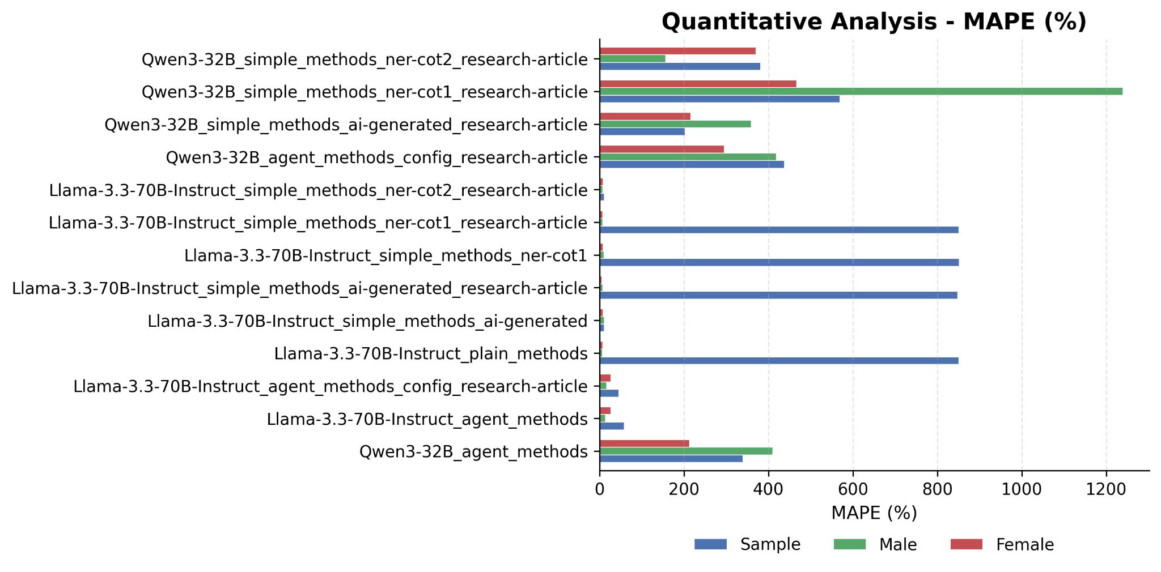
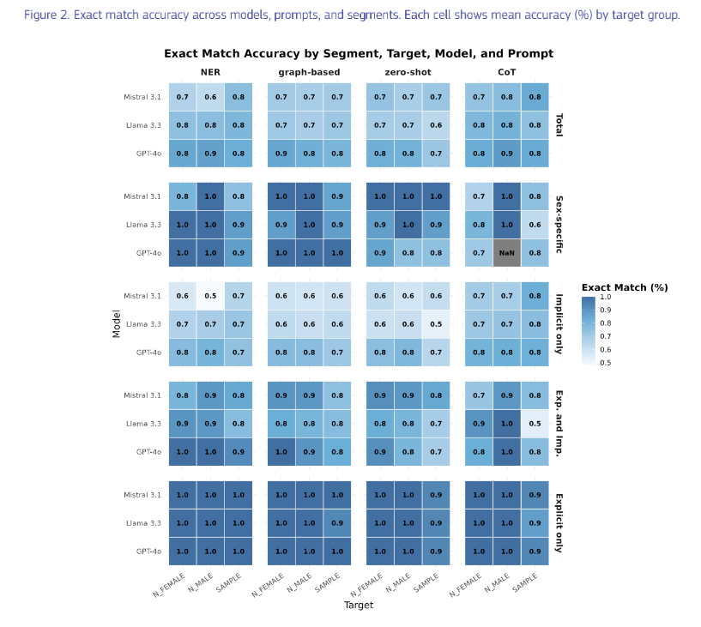
Annotation Results: Model performances
© 2025 BSC-CNS. Licensed under CC BY-NC-4.0

Slide 21
Preliminary results: Do not share please!
© 2025 BSC-CNS. Licensed under CC BY-NC-4.0

Slide 22
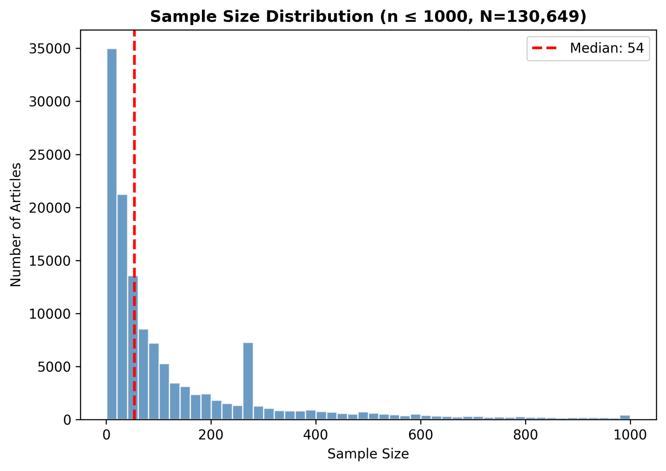
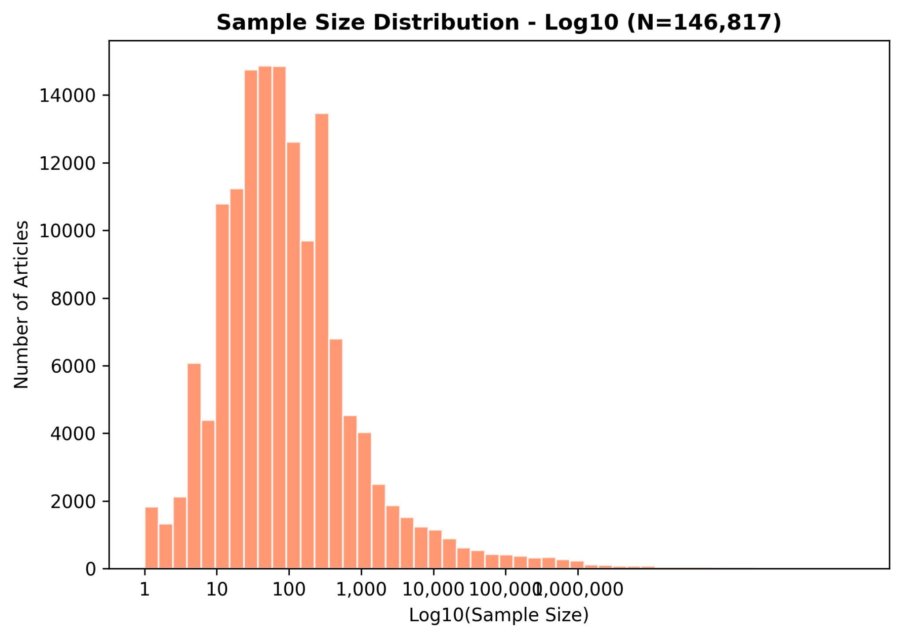
Preliminary results: Sample distribution
5 nodes (4 H100 64GB) - ~8 hours
// Processing and async function (vllm - Python)
Llama 3 70B
1M records (18GB SQL)
Metric | Count | Percentage
Total articles | 636787 | 100%
With sample size | 182580 | 28.7%
With any sex data | 104323 | 16.4%
With complete sex data | 88315 | 13.9%
Notes:
Sample size > 0 for the log10 (that’s why different number)

Slide 23
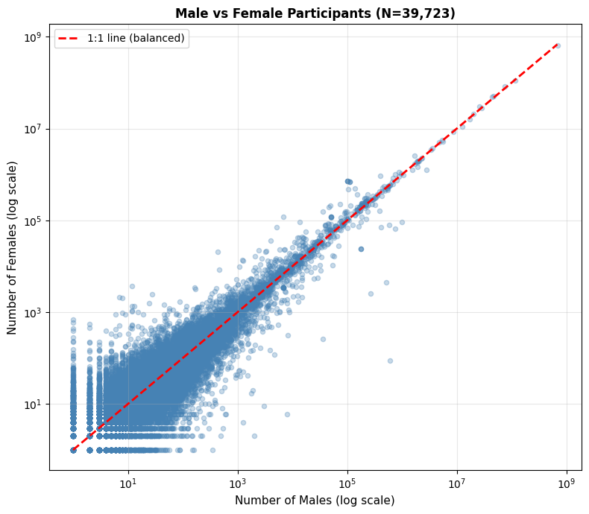
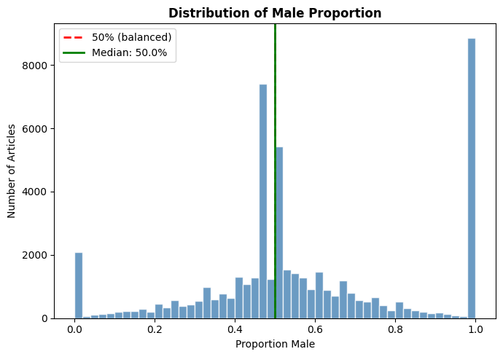
Preliminary results: Good overall balances
Notes:
Distribution of Male and Female well-balanced
N_male >0 and n_female > ) for the ratio (why it is different)

Slide 24
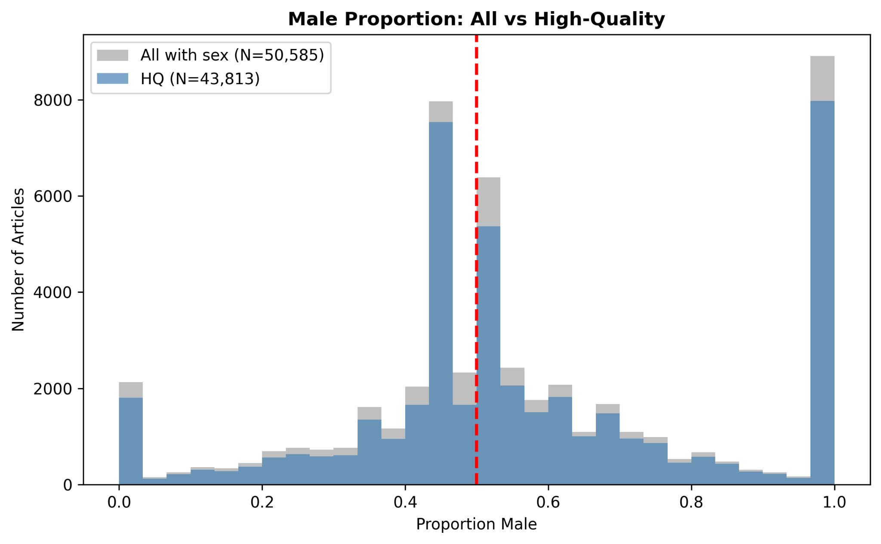
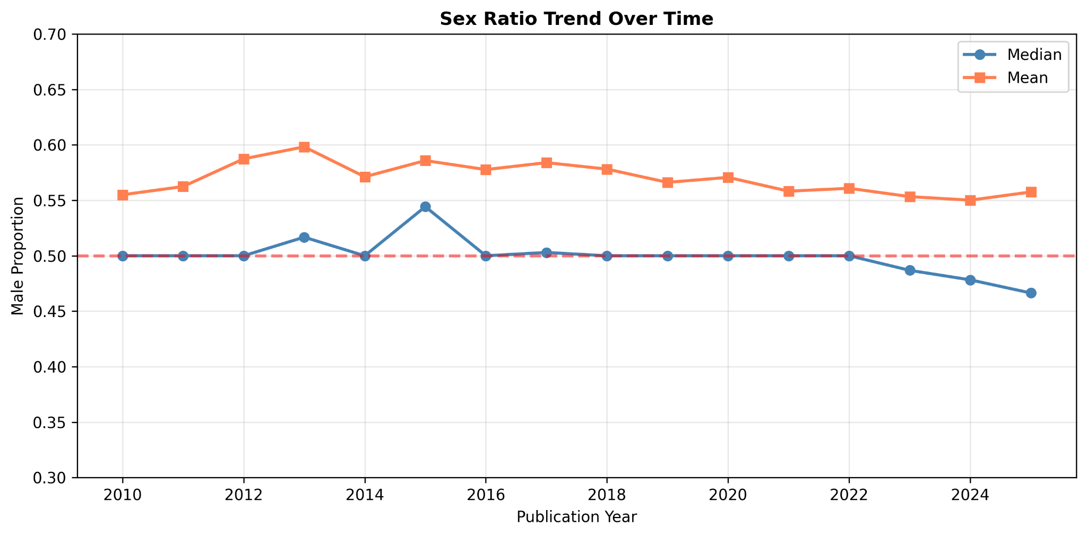
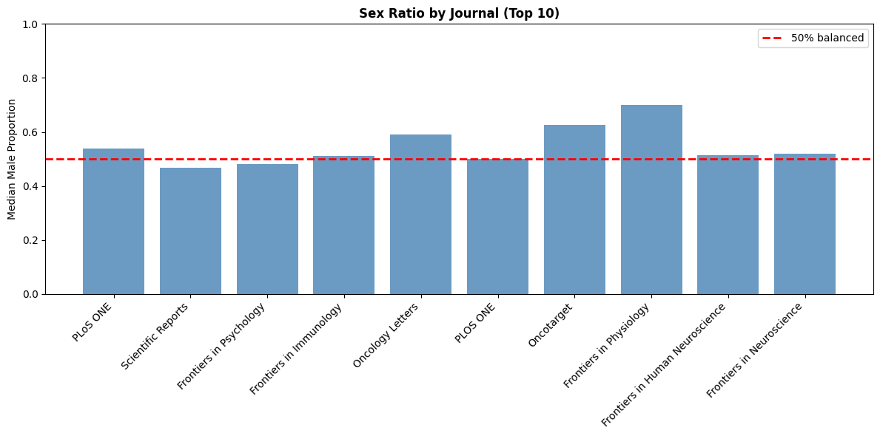
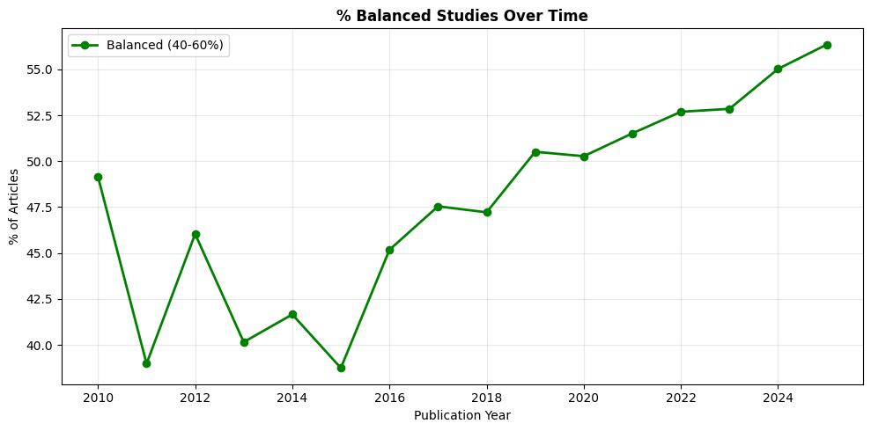
Preliminary results: HQ Good overall balances
Notes:
Balance data is study that have a ration between 40-60%

Slide 25
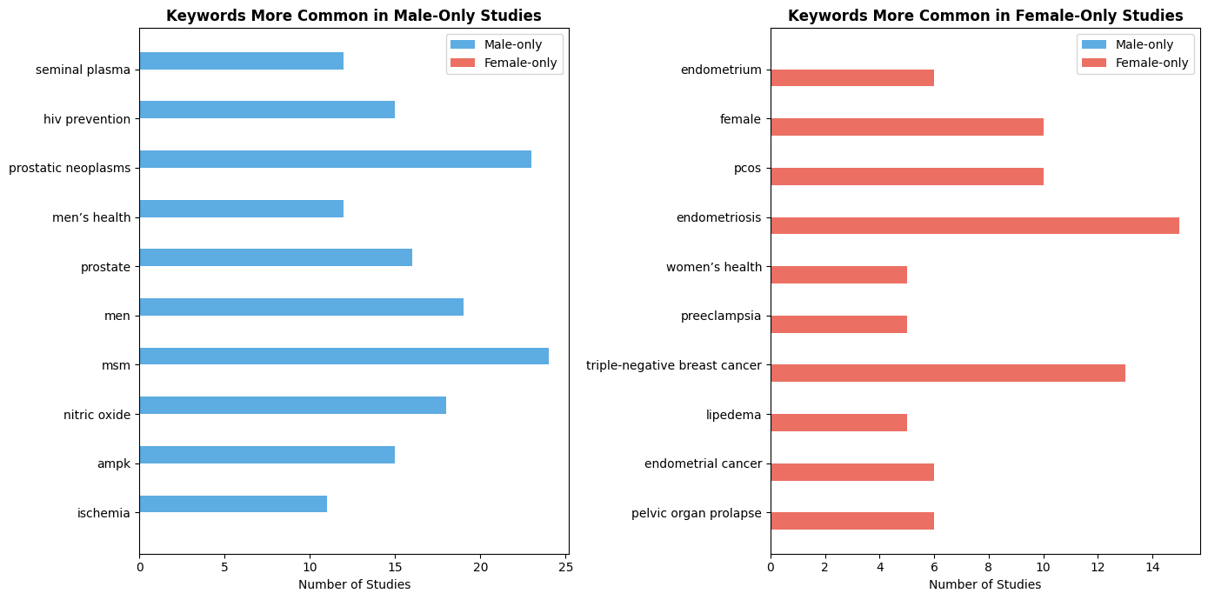
Preliminary results: HQ Keywords
Notes:
Create a reliable subset by filtering:
- Complete data: sample size + male + female counts present
- Consistent data: discrepancy within ±5%
- Remove outliers using IQR method

Slide 26
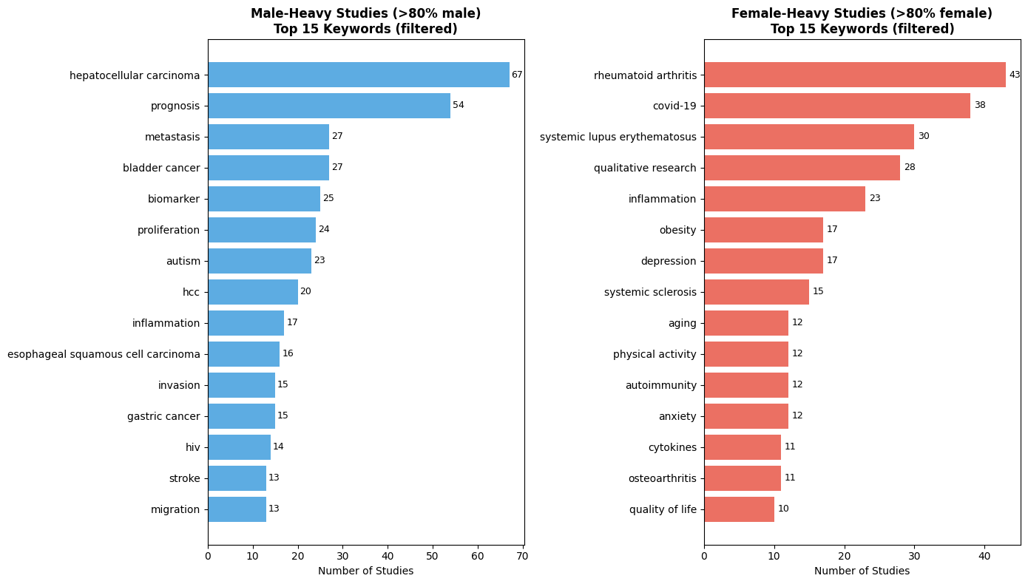
Preliminary results: HQ Keywords
Notes:
Create a reliable subset by filtering:
- Complete data: sample size + male + female counts present
- Consistent data: discrepancy within ±5%
- Remove outliers using IQR method

Slide 27
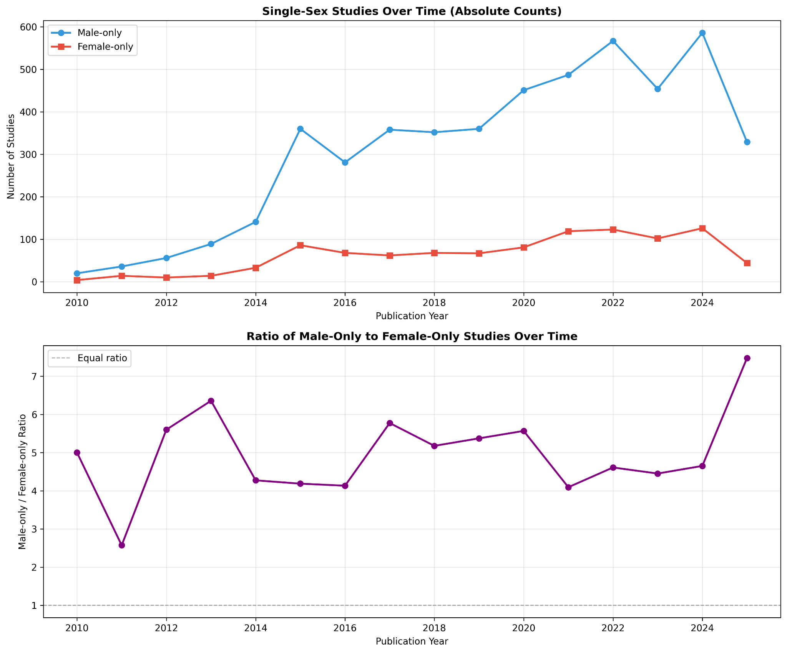
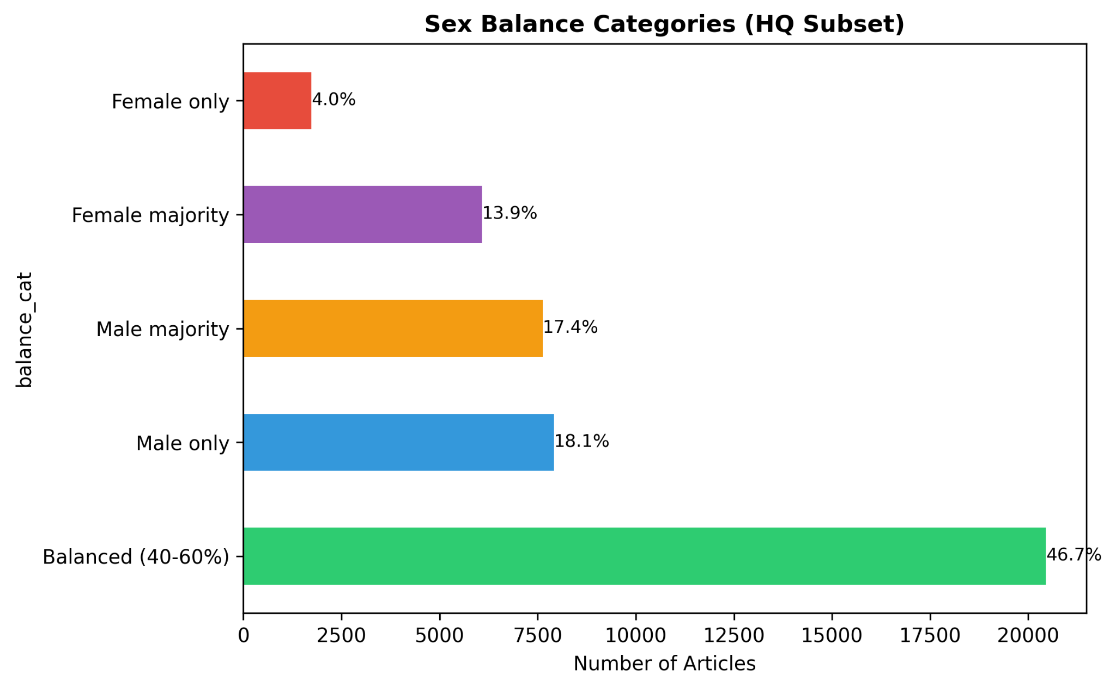
Preliminary results: HQ Proportion single studies
Category | Count | %
Male only | 8,830 | 17.5%
Female only | 2,032 | 4.0%
4.3x more male-only than female-only studies
Notes:
Create a reliable subset by filtering:
- Complete data: sample size + male + female counts present
- Consistent data: discrepancy within ±5%
- Remove outliers using IQR method

Slide 28
Preliminary results: Take away
We need AI to process what humans can't (scale)
  But we need humans to validate what AI produces
  Ground truth creation is the bottleneck
  Requires domain expertise, not just AI expertise (accuracy vs consistency)
  Bias can be hidden when processing large data
Simplification erases social and bodily complexity
Annotation process is hard, implementation is not easier
No validation = silence bias
We need open source models and HW to run them! (>$5000 one run)
Notes:
--- Method Section Statistics ---
Mean length (chars): 10,039
Median length (chars): 8,814
Max length (chars): 144,771
Min length (chars): 7
--- Token Estimates (input only) ---
Mean tokens per article: 4,493
Median tokens per article: 4,187
Max tokens per article: 38,176
--- Total Token Requirements ---
Total INPUT tokens for all articles: 2,034,540,178
Total INPUT tokens (millions): 2034.54M
Estimated OUTPUT tokens (~200 per article): 90,559,400
Estimated OUTPUT tokens (millions): 90.56M
=== GRAND TOTAL ===
Total tokens (input + output): 2,125,099,578
Total tokens (billions): 2.125B

Slide 29
Thank you!
Questions? (or suggestions for next step)
© 2025 Barcelona Supercomputing Center - Centro Nacional de Supercomputación. Author: (Olivier Philippe).
Material licensed under CC BY-NC-4.0.

