Slide 1
Scaling up OpenEBench to support community-driven AI model evaluation
Salvador Capella-Gutierrez
Technologies for Biomedical
Research Lab
29/Jan/2026
© 2025 Barcelona Supercomputing Center - Centro Nacional de Supercomputación.
Author: (Salvador Capella-Gutierrez). Material licensed under CC BY-NC-4.0.

Slide 2



Slide 3

Community-driven benchmarking
Mix of skills and knowledge from the different members that guarantees a more complete and unbiased benchmarking.
People with a similar background that want to collaborate in the understanding of specific scientific problems.
Useful for a wider group of people: software developers and users.
Follows the principles of Open Science to foster reproducibility, data sharing, ...

Slide 4
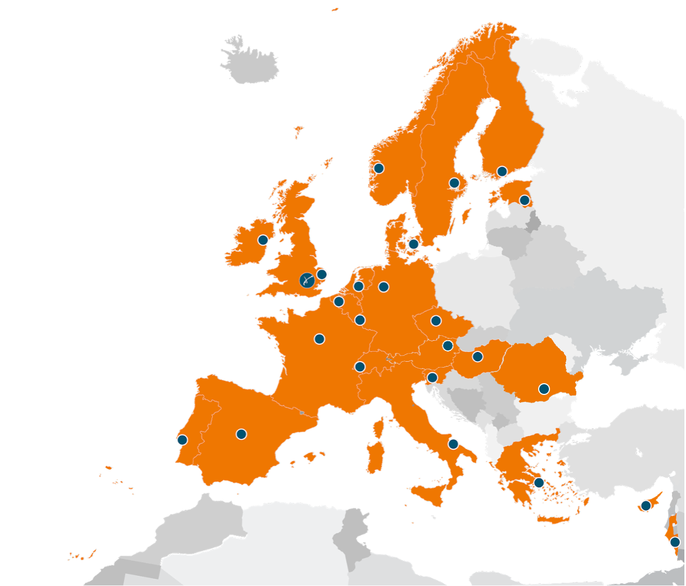
ELIXIR
ELIXIR is an intergovernmental organisation that brings together life science resources from 24 countries:
Databases
Software tools
Training resources
Interoperability resources
Compute resources
Data management support
We build and sustain life science informatics capacity and infrastructure in Europe, connect and develop a network of experts and provide hundreds of high-quality services and resources available to all.

Slide 5
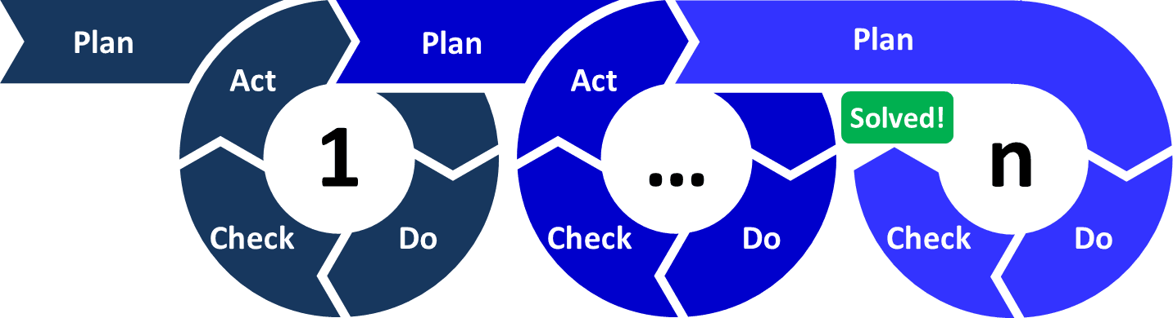
2017
2021
2025

Slide 6


Slide 7
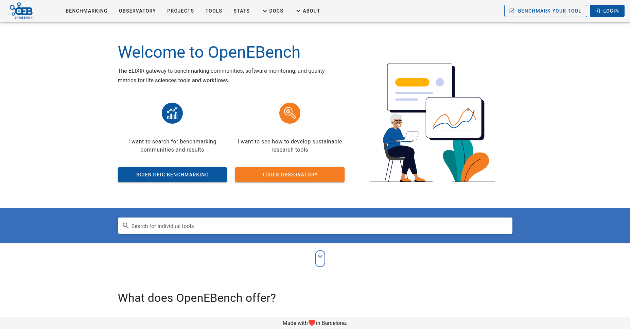
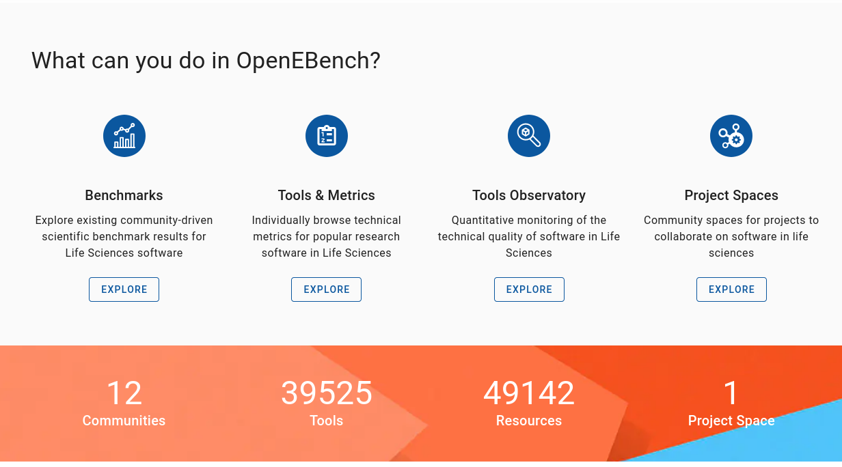
C
A
B
D

Slide 8
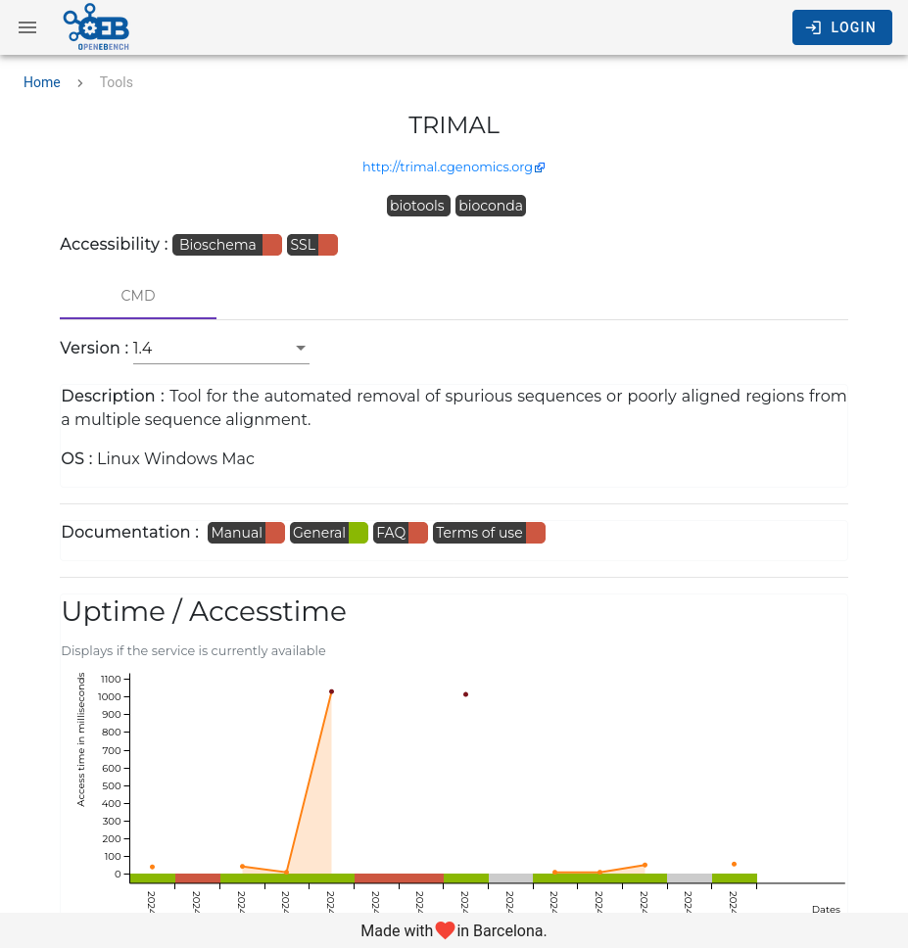
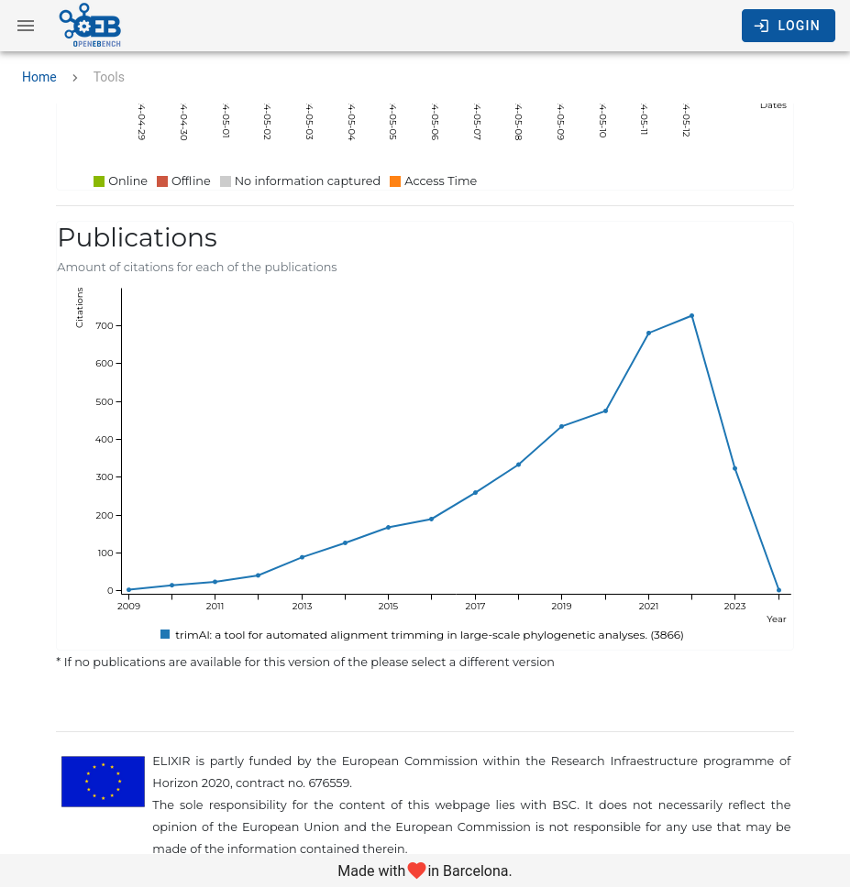
A
OpenEBench. Technical monitoring

Slide 9
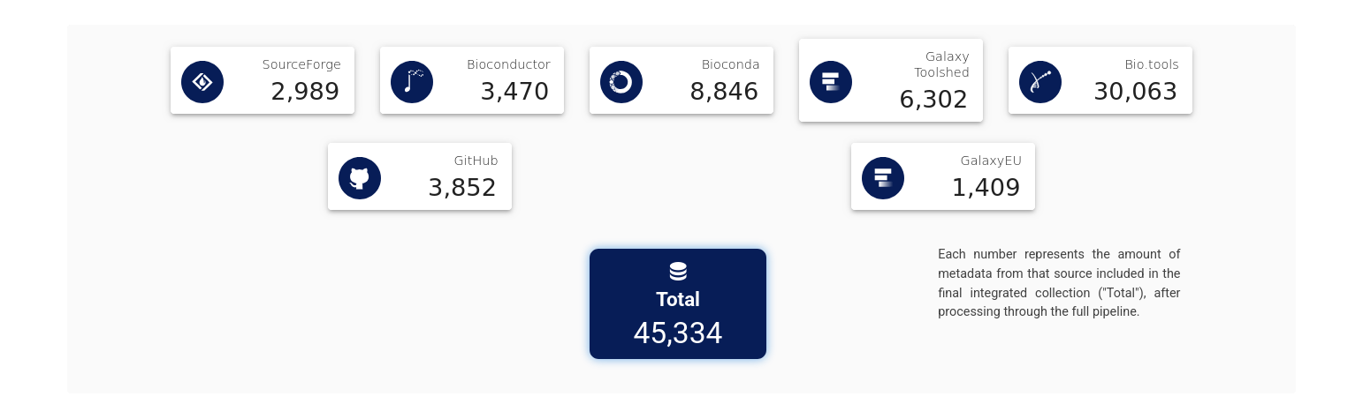
B
OpenEBench. Software Observatory

Slide 10
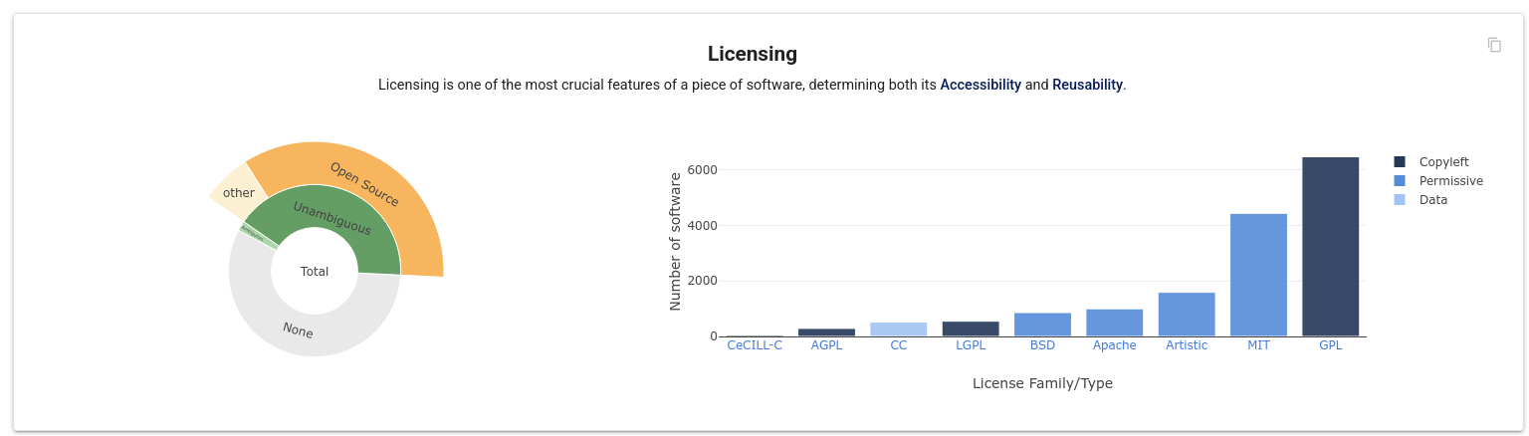
B
OpenEBench. Software Observatory

Slide 11
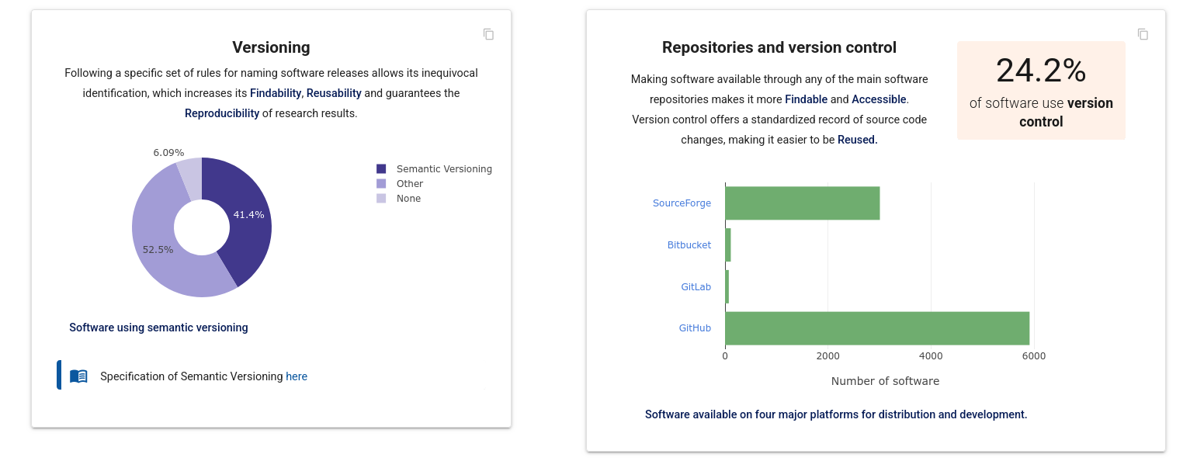
B
OpenEBench. Software Observatory

Slide 12
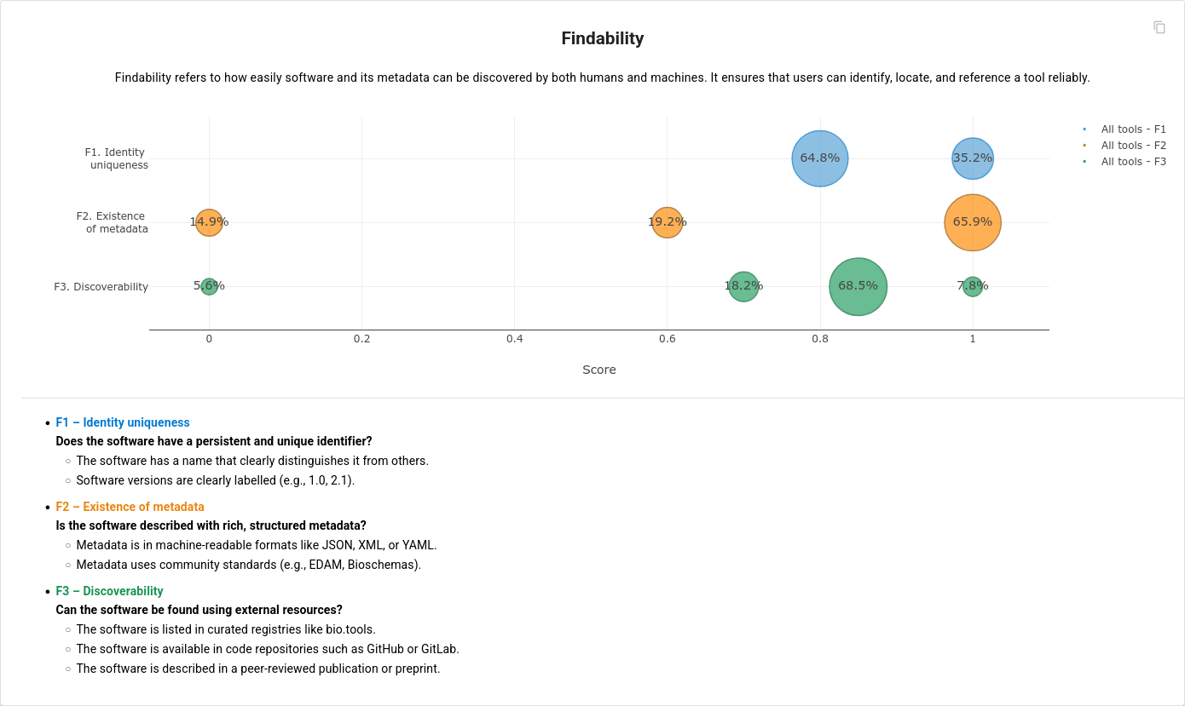
B
OpenEBench. Software Observatory

Slide 13
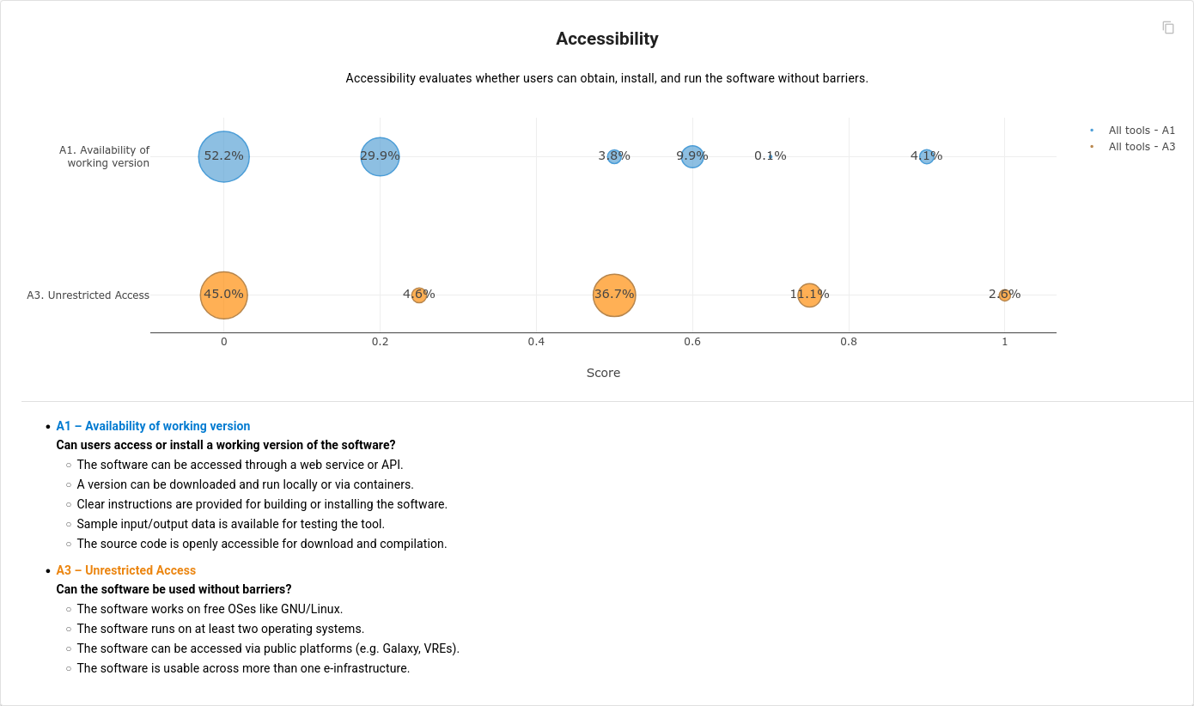
B
OpenEBench. Software Observatory

Slide 14
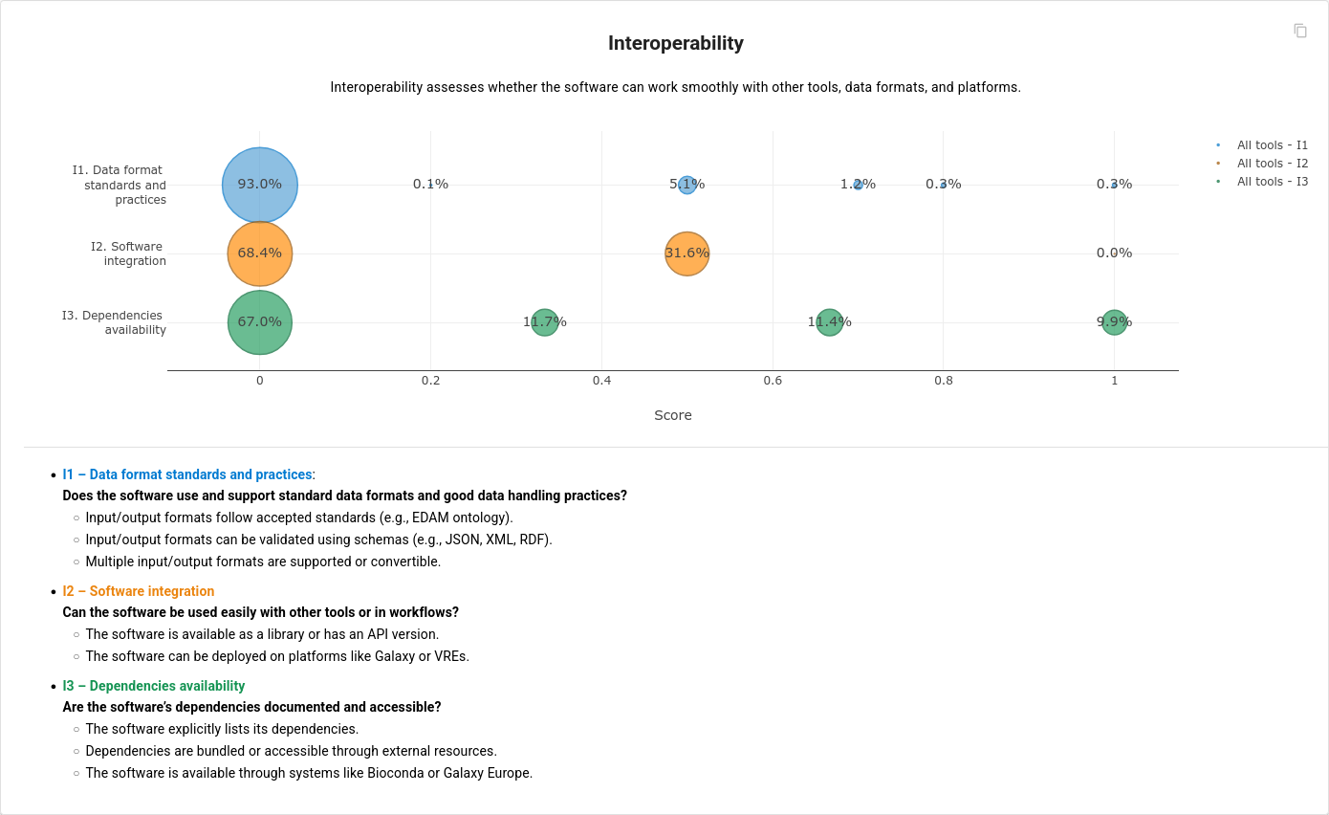
B
OpenEBench. Software Observatory

Slide 15
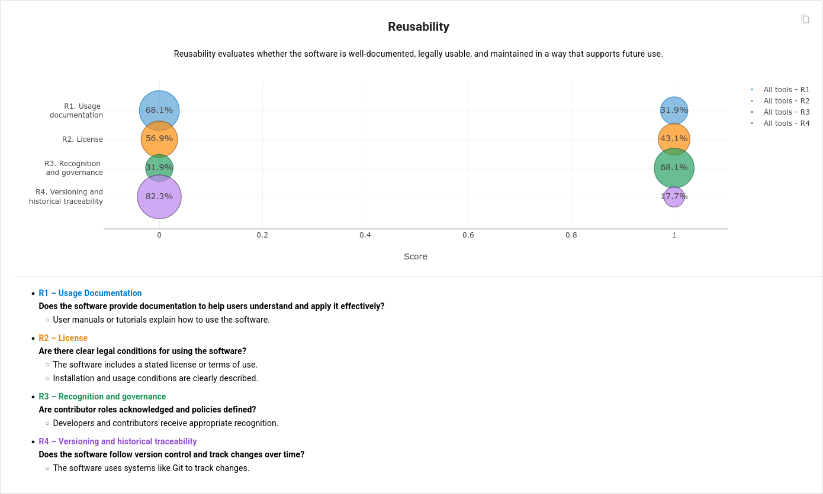
B
OpenEBench. Software Observatory

Slide 16
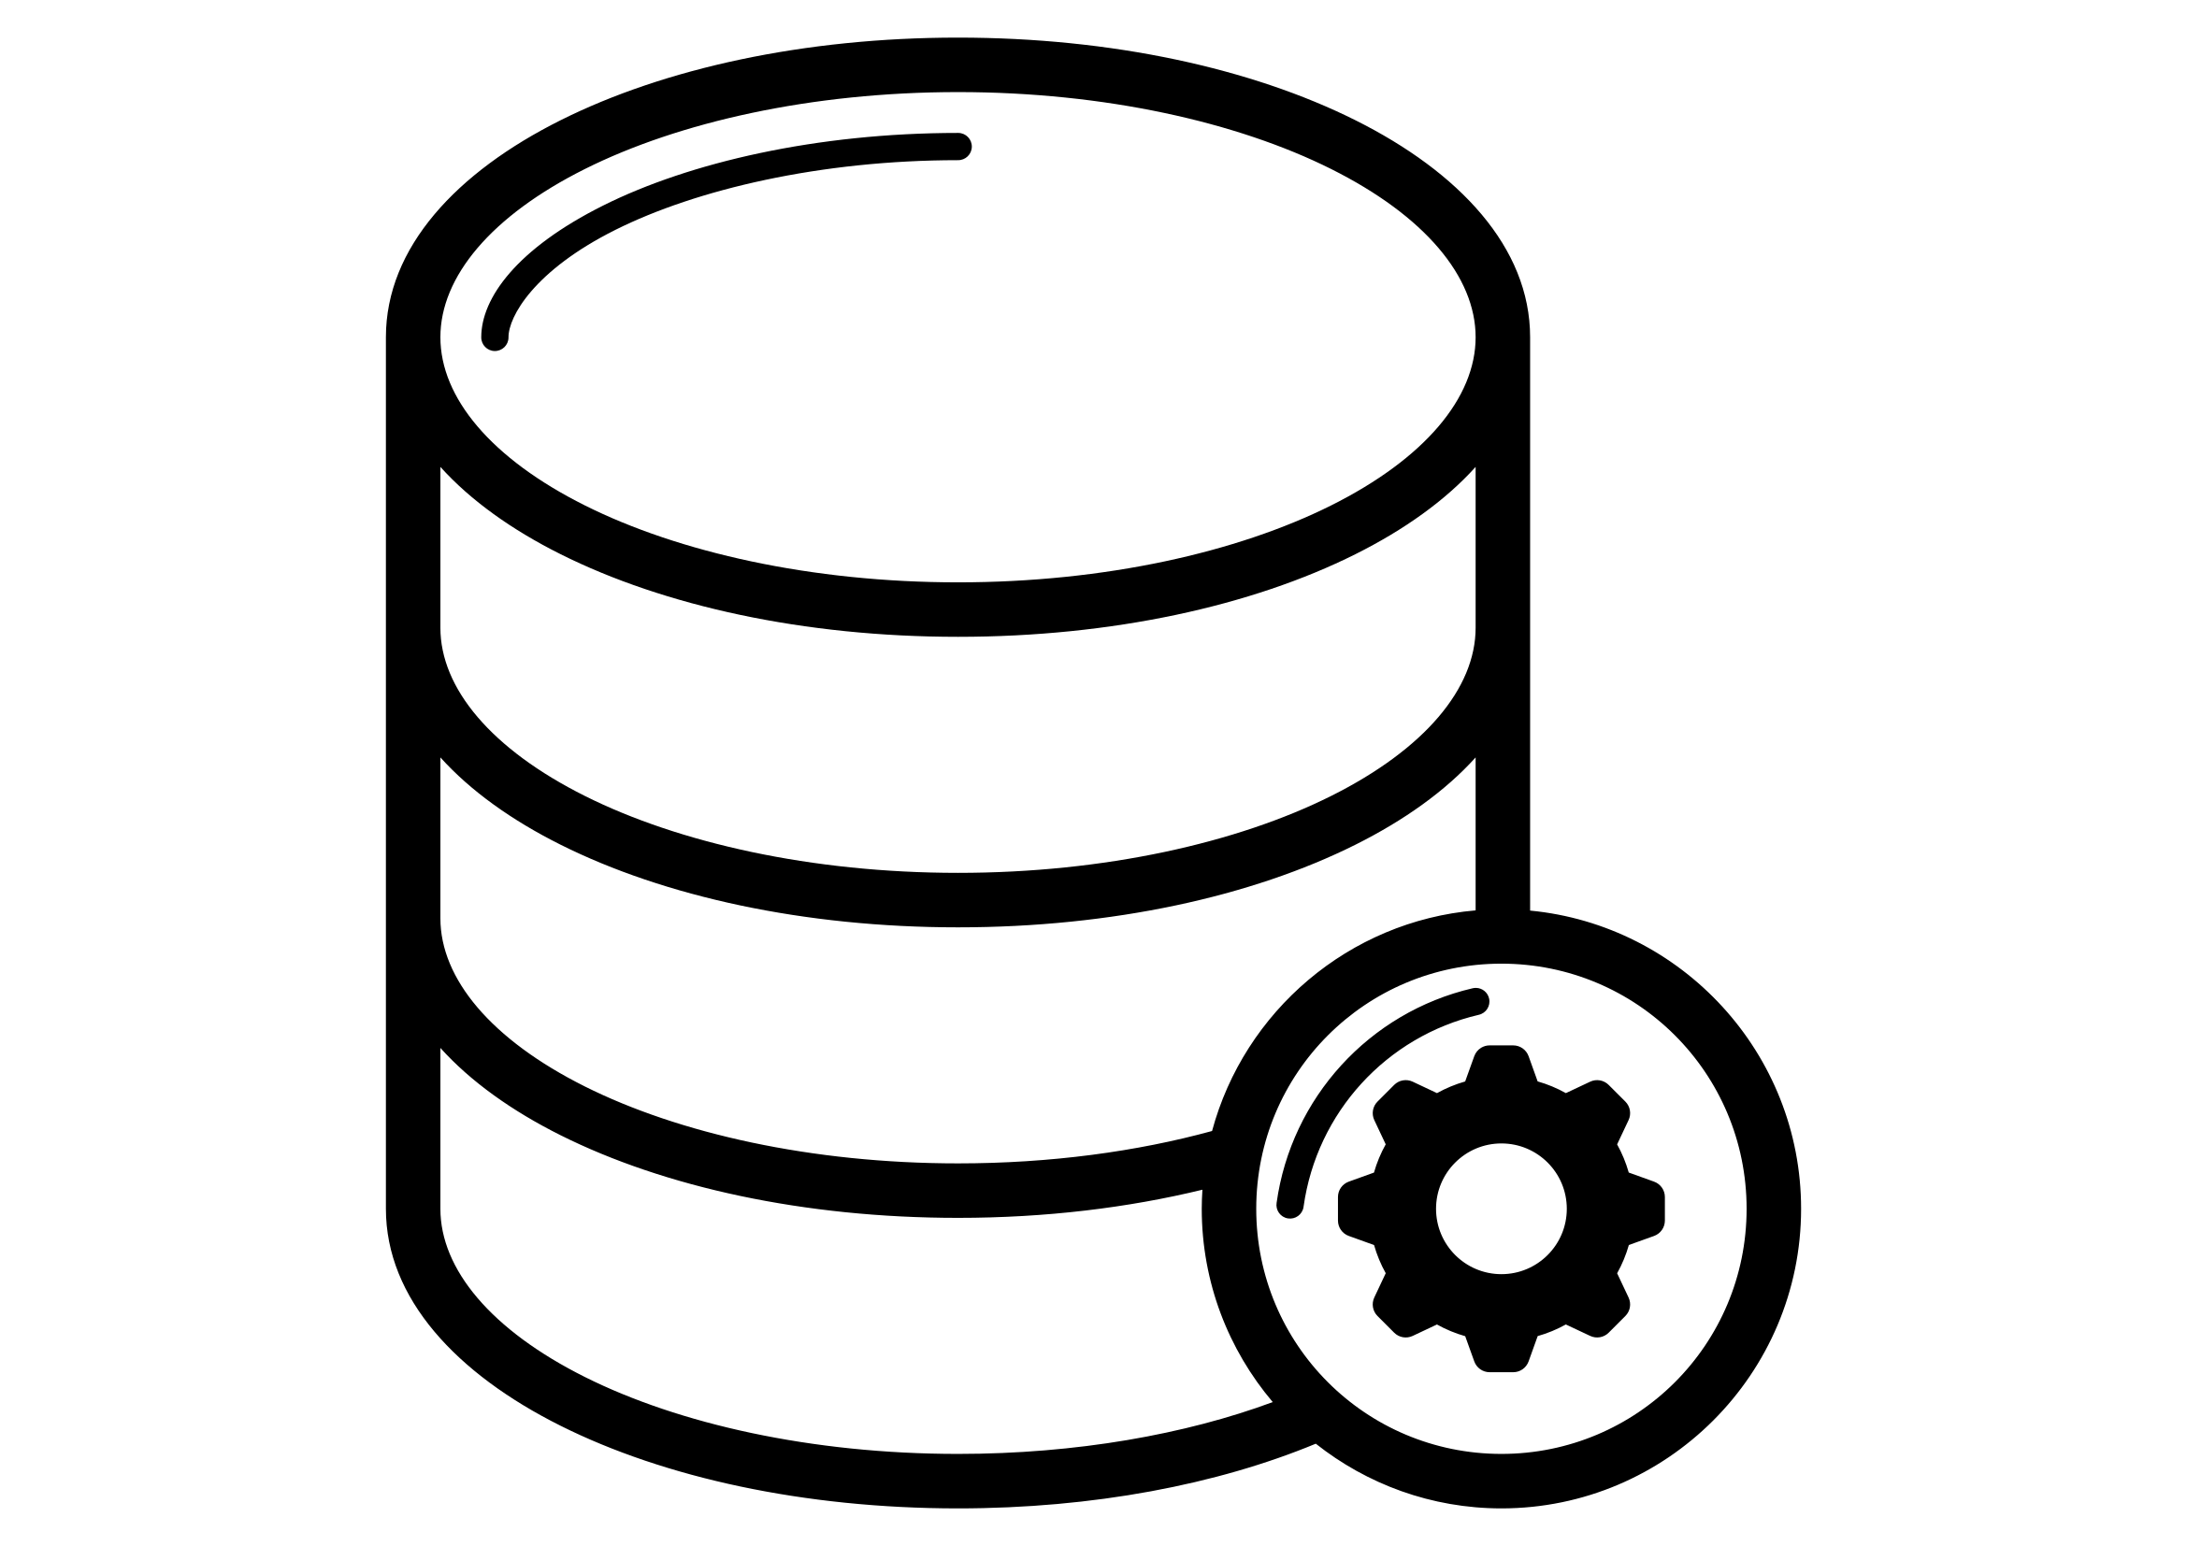

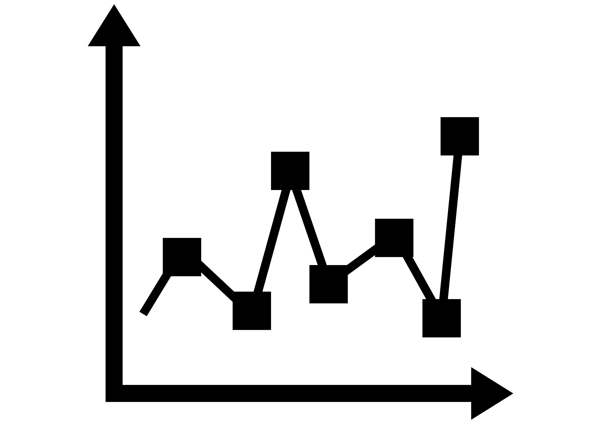

C
OpenEBench. Scientific Benchmarking
Datasets
Evaluation Metrics
Results Interpretation

Slide 17
C
OpenEBench. How OpenEBench is organized
Community
Benchmarking Events
Individual Challenges
Participants
https://github.com/inab/benchmarking-data-model

Slide 18
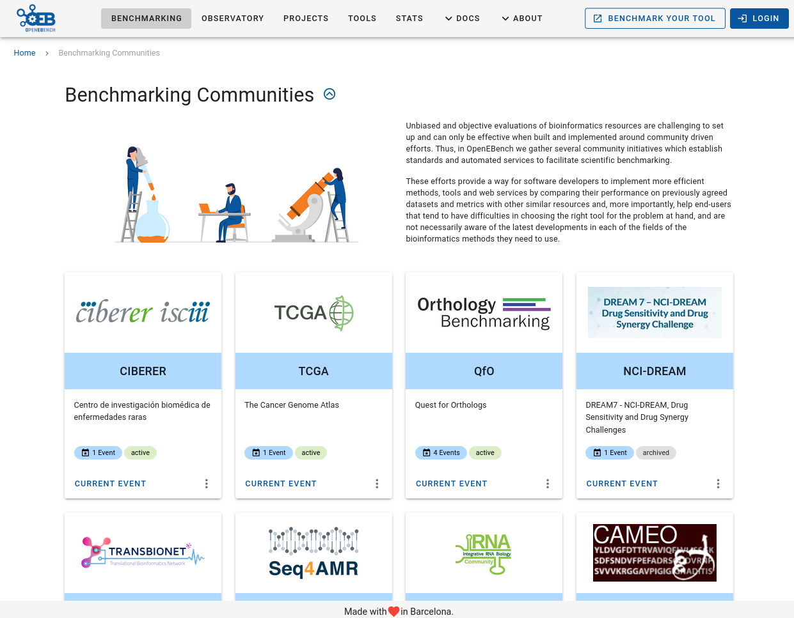

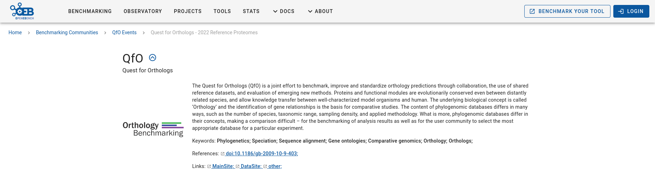
D
C
OpenEBench. Scientific Benchmarking & Spaces

Slide 19
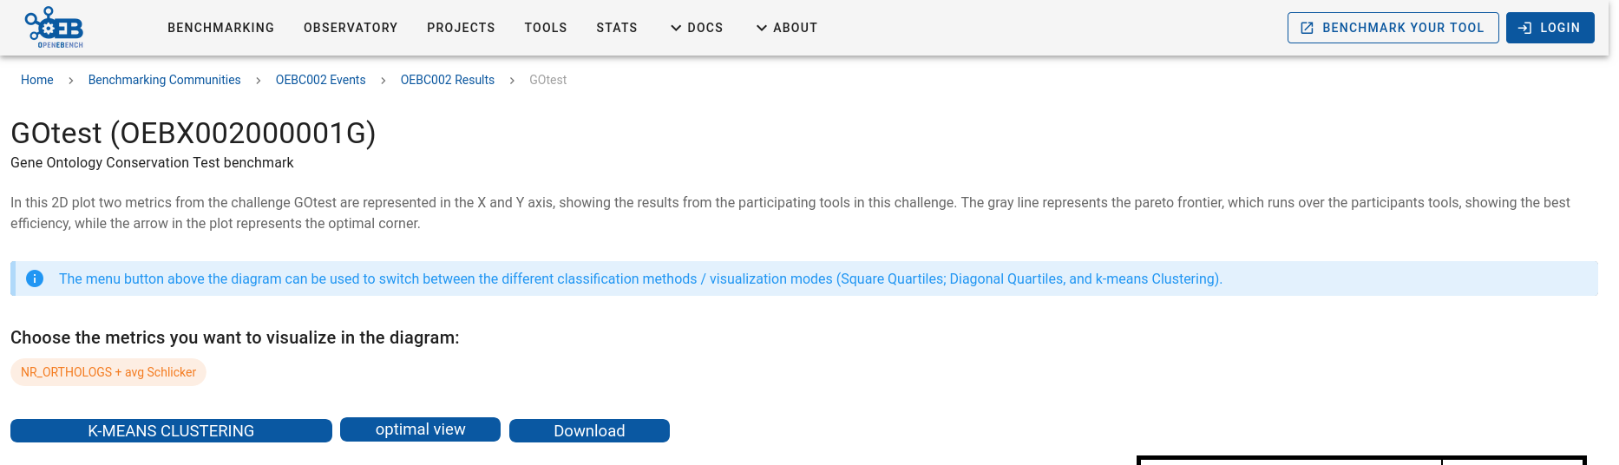
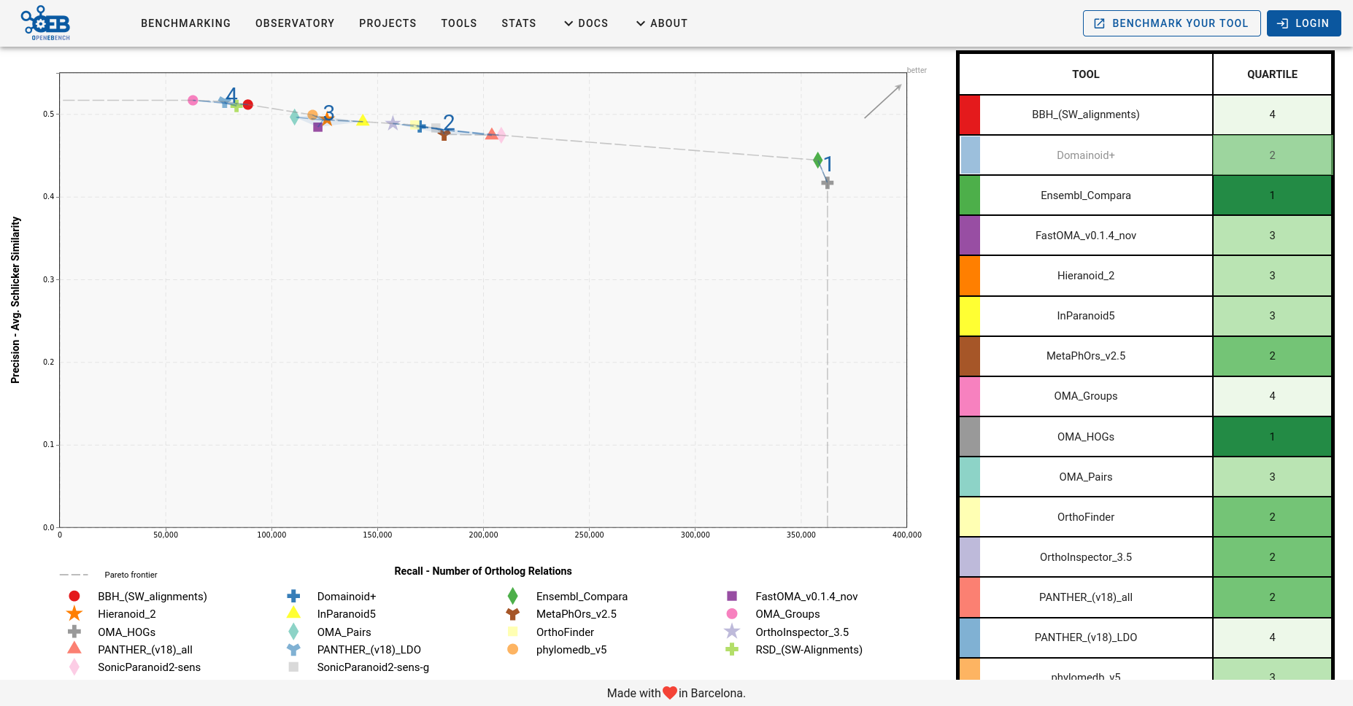
D
C
OpenEBench. Individual challenges

Slide 20
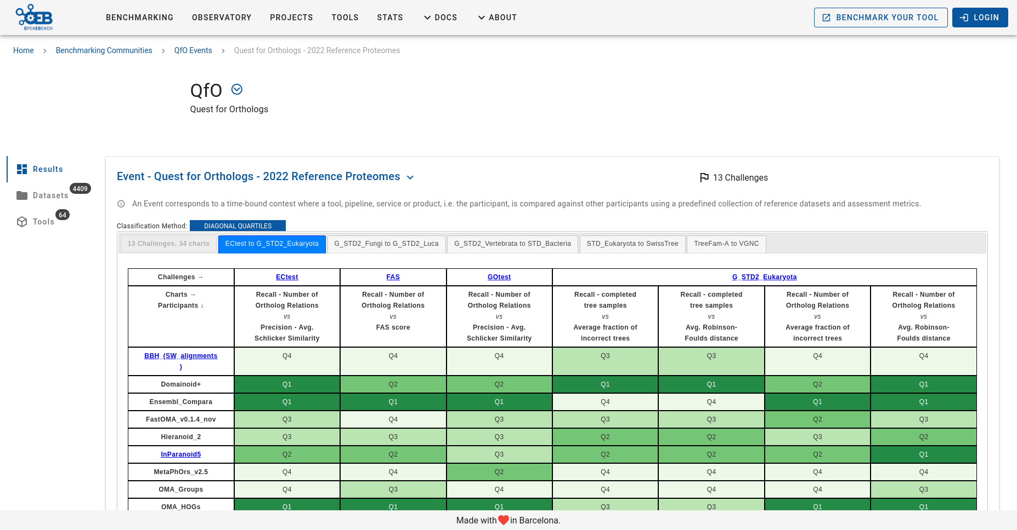
D
C
OpenEBench. Global (periodic) Events

Slide 21
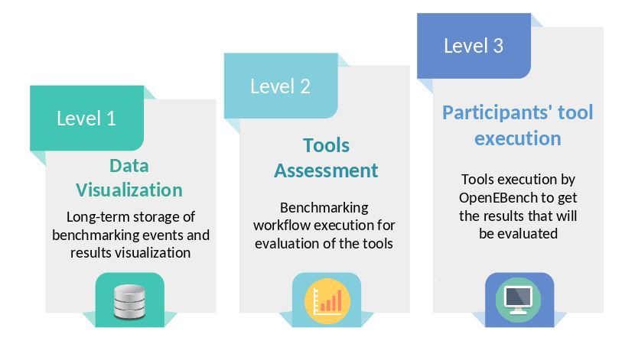
OpenEBench. Levels of Engagement

Slide 22
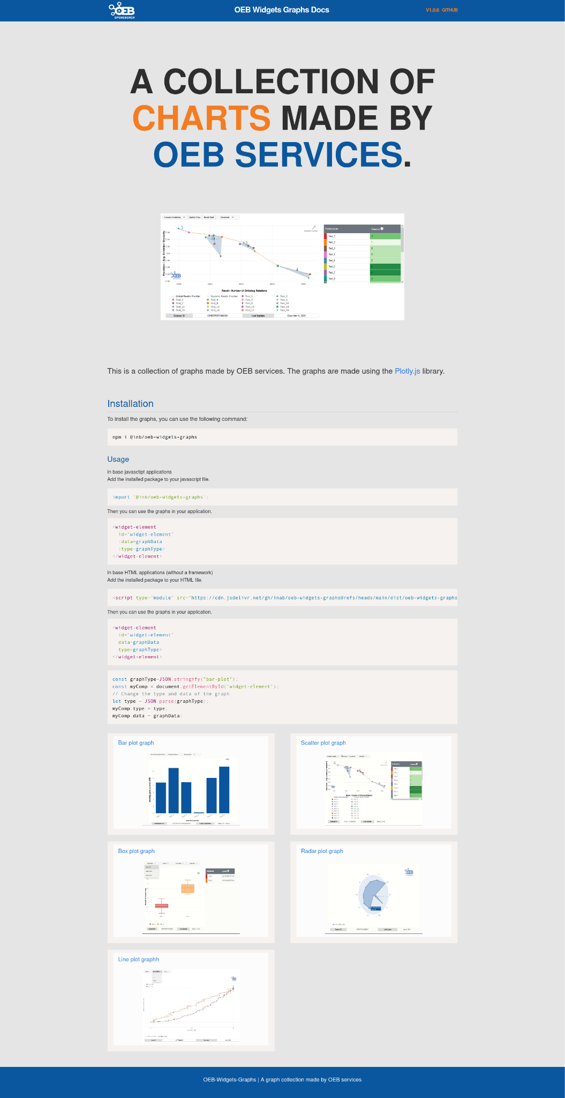
OpenEBench. Level 1 - Visualization widgets
https://inab.github.io/oeb-widgets-graphs/

Slide 23
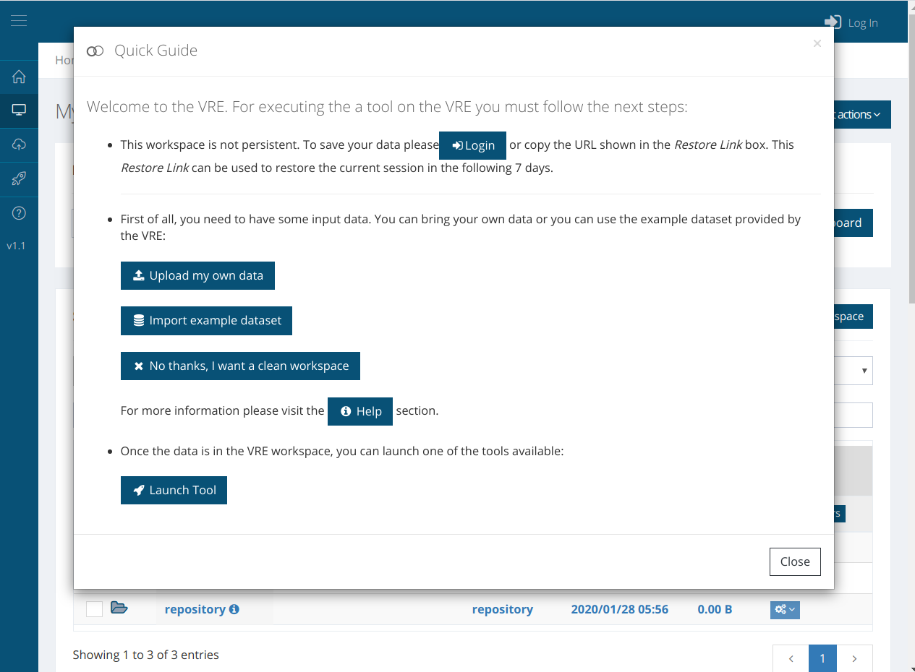
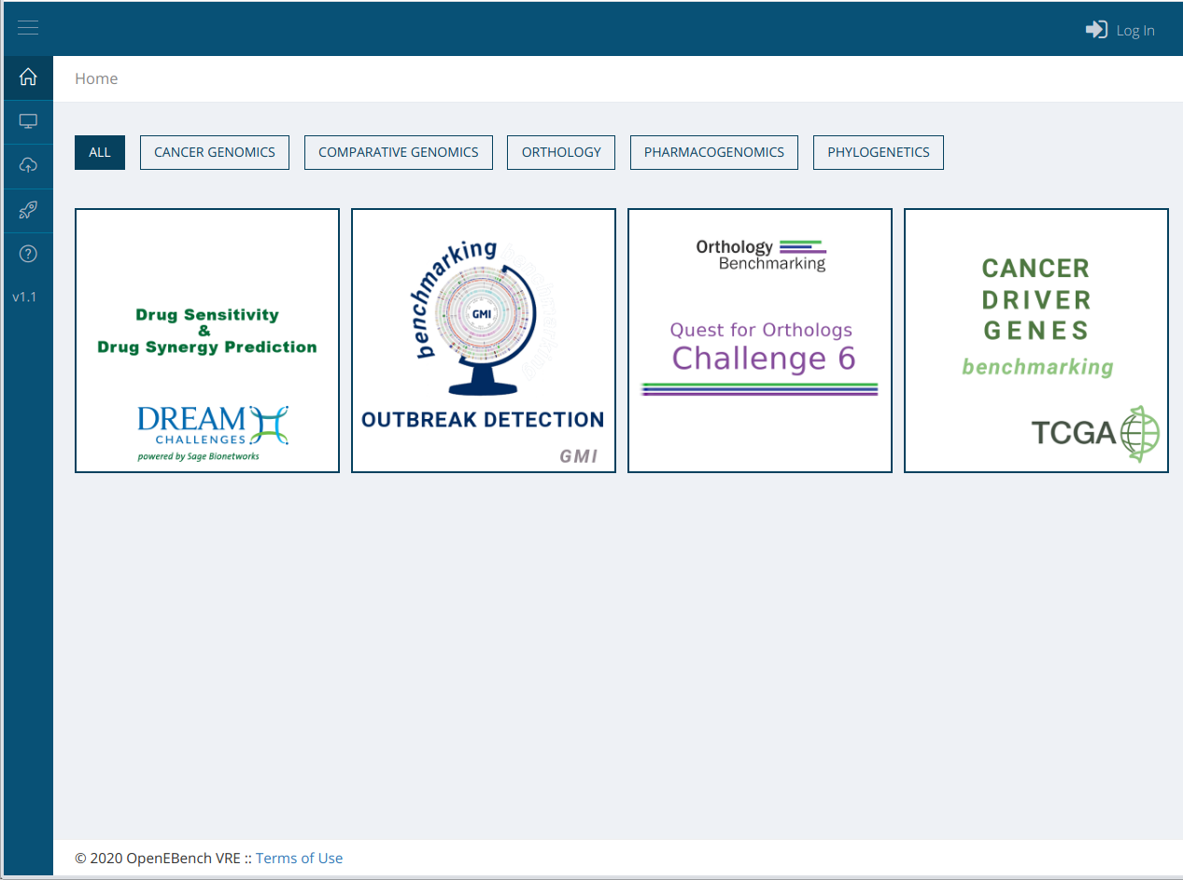
OpenEBench. Level 2 - Individual participants
https://openebench.bsc.es/vre

Slide 24





OpenEBench. Level 3 - On-site evaluation

Slide 25
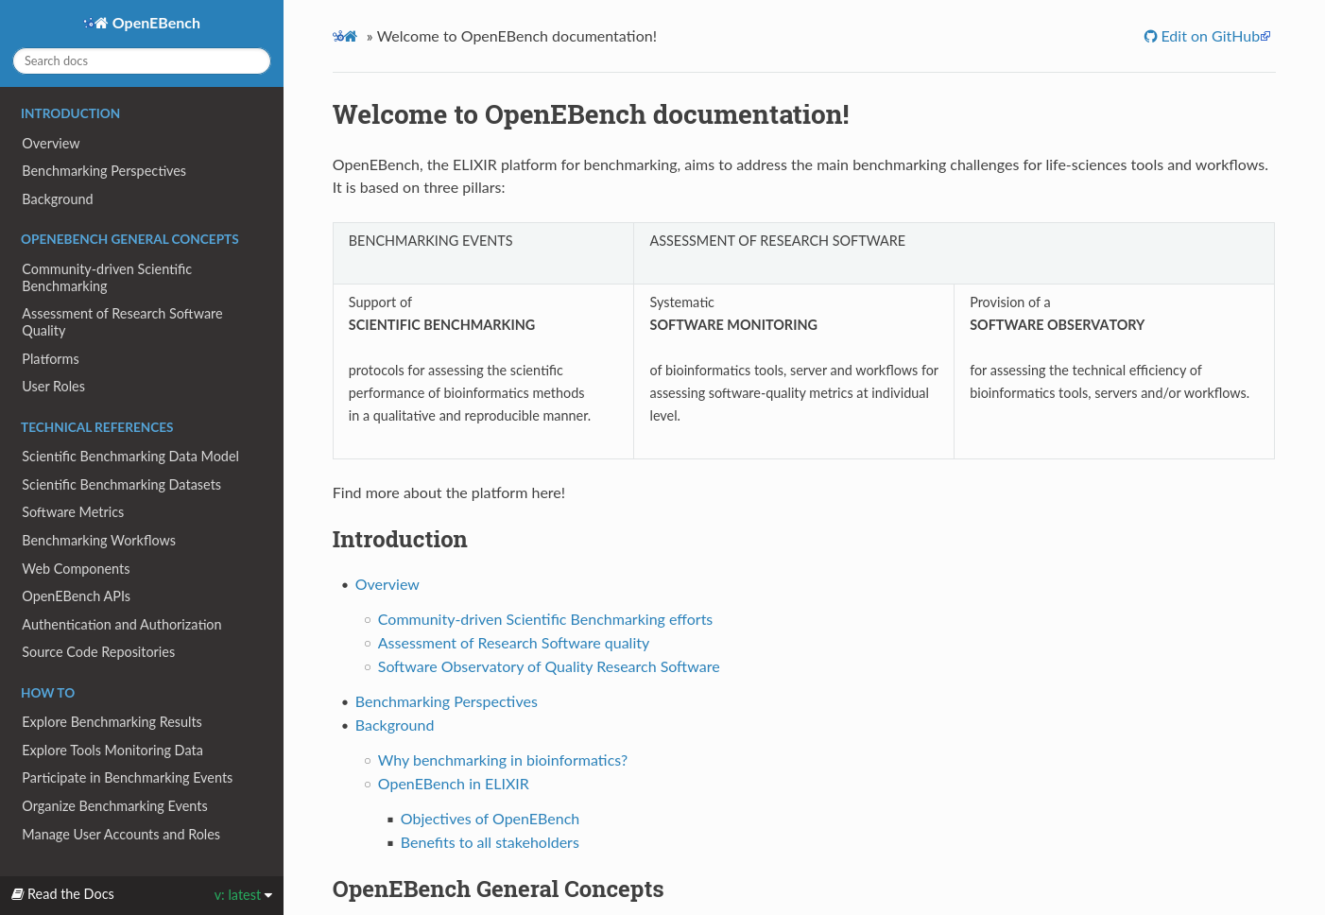
Want to know more about OpenEBench?
Your feedback always
is welcome!
https://openebench.readthedocs.io/

Slide 26

OEB4AI
expanding …
Software · Data · Models

Slide 28
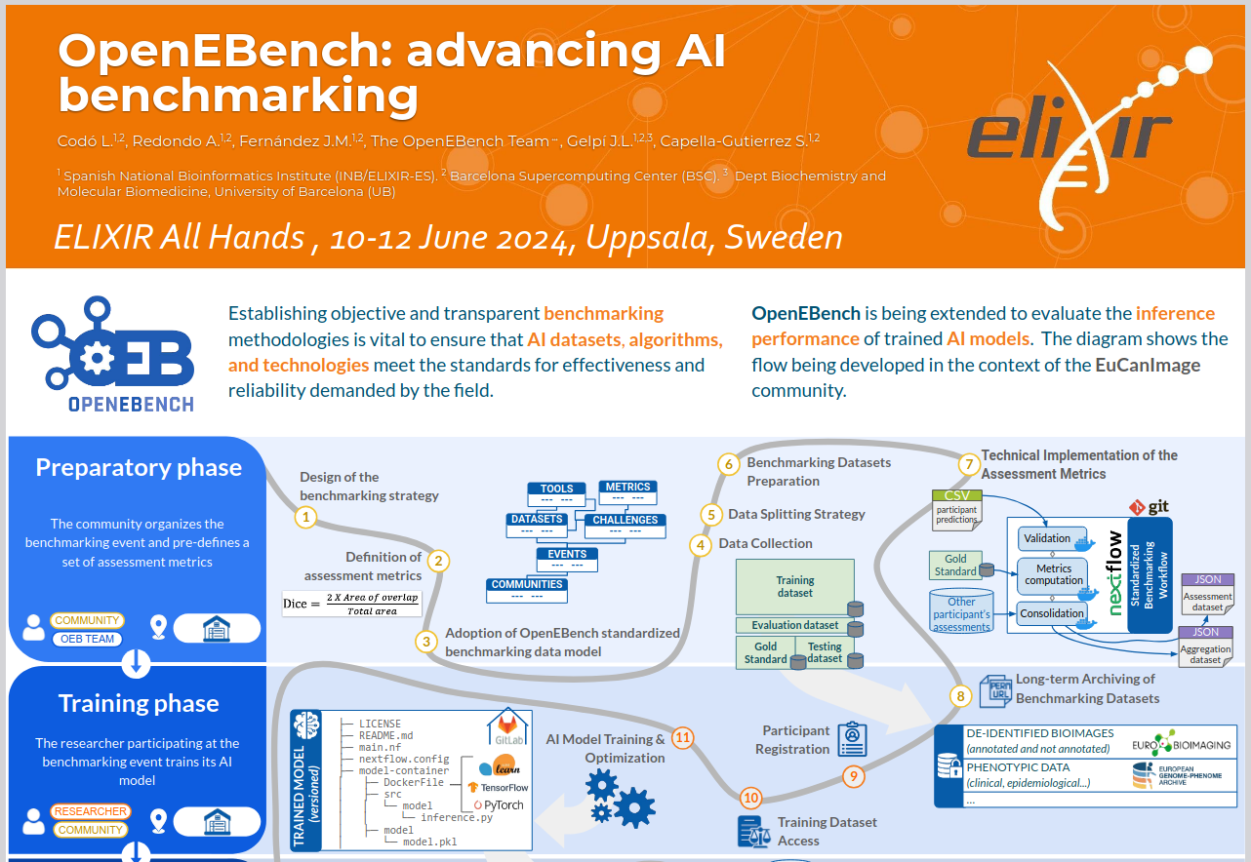
https://doi.org/10.7490/f1000research.1119729.1

Slide 29

OpenEBench AI model benchmarking
PREPARATORY PHASE
TRAINING PHASE
VALIDATION PHASE
TESTING PHASE
EVALUATION PHASE
PUBLICATION PHASE
Event Design & Planning
Assessment metrics
Data Collection & preparation
Who?
Training Dataset Access
AI Model training and optimization
Model Inference container
Trained AI model uploading
Inference on validation dataset
Inference on testing dataset
Assessment of inferred predictions
Metrics visualization & analysis
Benchmarking data submission
To OpenEBench portal
To EUDAT
Who?
Who?
Who?
Who?
Who?
COMMUNITY
RESEARCHER
RESEARCHER
RESEARCHER
RESEARCHER
RESEARCHER
OEB TEAM
COMMUNITY
OEB TEAM
OEB TEAM
OEB TEAM
OEB TEAM
COMMUNITY
Where?
Where?
Where?
Where?
Where?
Local
OpenEBench
OpenEBench
OpenEBench
OpenEBench

Slide 30
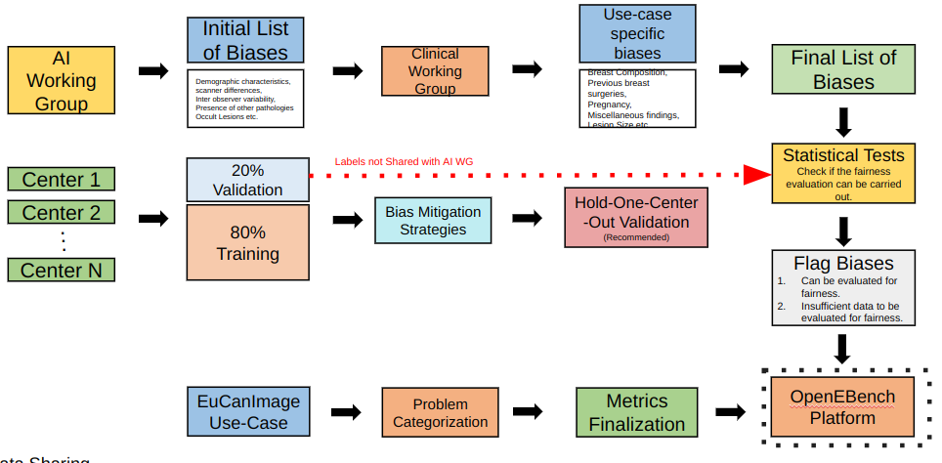
OpenEBench AI model benchmarking
PREPARATORY PHASE
TRAINING PHASE
VALIDATION PHASE
TESTING PHASE
EVALUATION PHASE
PUBLICATION PHASE
Event Design & Planning
Data Collection & preparation
Event Design & Planning
Assessment Metrics

Slide 31

OpenEBench AI model benchmarking
PREPARATORY PHASE
TRAINING PHASE
INTEGRATION PHASE
EVALUATION PHASE
ASSESSMENT PHASE
PUBLICATION PHASE
VRE
Training
dataset
No
Evaluation dataset
Gold
Standard
Predictor
AI Tool
Successful predictions?
Predictor
AI Tool
Participant output
Metrics generation
Assessment dataset
Yes
Assessment datasets
Consolidation
Aggregation dataset

Slide 32
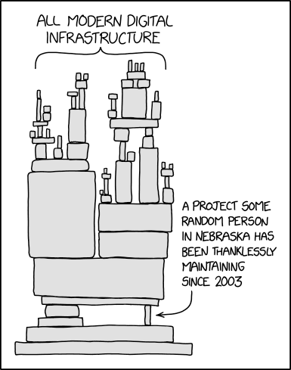
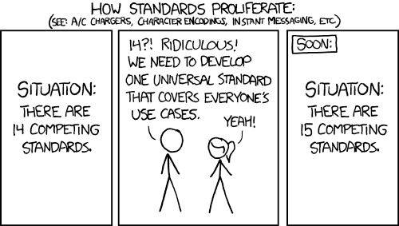
Take home messages
Designing, developing and deploying a community-driven platform for benchmarking is a long-term effort that requires substantial (human and computational) resources.
Communities are essential to ensure that the platform is fit-for-purpose in the broad sense. Platforms could be seen as a neutral broker facilitating these efforts.
Using, extending, and proposing standards for data, e.g. FAIR data principles, and software, e.g. software development good practices, are essential for sustainability.
It is important to foster collaboration and interoperability across benchmarking platforms for the greater good of the research community.
Artificial Intelligence will profoundly impact on how we organize (and support) community-driven benchmarking activities.
https://xkcd.com/2347/
https://xkcd.com/927/

Slide 33







Thank you!
Current and past members of the OpenEBench Team
Josep Ll. Gelpí
Alfonso Valencia
Andrea Morales
Anna Redondo
Ani Valle
Carles Hernández-Ferrer
Dmitry Repchevsky
Eva Martin del Pico
Jessica Martinez
José María Fernández
Karla Vizcarra
Laia Codó
Laura Portell
Dominik Brüchner
Meritxell Ferret
Javier Garrayo
Asier Gonzalez
Lidia López
Vicky Sundesha
Esther Vendrell
Sergi Aguilo

Slide 34
Q&A
Salvador Capella-Gutierrez
salvador.capella@bsc.es
© 2025 Barcelona Supercomputing Center - Centro Nacional de Supercomputación. Author: (Salvador Capella-Gutierrez).
Material licensed under CC BY-NC-4.0.

