Slide 1
Identifying Biases in Training Data for AI
Sex Bias in Drug Discovery: From Male-Default Research towards fair, AI-Driven Decisions
Barbara Füzi, Barcelona Supercomputing Center, Machine Learning for Biomedical Research Unite
27.01.2025
© 2025 Barcelona Supercomputing Center - Centro Nacional de Supercomputación.
Author: (XXXX). Material licensed under CC BY-NC-4.0.

Slide 2
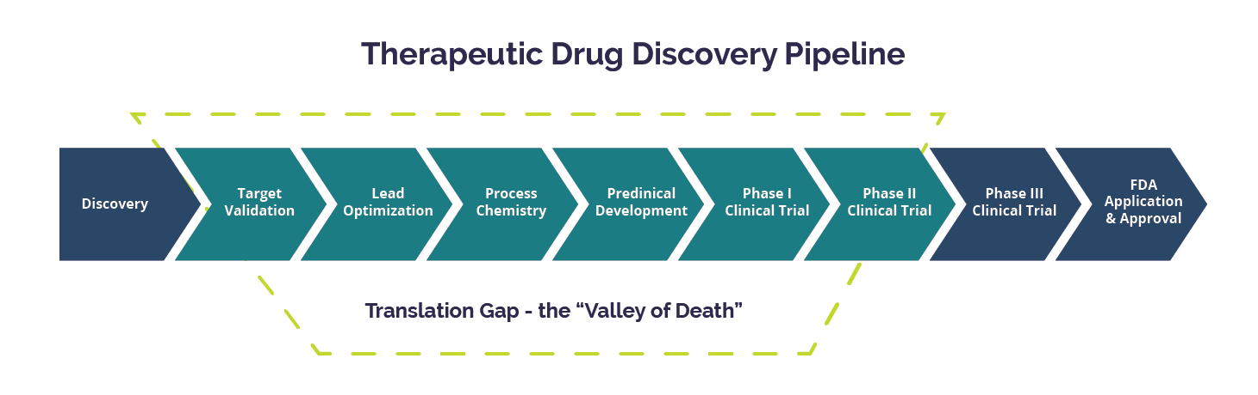
The Drug Discovery Pipeline
https://www.technologynetworks.com/drug-discovery/articles/academic-drug-discovery-repurposing-to-treat-disease-290036

Slide 3
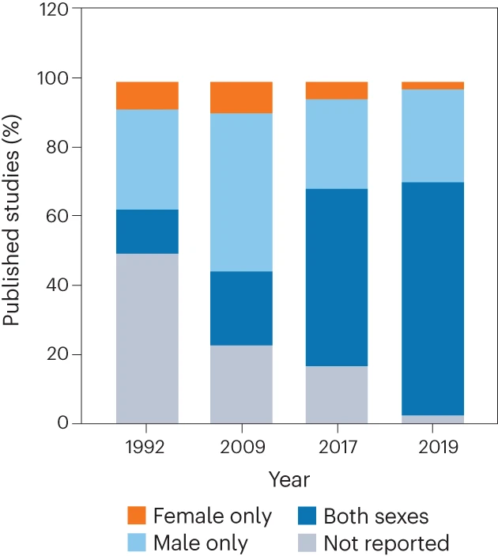
Sex bias in drug discovery
© 2025 BSC-CNS. Licensed under CC BY-NC-4.0
Drug discovery historically treated male biology as default
Modern standard sex as a biological variable, but historical data still can be problematic
AI/ML does not fix bias, it often learns and scales whatever is in the data
Changes in the percentage of published studies using male and female subjects by year
https://www.nature.com/articles/s44220-023-00083-3#Fig1

Slide 4
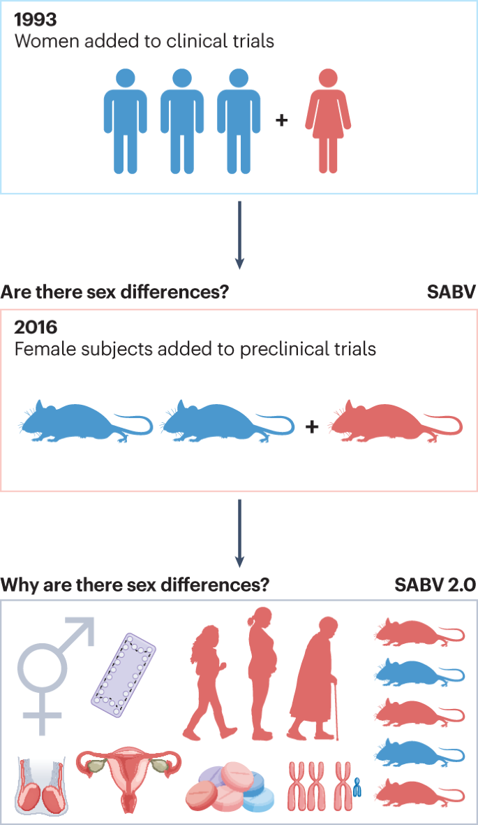
Where bias enters the pipeline and what is the effect of AI
© 2025 BSC-CNS. Licensed under CC BY-NC-4.0
Discovery and target ID: AI on omics/literature → inherits sex-skewed evidence
Screening: ML prioritizes compounds → performance depends on representativeness
Preclinical: single-sex animal/cell studies → biased ground truth for ML models
Clinical and post-market: AI for risk prediction/pharmacovigilance can underperform by sex
Example: Zolpidem showed real-world sex differences → dosing guidance adjusted
https://www.nature.com/articles/s44220-023-00083-3

Slide 5
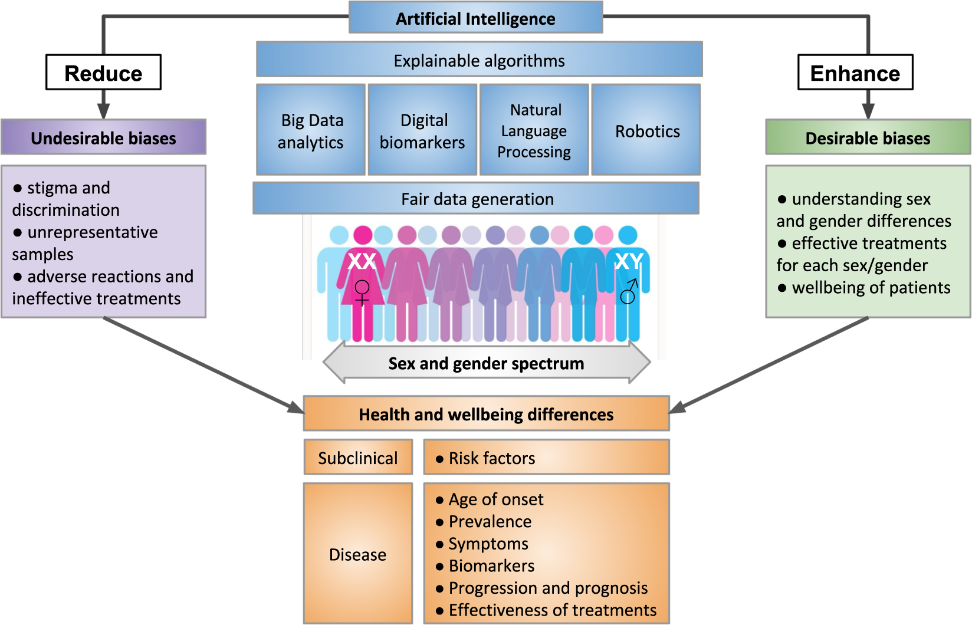
Why this happened and why AI makes it more urgent to act
© 2025 BSC-CNS. Licensed under CC BY-NC-4.0
Old rationale: females “too variable” (estrous cycle) → avoid “noise”
Inertia: legacy protocols + cost/power concerns
Best practice: include both sexes or justify/explain single-sex design + analyze by sex
AI risk: bias becomes faster + harder to notice (“looks objective”)
https://www.nature.com/articles/s41746-020-0288-5

Slide 6
AI is a mirror and a multiplier:
it reflects the data it’s given and can amplify bias at scale.

Slide 7



Sex differences in preclinical control data
Barbara Füzi
09.10.2025

Slide 8
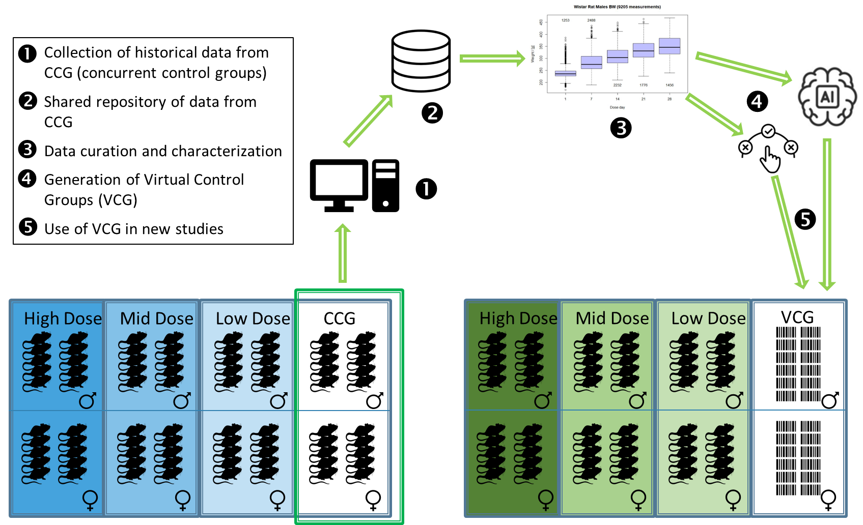
VICT3R project
The project is dedicated to reducing animal use in toxicology research by developing
Virtual Control Groups (VCGs).
Adapted from Steger-Hartmann et al. 2020, ALTEX; https://doi.org/10.14573/altex.2001311

Slide 9
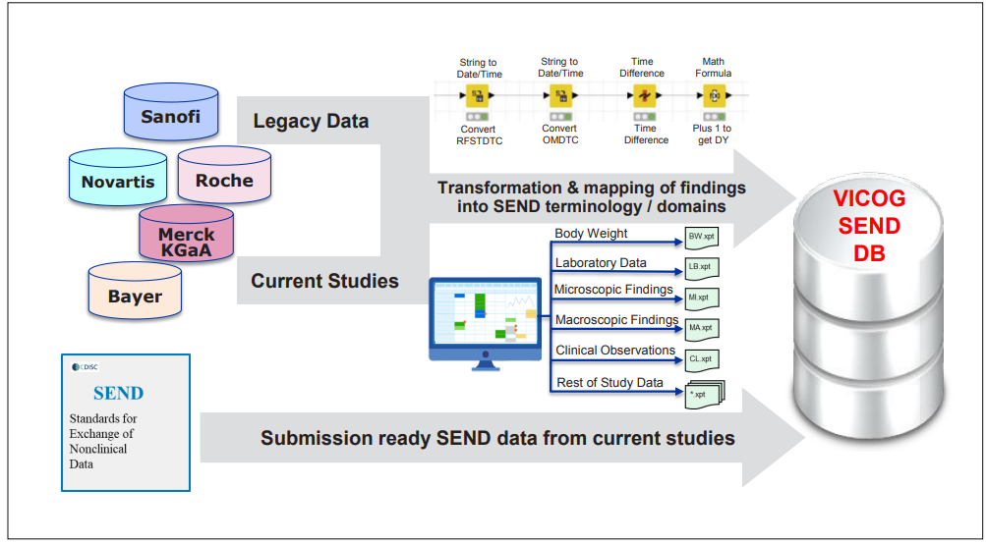
The Data
https://kops.uni-konstanz.de/server/api/core/bitstreams/7a7818b9-e1b8-4a2a-b643-b2f1a4eab689/content

Slide 10
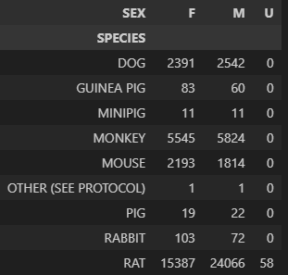
Sex differences in preclinical control data
Are there findings that occur significantly more often in one sex?
Understanding more about predispositions
The importance of including both sexes already in preclinical research

Slide 11
Statistics
Back to basics
To quantify sex-associated differences in organ involvement independent of predictive modeling, we performed a tissue-level burden analysis using the pathology category annotations from microscopic and macroscopic findings.
Sex differences were evaluated separately for each tissue using Fisher’s exact test in a 2×2 contingency framework comparing females vs males (affected vs unaffected among examined animals).
False discovery rate (FDR) correction across tissues was applied using the Benjamini–Hochberg method.
Results were summarized as log odds ratios (logOR; positive values indicate higher tissue involvement in females).

Slide 12
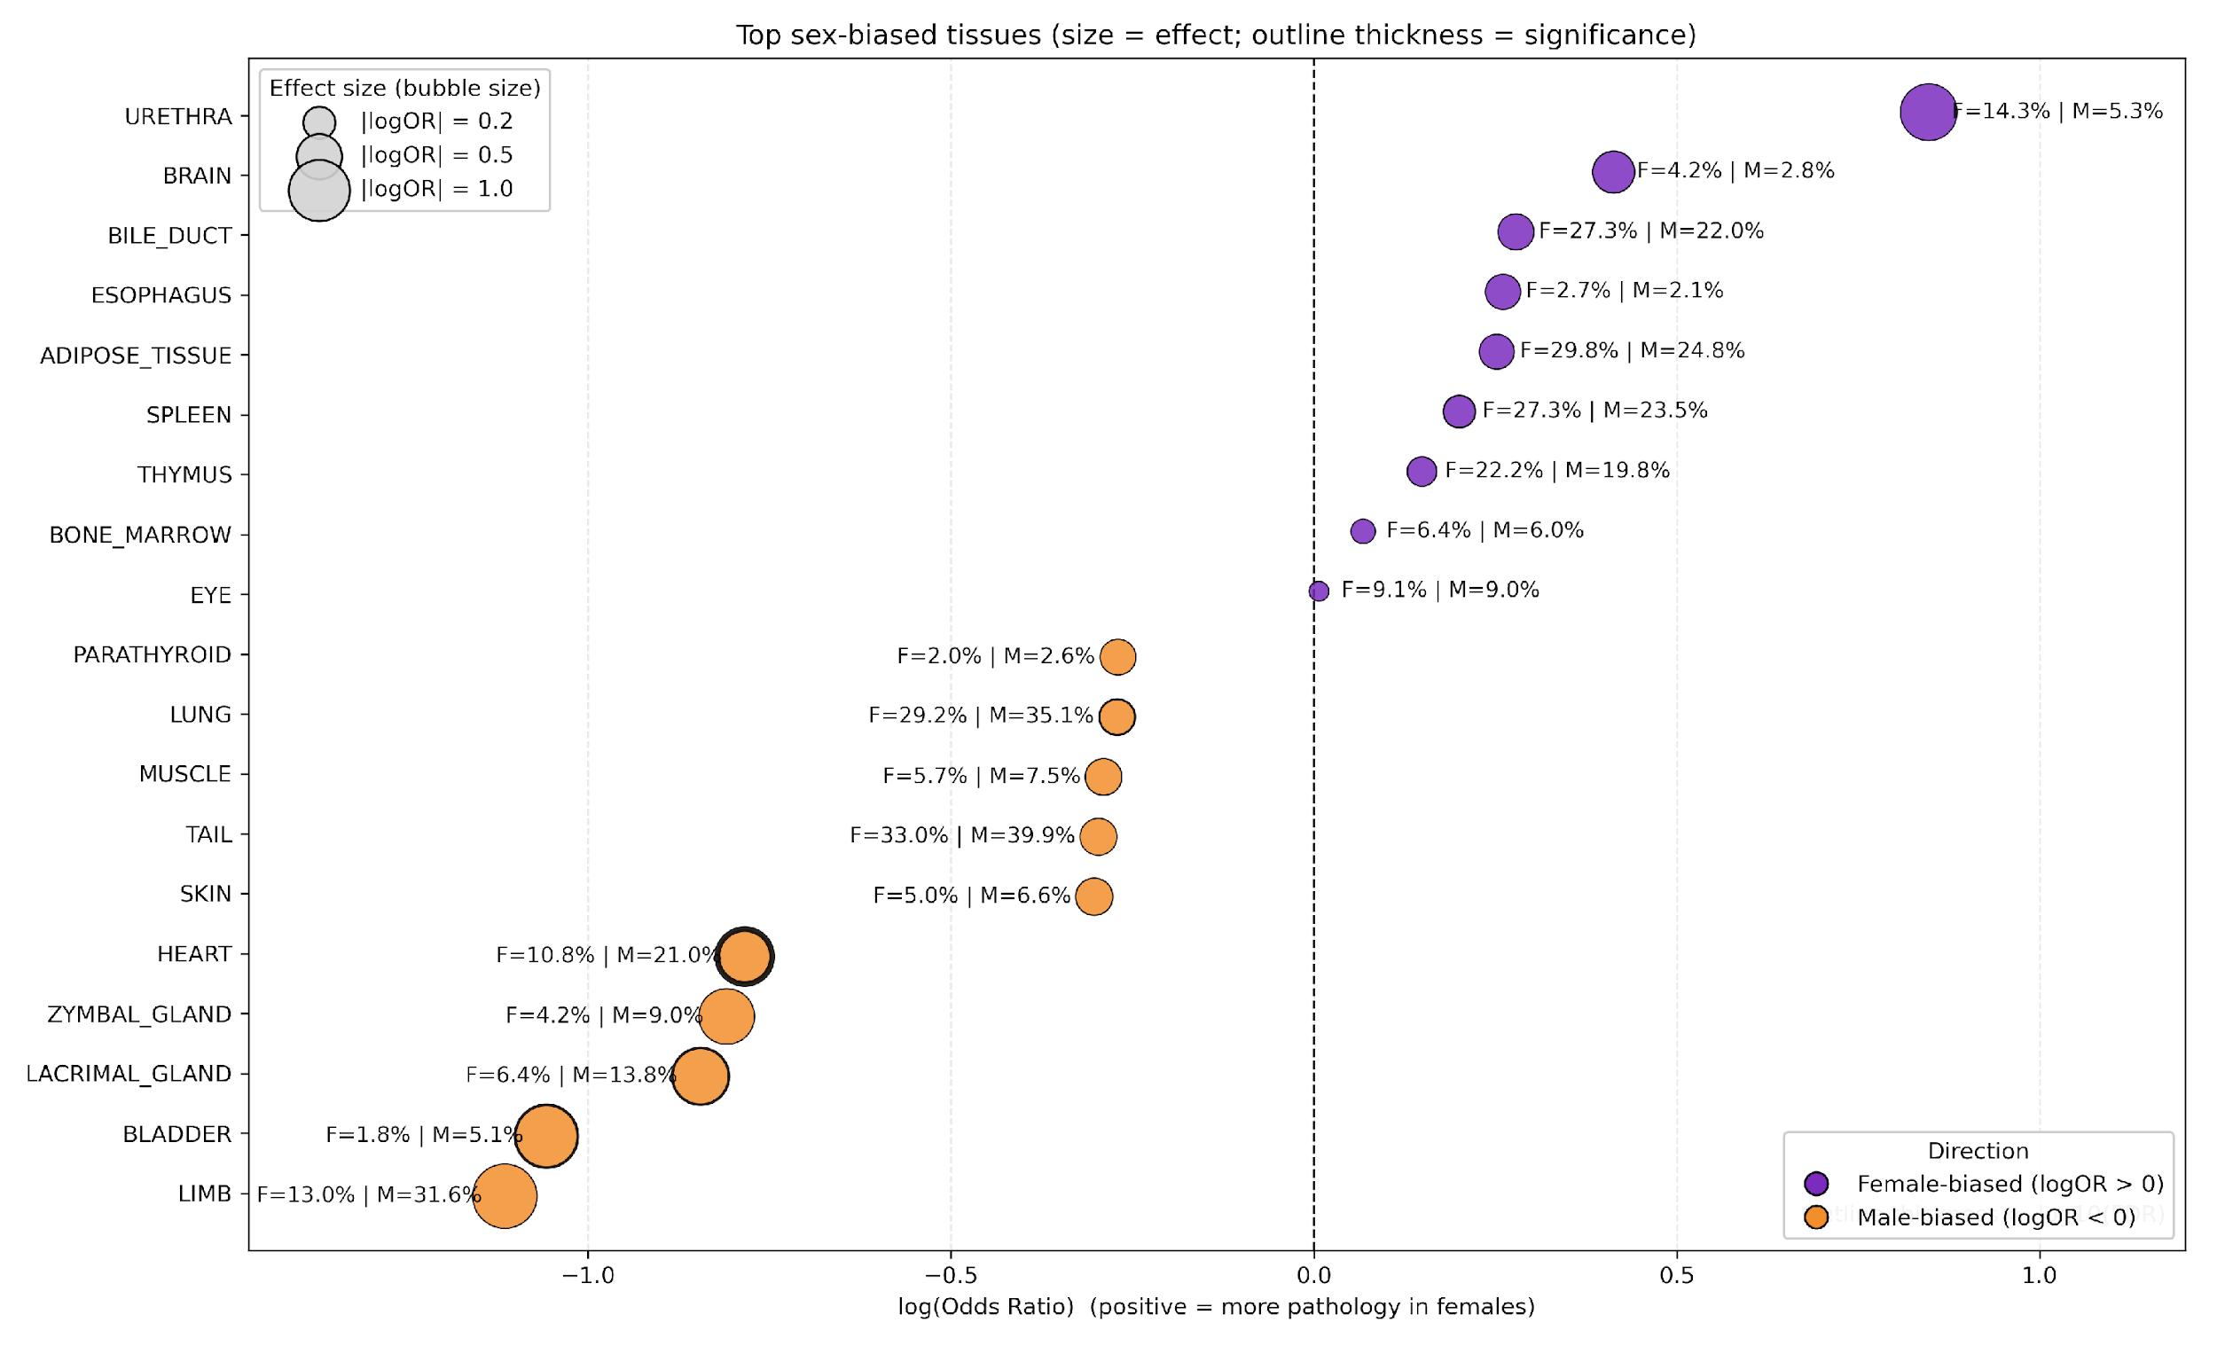
What statistics tells us
The Fisher/FDR tissue analysis tells us:
In which organs is pathology more frequent in females vs males?
with effect sizes (logOR) and corrected significance (FDR)
It is:
transparent
easy to interpret biologically
directly overview organ vulnerability
This is the confirmatory / descriptive layer.

Slide 13
Why adding ML?
Because pathology findings are multivariate and co-occur
Real toxicology pathology is not one lesion at a time it’s patterns like:
liver change + bile duct change + inflammation
lung infiltrate + hemorrhage + vascular signal
A model can learn:
combinations of findings that jointly separate sexes
non-linear interactions (dependencies) between lesions
rare but highly discriminative lesion descriptors
feature then tells you:
which specific lesions/features drive the classification
This is the discovery / pattern-mining layer.

Slide 14
Statistics vs. ML
Statistics = what differs in prevalence? (univariate, tissue burden)
ML + feature importance = what patterns best discriminate sex? (multivariate, lesion combinations)

Slide 15
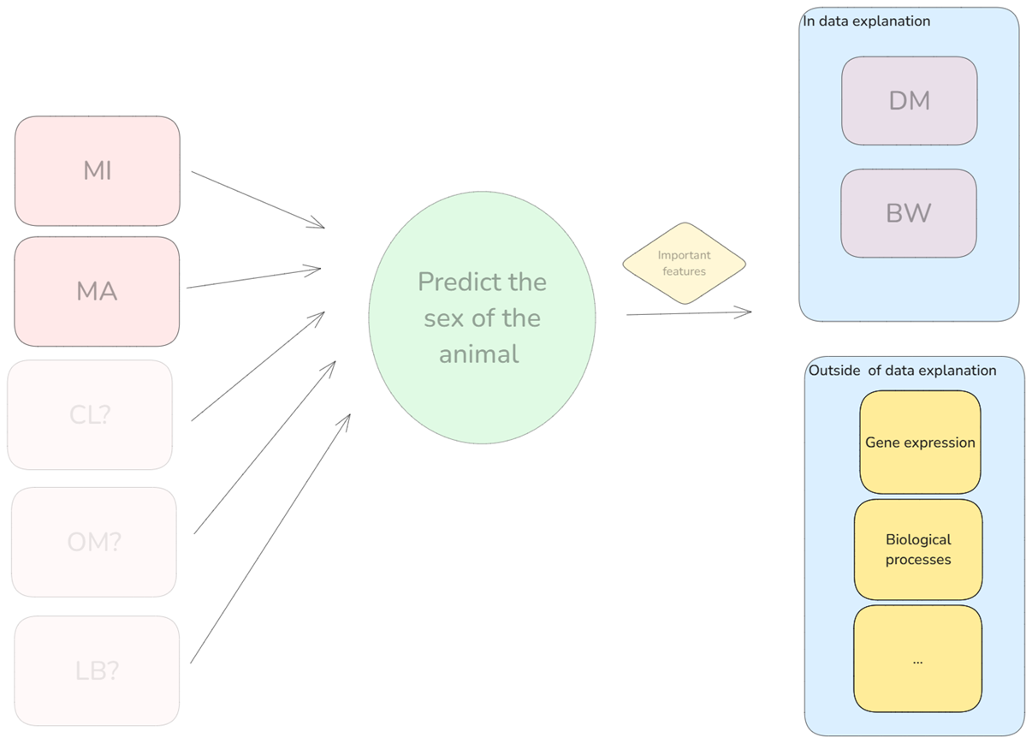


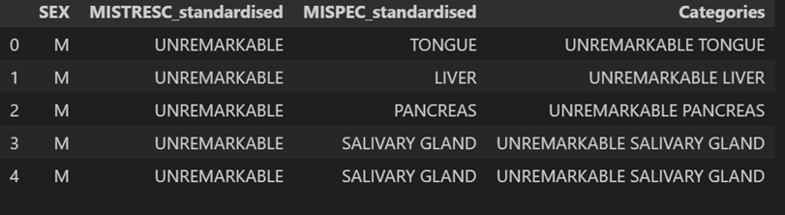
Schematic overview for the ML approach

Slide 16
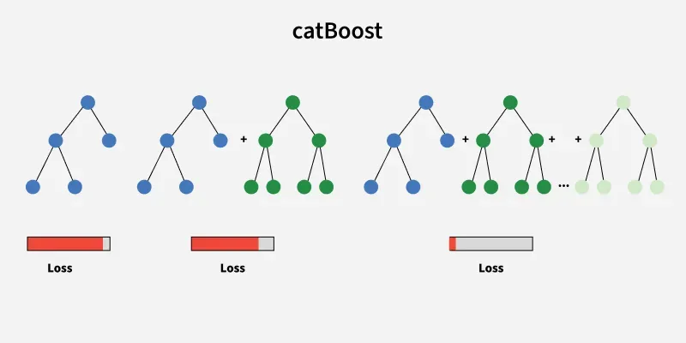
Machine Learning Model
CatBoost Model
Builds an ensemble of decision trees using gradient boosting
Each new tree corrects the mistakes of the previous ones
Uses ordered boosting to reduce overfitting and prediction bias
Handles categorical features natively

Slide 17
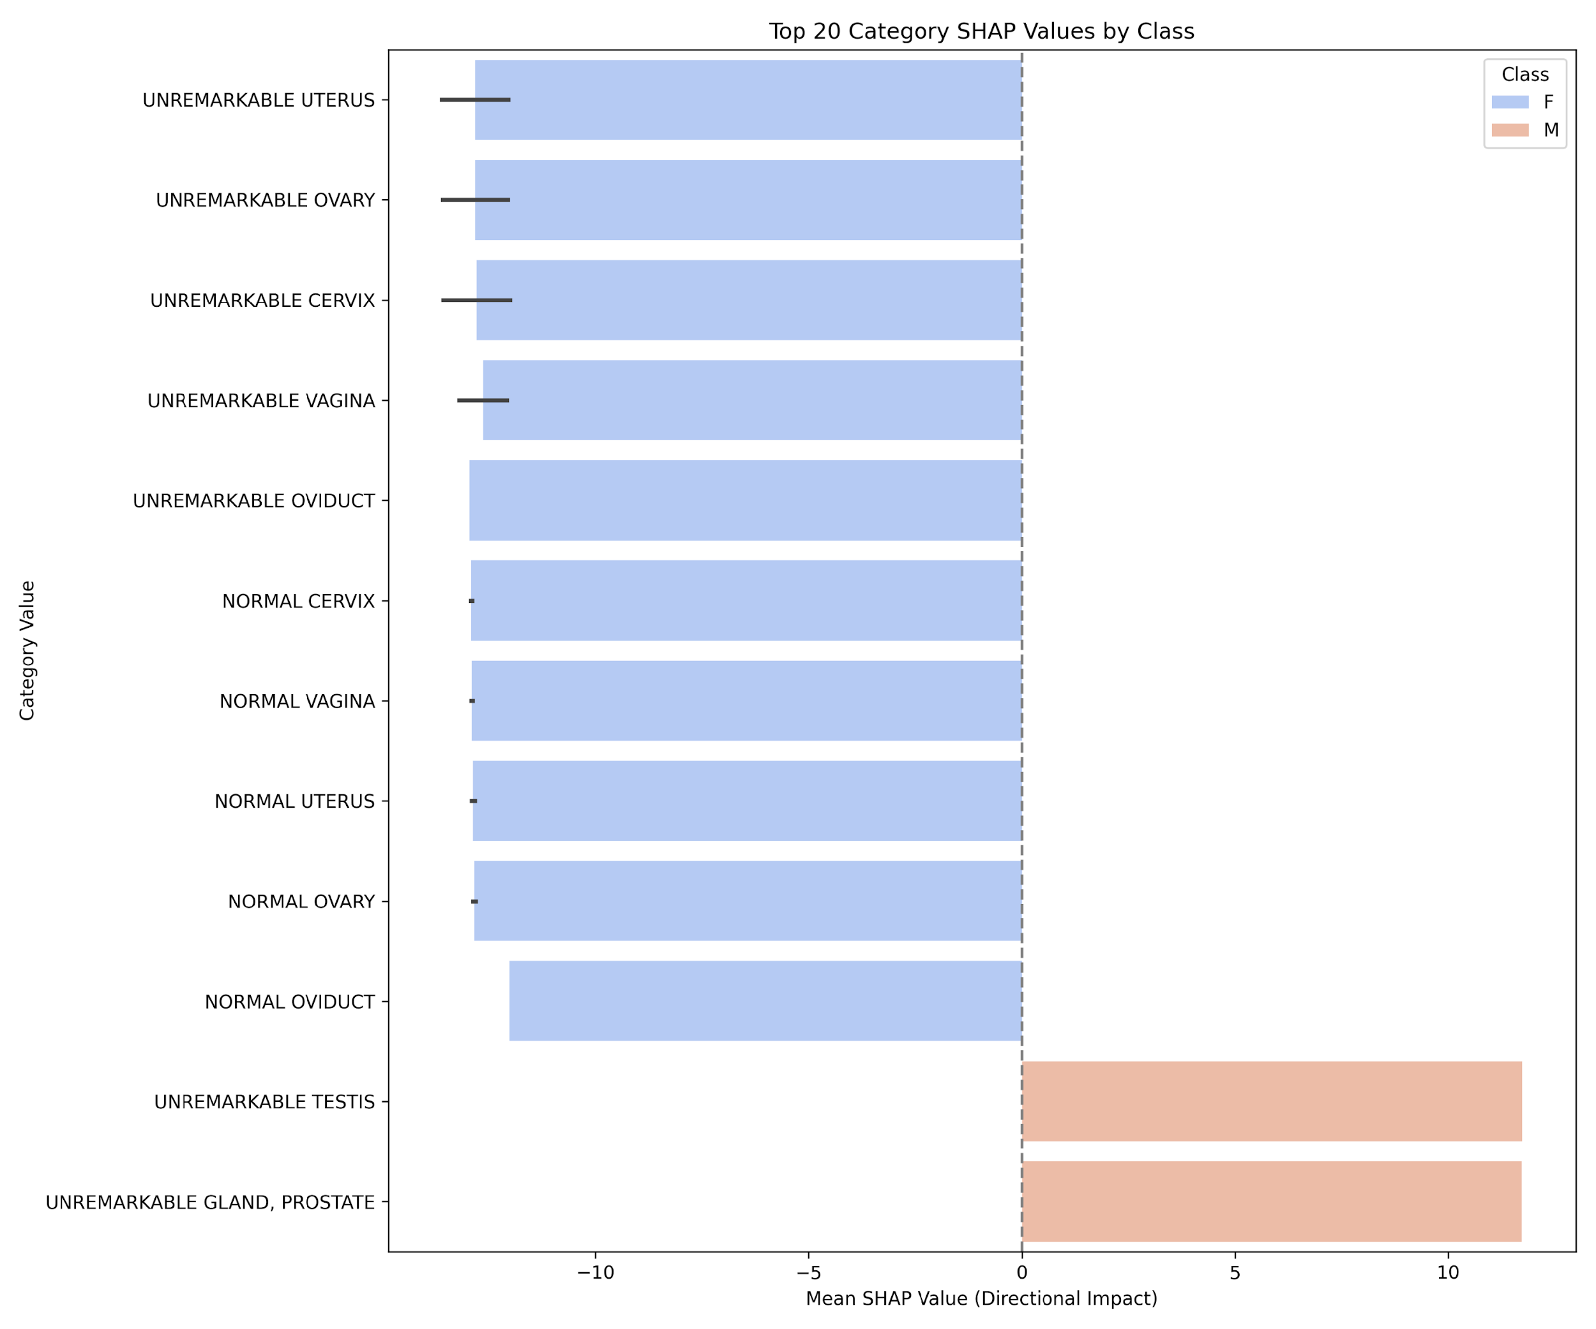
Feature importance - SHAP
CatBoost Model
SHAP feature importance
Explains machine learning predictions using Shapley values from game theory
Calculates each feature’s contribution in predicting the class
Delivers consistent, interpretable explanations with intuitive visualizations

Slide 18

Results for the model
 | precision | recall | f1-score
F | 0.61 | 0.65 | 0.63
M | 0.63 | 0.59 | 0.61
accuracy | 0.62 | 0.62 | 0.62
BAC | 0.62
 | precision | recall | f1-score
F | 0.99 | 0.99 | 0.99
M | 0.99 | 0.99 | 0.99
accuracy | 0.99 | 0.99 | 0.99
BAC | 0.99
Top SHAP100

Slide 19
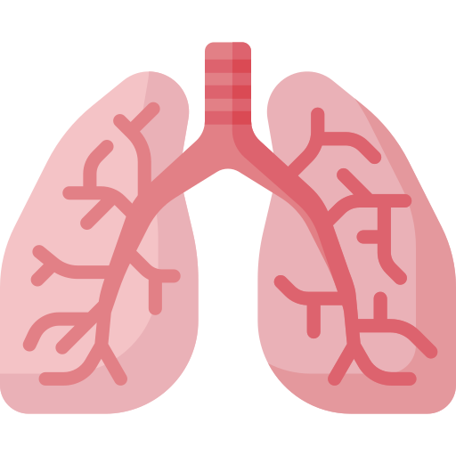
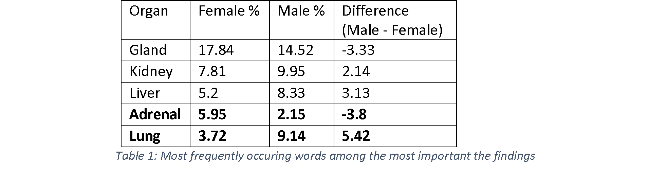

Tissue-specific differences
Most important features: how often occurring a tissue?
Is there a tissue that is a lot more often occurring for female/male?

Slide 20




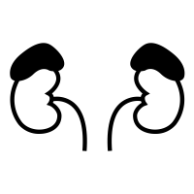

Biological explanation
Female adrenal, male lung
Sex-specific rat tissue expression data
Tissue-specific disease expression data
Overlap -> biological pathway overrepresentation analysis

Slide 21
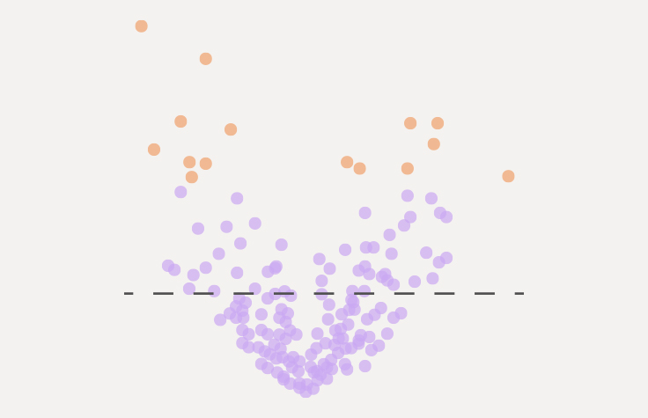
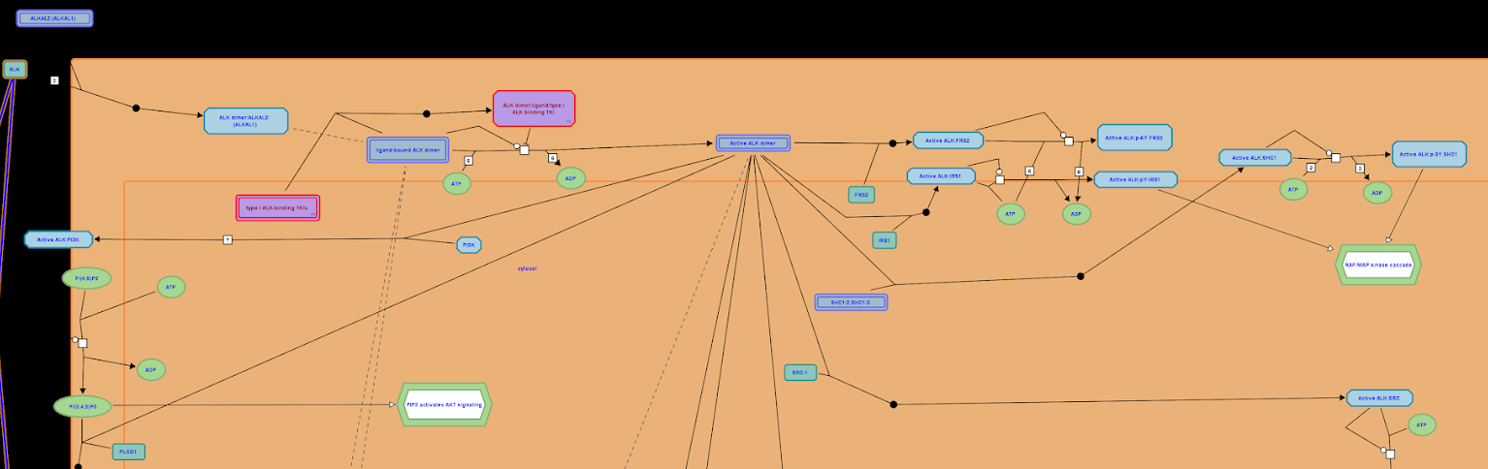
Pathway overrepresentation analysis
MDK and PTN in ALK signaling
Signaling by ALK
SUMOylation of intracellular receptors
Nuclear Receptor transcription pathway
Gene lists -> pathways
Top2a
Vdr
Cdkn1c …

Slide 22
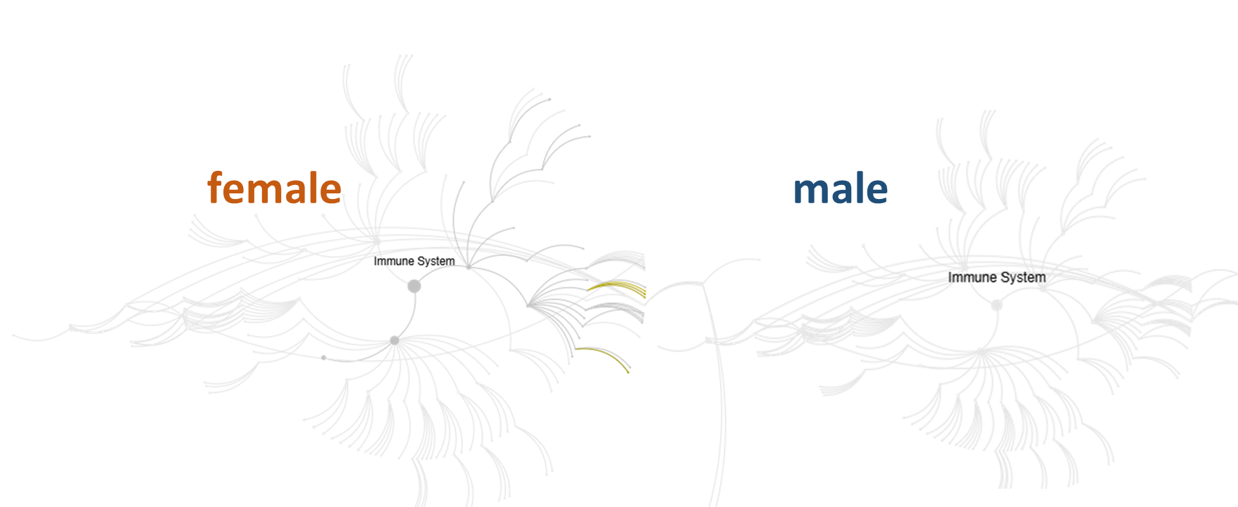
Relevant pathways
Regulation of HMOX1 expression and activity
TP53 Regulates Transcription of Genes Involved in G1 Cell Cycle Arrest
Female adrenal vulnerability: is rooted in high hormonal demand, cyclical endocrine modulation, and dependence on precise feedback and oxidative stress control.
Male lung vulnerability comes from a mismatch between strong repair/thrombotic readiness and weak metabolic/electrophysiological regulation, compounded by hormonal influences on inflammation.

Slide 23
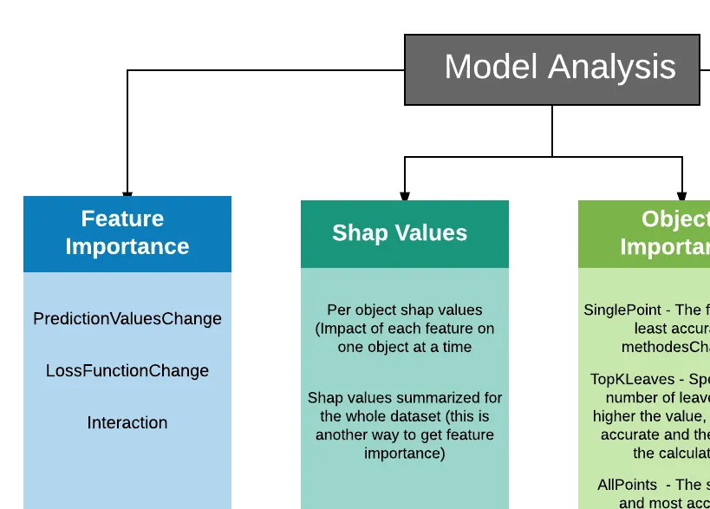
In-data explanation
the adrenal and lung findings could be associated with any demographic attributes?
lung_pos and adrenal_pos models
The features used in the analysis were: "SEX", "ARM", "STRAIN", "STUDYID", "BRTHDTC", "AGE".
CatBoost’s FeatureImportance method

Slide 24
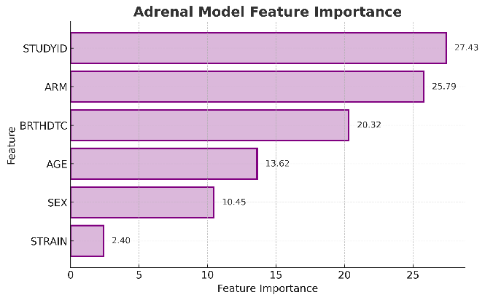
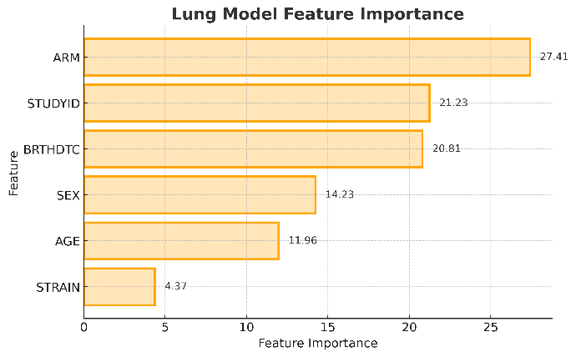
VICT3R demographic data explications

Slide 25
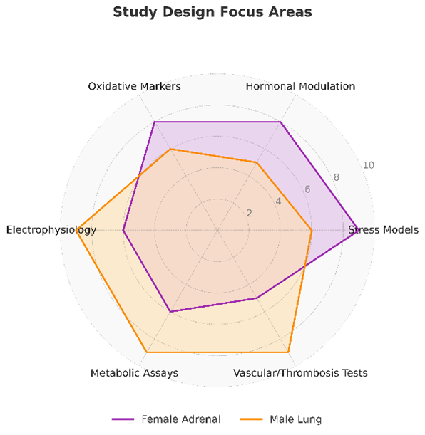
Take home message
Sex-based differences matter, treatment allocation, study-specific context, and temporal information are key drivers.
By aligning drug development strategies with these sex- and system-specific sensitivities, preclinical studies can increase both their predictive accuracy and their translational value.

Slide 26
Acknowledgement VICT3R
Davide Cirillo
Machine Learning Unit Barcelona Supercomputing Center
Members of VICT3R

Slide 27


Assessment checklist
© 2025 BSC-CNS. Licensed under CC BY-NC-4.0
Data inputs: sex balance and labeling quality
Model design: stratified training/testing, fairness checks, error by sex
Study design: randomization/blinding and sample size logic per sex
Outputs: sex-disaggregated efficacy/safety and interaction tests
Translation risk: could sex-skewed preclinical + AI prioritization miss female signals?

Slide 28
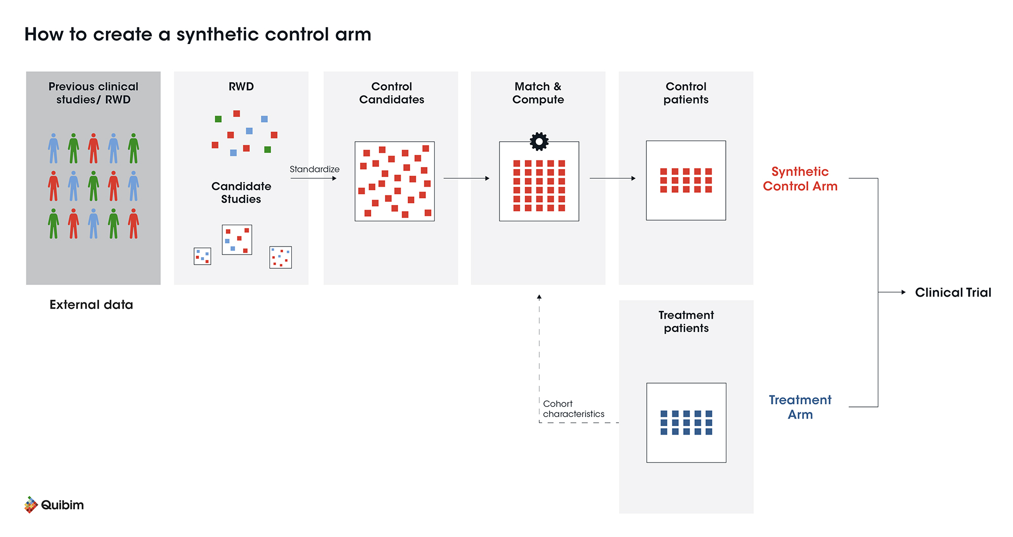
Towards un-biased synthetic data and Virtual Control Groups
Virtual control group external controls built from real-world data (RWD), preclinical, clinical
Benefits: faster trials, fewer patients on placebo, supports rare diseases
Risk: if historical data is sex-skewed → biased baseline and misleading effects
Fair controls need fair data: stratify by sex, validate balance, and test performance by subgroup
https://quibim.com/news/synthetic-control-arm-in-clinical-studies/

Slide 29
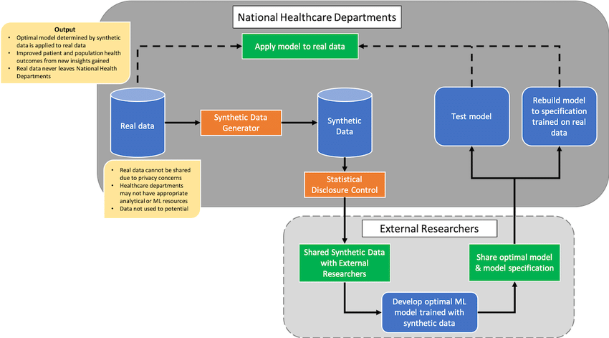
Synthetic data for unbiased control arms
Synthetic data can augment under-represented groups (e.g., females) → better equity
Can support privacy-preserving sharing and multi-site collaboration
Synthetic data can still encode bias, over-smooth rare patterns, or leak artifacts
https://www.researchgate.net/figure/Proposed-synthetic-data-sharing-pipeline-illustrates-how-synthetic-data-could-be_fig1_341921647

Slide 30
Thank you!
© 2025 BSC-CNS. Licensed under CC BY-NC-4.0
Disclaimer:
This project has received funding from the European High-Performance Computing Joint Undertaking (JU) under grant agreement No 101234399 and Portugal, Romania and Türkiye. The JU receives support from the European Union’s Horizon Europe Programme. It is also co-funded by the Department of Research and Universities of the Government of Catalonia and the Spanish Ministry for Digital Transformation and Public Service.
© 2025 Barcelona Supercomputing Center - Centro Nacional de Supercomputación. Author: (XXXX).
Material licensed under CC BY-NC-4.0.

