Slide 1
Evaluation of AI algorithms for biomedical research and sex and gender biases in AI
Block 1: Fundamentals and Concepts. Part 2
Carolina Belver Aguilar, BSC
26/01/26
© 2026 Barcelona Supercomputing Center - Centro Nacional de Supercomputación.
Author: Carolina Belver Aguilar. Material licensed under CC BY-NC-4.0.

Slide 2
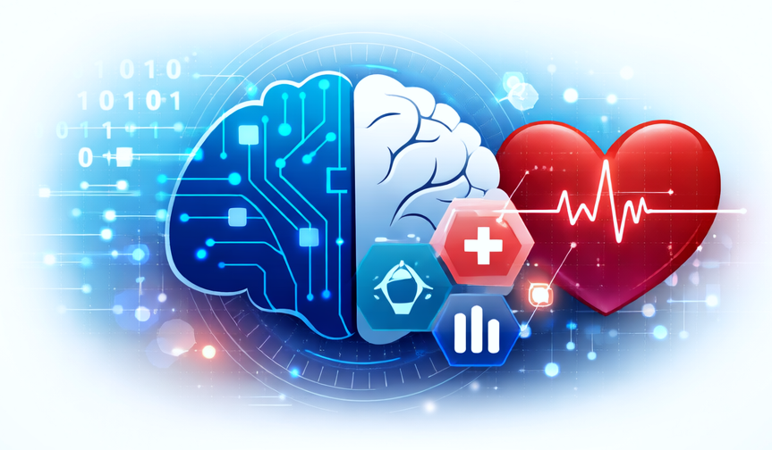
Why this session matters
© 2026 BSC-CNS. Licensed under CC BY-NC-4.0
AI systems increasingly influence clinical and research decision in healthcare.
These decisions affect real patients, often in high-risk contexts such as diagnosis and treatment selection.
When bias is present in AI system, its impact is not theoretical. It can lead to unequal performance, unfair decisions and harm to specific population groups.

Slide 3
Conceptual roadmap of the session
© 2026 BSC-CNS. Licensed under CC BY-NC-4.0
This session follows a conceptual progression:
We will focus on building the conceptual foundations needed to understand why sex and gender are critical variables in AI-based research and healthcare applications.
AI
Responsible AI
Bias
Sex and Gender

Slide 4
What Do We Mean by AI?
© 2025 BSC-CNS. Licensed under CC BY-NC-4.0
Artificial Intelligence refers to computational systems designed to perform tasks that typically require human intelligence.
In healthcare, AI systems analyse complex data, identify patterns and support or automate decisions.

Slide 5
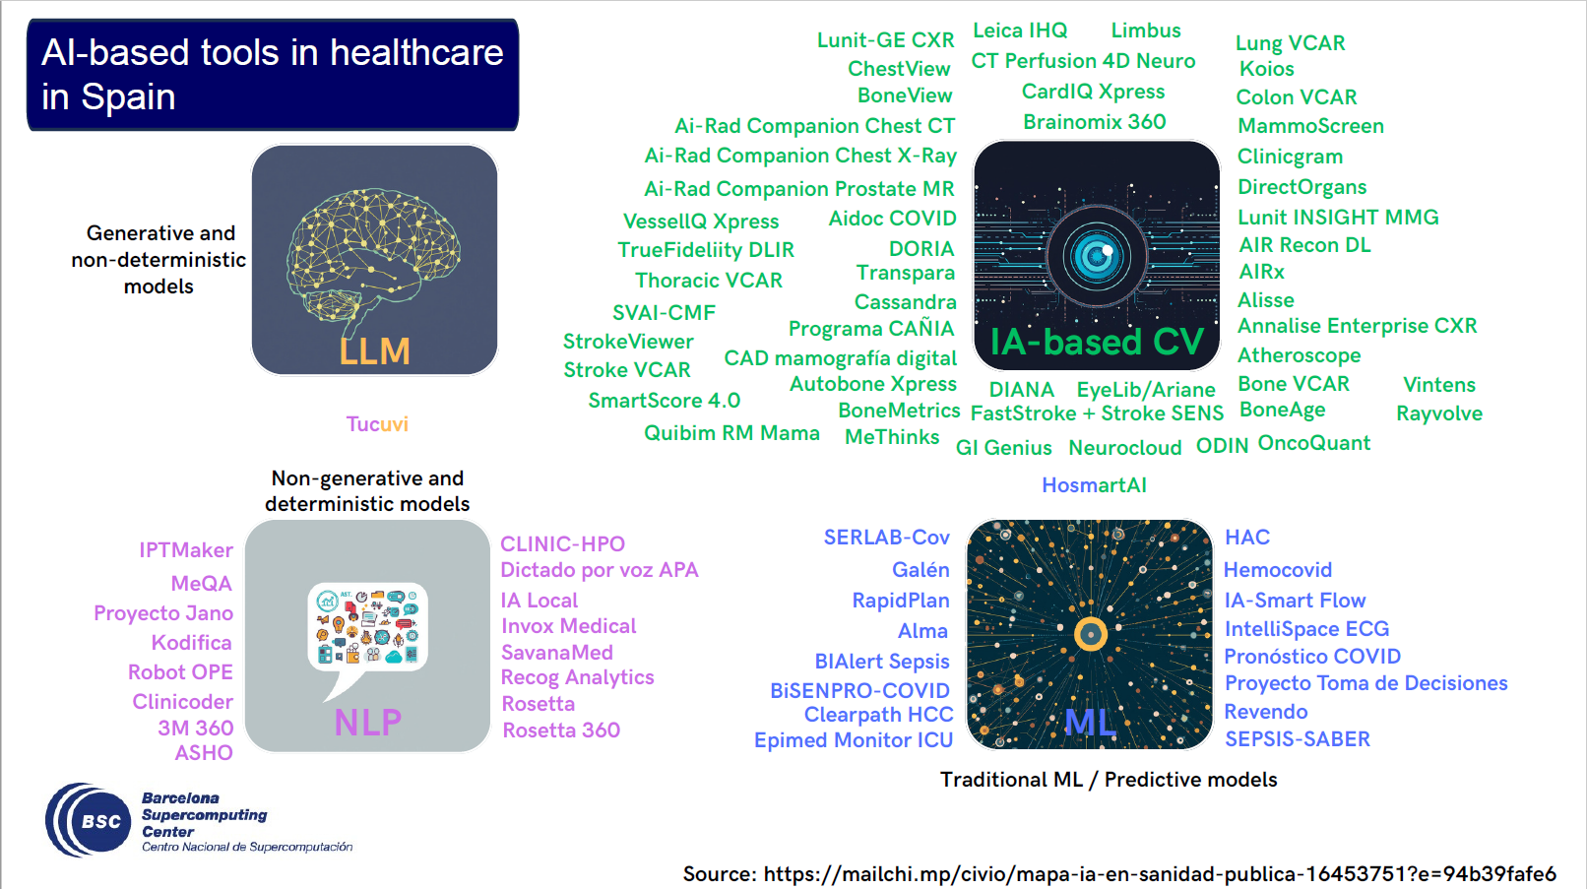
What Do We Mean by AI?
© 2025 BSC-CNS. Licensed under CC BY-NC-4.0

Slide 6
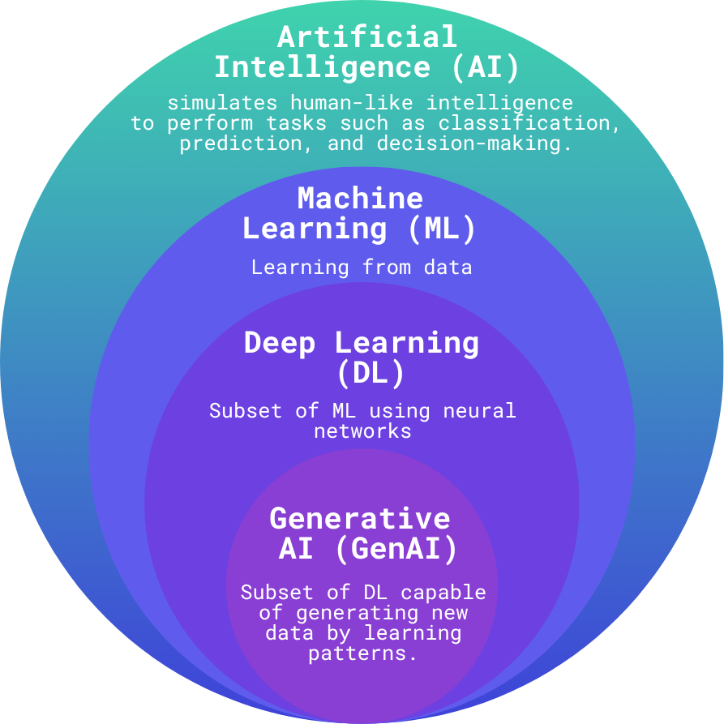
AI, Machine Learning and Deep Learning
© 2025 BSC-CNS. Licensed under CC BY-NC-4.0
AI is a broad field that includes different approaches.
ML is the most common approach in healthcare-AI and refers to systems that learn patterns from data.
DL is a subset of ML based on NN and is widely used in imaging and signal processing.
GenAI is a subset of DL able to generate new data.
J. Carbonell and K. Vizcarra, “The Technology of AI - Introduction”, AHEAD Training, July 2025.

Slide 7
How an AI system works in practice
© 2025 BSC-CNS. Licensed under CC BY-NC-4.0
Most AI systems in healthcare follow a similar pipeline:
Data are collected from patients or populations.
A model is trained to learn patterns from these data.
The trained model produces outputs, such as predictions.
Bias introduced at any stage of this pipeline can propagate to the outcome.

Slide 8
From past AI to generative AI
© 2025 BSC-CNS. Licensed under CC BY-NC-4.0
Traditional AI systems focused on classification and prediction tasks, such as identifying disease or estimating risk.
More recent systems can generate text, images or recommendations, and interact directly with users.
As AI systems become more autonomous and more present, the potential impact of bias and design choices increases.

Slide 9
Why AI is used in healthcare
© 2025 BSC-CNS. Licensed under CC BY-NC-4.0
AI is applied across the healthcare process, including:
Supporting diagnosis and risk prediction.
Optimising treatment and personalised medicine.
Monitoring patients and healthcare systems.
Enabling prevention and early detection.
Because AI can influence decisions at multiple stages, its quality and fairness are crucial.

Slide 10
Health questions AI aims to answer
© 2025 BSC-CNS. Licensed under CC BY-NC-4.0
AI systems in healthcare are often designed to help answer fundamental questions:
Am I sick?
Will I develop a disease in the future?
Which treatment is most appropriate for me?
These questions are deeply personal and sensitive, which increases the ethical and societal responsibility of AI systems.

Slide 11
The promise and the reality of AI in health
© 2025 BSC-CNS. Licensed under CC BY-NC-4.0
AI promises faster diagnosis, improved accuracy and more personalised care.
However, many AI systems have limited validation, are tested on narrow populations and fail to generalise to real-world clinical settings.
This gap between promise and reality is where many biases emerge.

Slide 12
Roadmap
© 2025 BSC-CNS. Licensed under CC BY-NC-4.0
AI
Responsible AI
Bias
Sex and Gender

Slide 13
AI in healthcare is high-risk
© 2025 BSC-CNS. Licensed under CC BY-NC-4.0
Most AI systems used in health are considered high-risk technologies.
They can influence clinical decisions such as diagnosis, treatment selection, monitoring or triage.
Errors or biases in these systems may directly affect patient safety, health outcomes and trust in healthcare systems.

Slide 14
What do we mean by Responsible AI
© 2025 BSC-CNS. Licensed under CC BY-NC-4.0
Responsible AI refers to the development and use of AI systems that are:
Fair and non-discriminatory.
Transparent and explainable.
Accountable and auditable.
Robust and safe.
In healthcare, Responsible AI aims to ensure that AI improve care for all, not only for some groups.

Slide 15
Responsible AI goes beyond ethics
© 2025 BSC-CNS. Licensed under CC BY-NC-4.0
Responsible AI is not only an ethical concern.
It also involves:
Technical quality and robustness
Legal and regulatory compliance
Social impact and trust
Clinical relevance
Ignoring any of these dimensions can compromise the effectiveness of AI in healthcare.

Slide 16
Why responsible AI matters in health
© 2025 BSC-CNS. Licensed under CC BY-NC-4.0
Responsible AI contributes to:
Safer clinical decision-making
Reduced risk of harm and inequality
Increased trust from patients and professionals
Better adoption in real-world settings
In healthcare, responsibility is a prerequisite for impact.

Slide 17
Transparency and open approaches
© 2025 BSC-CNS. Licensed under CC BY-NC-4.0
Transparency is a key component of Responsible AI.
Open approaches, such as shared documentation, open methods and community review, can help identify limitations, biases and risks earlier.
Transparency does not eliminate bias, but it makes it visible and actionable.

Slide 18
Take-home: Responsible AI
© 2025 BSC-CNS. Licensed under CC BY-NC-4.0
Responsible AI in healthcare is about quality.
It aims to ensure that AI systems are reliable, fair and useful in real clinical contexts.
Without responsibility, AI risks enforcing existing problems rather than solving them.

Slide 19
Roadmap
© 2025 BSC-CNS. Licensed under CC BY-NC-4.0
AI
Responsible AI
Bias
Sex and Gender

Slide 20
What is bias
© 2025 BSC-CNS. Licensed under CC BY-NC-4.0
Bias refers to a systematic error introduced by humans or machines.
It leads to unfair or inaccurate outcomes that disadvantage certain individuals or groups, often based on attributes such as sex, gender, age or socio-economic status.
Bias is not random noise, it follows patterns.

Slide 21
Why bias matters in healthcare
© 2025 BSC-CNS. Licensed under CC BY-NC-4.0
When bias is present in healthcare AI systems, it can lead to:
Unequal performance across population groups.
Systematic under- or over-diagnosis.
Reinforcement of existing health inequalities.
Because healthcare decisions are high-risk, the consequences of bias can be severe.

Slide 22
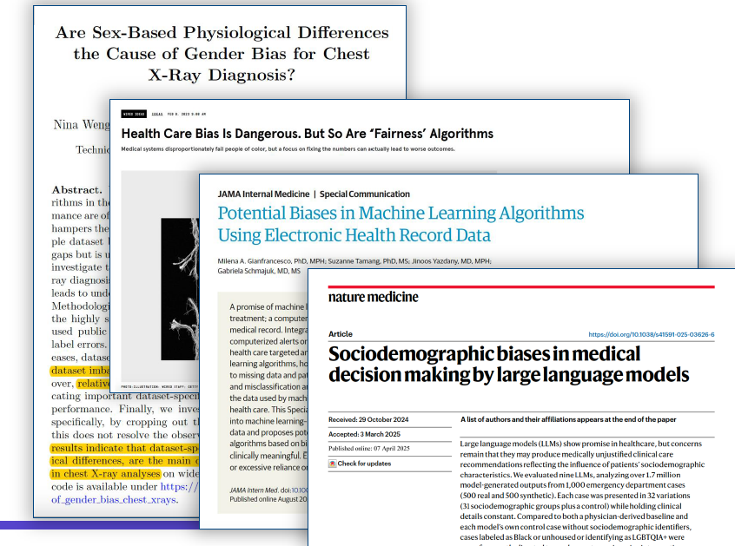
Why bias matters in healthcare
© 2025 BSC-CNS. Licensed under CC BY-NC-4.0
M. Cano, “Ethics of AI”, AHEAD Training, July 2025.
Notes:
Deployment bias different tan training conditions

Slide 23
Bias is not a random error
© 2025 BSC-CNS. Licensed under CC BY-NC-4.0
Unlike random errors, bias is:
Systematic
Predictable
Often embedded in processes and assumptions.
Because of this, bias can persist across datasets, models and deployments if it is not explicitly addressed.

Slide 24
Bias exists even in simple AI systems
© 2025 BSC-CNS. Licensed under CC BY-NC-4.0
Bias is not limited to complex or clinical AI systems.
Even widely used applications, such as language translation tools, have shown gender and cultural biases that reflect stereotypes present in training data.

Slide 25
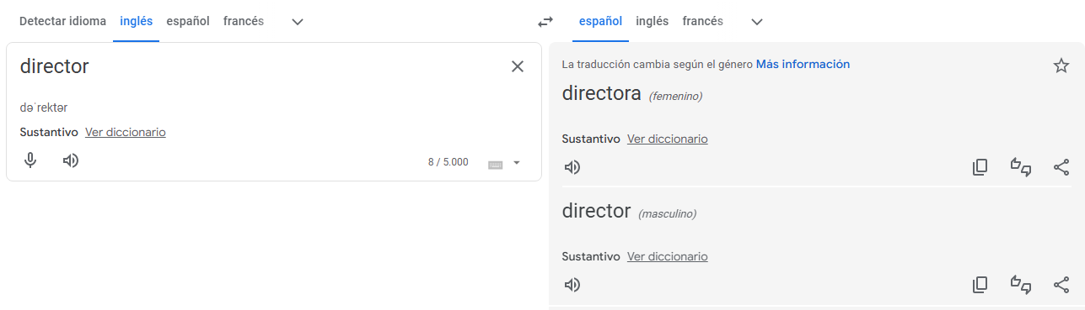
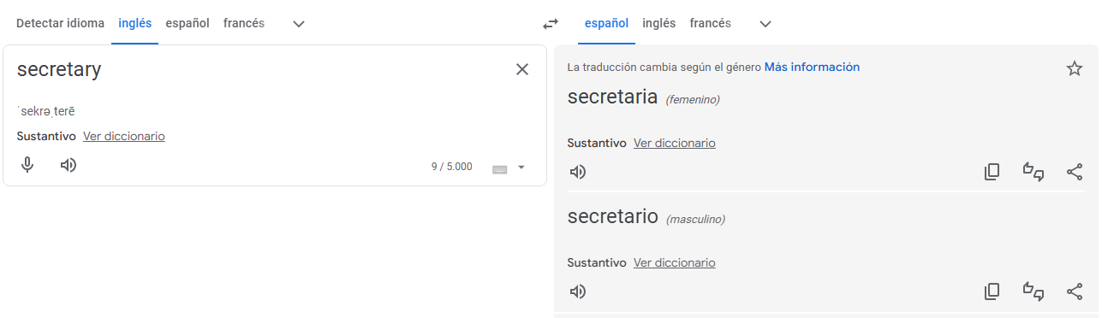
Bias on Google Translator
© 2025 BSC-CNS. Licensed under CC BY-NC-4.0
M.J. Rementeria, “Sex and Gender Bias in Health & AI”, AHEAD Training, July 2025.

Slide 26


Bias on Google Translator
© 2025 BSC-CNS. Licensed under CC BY-NC-4.0
M.J. Rementeria, “Sex and Gender Bias in Health & AI”, AHEAD Training, July 2025.

Slide 27
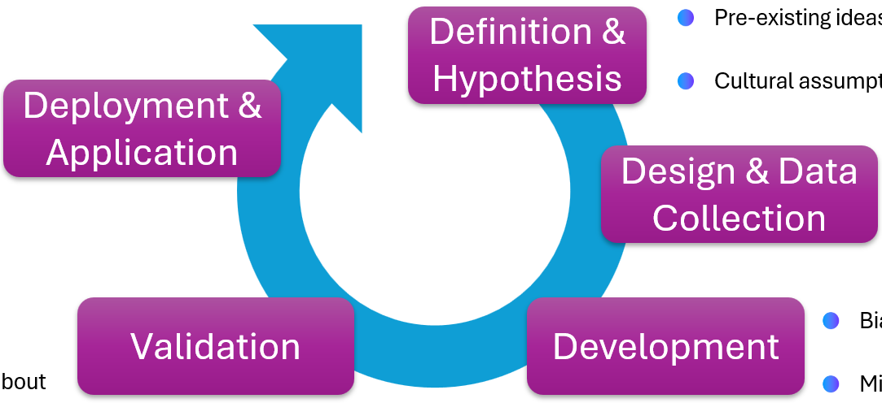
Bias exists across the AI lifecycle
© 2025 BSC-CNS. Licensed under CC BY-NC-4.0
Bias in AI systems does not appear in a single moment.
It can emerge at any stage of the AI lifecycle, from the initial problem definition to deployment in real-world settings.
Understanding where bias arises is essential to know how to prevent or mitigate it.
C. Rosas and M. Morales, “AI and Evaluation Concerns: Ground Truth, Assessment Frameworks and Techniques”, AHEAD Training, July 2025.

Slide 28
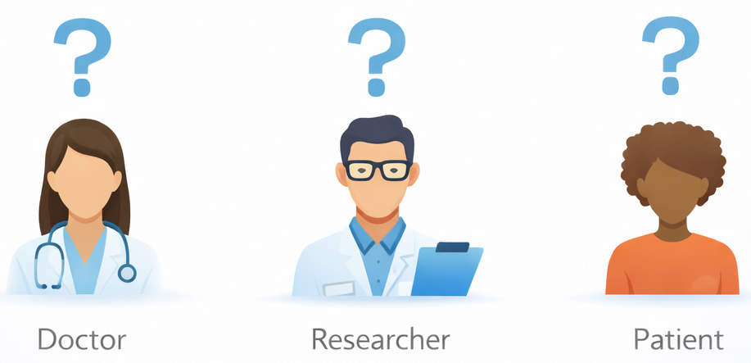
Bias at problem definition
© 2025 BSC-CNS. Licensed under CC BY-NC-4.0
Bias can already be introduced when defining the problem the AI system is meant to solve.
Key questions include:
  Who defines the problem?
  For whom is the solution designed?
  Which needs or perspectives are prioritised or ignored?
Early assumptions shape everything that follows.

Slide 29
Bias in data collection and preparation
© 2025 BSC-CNS. Licensed under CC BY-NC-4.0
Data used to train AI systems reflect historical, social and institutional practices.
As a result, bias can be introduced during data collection through:
  Historical bias: reflecting past inequalities.
  Representation (sampling) bias: missing or underrepresented groups.
  Measurement bias: systematic errors in how data are recorded.
These biases can persist even when data are larger or high-quality.

Slide 30
Historical bias
© 2025 BSC-CNS. Licensed under CC BY-NC-4.0
Historical bias occurs when datasets reflect social or medical practices that are no longer acceptable or representative.
In healthcare, this includes long-standing exclusions or underrepresentation of certain populations in research and clinical studies.
Even if data are accurately collected, they may still encode outdated inequalities.

Slide 31
Representation (sampling) bias
© 2025 BSC-CNS. Licensed under CC BY-NC-4.0
Representation bias arises when the dataset used to train an AI system does not adequately represent the population it is intended to serve.
Some groups may be missing, underrepresented or poorly characterised.
As a result, AI systems may perform well on average while failing for specific subgroups.

Slide 32
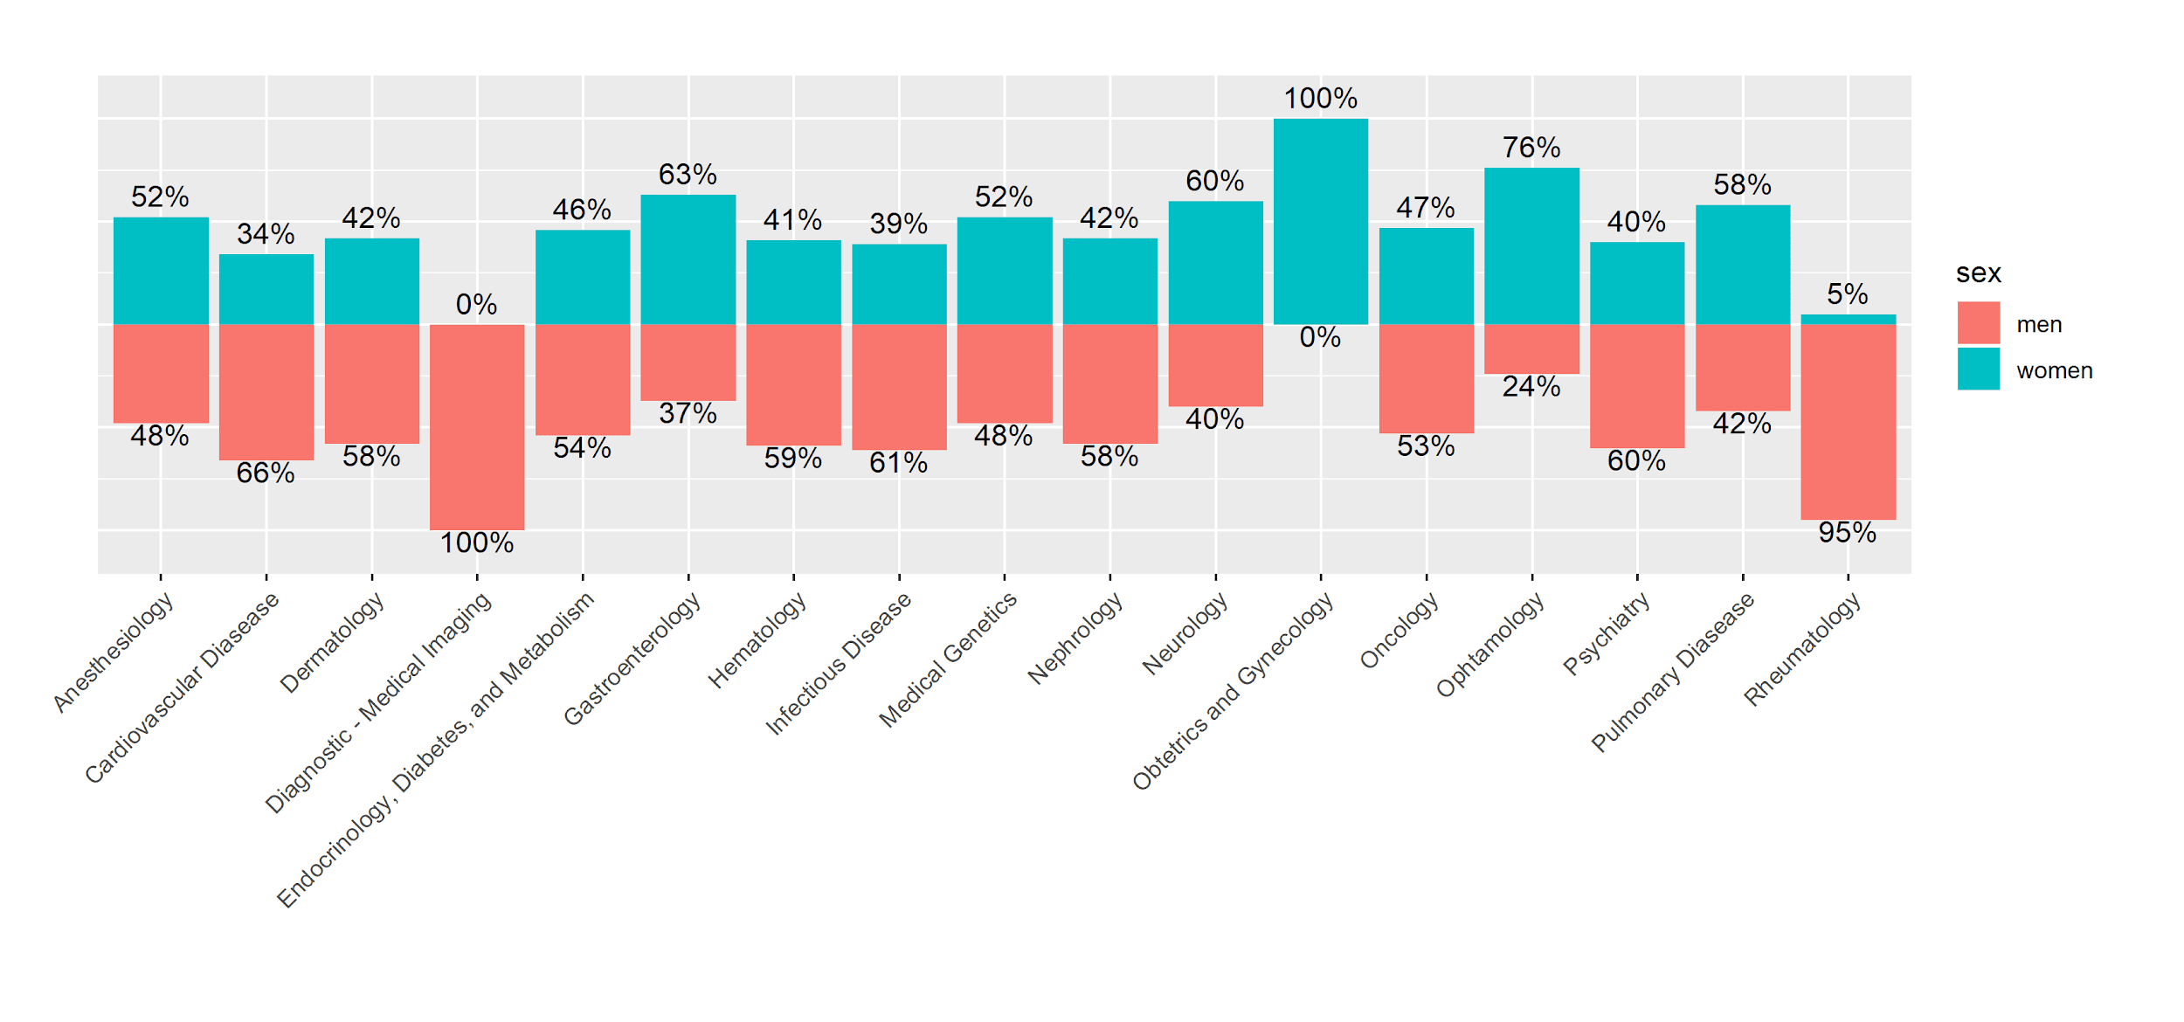
Bias in Clinical Trials
© 2025 BSC-CNS. Licensed under CC BY-NC-4.0
Ayuso. Cont Clin Trials (2019)
Trials for New Molecular Entities (NMEs) approved in 2015–2016
source: FDA & Office of Women's Health (OWH)
M.J. Rementeria, “Sex and Gender Bias in Health & AI”, AHEAD Training, July 2025.

Slide 33
Measurement bias
© 2025 BSC-CNS. Licensed under CC BY-NC-4.0
Measurement bias occurs when data are systematically collected or recorded in a way that favours certain outcomes or groups.
This can include:
  Different data quality across groups.
  Missing values not at random.
  Proxy variables that inadequately capture reality.
Measurements bias can distort both training and evaluation.

Slide 34
Bias in model development
© 2025 BSC-CNS. Licensed under CC BY-NC-4.0
Bias can also be introduced during model development through design choices. Examples include:
  Aggregation bias: combining heterogeneous groups into a single model.
  Optimisation strategies that prioritise overall accuracy over subgroup performance.
These choices can lead to a “one-size-fits-all” model that fits no one well.

Slide 35
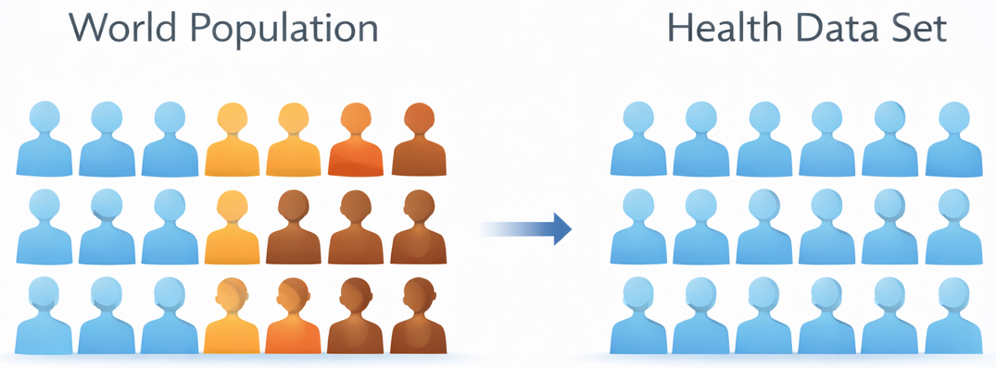
Evaluation bias
© 2025 BSC-CNS. Licensed under CC BY-NC-4.0
Evaluation bias occurs when AI systems are assessed using benchmarks or metrics that do not represent the target population or real-world context.

Slide 36
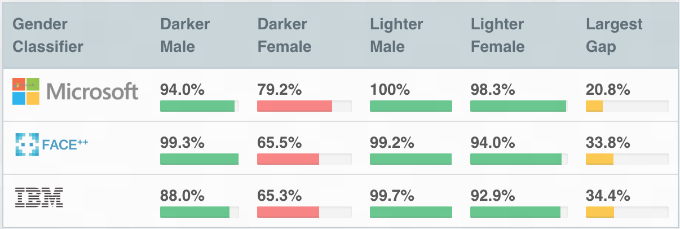
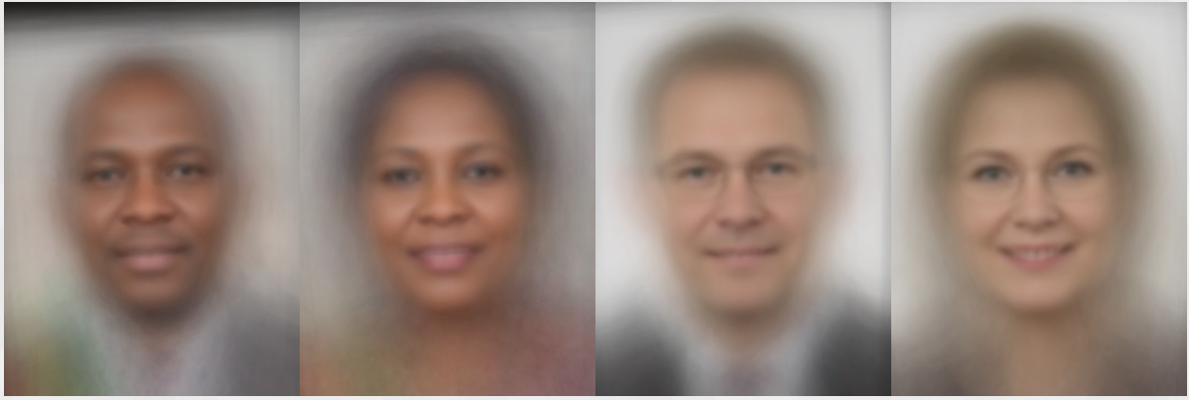
Evaluation bias
© 2025 BSC-CNS. Licensed under CC BY-NC-4.0
Relying on a single metric or average performance can hide systematic differences between groups.
This can give a false sense of model quality and fairness.
A. Cortés, “Responsible AI for Healthcare”, AHEAD Training, July 2025.
Notes:
Sex different than gender, and both can be missing

Slide 37
Bias in deployment
© 2025 BSC-CNS. Licensed under CC BY-NC-4.0
Deployment bias appears when the context in which an AI system is used differs from the context in which it was trained or evaluated.
Differences in infrastructure, users, patient populations or access to care can lead to unintended and unequal outcomes.
The real world is rarely as clean as the training environment.

Slide 38
Key message: bias is sociotechnical
© 2025 BSC-CNS. Licensed under CC BY-NC-4.0
Bias in AI systems is not only a technical issue.
It emerges from the interaction between data, models, institutions and society.
Addressing bias requires combining technical methods with social, clinical and ethical understanding.

Slide 39
Roadmap
© 2025 BSC-CNS. Licensed under CC BY-NC-4.0
AI
Responsible AI
Bias
Sex and Gender

Slide 40
Why sex and gender belong in AI discussions
© 2025 BSC-CNS. Licensed under CC BY-NC-4.0
Sex and gender are not optional or external topics.
They are fundamental variables that shape:
Health and disease processes.
Data generation and collection.
Model performance and outcomes.
Ignoring sex and gender can introduce systematic bias across the entire AI lifecycle.

Slide 41
What do we mean by sex
© 2025 BSC-CNS. Licensed under CC BY-NC-4.0
Sex refers to biological attributes such as chromosomes, gene expression, hormone levels and reproductive anatomy.
Although often categorised as female or male, sex-related biological characteristics exist along a spectrum and shown considerable variation.
Sex influences disease risk, symptoms, progression and response to treatment.

Slide 42
What do we mean by gender
© 2025 BSC-CNS. Licensed under CC BY-NC-4.0
Gender refers to socially constructed roles, behaviours, identities and power relations.
It shapes how people interact with healthcare systems, seek care, adhere to treatments and experience disease.
Gender is not binary, not static and interacts with other social determinants such as age, socio-economic status and culture.

Slide 43
Sex and gender are not interchangeable
© 2025 BSC-CNS. Licensed under CC BY-NC-4.0
Sex and gender capture different dimensions of health and disease.
Using them interchangeably, or reducing one to the other, is a methodological error.
Failing to distinguish between sex and gender can lead to incorrect assumptions, misleading analyses and biased conclusions.

Slide 44
How sex and gender affect health data
© 2025 BSC-CNS. Licensed under CC BY-NC-4.0
Sex and gender influence:
Which data are collected.
How symptoms are reported.
How measurements are taken.
As a result, datasets may systematically differ across sex and gender groups, even before any model is trained.

Slide 45
Sex and gender across the AI lifecycle
© 2025 BSC-CNS. Licensed under CC BY-NC-4.0
Sex and gender can influence every stage of the AI lifecycle:
Problem definition: which outcomes matter.
Data: representation and measurement.
Model development: aggregation vs stratification.
Evaluation: subgroup performance.
Deployment: real-world impact.
They are not limited to data stage.

Slide 46
Ignoring sex and gender introduces bias
© 2025 BSC-CNS. Licensed under CC BY-NC-4.0
When sex and gender are ignored or inadequately addressed, AI systems may:
Confuse biological differences with disease effects.
Mask unequal performance across groups.
Reinforce existing health inequalities.
This is not an ethical oversight, but a methodological one.

Slide 47
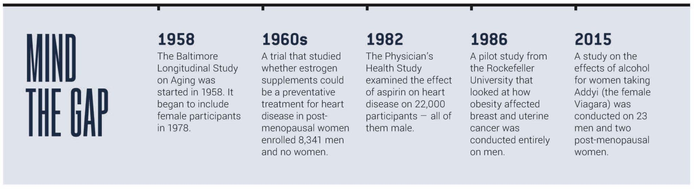
Sex and gender bias in data collection
© 2025 BSC-CNS. Licensed under CC BY-NC-4.0
Source: Why women have been excluded from medical studies about their own bodies
A. Cortés, “Responsible AI for Healthcare”, AHEAD Training, July 2025.

Slide 48
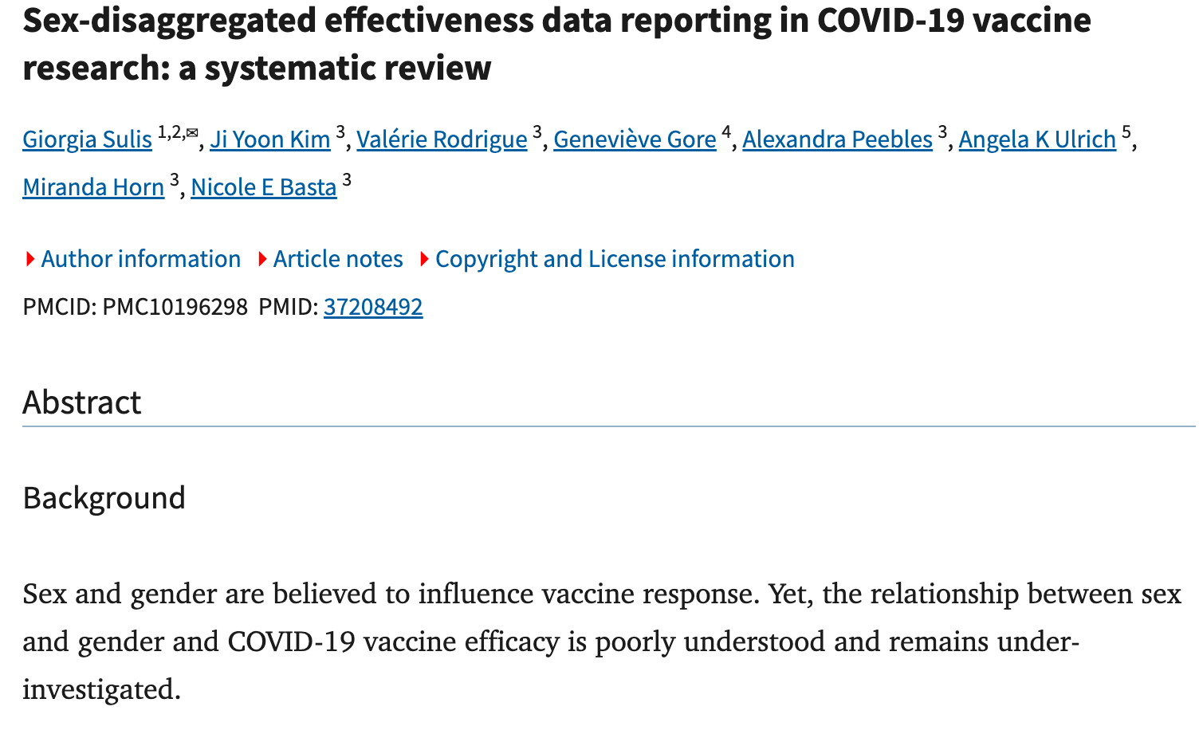
Sex and gender bias in model development
© 2025 BSC-CNS. Licensed under CC BY-NC-4.0
A. Cortés, “Responsible AI for Healthcare”, AHEAD Training, July 2025.
Notes:
Sex different than gender, and both can be missing

Slide 49
From bias to harm in healthcare
© 2025 BSC-CNS. Licensed under CC BY-NC-4.0
Bias related to sex and gender can translate into real-world harm, including:
Delayed or missed diagnoses.
Inappropriate treatment recommendations.
Unequal access to care or innovation.
In high-risk domains such as healthcare, these effects are amplified.

Slide 50
Gender balance ≠ gender dimension
© 2025 BSC-CNS. Licensed under CC BY-NC-4.0
Gender balance and gender dimension address different aspects of research and innovation.
Gender balance refers to the composition of research teams and decision-making bodies.
Gender dimension refers to the integration of sex and gender analysis into the content of research.
Having a gender-balanced team does not automatically ensure that sex and gender are addressed in the research itself.

Slide 51
More data does not mean less bias
© 2025 BSC-CNS. Licensed under CC BY-NC-4.0
Increasing the amount of data does not automatically reduce bias.
If data are unbalanced, incomplete or systematically skewed, more data can reinforce existing biases rather than correct them.
In healthcare AI, data quality, representativeness and context are more important than volume.

Slide 52
Fair does not mean identical
© 2025 BSC-CNS. Licensed under CC BY-NC-4.0
Fairness in AI does not mean treating everyone identically.
In healthcare, fair systems must account for biological and social differences that influence health outcomes.
Ignoring relevant differences can lead to unequal performance and unfair results, even if the system appears ‘neutral’.

Slide 53
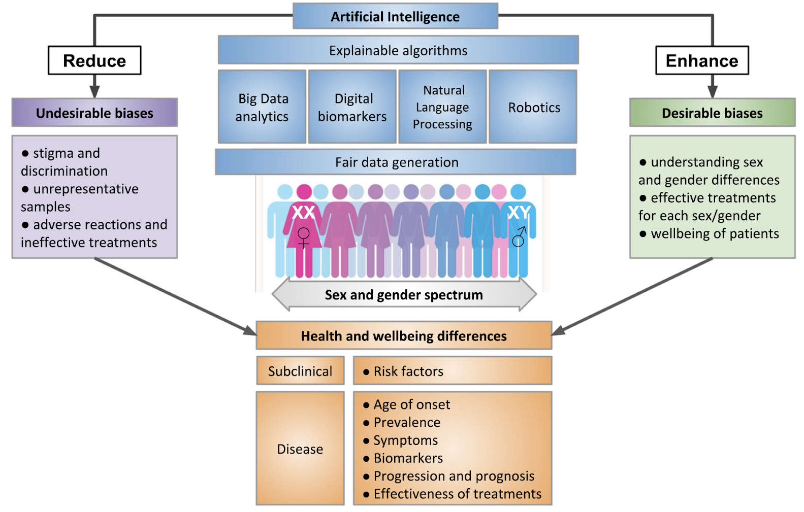
Desirable vs Undesirable Bias
© 2025 BSC-CNS. Licensed under CC BY-NC-4.0
Cirillo et al. 2020, p.9

Slide 54
Bias in Health & AI: A path forward
© 2025 BSC-CNS. Licensed under CC BY-NC-4.0
Treat biased data as sociotechnical artifacts.
Analyse how and why models learn discriminatory shortcuts.
Combine technical evaluation with ethical and historical analysis.
Design with equity as a core objective, not an “after-thought”
Involve interdisciplinary teams.
Monitor the hidden biases and systematic disparities during deployment.
C. Rosas and M. Morales, “AI and Evaluation Concerns: Ground Truth, Assessment Frameworks and Techniques”, AHEAD Training, July 2025.
Notes:
Deployment bias different tan training conditions

Slide 55
Key messages from this session
© 2025 BSC-CNS. Licensed under CC BY-NC-4.0
AI systems in healthcare are powerful and high-risk.
Bias is systematic and can appear at every stage of the AI lifecycle.
Sex and gender are fundamental variables that influence data, models and outcomes.
A human and societal perspective improves AI quality.

Slide 56
Thanks!
Questions?
© 2025 Barcelona Supercomputing Center - Centro Nacional de Supercomputación. Author: (XXXX).
Material licensed under CC BY-NC-4.0.

