Slide 1



Fundamentals and Concepts
María Flores Rodero, M.Sc.
Ph.D. student
26/01/2026
© 2025 Barcelona Supercomputing Center - Centro Nacional de Supercomputación.
Author: (XXXX). Material licensed under CC BY-NC-4.0.

Slide 2
Icebreaker

Slide 3





MY TRAJECTORY
Máster de investigación en Salud Femenina y Ciencia Reproductiva
RE1 - Unidad de Social Link Analytics
2020
2022
2019
2022
2024
Grado en Medicina Celular y Molecular
Máster de Bioinformática
Doctorado en Comorbilidades (Facultad de Medicina)
2

Slide 4
Before we begin

Slide 5
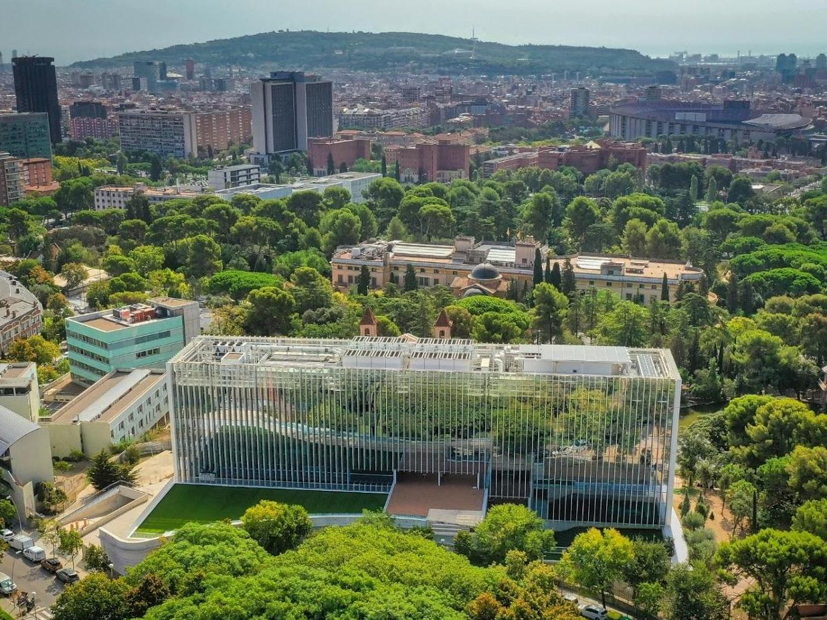

Bienvenidos al BSC

Slide 6
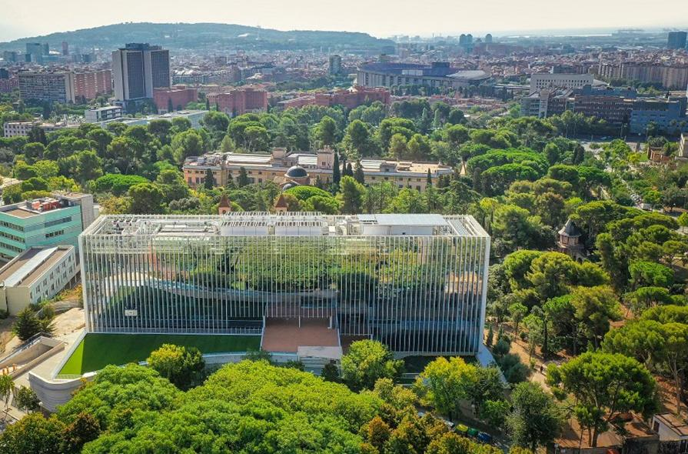



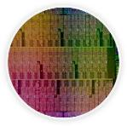





Barcelona Supercomputing Center
Over 1.250 scientists and engineers
4 Departments
The third Spanish Institution in EU funding
Computer Sciences
Life Sciences
Earth Sciences
Engineering Applications
(CASE)

Slide 7







MN-GPP
General Purpose
6480x2 Intel Shapire Rapids with 56 cores each
MN-ACC
Accelerator
4480 Nvidia H100

Slide 8


Slide 9
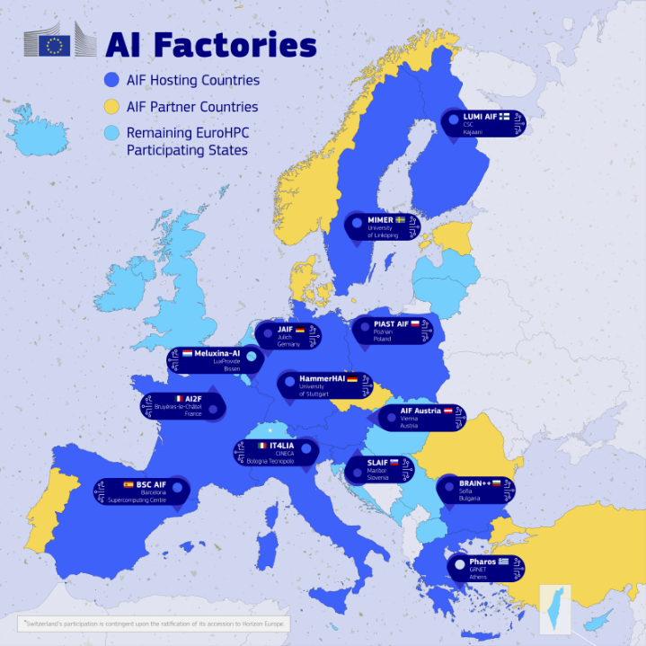
The EuroHPC infrastructure is now accessible to AI-optimised supercomputers to startups and the broader innovation community.
source: https://digital-strategy.ec.europa.eu/en/policies/ai-factories

Slide 10









Machine Learning for Biomedical Research
SYNTHETIC DATA GENERATION
GRAPH-BASED MULTIMODAL DATA INTEGRATION
DIGITAL HEALTH AND WEARABLE DEVICES
SEX & GENDER BIAS IN AI

Slide 11







Bioinfo4Women
Promoting diversity in Computational Biology since 2018
@Bioinfo4Women
Network and consortia affiliate
LinkedIn
Recorded seminars

Slide 12
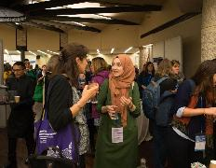

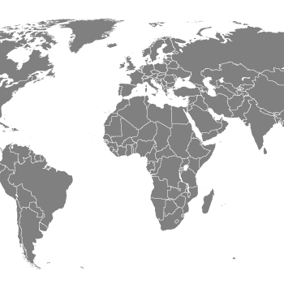

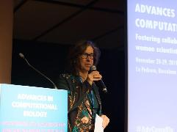


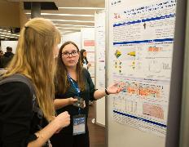

B4W: From Context to Action
Context
Action
Unbalanced representation of researchers & Glass ceiling
How can we improve this?
Total amount of researchers in STEM fields*
39%
61%
♀
♂
Visibility
Collaboration
28%
72%
♀
♂
Women leadership
Role models
25%
75%
♀
♂
Computational Biology
*EsadeEcPol. (2024, February 6). Mujeres en STEM: Cuatro recomendaciones para cerrar la brecha de género. Esade Center for Economic Policy. https://www.esade.edu/ecpol/en/publications/mujeres-en-stem/
Palmer, K. (2024, June 11). Women make global gains as researchers, but gaps persist. Inside Higher Ed. https://www.insidehighered.com/news/diversity/sex-gender/2024/06/11/women-make-global-gains-researchers-gaps-persist
Research

Slide 13
Who are we
Established in 2018, Bioinfo4Women is a flagship, transversal initiative of the Life Sciences Department at the Barcelona Supercomputing Center (BSC).
Our mission is to amplify the visibility and impact of women in computational biology by celebrating their research, fostering leadership, and creating a strong support network.
We are committed to empowering women researchers at all stages of their careers, through mentorship, training, and meaningful opportunities for growth.

Slide 14











People
Steering Committee
Department Support
An initiative developed within the Life Sciences Department aiming to promote equity and excellence in the field
Volunteers
Powered by volunteer commitment and collaboration
Formed by members across career stages and diverse professional backgrounds
International Advisory Board
Expert consultative group offering strategic insights and diverse perspectives to guide the project
We put diversity and complementary perspectives at the core

Slide 15





Timeline of main B4W activities
Palau Macaya Conference
Palau Macaya Conference
WHAW*
FEBS Network
Article
B4W is born
ECCB2022 BoF
B4W Mentoring Programme 2nd Ed.
AdvCompBio &
Women Leaders
BSC
Seminars
ELIXIR
BH2021
ELIXIR BH2022
ISMB/ECCB
2025 BoF
2018
2019
2020
2021
2022
2023
2024
2025
NEW STRATEGY
Co-Creation
de.NBI BH2023
Handbook sex and gender dimension in research
BSC LS
Open Day*
B4W Mentoring Programme
ECCB2024
Workshop
ELIXIR BH2024
Research Line Kick-off
B4W Fellows Programme
AHEAD
* Activities have continued annually since their launch
Incorporation of sex and gender dimension in research

Slide 16




Inspiring similar efforts at BSC
Inspire similar Efforts

Slide 17




Our mission(s)
Research
Communication
Include the sex and gender perspective in the research practice by:
      -- Developing guidelines for researchers.
      -- Producing peer-reviewed research results.
Dissemination of events organised by B4W and those external of relevance, publications, and inspiring stories.
Outreach to the research community and beyond.
Support women’s scientific career
Cultural Change and Networking
B4W Mentoring programme from 2022 - international role models to junior researchers and postdocs.
Research seminars at BSC including reflection of experiences of women in science.
B4W Fellows programme.
Promote an international collaboration network of women in computational biology.
Organisation of events to discuss gender equality in science and women’s health (ISMB/ECCB BoF, Open Day, WHAW).
Participation/organization of scientific events (ELIXIR Biohackathon, de.NBI Biohackathon).
Gender dimension in research incorporated into PhD training programme at BSC, external courses.

Slide 18
Our outreach and educational activities

Slide 19
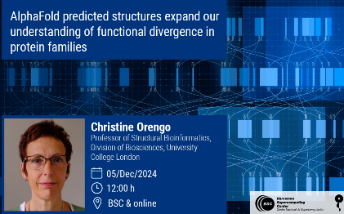
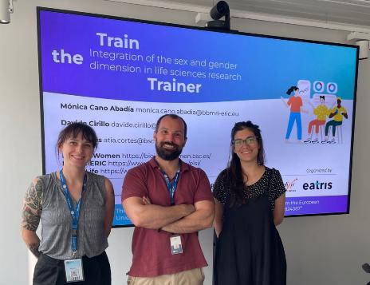
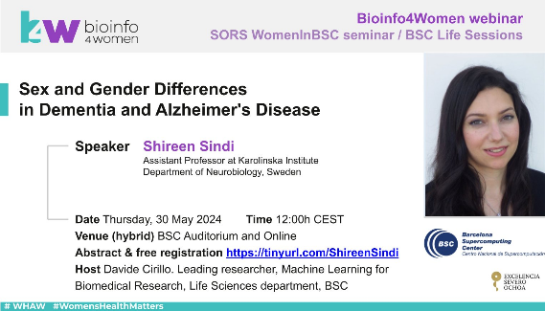

Educational Activities
Seminars
Resources are allocated to invite women researchers to present their work at departmental seminars
Trainings
Training on Sex and Gender dimension in research and bias in health and artificial intelligence has been delivered to external healthcare professionals and PHD students across multiple disciplines
B4W playlist

Slide 20

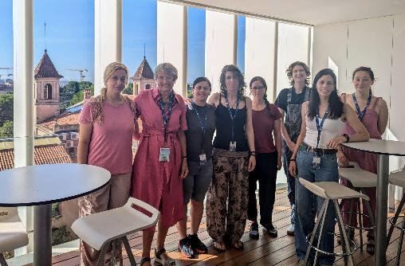
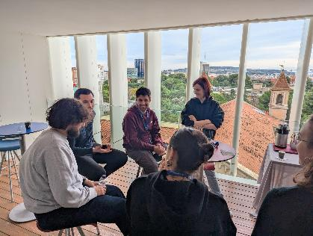
International Mentoring Programme
ELEAD - ELIXIR Leadership and Diversity programme
Peer Mentoring for women Postdoctoral researchers
For PHD students
Duration increased from 12 to 18 months
Including interim meetings among mentees
For PhD students and junior profiles staying at BSC for at least 18 months
For Postdoctoral Researchers
Helping scientists to establish themselves as independent researchers
Aimed at women postdoctoral researchers who stay at BSC for at least the entire length of the programme
Mentoring programme for PhD students

Slide 21
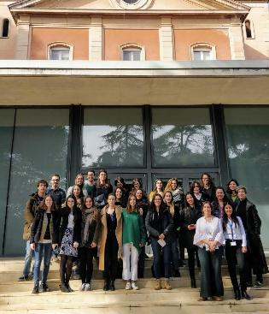
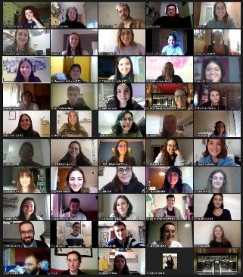

Women role models at the
BSC Life Science Department Open Day
An event for Bachelor’s and Master’s students to discover the work of women bioinformaticians at the BSC.
Through informal 15-minute talks, participants are able to connect with women researchers working in cutting-edge areas in bioinformatics and are introduced to the different teams within the Life Sciences Department

Slide 22


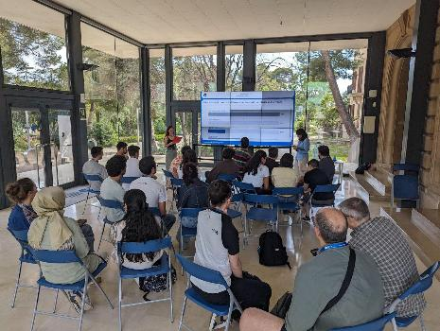
Women's Health Awareness Week (WHAW)
Aligned with the International Day of Action for Women's Health on May 28, WHAW aims to raise awareness about women's health issues and promote gender equity in biomedical research.
The week-long event features a diverse range of activities:
Scientific Seminars
Round Tables
Art and Science Dialogues
Interactive Sessions
Quizs

Slide 23
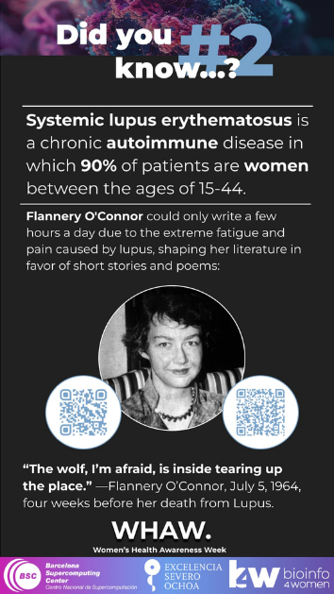
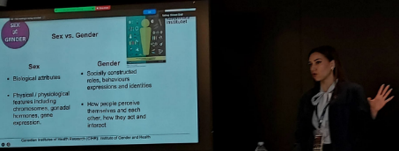
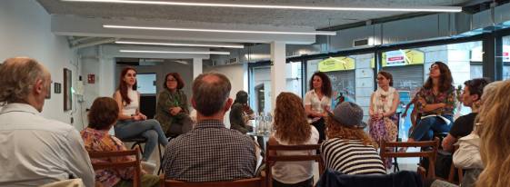
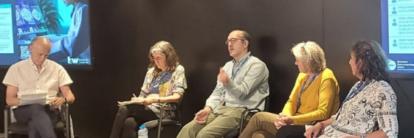
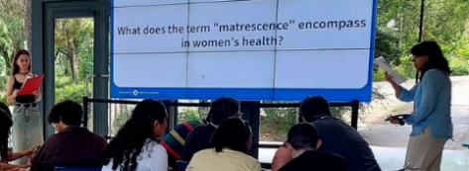
Women's Health Awareness Week (WHAW)
Scientific Seminars
Round Tables
WHAQ (Quiz)

Slide 24
Our research and academic contributions

Slide 25
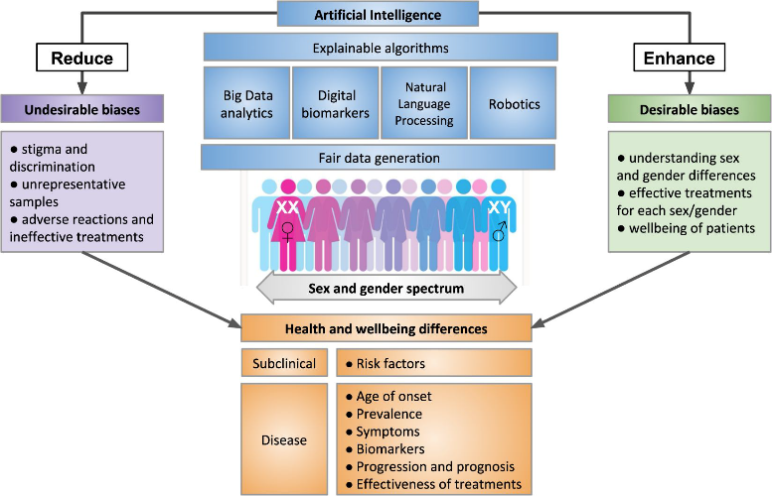
Bioinfo4Women Research Line
Opportunities:
Artificial Intelligence has a huge impact on our society, in particular biomedical research and decision making in clinical research.
Cost-efficiency, dynamic access to health information, effective handling of complex problems related to human diseases.
Challenges:
Identify unnoticed bias towards sex and gender categories could potentially lead to propagation of discrimination and inequality.
Understand sex and gender differences medically relevant and needed in training dataset to achieve fair Precision Medicine.
Cirillo D., Catuara-Solarz, S. et al. npj Digit. Med. 3, 81 (2020) DOI: 10.1038/s41746-020-0288-5

Slide 26
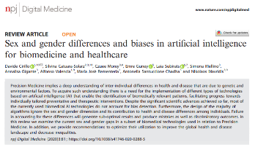
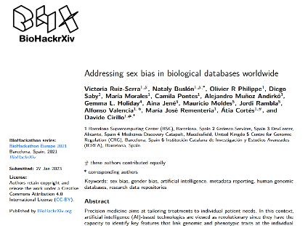
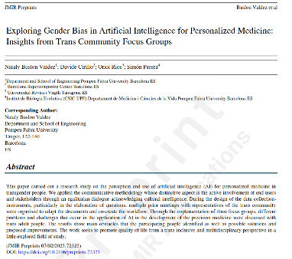
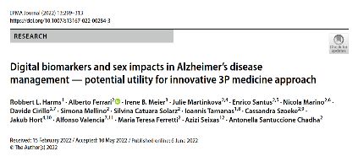
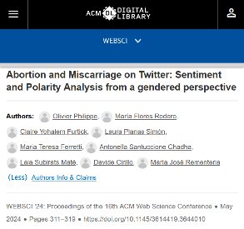
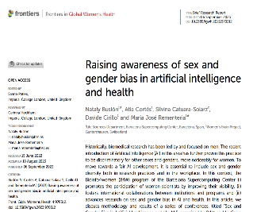
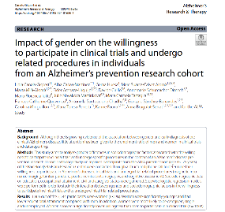
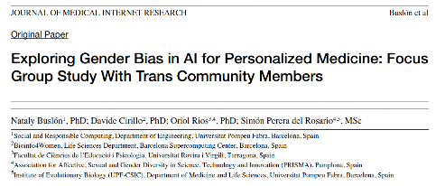
Scientific Publications

Slide 27
Scientific Publications
Notes:
Percepción y Aplicación de la Inteligencia Artificial en la Medicina Personalizada para la Comunidad Trans
Antecedentes: Este artículo explora la percepción y la aplicación de la Inteligencia Artificial (IA) en la medicina personalizada dentro de la comunidad trans, una población a menudo olvidada en el ámbito más amplio de la medicina de precisión. A pesar de los crecientes avances en las soluciones sanitarias impulsadas por la IA, se ha dedicado poca investigación a comprender cómo estas tecnologías pueden adaptarse para satisfacer las necesidades sanitarias únicas de las personas trans. Abordar esta brecha es crucial para garantizar que la medicina de precisión sea genuinamente inclusiva y efectiva para todas las poblaciones.
Objetivo: Este estudio tuvo como objetivo identificar los desafíos, obstáculos y soluciones potenciales específicos asociados con el despliegue de tecnologías de IA en el desarrollo de la medicina personalizada para personas trans. Esta investigación enfatiza una perspectiva trans-inclusiva y multidisciplinar, destacando la importancia de la competencia cultural y el compromiso comunitario en el diseño e implementación de soluciones sanitarias impulsadas por la IA.
Métodos: Se aplicó una metodología comunicativa en este estudio, que priorizó la participación activa de los usuarios finales y las partes interesadas a través de un diálogo igualitario que reconoce y valora la inteligencia cultural. El diseño metodológico incluyó consultas iterativas con representantes de la comunidad trans para cocrear el flujo de trabajo de la investigación y adaptar los instrumentos de recopilación de datos. Este enfoque participativo aseguró que las perspectivas y experiencias vividas de las personas trans fueran parte integral del proceso de investigación. La recopilación de datos se llevó a cabo a través de 3 grupos focales con 16 adultos trans, con el objetivo de discutir los desafíos, riesgos y el potencial transformador de la IA en la medicina de precisión.
Resultados: El análisis de las discusiones de los grupos focales reveló varias barreras críticas que impactan la integración de la IA en la medicina personalizada para personas trans, incluyendo preocupaciones sobre la privacidad de los datos, los sesgos en la toma de decisiones algorítmica y la falta de datos sanitarios adaptados que reflejen las experiencias trans. Los participantes expresaron aprensiones sobre posibles diagnósticos erróneos o tratamientos inapropiados debido a modelos de datos cisnormativos. Sin embargo, también identificaron oportunidades para que la IA mejore los resultados sanitarios, abogando por iniciativas de recopilación de datos lideradas por la comunidad y una mayor transparencia algorítmica. Las soluciones propuestas incluyeron mejorar los conjuntos de datos con marcadores de salud específicos para personas trans, incorporar voces comunitarias en los procesos de desarrollo de la IA y priorizar marcos éticos que respeten la diversidad de género.
Conclusiones: Este estudio subraya la necesidad de un enfoque trans-inclusivo en la medicina de precisión, facilitado por tecnologías de IA que sean sensibles a las necesidades sanitarias y las realidades vividas de las personas trans. Al abordar los desafíos identificados y adoptar soluciones impulsadas por la comunidad, la IA tiene el potencial de cerrar las brechas sanitarias existentes y mejorar la calidad de vida de las personas trans. Esta investigación contribuye al creciente discurso sobre la innovación sanitaria equitativa, haciendo un llamado a prácticas de diseño de IA más inclusivas que extiendan los beneficios de la medicina de precisión a las comunidades marginadas.

Slide 28
















Scientific Publications
“It’s a must read for anyone working in this area; the materials presented here should be integrated into medical school curricula.”
Londa Schiebinger
John L. Hinds Professor of History of Science, Stanford University
Founding director, Gendered Innovations in Science, Health & Medicine, Engineering, and Environment
28
ISBN: 9780128213926

Slide 29

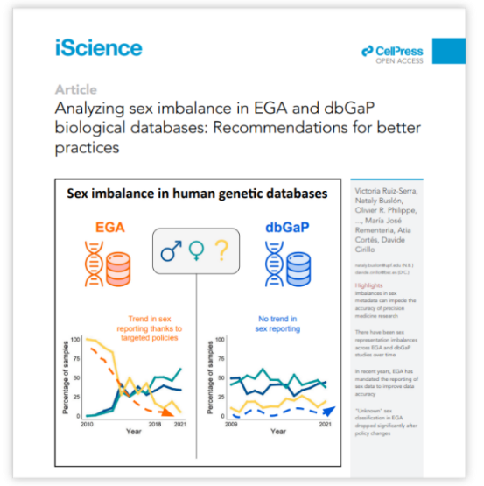



BioHackathon
Our projects over the years
2021 ELIXIR BioHackathon Europe (Barcelona)
Sex imbalance in data repositories: EGA & dbGaP
2022 ELIXIR BioHackathon Europe (Paris)
An AI model to parse scientific articles
2023 BioHackathon Germany (Biolefeld)
An AI model to parse scientific articles
2024 ELIXIR BioHackathon Europe (Barcelona)
Gender representation in ELIXIR articles
Ruiz-Serra, Buslón et al. 2024, iScience

Slide 30


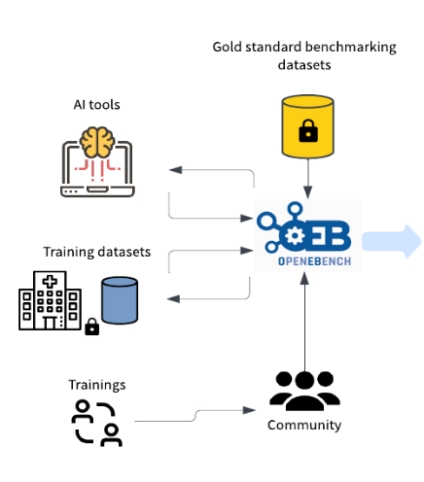

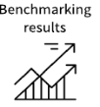




BAIHA: Bias in AI-Healthcare Applications
BAIHA Evaluation
OpenEBench is an ELIXIR platform for benchmarking and monitoring bioinformatics tools, web servers, and workflows.
Transdisciplinary Community
Medical Experts
Offer medical insights for AI model assessment
The BAIHA project will establish indicators and evaluation metrics to identify sex and gender biases in AI-health solutions
Sw Engineers
Maintain the technical infrastructure for AI benchmarking
Gold Standard
AI tool
NGOs & Patient Organizations
Benchmarking Results
Contribute patient and social perspectives
Sociologists & Psychologists
Contribute personal and social perspectives
Training dataset
AI Developers
Health Charts
Design and implement AI algorithms and health apps
Legal and Ethical experts
Trainings
Advise on legal and ethical issues

Slide 31



AHEAD Project
Efficiency
Integration with other systems
Fairness
Security
Reliability
Accessibility
Environmental impact
Technical Indicators
Accessibility
Patient impact
Bias & Intersectionality
Data Security
Usability
Social norms
Traceability
Compliance
Ethical considerations
Human Interaction Indicators
Robustness
Explainability
Societal Indicators
Bias in Science - Sex and Gender Perspective in Research (9th October 2025)

Slide 32
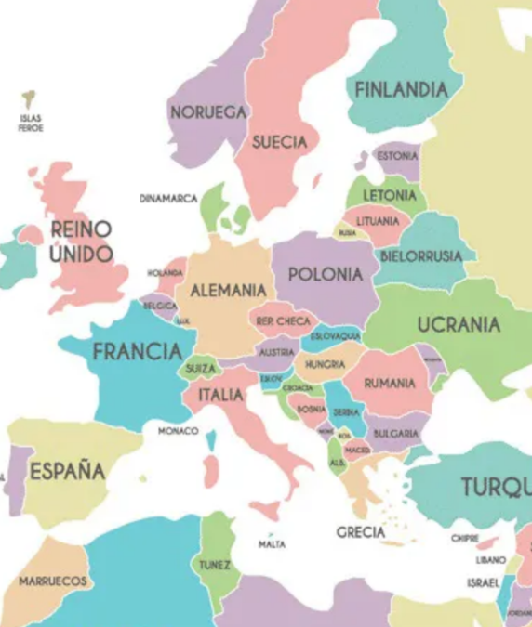

AHEAD Network
Academy
Barcelona Supercomputing Center (Coordinator)
U. Trento – legal (Italy)
Bassel U. Institute for Biomedical Ethics (Swiss)
CERTH - Technical (Greece)
CERTH – Psychology (Greece)
BBMRI - ERIC – Gender (Austria)
New York University – Ethics (USA)
Helsinki University – Sociology (Finland)
Hebrew University Medical Center (Israel)
Administration
EU Parliament
Parliament of Catalonia
ISCII
TIC Salut (Spain)
Companies
Organizations
IBM (Israel)
IBM (Swiss)
NTT Data (Spain)
Nostrum (Spain)
Lygature (Nederland)
PRISMA (Spain)
Barcelona Beta (Spain)
Women Brain Foundation (Swiss)

Slide 33
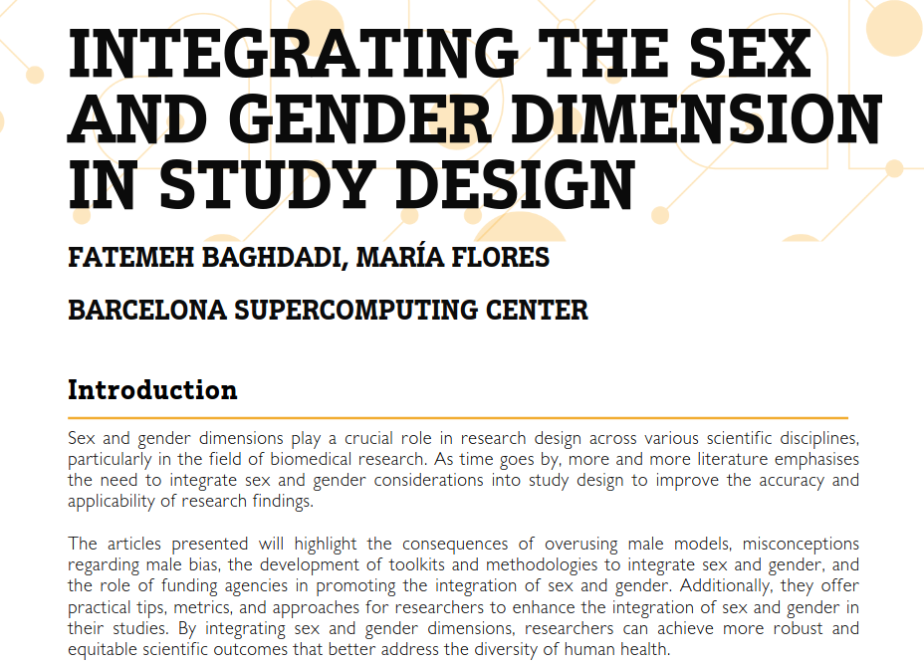


Research Handbook (B4W Train the Trainer)

Slide 34
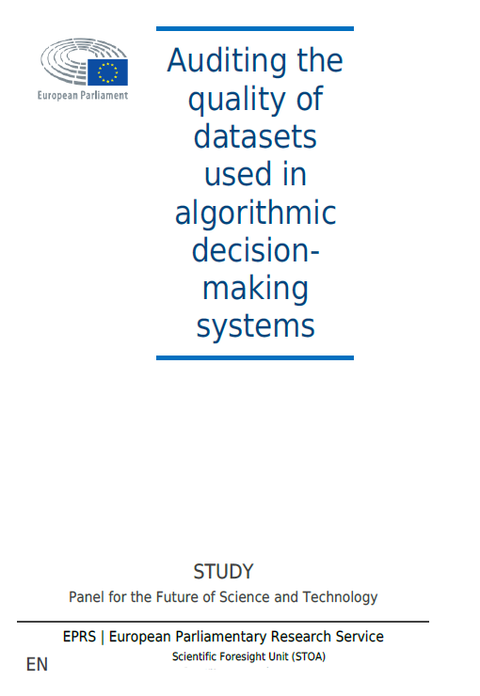
European Parliament Report
Policy Option #1 Do not create new regulations that
specifically target bias. Instead, focus on the mismatches
between the different regulatory tools
Policy Option #2 Precautionary approach: strengthen bias
mitigation from data collection
Policy Option #3 Promote database certification: enforce
bias awareness early in the life cycle of algorithmic systems
Policy Option #4 Strengthening transparency rights of AI
system stakeholders: open a window to find the source of biased results
Policy Option #5 Facilitate implementation of the proposed AI Act *
Presented at the European Parliament (Strasbourg, France) on July 7, 2022
* COM/2021/206 final

Slide 35
Let’s get started

Slide 36

INTERACTIVE QUIZ!

Slide 37



Do not edit
How to change the design
Join at slido.com
#4635075
Presenting with animations, GIFs or speaker notes? Enable our Chrome extension
Notes:
📣 This is Slido interaction slide, please don't delete it.
✅ Click on 'Present with Slido' and the joining instructions will appear when you get to this slide.

Slide 38
Gender

Slide 39

Do not edit
How to change the design
What word would you use to define "gender"?
Presenting with animations, GIFs or speaker notes? Enable our Chrome extension
Notes:
📣 This is Slido interaction slide, please don't delete it.
✅ Click on 'Present with Slido' and the poll will launch automatically when you get to this slide.

Slide 40

What is Gender?
Gender refers to the socially constructed roles, behaviours, expressions and identities of girls, women, boys, men, and gender diverse people. It influences how people perceive themselves and each other, how they act and interact, and the distribution of power and resources in society. Gender identity is not confined to a binary (girl/woman, boy/man) nor is it static; it exists along a continuum and can change over time. There is considerable diversity in how individuals and groups understand, experience and express gender through the roles they take on, the expectations placed on them, relations with others and the complex ways that gender is institutionalised in society.
CIHR Institute of Gender & Health. What Is Gender? What Is Sex? 2020.
Source: https://cihr-irsc.gc.ca/e/48642.html

Slide 41
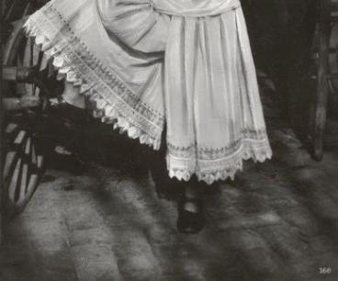
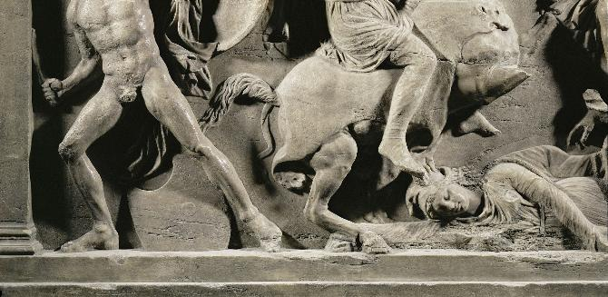
Activity #2
Which image represents a masculine characteristic, and which represents a feminine characteristic?
1
2

Slide 42
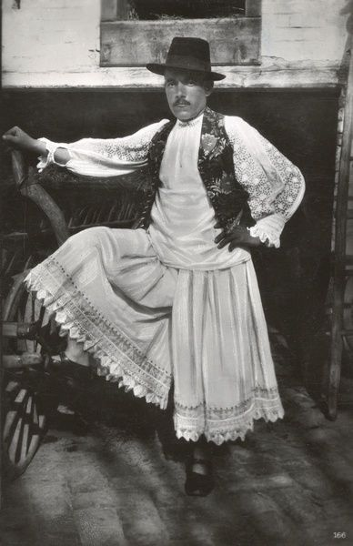
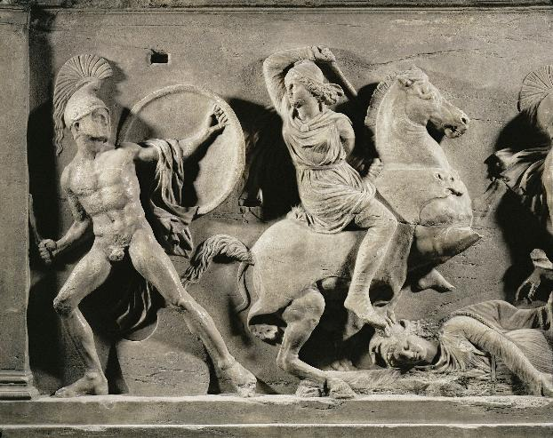
Activity #2
Traditional male dress
(Baranya, Hungary, 1920s)
Amazons in battle. Greek relief
(4th century BC. Künsthistorische Museum, Vienna)

Slide 43

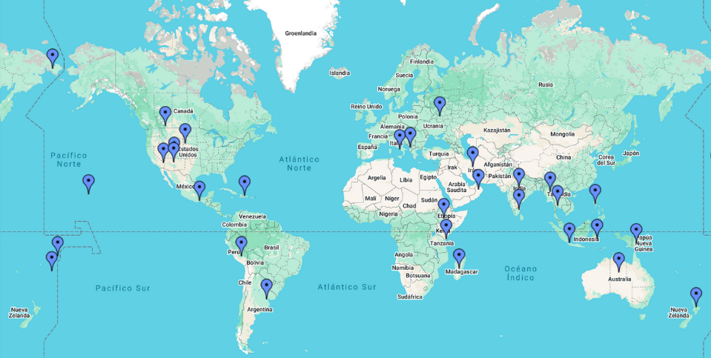
Cultural and historical context of the genre
Map of gender-diverse cultures

Slide 44
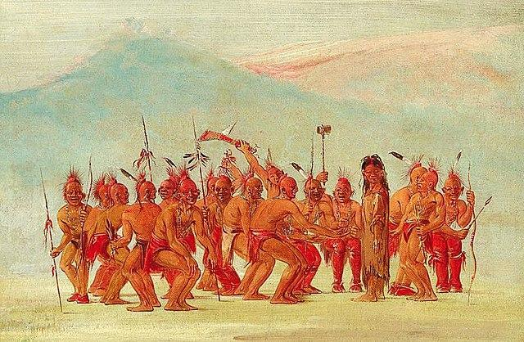
Cultural and historical context of the genre
The two spirits gender
George Catlin, "Dance to the Berdache" (1861-1869)

Slide 45

Cultural and historical context of the genre
Cover of Vogue Mexico and the muxes. - Vogue Mexico

Slide 46
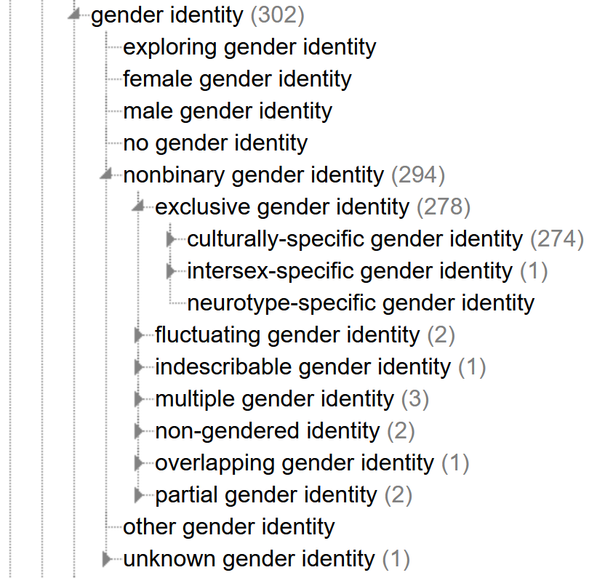

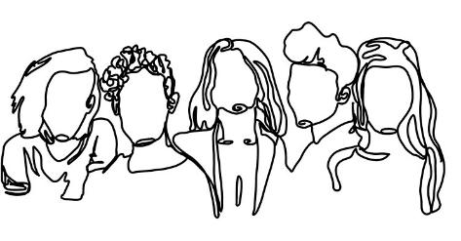
Cultural and historical context of the genre
Gender, Sex, and Sexual Orientation Ontology (GSSO)
https://bioportal.bioontology.org/ontologies/GSSO

Slide 47
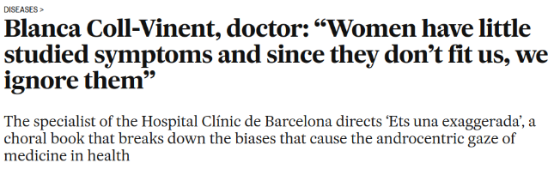

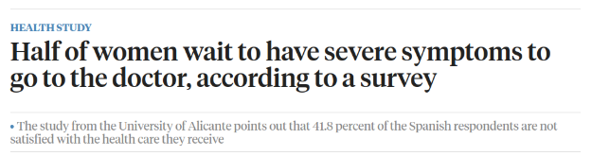

Why does gender matter in health too?
Q. Are women listened to less during consultations? Are their words taken less seriously?
A. There is also a problem of time and resources here: a consultation with a family doctor lasts eight, six or 15 minutes, and there is not enough time to listen to many things. I think women are generally not listened to very much.
Women are the most disadvantaged group because their symptoms are not well studied and, as they don't fit in, we simply ignore them, attribute them to anxiety or misclassify them. I think that, in general, the lack of time and resources is going to harm everyone. But I insist: the main problem is the fact that everyone is lumped together.
Q. What is it that you haven't looked at properly when it comes to women?
A. It's not that we don't do it properly. We do what we know, we do what the protocols say we have to do. So, exactly, as it hasn't been studied, I can't tell you what we don't do and, perhaps, what should be done. We need to study much more to see what needs to be done for women that isn't done for men, or vice versa. It's very important to listen to or ask about the needs of the people in front of us, because women's health needs and concerns may not be the same as men's.
Thus, 67.7% of respondents think that women and men react differently to the same symptoms or disease. 49.7% of women surveyed say they usually wait for severe symptoms to see a doctor. 56.9% of respondents think that, in the face of the same disease/health problem, they are not heard and are not made the same effort for diagnosis and treatment as men.

Slide 48
Sex

Slide 49
Do not edit
How to change the design
What words would you use to define "sex"?
Presenting with animations, GIFs or speaker notes? Enable our Chrome extension
Notes:
📣 This is Slido interaction slide, please don't delete it.
✅ Click on 'Present with Slido' and the poll will launch automatically when you get to this slide.

Slide 50
What is Sex?
Sex refers to a set of biological attributes in humans and animals. It is primarily associated with physical and physiological features including chromosomes, gene expression, hormone levels and function, and reproductive/sexual anatomy. Sex is usually categorised as female or male but there is variation in the biological attributes that comprise sex and how those attributes are expressed.
CIHR Institute of Gender & Health. What Is Gender? What Is Sex? 2020.
Source: https://cihr-irsc.gc.ca/e/48642.html

Slide 51
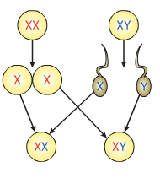
Is sex binary?
Progenitores
Gametos
Progenie
Notes:
A lo largo de la historia, la biología tradicional ha establecido un modelo estrictamente binario del sexo basado principalmente en la configuración cromosómica: XX para mujeres y XY para hombres. Sin embargo, esta perspectiva reduccionista se limita a una interpretación simplificada que considera únicamente ciertos aspectos anatómicos predeterminados y la expresión gonadal (como la presencia de ovarios o testículos) como los elementos definitorios del sexo biológico. No se trata de negar el papel fundamental que tienen los cromosomas en la determinación sexual; sin embargo, esta visión clásica omite la compleja interacción de múltiples factores biológicos que intervienen a lo largo de todo el desarrollo sexual y que no necesariamente están siempre vinculados directamente con los cromosomas sexuales. ¿Qué ocurre cuando nos detenemos a mirar más de cerca?

Slide 52
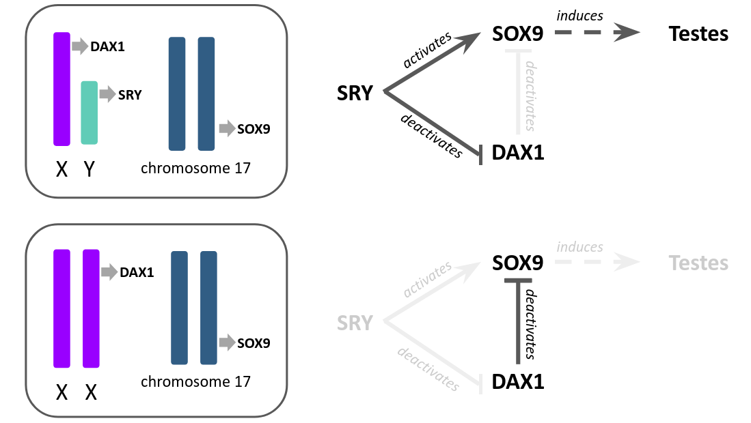
Is sex binary?
Is SOX9 really less essential than SRY?

Slide 53
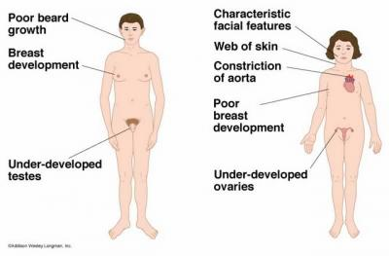
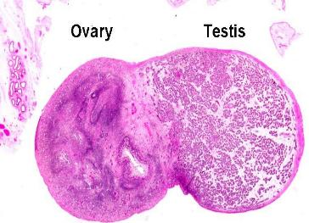
Is sex binary?
Klinefelter
syndrome
Turner
syndrome
Ovotesticular disorder of sexual development
("true hermaphroditism")
Approximate incidence of less than 1 in 20,000
X
X
Y
X

Slide 54


Story Time!
  Genetic testing of female athletes during the Olympic Games.
  In 1996, eight women tested positive in differential tests for sexual development.

Slide 55

Story Time!
  Genetic testing of female athletes during the Olympic Games.
  In 1996, eight women tested positive in differential tests for sexual development.
Síndrome Swyer
Imane Khelif

Slide 56

Credit: Pitch Interactive and Amanda Montañez; Source: Research by Amanda Hobbs; Expert review by Amy Wisniewski University of Oklahoma Health Sciences Center

Slide 57

Sex and Gender map
Let’s have a closer look
https://bit.ly/3RAkQa0

Slide 58
Sex & Gender Summary

Slide 59

Summary

Slide 60

Other concept associated with gender

Slide 61
Intersectionality

Slide 62



Intersectionality
Intersectionality describes the overlap of categories such as gender, ethnicity, or class, which together shape people's identities and experiences. Thus, researchers must consider that sex and gender constantly interact with other social attributes, so their norms and relationships cannot be understood in isolation.
Bias in Science - Sex and Gender Perspective in Research (9th October 2025)

Slide 63
Quiz Time!

Slide 64

Do not edit
How to change the design
What historical term, derived from the Greek word for uterus, has been used to misdiagnose women's medical conditions for centuries?
Presenting with animations, GIFs or speaker notes? Enable our Chrome extension
Notes:
📣 This is Slido interaction slide, please don't delete it.
✅ Click on 'Present with Slido' and the poll will launch automatically when you get to this slide.

Slide 65


“What’s wrong with women?”
Migraines?
Hypothyroidism?
Stomach cancer?
Endometriosis?

Slide 66

Historically: Hysteria
Notes:
This term persisted in medical texts for centuries and was only officially removed as a diagnosis by the American Psychiatric Association in 1980. The legacy of this misdiagnosis has contributed to a long history of women's symptoms being downplayed or dismissed by healthcare professionals.

Slide 67
Do not edit
How to change the design
Why are women more likely than men to be misdiagnosed following a heart attack?
Presenting with animations, GIFs or speaker notes? Enable our Chrome extension
Notes:
📣 This is Slido interaction slide, please don't delete it.
✅ Click on 'Present with Slido' and the poll will launch automatically when you get to this slide.

Slide 68


Slide 69
Do not edit
How to change the design
Does the gender of a patient and the gender of their surgeon affect the patient’s chances of having adverse effects from the surgery?
Presenting with animations, GIFs or speaker notes? Enable our Chrome extension
Notes:
📣 This is Slido interaction slide, please don't delete it.
✅ Click on 'Present with Slido' and the poll will launch automatically when you get to this slide.

Slide 70
Do not edit
How to change the design
According to large cancer clinical trial analyses, how does the risk of severe adverse effects after cancer treatment differ between women and men?
Presenting with animations, GIFs or speaker notes? Enable our Chrome extension
Notes:
📣 This is Slido interaction slide, please don't delete it.
✅ Click on 'Present with Slido' and the poll will launch automatically when you get to this slide.

Slide 71
Do not edit
How to change the design
Which of these are the correct proportions of men and women to suffer depression in elderly populations?
Presenting with animations, GIFs or speaker notes? Enable our Chrome extension
Notes:
📣 This is Slido interaction slide, please don't delete it.
✅ Click on 'Present with Slido' and the poll will launch automatically when you get to this slide.

Slide 72
Do not edit
How to change the design
In automated skin cancer detection systems, which bias has been repeatedly observed?
Presenting with animations, GIFs or speaker notes? Enable our Chrome extension
Notes:
📣 This is Slido interaction slide, please don't delete it.
✅ Click on 'Present with Slido' and the poll will launch automatically when you get to this slide.

Slide 73
Do not edit
How to change the design
How does socioeconomic status most commonly introduce bias into health AI datasets?
Presenting with animations, GIFs or speaker notes? Enable our Chrome extension
Notes:
📣 This is Slido interaction slide, please don't delete it.
✅ Click on 'Present with Slido' and the poll will launch automatically when you get to this slide.

Slide 74
Do not edit
How to change the design
What proportion of global health datasets used to train AI models comes from high-income countries?
Presenting with animations, GIFs or speaker notes? Enable our Chrome extension
Notes:
📣 This is Slido interaction slide, please don't delete it.
✅ Click on 'Present with Slido' and the poll will launch automatically when you get to this slide.

Slide 75
Do not edit
How to change the design
What bias has been identified in AI models trained to predict drug response or adverse drug reactions?
Presenting with animations, GIFs or speaker notes? Enable our Chrome extension
Notes:
📣 This is Slido interaction slide, please don't delete it.
✅ Click on 'Present with Slido' and the poll will launch automatically when you get to this slide.

Slide 76
Do not edit
How to change the design
In how many drugs out of the 10 medicines withdrawn from the market due to side effects were such effects produced mainly in women?
Presenting with animations, GIFs or speaker notes? Enable our Chrome extension
Notes:
📣 This is Slido interaction slide, please don't delete it.
✅ Click on 'Present with Slido' and the poll will launch automatically when you get to this slide.

Slide 77
Do not edit
How to change the design
What pattern of bias against older women was found when large language models were asked to generate CVs for hypothetical job candidates?
Presenting with animations, GIFs or speaker notes? Enable our Chrome extension
Notes:
📣 This is Slido interaction slide, please don't delete it.
✅ Click on 'Present with Slido' and the poll will launch automatically when you get to this slide.

Slide 78
Do not edit
How to change the design
Approximately what percentage of AI companies report explicitly considering sex and gender variables during model development and evaluation?
Presenting with animations, GIFs or speaker notes? Enable our Chrome extension
Notes:
📣 This is Slido interaction slide, please don't delete it.
✅ Click on 'Present with Slido' and the poll will launch automatically when you get to this slide.

Slide 79
Other examples regarding AI biases

Slide 80
https://www.crescendo.ai/blog/ai-bias-examples-mitigation-guide

Slide 81
Issues relating sex and gender in health

Slide 82
What was the leading cause of cancer death among women in Spain in 2024?
A) Lung cancer
B) Colorectal cancer
C) Breast cancer
D) Ovarian cancer
Notes:
Gender-related factors in patient–physician communication might also contribute to differences in CVD outcomes.
In a US study, women patients with myocardial infarction (MI) who were treated by a woman physician survived better than those treated by a man physician. However, if men physicians had more women colleagues in their departments, their performance with women as patients improved.
The influence of physician–patient gender concordance on treatment outcomes in women was confirmed in a large, population-based study in Ontario, Canada, published in 2022. Women patients treated by men surgeons more often encountered adverse outcomes than women patients treated by women surgeons. No difference in outcomes according to the gender of the surgeon was found in men patients. The differences were most pronounced in cardiovascular surgery. Therefore, the predominantly men leadership and workforce in cardiology might represent another disadvantage for women patients.

Slide 83

Women have a higher biological risk of developing lung cancer than men, especially non-smokers.
Among non-smokers, 20–25% of lung cancers in women occur without smoking, compared to 5–10% in men (greater genetic susceptibility caused by hormonal (oestrogen) or metabolic factors).
Women who smoke develop cancer with less exposure to tobacco (4 times greater relative risk than non-smokers, and greater susceptibility to carcinogens than men).
Hormonal factors, differences in DNA repair, and greater exposure to second-hand smoke explain this greater biological fragility in women, regardless of smoking habits.
Notes:
Gender-related factors in patient–physician communication might also contribute to differences in CVD outcomes.
In a US study, women patients with myocardial infarction (MI) who were treated by a woman physician survived better than those treated by a man physician. However, if men physicians had more women colleagues in their departments, their performance with women as patients improved.
The influence of physician–patient gender concordance on treatment outcomes in women was confirmed in a large, population-based study in Ontario, Canada, published in 2022. Women patients treated by men surgeons more often encountered adverse outcomes than women patients treated by women surgeons. No difference in outcomes according to the gender of the surgeon was found in men patients. The differences were most pronounced in cardiovascular surgery. Therefore, the predominantly men leadership and workforce in cardiology might represent another disadvantage for women patients.

Slide 84




Why does gender also matter in health?
Gender impacts health behaviors, such as how individuals seek medical care or adhere to treatment protocols, which in turn affects the course of many conditions, including mental health disorders and cardiovascular disease.
By jiazi, CC BY-SA 2.0.
Dimensión de Sexo y Género en Investigación (19 Mayo 2025)

Slide 85




Why does gender also matter in health?
Caregiving burden, very often carried by women
Speed of diagnosis, support attitude, disease management, treatment regimen
Castro-Aldrete, Laura et al. Front Aging Neurosci. 2023; doi:10.3389/fnagi.2023.1105620
Rademaker, M. Am J Clin Dermatol 2, 349–351 (2001). https://doi.org/10.2165/00128071-200102060-00001
Drici MD, Clément N. Drug Saf. 2001;24(8):575-585. https://doi.org/10.2165/00002018-200124080-00002
Sex and Gender Dimension in Research (19 May 2025)

Slide 86
Impacto de género en salud
Hábitos de salud | Hombres | Mujeres
Fuma al menos un día por semana | 27% | 17%
Consume alcohol al menos una vez a la semana | 51% | 34%
Considera que mantienen hábitos saludables | 65% | 66%
Situaciones de riesgo
Perdió la consciencia después de consumir alcohol u otras substancias | 15% | 8%
Participó en discusiones con violencia física | 22% | 17%
Condujo un automovil o motocicleta a exceso de velocidad bajo los efectos de alguna sustancia | 29% | 10%

Slide 87
Other examples
Pregnant women are not included in clinical trials.
Diagnosis of psychiatric disorders.
Auto-immune diseases.
Women face greater health risks than men due to climate change.
Sensitivity to anaesthesia.
Side effects of medicines and vaccines.
Infections, infection patterns, and immunity.
Comorbidity patterns.

Slide 88
Thank you for your attention
Any question?
© 2025 Barcelona Supercomputing Center - Centro Nacional de Supercomputación. Author: (XXXX).
Material licensed under CC BY-NC-4.0.

