Slide 1
Beyond the metrics
BAIHA: case study
María Morales Martínez
Social Link Analytics
date
© 2025 Barcelona Supercomputing Center - Centro Nacional de Supercomputación.
Author: (XXXX). Material licensed under CC BY-NC-4.0.

Slide 2




Metrics are important, but...
© 2025 BSC-CNS. Licensed under CC BY-NC-4.0
Do we know how to use them to interpret correctly?
Do we know how to use them to choose the right model?
Do they guarantee our models will work in other contexts?
Bias in Science - Sex and Gender Perspective in Research (29th January 2026)

Slide 3
Do we know how to apply them to interpret correctly?
© 2025 BSC-CNS. Licensed under CC BY-NC-4.0
MALE (n=1000)
FEMALE (n=1000)
Sensitivity (TPR): The proportion of actual positive cases that are correctly identified as positive.
Specificity (TNR): The proportion of actual negative cases that are correctly identified as negative.
Accuracy: The proportion of all cases (both positive and negative) that are correctly classified.
False Positive Rate: The proportion of actual negative cases that are incorrectly identified as positive.
 | POSITIVE | NEGATIVE
TRUE | 180 | 700
FALSE | 100 | 20
 | POSITIVE | NEGATIVE
TRUE | 180 | 30
FALSE | 770 | 20
actual sick:200
actual Health:800
actual sick:200
actual Health:800
Classic Metrics
Sensitivity (TPR): 180/200 = 90.0%
Specificity (TNR): 700/800 = 87.5%
Accuracy: (180+100)/1000 = 88.0%
False Positive Rate: 100/800= 12.5%
Classic Metrics
Sensitivity (TPR): 180/200 = 90.0%
Specificity (TNR): 770/800 = 96.2%
Accuracy: (180+770)/1000 = 95.00%
False Positive Rate: 30/800 = 3.75%
Bias in Science - Sex and Gender Perspective in Research (29th January 2026)

Slide 4
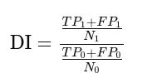



Do we know how to apply them to interpret correctly?
© 2025 BSC-CNS. Licensed under CC BY-NC-4.0
Fairness Metrics Comparison
Disparate Impact (DI = 0.75)
Ratio of positive outcome rates across groups.
Average Odds Difference (AOD = -0.04375)
Average of two differences between groups: difference in TPR (Sensitivity) and difference in FPR (False Positive Rate)
Women are 25% less likely to receive a positive diagnosis overall.
Healthy men are 3.3 times more likely to receive false positives than healthy women.
Statistical Parity Difference (SPD = -0.07)
Difference in positive outcome rates across groups.
Equal Opportunity Difference (EOD = 0)
Difference in true positive rates across groups.
For every 100 patients, 7 fewer women receive a positive diagnosis compared to men.
If you are ill, you have the same probability (90%) of being diagnosed, regardless of your gender.
Saplicki & Bante, 2022, Medium (IBM Data Science in Practice)
Fairness Explained: Definitions and Metrics
Bias in Science - Sex and Gender Perspective in Research (29th October 2025)

Slide 5
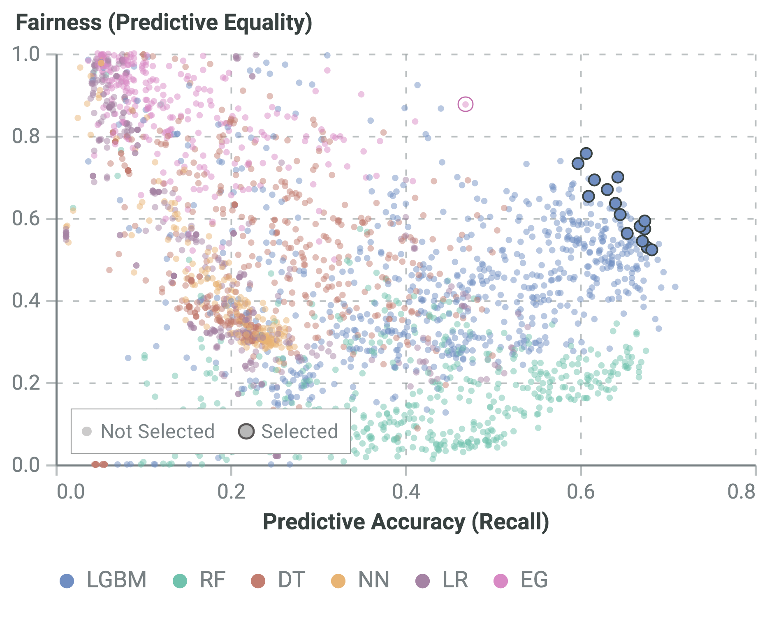
Do we know how to use them to choose the right model?
© 2025 BSC-CNS. Licensed under CC BY-NC-4.0
Dataset: Feedzai Account Opening Fraud dataset
Models: Neural Network (NN), Random Forest (RF), Decision Tree (DT), Logistic Regression (LR), LightGBM (LGBM), Exponentiated Gradient reduction for fair classification (EG)
Curz et al. Promoting Fairness through Hyperparameter Optimization. ICLR 2021 Workshop on Responsible AI
Bias in Science - Sex and Gender Perspective in Research (29th January 2026)
Notes:
Cómo leerla — paso a paso (lo que señalas al público)
“Eje X = Predictive accuracy (Recall)”: cuanto más a la derecha, mejor detecta los casos positivos (por ejemplo, fraudes).
“Eje Y = Fairness (Predictive Equality)”: cuanto más arriba, menor es la diferencia entre grupos en la tasa de falsos positivos (más equitativo).
Breve aclaración: predictive equality busca que los falsos positivos sean igual de frecuentes entre grupos protegidos.
“Colores = tipos de modelo”: cada color = una familia (LGBM, RF, DT, NN, LR, EG).
“Puntos pequeños = todas las configuraciones probadas. Círculos grandes = los modelos que cada buscador/tuner seleccionó para devolver.”
“La región ‘ideal’ está arriba a la derecha: alta recall y alta equidad.”
Qué cuento con la imagen (interpretación para la audiencia)
“Vemos que no todos los modelos iguales en rendimiento tienen la misma equidad: hay nubes dispersas.”
“Algunos métodos/modelos (o configuraciones) entregan muy buen recall pero mala equidad (derecha-abajo). Otros son muy equitativos pero con menor recall (izquierda-arriba).”
“Los círculos grandes (modelos seleccionados) muestran que los métodos fairness-aware tienden a elegir soluciones más arriba (más justas) sin caer mucho a la izquierda — es decir, conservan recall razonable mientras mejoran equidad.”
“También se ve que distintas familias de modelos ocupan zonas distintas: por ejemplo (obsérvese en la gráfica), una familia puede concentrarse hacia mayor recall y otra hacia mayor fairness — eso sugiere que elegir el tipo de modelo también influye en el trade-off.”

Slide 6
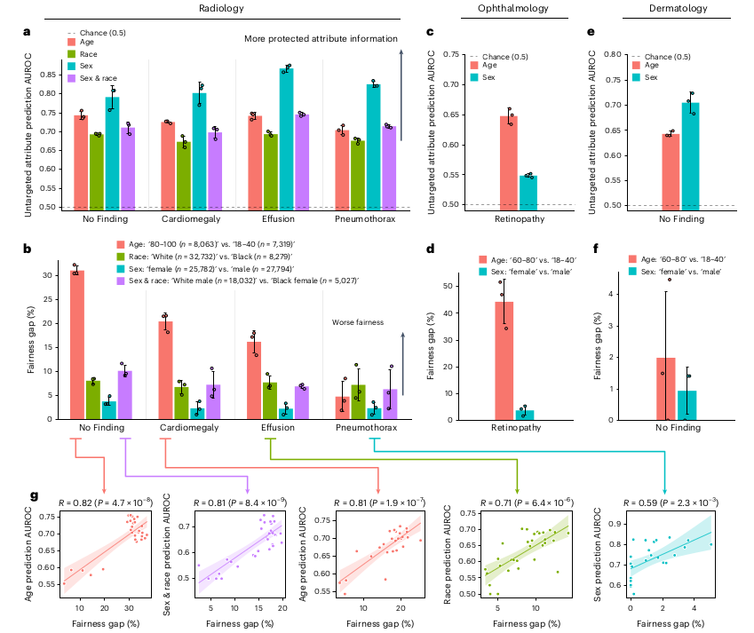
Do they guarantee our models will work in other contexts?
© 2025 BSC-CNS. Licensed under CC BY-NC-4.0
What is a demographic ‘shortcut’?
The model learns implicit demographic attributes (such as age, gender, or race) as a signal which is correlated with the label in the dataset but is not the actual medical cause.
AUROC (Area Under the ROC Curve) measures how well a model separates two classes (0.5 means random, 1.0 means perfect separation)
Fairness Gap measures the difference in error rates (FPR or FNR) between demographic subgroups.
The better the model can predict a demographic attribute from its representation, the greater the fairness gap.
Yang et al., 2024, Nature Medicine
The limits of fair medical imaging AI in real-world generalization
Bias in Science - Sex and Gender Perspective in Research (29th January 2026)

Slide 7
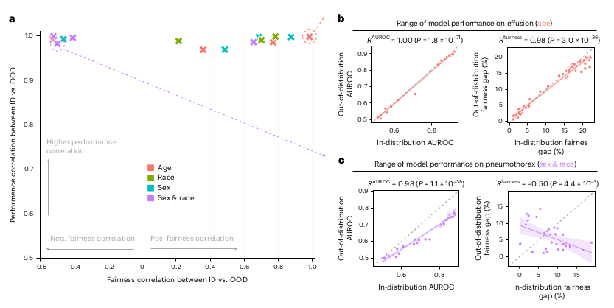
Do they guarantee our models will work in other contexts?
© 2025 BSC-CNS. Licensed under CC BY-NC-4.0
In-Distribution (within the training distribution): data from the same hospital/dataset where you trained and validated the model.
Out-Of-Distribution: data from hospitals, scans or populations not seen during training.
If the model uses this information as a shortcut to predict diseases, its behavior by subgroup depends on how these signals are distributed:
Average performance can be maintained if the clinical signal detector continues to function, but the way errors are distributed among groups may change significantly because shortcuts no longer correlate equally with diseases.
Yang et al., 2024, Nature Medicine
The limits of fair medical imaging AI in real-world generalization
Bias in Science - Sex and Gender Perspective in Research (29th January 2026)

Slide 8
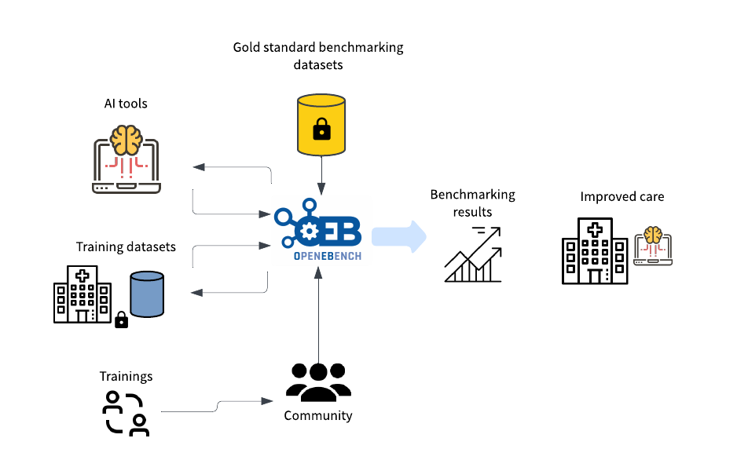
BAIHA: Bias in AI-Healthcare Applications
© 2025 BSC-CNS. Licensed under CC BY-NC-4.0
BAIHA Evaluation
OpenEBench is an ELIXIR platform for benchmarking and monitoring bioinformatics tools, web servers, and workflows.
Transdisciplinary Community
Medical Experts
Offer medical insights for AI model assessment
The BAIHA project will establish indicators and evaluation metrics to identify sex and gender biases in AI-health solutions
Sw Engineers
Maintain the technical infrastructure for AI benchmarking
Gold Standard
AI tool
NGOs & Patient Organizations
Benchmarking Results
Contribute patient and social perspectives
Sociologists & Psychologists
Contribute personal and social perspectives
Training dataset
AI Developers
Health Charts
Design and implement AI algorithms and health apps
Legal and Ethical experts
Trainings
Advise on legal and ethical issues
Bias in Science - Sex and Gender Perspective in Research (29th January 2026)

Slide 9
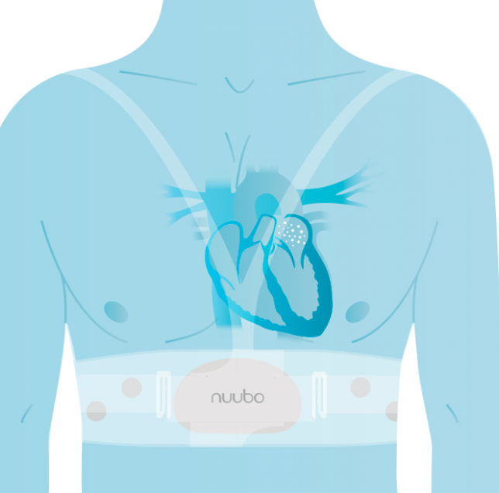

First BAIHA Evaluation: Atrial Fibrillation
© 2025 BSC-CNS. Licensed under CC BY-NC-4.0
Training Dataset
Heart rates were measured in cohort of 25 volunteers (15 men/9 women) from the Freno al ICTUS Foundation. ECGs were monitored using Nuubo, device designed by arrhythmia specialized cardiologists.
AI tool
For each patient the model compiles: Lifestyle data from questionnaires, biochemical metrics, digital heart parameters .
EEGs used to train the model were obtained by The 2017 PhysioNet/CinC Challenge, but they don't offer sex information of patients
Gold Standard
Due to the lack of established guidelines and medical assessment for its construction, a balanced cohort was assumed for the proof of concept.
This cohort consisted of 10 individuals with and without AF (5 males/ 5 females)
Bias in Science - Sex and Gender Perspective in Research (29th January 2026)

Slide 10


New BAIHA Evaluation: TCGA Pan-Cancer
© 2025 BSC-CNS. Licensed under CC BY-NC-4.0
Training Dataset
A gene expression RNAseq cohort with batch effects normalized mRNA data from 532 patients (269 males/263 females) with 1,064 samples (535 Primary Tumor/529 Solid Tissue Normal) for 19,423 genes was used. enriched with sample type information and primary tumor information. The row data was downloaded in UCSC Xena.
AI tool
XGBoost is a machine learning algorithm based on decision trees, with a high capacity to handle large volumes of data and improve performance through techniques such as boosting.
In this case, it is used in combination with Optuna to perform hyperparameter optimization in an efficient manner to maximize.
Gold Standard
Due to the lack of established guidelines and medical assessment for its construction, a balanced cohort was assumed for the proof of concept.
This cohort consisted of 79 individuals with and without Primary Tumor (39 males/ 40 females)
Bias in Science - Sex and Gender Perspective in Research (29th January 2026)

Slide 11



XGBoost model: TCGA Pan-Cancer
© 2025 BSC-CNS. Licensed under CC BY-NC-4.0
Merge data sources
(11060 samples and 20.532 genes)
RNA-seq Expression
Tissue status information
Pre-feature selection (19421 genes):
Remove duplicated samples
Remove genes with 20% > NaNs/0
Wrong Assigned sex
 | Test | GS
ROC AUC | 0.9947 | 0.9821
Accuracy | 0.9551 | 0.9494
Log Loss | 0.0942 | 0.1581
Precision | 0.9690 | 0.9487
Recall | 0.9398 | 0.9487
F1-Score | 0.9542 | 0.9487
Select patients based on their sample tissue (patients 711 - 1422 samples):
Primary Tumor sample
Solid Tissue Normal
Gold Standard (GS)
Patients with 2 samples types
Training model:
XGBoost + Optuna
PCA reduction
Threshold predictions > 0.6
Model Results
Bias in Science - Sex and Gender Perspective in Research (29th January 2026)

Slide 12
Metrics for Evaluation in OpenEBench platform
© 2025 BSC-CNS. Licensed under CC BY-NC-4.0
Training Datasets
Model Outputs
Class Imbalance
Overall Accuracy
Disparate Impact
Female Positive Label Percentage
Accuracy Difference
Statistical Parity
Female Negative Label Percentage
Difference in Conditional Acceptance
Positive Label Imbalance
Equal Opportunity
Negative Label Imbalance
Difference in Conditional Rejection
Predictive Equality
Female Conditional Demographic Disparity
False Negative Rate
Treatment Equality
Male Conditional Demographic Disparity
Bias in Science - Sex and Gender Perspective in Research (29th January 2026)

Slide 13
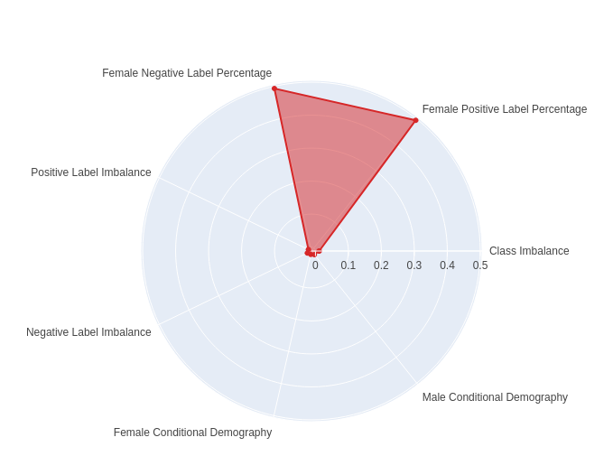
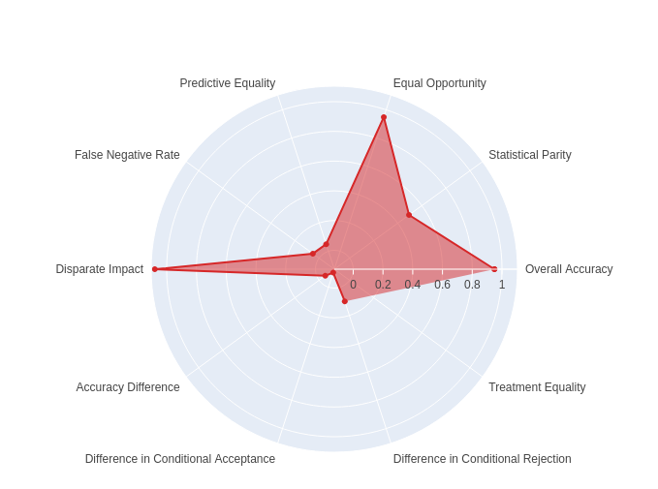
Statistical Metrics for Bias Detection
© 2025 BSC-CNS. Licensed under CC BY-NC-4.0
Training Dataset
Model Output
Bias in Science - Sex and Gender Perspective in Research (29th January 2026)

Slide 14
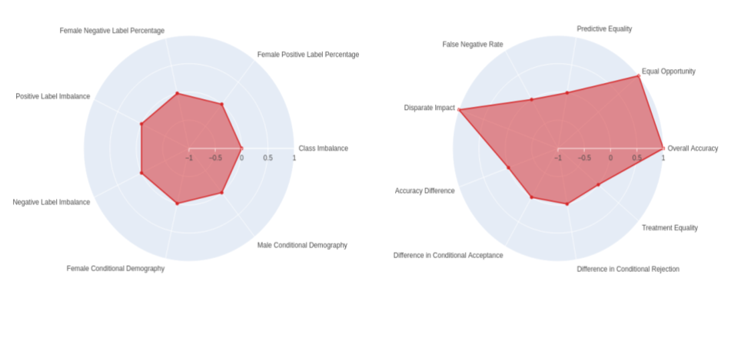
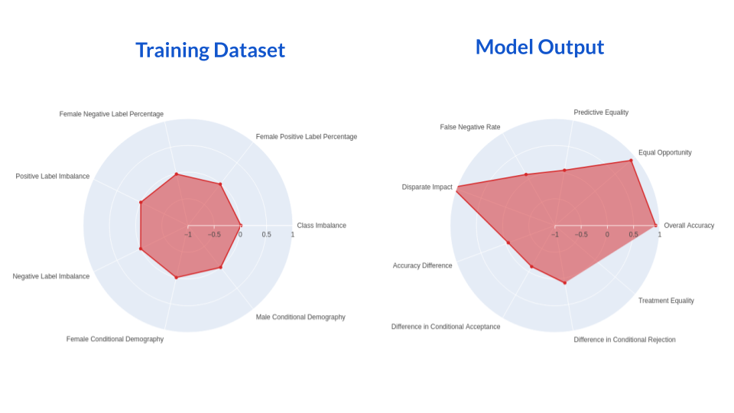
Statistical Metrics for Bias Detection
© 2025 BSC-CNS. Licensed under CC BY-NC-4.0
Evaluator
Pan-Cancer
Training Dataset
Output Models
Training Dataset
Output Models
Bias in Science - Sex and Gender Perspective in Research (29th January 2026)

Slide 15
Limitations and Next Steps
© 2025 BSC-CNS. Licensed under CC BY-NC-4.0
Limitations
It is not possible to conduct a formal study on any specific type of cancer due to a lack of data.
‘Healthy’ tissues are liminal tissues between healthy tissue and cancerous tissue.
How can we adapt these metrics to diagnoses that have different prevalence rates among men and women?
Without access to a true Gold Standard, we relied on a medical expert team for pathology assessment.
Questions
How can we adapt these metrics to diagnoses that have different prevalence rates among men and women?
How much do metrics need to differ between genders for it to be a significant change?
Can we identify which features are most important across all cancer types and use them to explain the model?
Bias in Science - Sex and Gender Perspective in Research (29th January 2026)

Slide 16















AHEAD Project
© 2025 BSC-CNS. Licensed under CC BY-NC-4.0
AHEAD
AI for Health: Evaluation of Applications & Datasets
MARIE SKŁODOWSKA-CURIE ACTIONS
Staff Exchanges (SE)
Bias in Science - Sex and Gender Perspective in Research (29th January 2026)

Slide 17


AHEAD Project
© 2025 BSC-CNS. Licensed under CC BY-NC-4.0
Efficiency
Integration with other systems
Fairness
Security
Reliability
Accessibility
Environmental impact
Technical Indicators
Accessibility
Patient impact
Bias & Intersectionality
Data Security
Usability
Social norms
Traceability
Compliance
Ethical considerations
Human Interaction Indicators
Robustness
Explainability
Societal Indicators
Bias in Science - Sex and Gender Perspective in Research (29th January 2026)

Slide 18
Thank you for your attention!
© 2025 Barcelona Supercomputing Center - Centro Nacional de Supercomputación. Author: (XXXX).
Material licensed under CC BY-NC-4.0.

