Slide 1

AI & Evaluation Concerns:
Ground Truth, Assessment Frameworks and Techniques
Claudia Rosas Mendoza* BSC
““fellowship within the “Generación D” initiative, Red.es, Ministerio para la Transformación Digital y de la Función Pública, for talent attraction (C005/24-ED CV1). Funded by the European Union NextGenerationEU funds, through PRTR”
29/01/2026
© 2025 Barcelona Supercomputing Center - Centro Nacional de Supercomputación.
Author: (Claudia Rosas Mendoza). Material licensed under CC BY-NC-4.0.

Slide 2
What are we going to cover today?
Ground Truth: Friend of Foe?
How do you choose against whom to compare?
Benchmarking and assessment frameworks

Slide 3
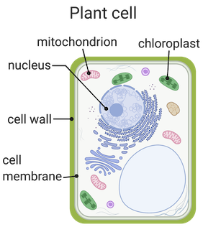
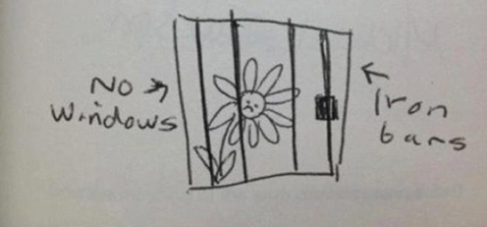
Clear Instructions
© 2025 BSC-CNS. Licensed under CC BY-NC-4.0
Following “unexpectedly” unclear instructions, e.g.
“Draw a plant cell and identify its most important parts”
https://www.khanacademy.org/science/ms-biology/x0c5bb03129646fd6:cells-and-organisms/x0c5bb03129646fd6:cell-parts-and-functions/a/cell-parts-and-functions

Slide 4


An easy recipe
© 2025 BSC-CNS. Licensed under CC BY-NC-4.0
Recipes are easy to follow:
Notes:
Imagine teaching a student with an answer key—if the key is wrong, the student learns the wrong things.
In AI, “ground truth” is our answer key. It’s what we use to judge if the AI is right or wrong.
Getting this right is especially important in healthcare, where mistakes can have real consequences.

Slide 5
The Foundation for Judging AI Performance
© 2025 BSC-CNS. Licensed under CC BY-NC-4.0
Refers to the accurate, verified data or outcomes used as the reference standard for evaluating, training, and testing AI models. It represents the "correct answers" against which model predictions are compared.
Notes:
Imagine teaching a student with an answer key—if the key is wrong, the student learns the wrong things.
In AI, “ground truth” is our answer key. It’s what we use to judge if the AI is right or wrong.
Getting this right is especially important in healthcare, where mistakes can have real consequences.

Slide 6

Ground Truth in Traditional Machine Learning
© 2025 BSC-CNS. Licensed under CC BY-NC-4.0
Supervised Learning:
  Ground Truth is the cornerstone of Supervised Learning.
  Like grading homework with an answer sheet—AI learns from examples with correct answers.
    If the answers are wrong or unclear, the AI gets confused and makes mistakes.

Slide 7
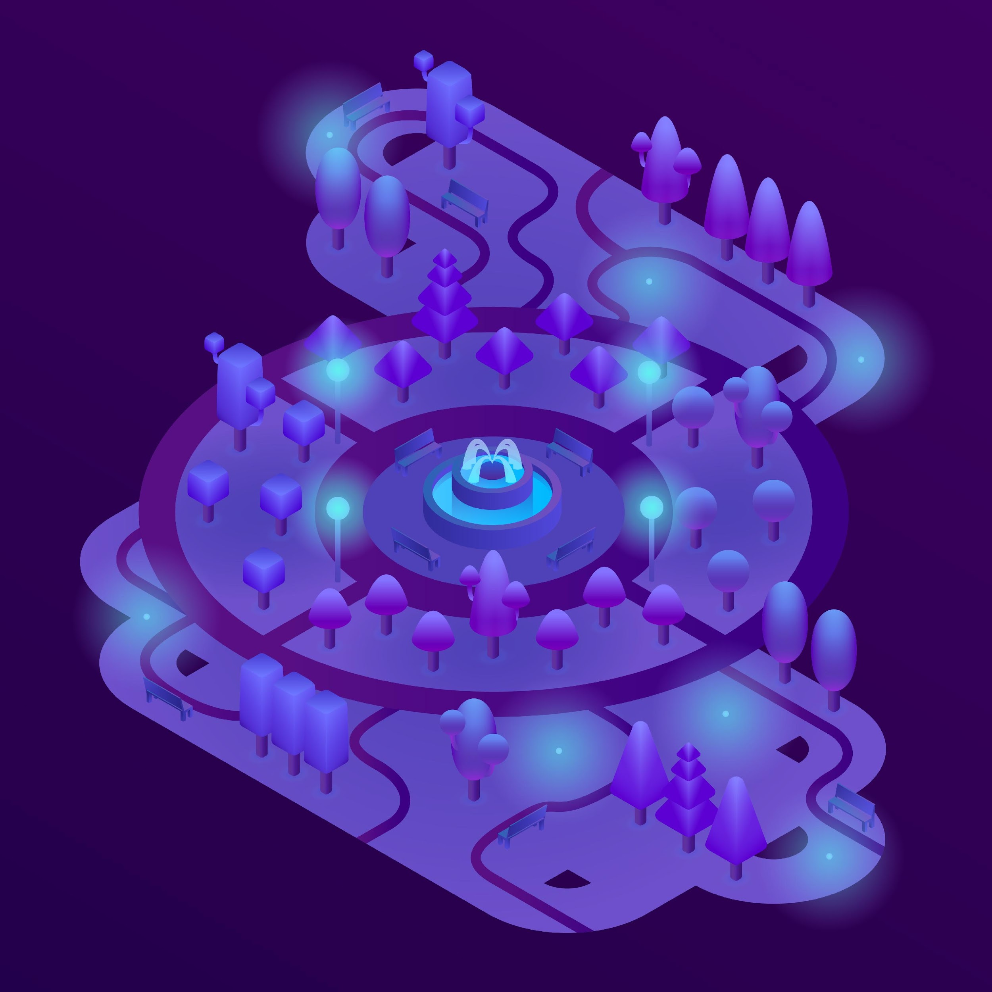
Ground Truth in Traditional Machine Learning
© 2025 BSC-CNS. Licensed under CC BY-NC-4.0
Unsupervised Learning:
  Analyse unlabelled data; e.g. no “correct answers” are provided.
    The AI tries to find patterns on its own.
    Results can be harder to interpret than supervised learning, since there’s no ground truth for validation.

Slide 8
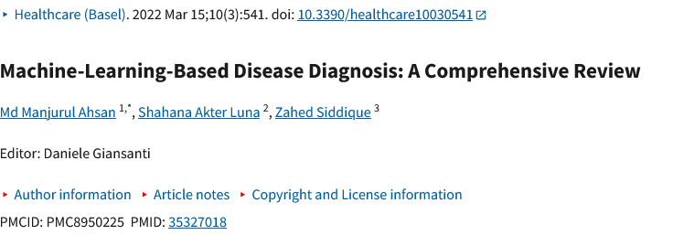



Examples using Supervised ML in Biomedicine
© 2025 BSC-CNS. Licensed under CC BY-NC-4.0
Disease Diagnosis from Medical Data
Medical Imaging and Cancer Detection*
Triage and Risk Prediction
Treatment Response and Personalized Medicine
Notes:
Predicting diseases such as diabetes, heart failure, breast cancer, pneumonia, and kidney disease using labeled patient data.
Algorithms like logistic regression, random forest, SVM, and neural networks are trained on datasets where each patient record is labeled with a diagnosis (e.g., “has kidney disease” or “no kidney disease”).
Researchers used labeled datasets to train models that identify chronic kidney disease, achieving accuracies up to 99% with neural networks and SVMs
In Parkinson’s disease, supervised models like random forests and deep neural networks have been developed to distinguish between patients and healthy controls based on voice or movement data
2. Detecting cancer (e.g., breast, lung, or skin cancer) by analyzing labeled medical images (X-rays, MRIs, CT scans, pathology slides).
Deep learning models (e.g., convolutional neural networks) are trained on images labeled by experts as “cancerous” or “non-cancerous.”
In breast cancer detection, algorithms trained on labeled mammography images achieved diagnostic accuracy rates comparable to, or even exceeding, human experts.
In oncology, tools like DeepGene use labeled genetic data to classify tumor types and detect somatic mutations.
3. Predicting which patients are at highest risk for complications or need urgent care.
Models are trained on labeled clinical data (e.g., age, vital signs, comorbidities) to predict outcomes like ICU admission or mortality.
Machine learning-based triage systems in emergency departments use supervised algorithms to predict in-hospital death or ICU admission, outperforming conventional triage methods
4. Predicting which patients will respond to specific treatments.
Models are trained on labeled data linking patient characteristics to treatment outcomes.
AI models analyze blood samples from rheumatoid arthritis patients to predict who will benefit from anti-rheumatic drugs, supporting personalized treatment plans

Slide 9
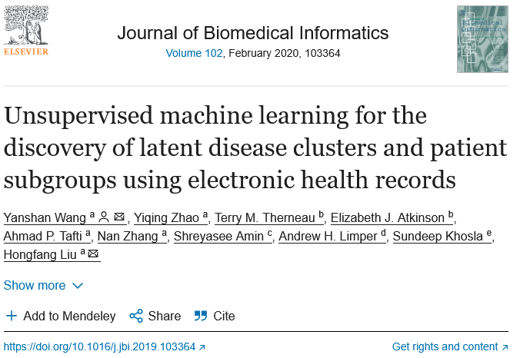

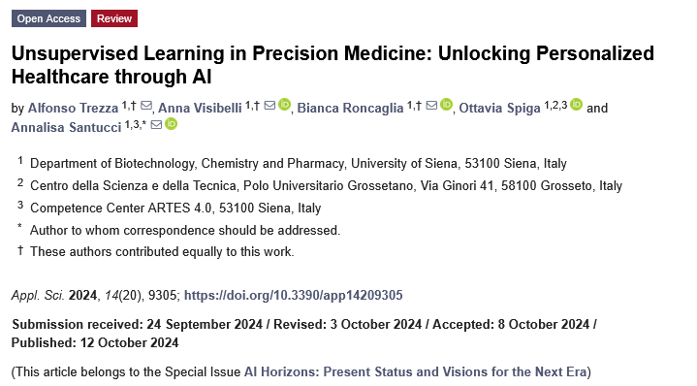

Examples using Unsupervised Machine Learning in Biomedicine
© 2025 BSC-CNS. Licensed under CC BY-NC-4.0
Patient Subgroup Discovery in Electronic Health Records
Cancer Genomics and Precision Medicine
Neuroimaging Analysis
Phenotyping in Chronic Diseases
Anomaly Detection in Medical Imaging and Monitoring
Notes:
1. Unsupervised algorithms (e.g., K-means, hierarchical clustering) analyze EHR data to group patients with similar characteristics, clinical histories, or responses to treatment—without any predefined labels.
Reveals previously unrecognized disease subtypes or patient risk profiles, guiding more personalized care and targeted interventions.
2. Clustering and dimensionality reduction techniques are applied to genetic and molecular data from tumors to identify distinct molecular subtypes of cancer.
Enables oncologists to classify cancers more precisely, predict prognosis, and tailor therapies to specific genetic profiles.
3. Unsupervised learning analyzes brain imaging data (e.g., MRI, fMRI) to find patterns of connectivity or structural similarities among patients.
Helps researchers identify new subtypes of neurological or psychiatric disorders, such as Alzheimer’s disease or schizophrenia, which may not be apparent through traditional analysis.
4. Algorithms cluster patients with chronic diseases (e.g., asthma, heart failure) based on symptoms, comorbidities, and treatment responses.
Supports the discovery of clinically meaningful phenotypes, improving disease management and research into underlying mechanisms.
5. Unsupervised techniques flag unusual patterns in radiology images or continuous monitoring data (e.g., from ICU or wearable devices).
Assists clinicians in early detection of rare conditions, complications, or equipment malfunctions, enhancing patient safety.

Slide 10
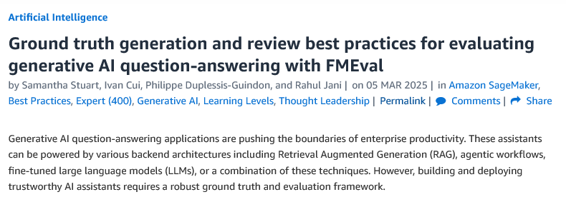

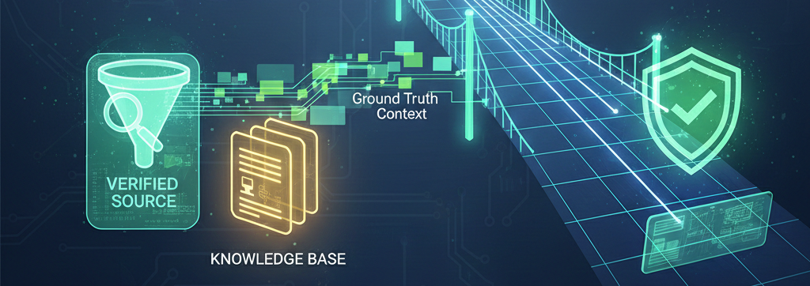
Ground Truth in Generative AI (LLMs) as in July, 2025
© 2025 BSC-CNS. Licensed under CC BY-NC-4.0
Answers can be open-ended: like writing an essay instead of picking A, B, or C.
There can be many “right” answers, so it’s harder to judge if the AI is correct.
We often rely on expert opinions or group consensus to decide what’s “right.”

Slide 11
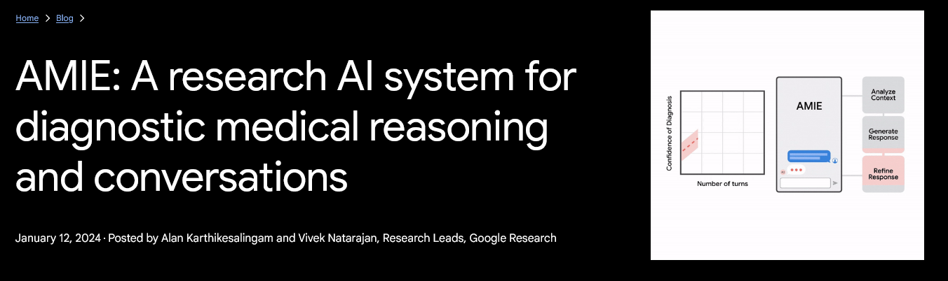


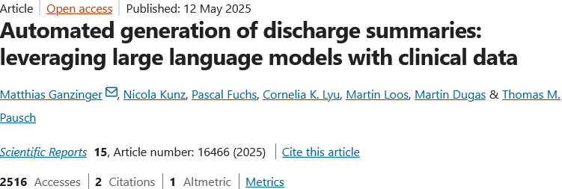


Examples using LLMs in Biomedicine
© 2025 BSC-CNS. Licensed under CC BY-NC-4.0
Notes:
Diagnostic Decision Support and Clinical Conversations
Automated Discharge Summaries
Virtual Medical Assistants and Patient Engagement
Medical Research and Literature Analysis
And many more…

Slide 12

How Bias Creeps in
© 2025 BSC-CNS. Licensed under CC BY-NC-4.0
Pre-existing ideas
Cultural assumptions
Funding choices
Publishing only “good” results
Definition & Hypothesis
Deployment & Application
Design & Data Collection
Who is represented?
Errors in how data is collected or labelled
Testing with unfair comparisons
Wrong assumptions about cases
Validation
Development
Bias in models
Missing data from certain group
Notes:
If our answer key mostly represents one group or viewpoint, the AI can become biased.
This means it might work well for some people but not for others.
Regular checks and diverse data help reduce this risk.

Slide 13

Bias in Healthcare AI: Challenges and a Path Forward
© 2025 BSC-CNS. Licensed under CC BY-NC-4.0
Key Challenges
  Demographic inference from clinical images
  Spurious correlations mistaken for causal patterns
  Historical data = historically biased care
  Technical fixes (de-biasing algorithms) are often insufficient
Proposed Approach
  Treat biases data as sociotechnical artifacts
  Analyse how and why models learn discriminatory shortcuts
  Combine technical evaluation with ethical and historical analysis
Action
  Design with equity as a core objective, not an aftertought
  Involve interdisciplinary teams
  Monitor the hidden biases and systemic disparities during deployment
Notes:
Diagnostic Decision Support and Clinical Conversations
Automated Discharge Summaries
Virtual Medical Assistants and Patient Engagement
Medical Research and Literature Analysis
And many more…

Slide 14
Assessment Frameworks
© 2025 BSC-CNS. Licensed under CC BY-NC-4.0

Slide 15
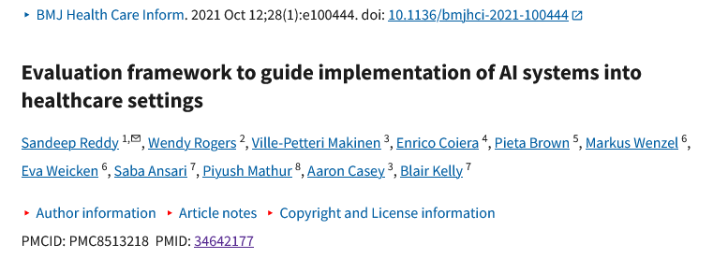
TEHAI
© 2025 BSC-CNS. Licensed under CC BY-NC-4.0
Aligned with Translational Research (TR)
Bridges scientific evidence and real-world practice
Promotes evidence-based interventions from lab, clinic, or community
Informed by Health Technology Assessment (HTA)
Systematic evaluation of health technologies and interventions
“TEHAI includes three main components: capability, utility and adoption. The emphasis on translational and ethical features of the model development and deployment distinguishes TEHAI from other evaluation instruments. In specific, the evaluation components can be applied at any stage of the development and deployment of the AI system.”
Core TR Principles
Focus on health impact
Encourage multidisciplinary collaboration
Enable adoption of evidence-based approaches
Notes:
Diagnostic Decision Support and Clinical Conversations
Automated Discharge Summaries
Virtual Medical Assistants and Patient Engagement
Medical Research and Literature Analysis
And many more…

Slide 16
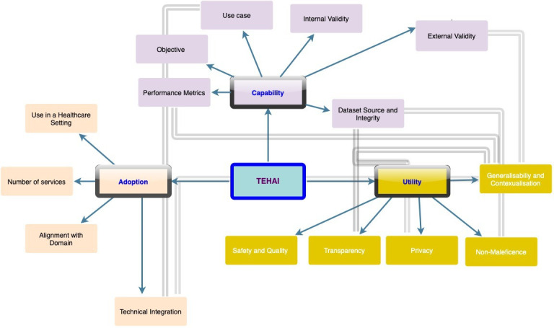
TEHAI
© 2025 BSC-CNS. Licensed under CC BY-NC-4.0
Translational evaluation of healthcare AI. Three main components—capability, utility and adoption, with 15 subcomponents. The components and associated subcomponents are represented in the same colour. Subcomponents with cross-relationships are linked by bold arrows. AI, artificial intelligence; TEHAI, Translational Evaluation of Healthcare AI.
Notes:
Diagnostic Decision Support and Clinical Conversations
Automated Discharge Summaries
Virtual Medical Assistants and Patient Engagement
Medical Research and Literature Analysis
And many more…

Slide 17

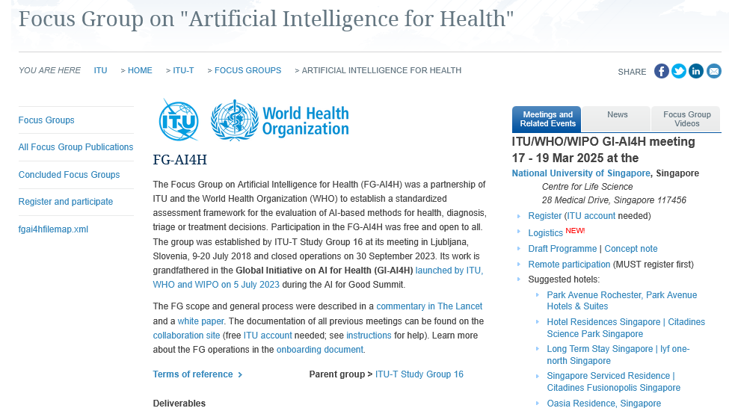
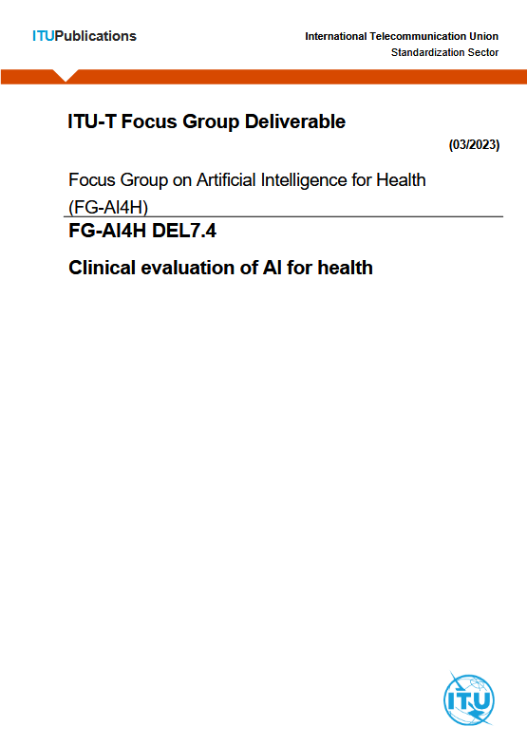
FG-AI4H https://giai4h.org/
© 2025 BSC-CNS. Licensed under CC BY-NC-4.0
Notes:
Diagnostic Decision Support and Clinical Conversations
Automated Discharge Summaries
Virtual Medical Assistants and Patient Engagement
Medical Research and Literature Analysis
And many more…

Slide 18
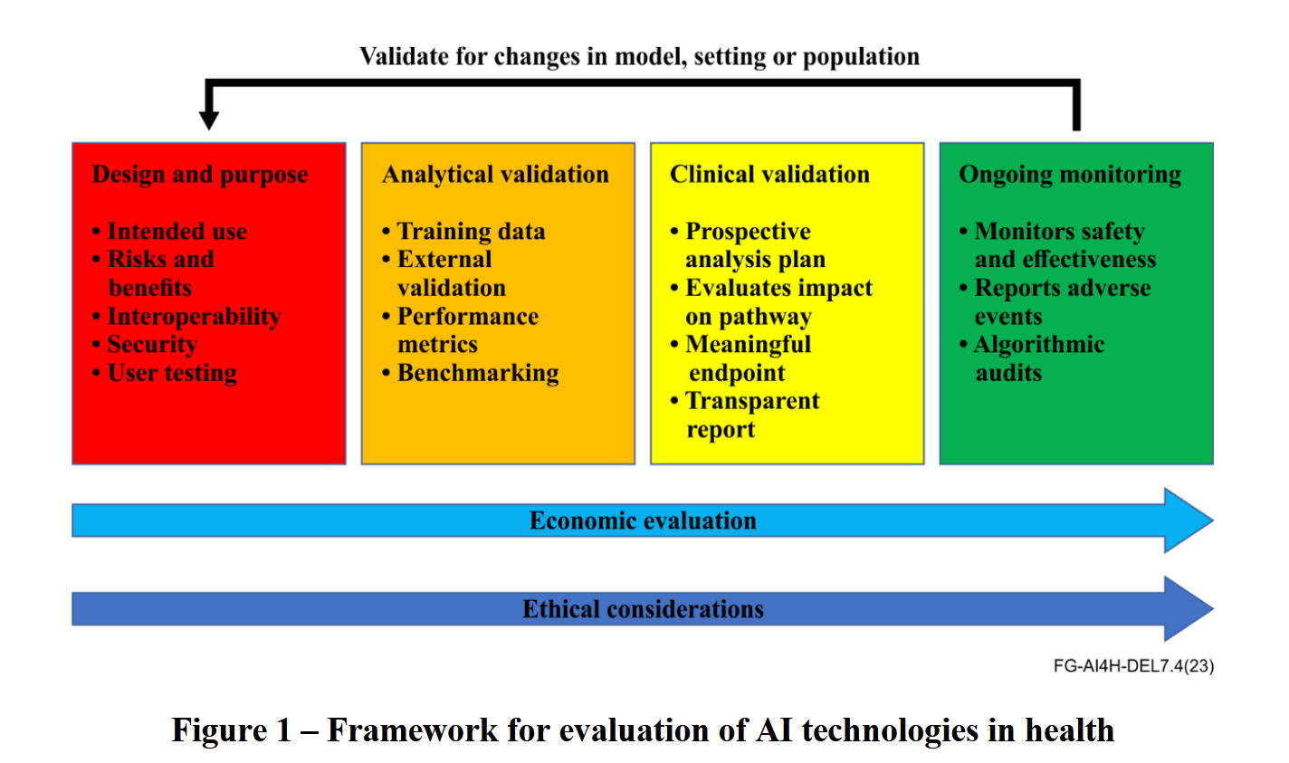
FG-AI4H https://giai4h.org/
© 2025 BSC-CNS. Licensed under CC BY-NC-4.0
Notes:
Diagnostic Decision Support and Clinical Conversations
Automated Discharge Summaries
Virtual Medical Assistants and Patient Engagement
Medical Research and Literature Analysis
And many more…

Slide 19
FG-AI4H https://giai4h.org/
© 2025 BSC-CNS. Licensed under CC BY-NC-4.0
“Benchmarking against the current standard of care or other AI models
In order to understand the performance of the tool, an evaluation against an accepted standard should be made. The most appropriate standard for comparison may differ according to the intended use but common examples of standards are human performance in a similar task or other models (for example derived from logistic regression). Depending on the intended use, the performance requirements may vary depending on whether the intended use is for screening or for diagnosis.” (FG-AI4H DEL7.4)
Notes:
Diagnostic Decision Support and Clinical Conversations
Automated Discharge Summaries
Virtual Medical Assistants and Patient Engagement
Medical Research and Literature Analysis
And many more…

Slide 20
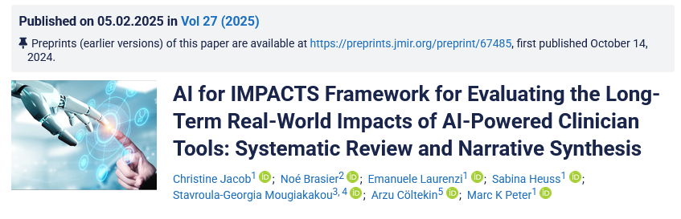

AI for IMPACTS
© 2025 BSC-CNS. Licensed under CC BY-NC-4.0
AI in Healthcare: “the ability of algorithms and software to analyze complex medical data and support health care providers by improving decision-making, predicting outcomes, and enhancing clinical efficiency” WHO
https://www.who.int/publications/i/item/9789240029200
Notes:
Diagnostic Decision Support and Clinical Conversations
Automated Discharge Summaries
Virtual Medical Assistants and Patient Engagement
Medical Research and Literature Analysis
And many more…

Slide 21
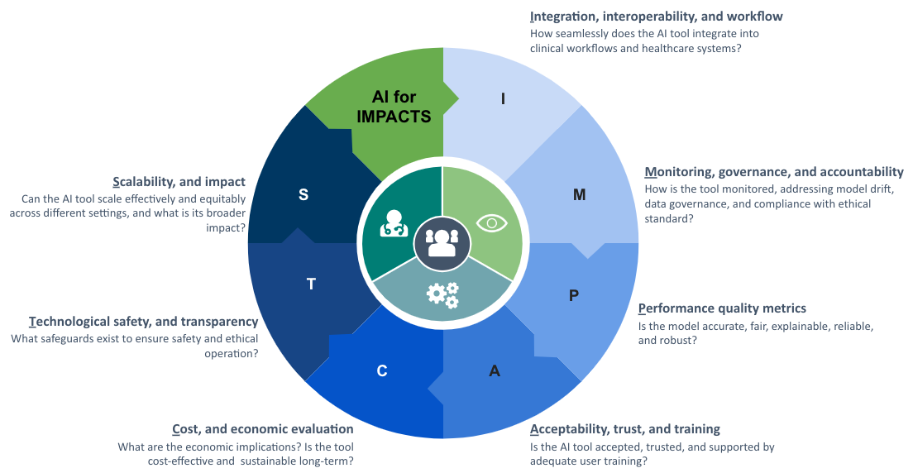
AI for IMPACTS
© 2025 BSC-CNS. Licensed under CC BY-NC-4.0
Notes:
Diagnostic Decision Support and Clinical Conversations
Automated Discharge Summaries
Virtual Medical Assistants and Patient Engagement
Medical Research and Literature Analysis
And many more…

Slide 22

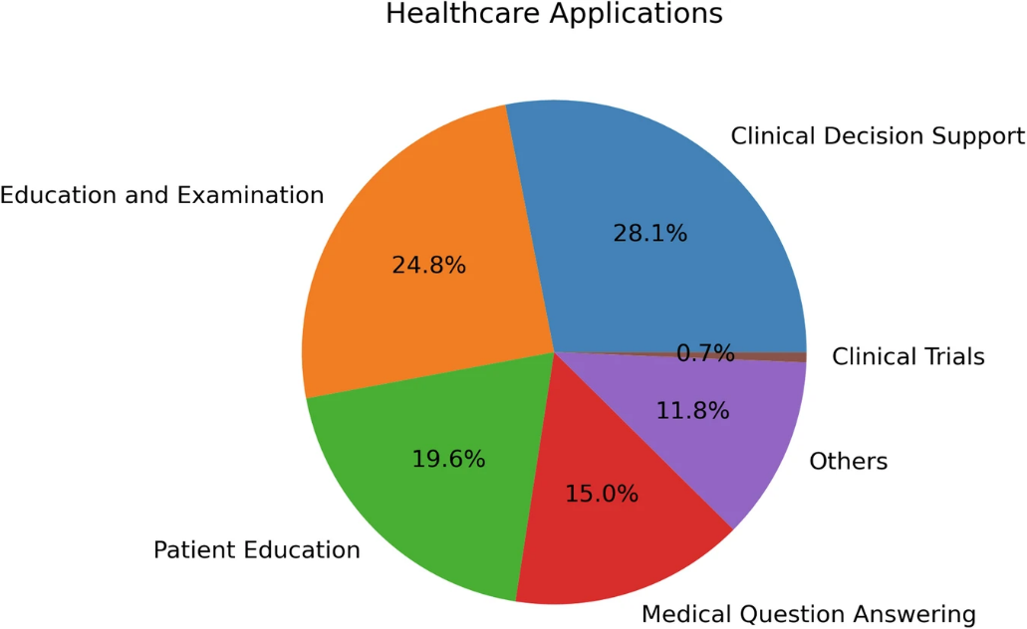

QUEST
© 2025 BSC-CNS. Licensed under CC BY-NC-4.0
Traditional Metrics
  BLEU (Translation), ROUGE (Summarization), Accuracy, F-Measure, AUROC
  Useful for statistical evaluation, but limited for generative tasks
Human Evaluation is essential for assessing:
  Reliability
  Accuracy in clinical context
  Safety & ethics
Notes:
Do not capture clinical utility, nuance, or ethical risks
Inadequate for evaluating large language models (LLMs) in healthcare

Slide 23
QUEST
© 2025 BSC-CNS. Licensed under CC BY-NC-4.0
Quality of Information:
  Accuracy, relevance, timeliness, completeness, consistency, agreement, and usefulness.
Understanding & Reasoning:
  Ability to grasp the prompt and provide logical, coherent responses.
Expression Style & Persona:
  Clarity, tone, and empathy in communication.
Safety & Harm:
  Assessment of bias, potential harm, self-awareness, and avoidance of false or plagiarized content.
Trust & Confidence:
  User perception of trustworthiness and overall satisfaction.
Notes:
Diagnostic Decision Support and Clinical Conversations
Automated Discharge Summaries
Virtual Medical Assistants and Patient Engagement
Medical Research and Literature Analysis
And many more…

Slide 24
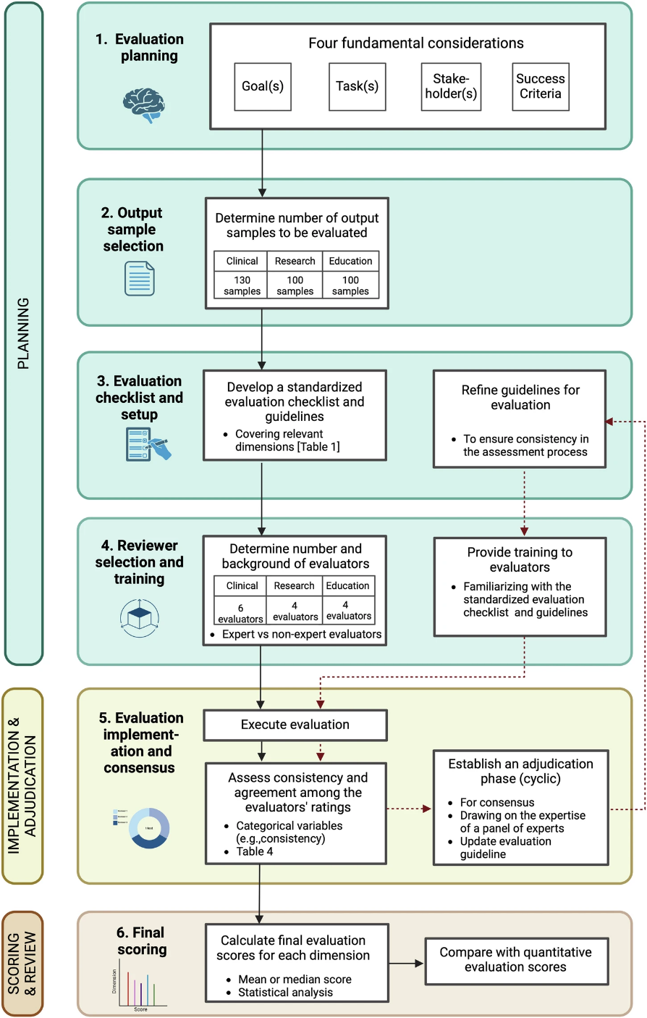
QUEST
© 2025 BSC-CNS. Licensed under CC BY-NC-4.0
Notes:
Diagnostic Decision Support and Clinical Conversations
Automated Discharge Summaries
Virtual Medical Assistants and Patient Engagement
Medical Research and Literature Analysis
And many more…

Slide 25
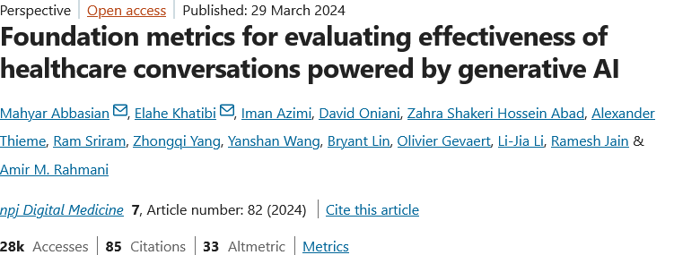

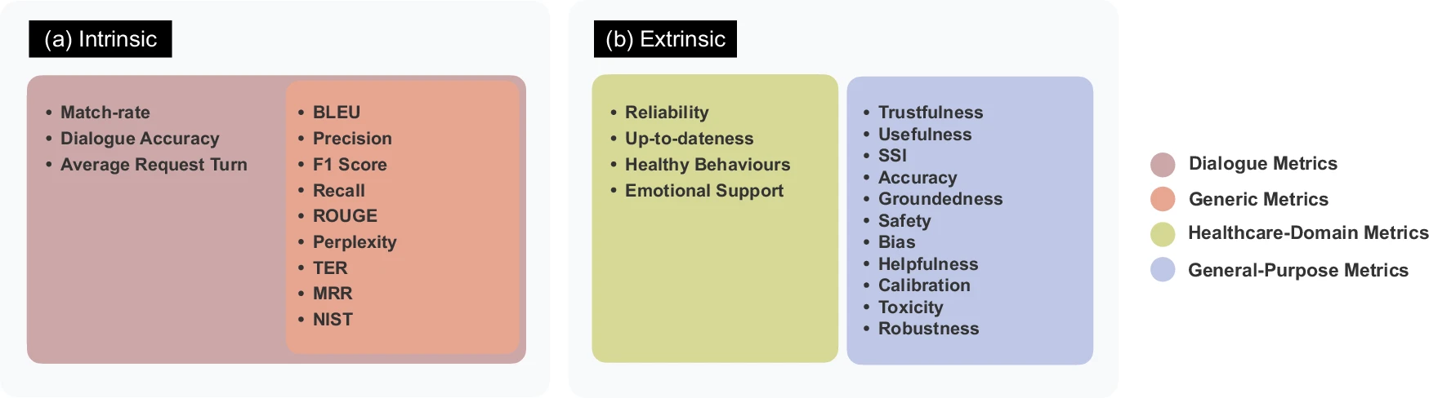
© 2025 BSC-CNS. Licensed under CC BY-NC-4.0
Without “fancy” acronyms
Notes:
Intrinsic Evaluation
Focuses on language quality
Measures coherence, fluency, grammar
Uses automatic metrics
Categories: • General (BLEU, ROUGE) • Dialog-based (BLEURT, USR)
No human involvement
Extrinsic Evaluation
Focuses on real-world impact
Measures user satisfaction & utility
Involves human feedback
Categories: • General-purpose • Health-specific
Requires human judgment

Slide 26
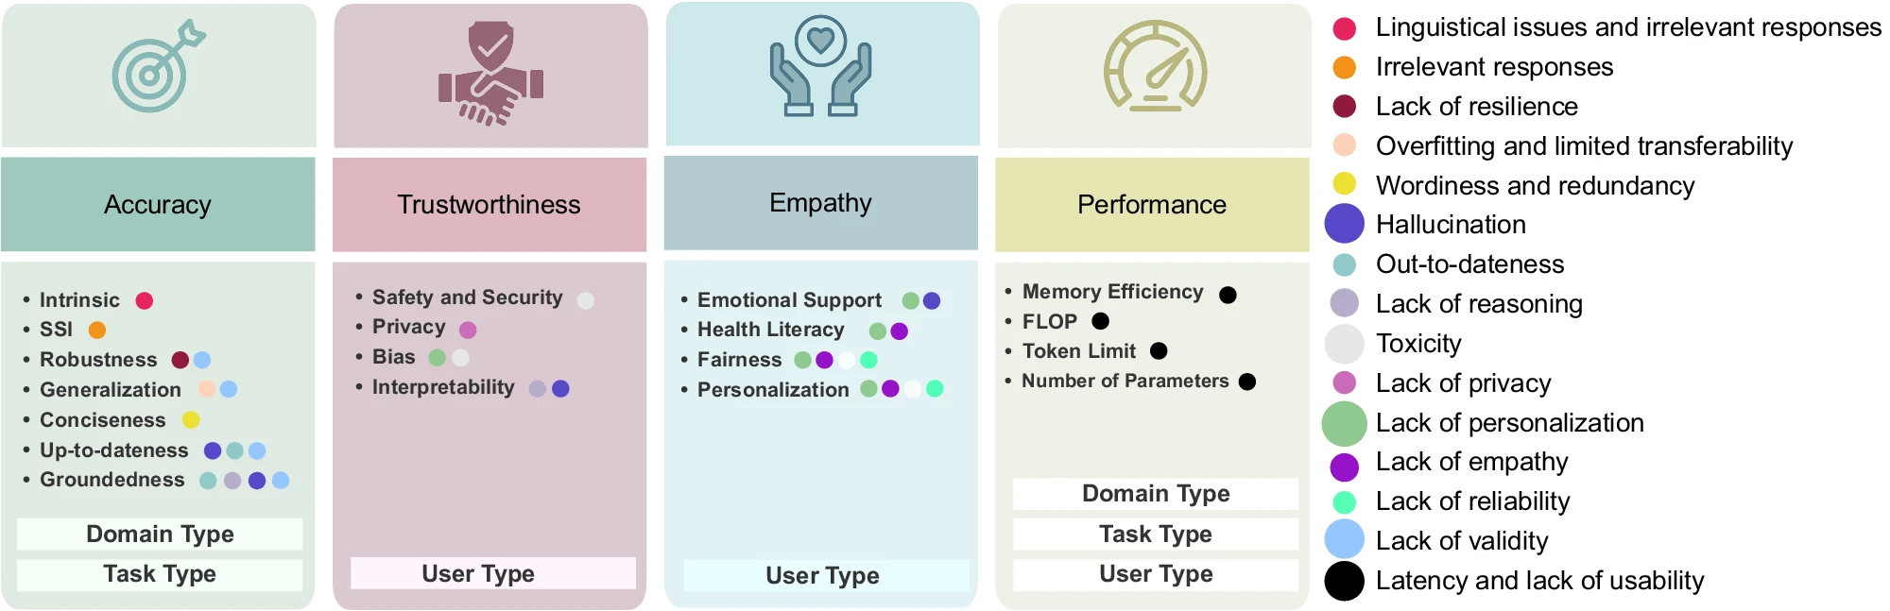
© 2025 BSC-CNS. Licensed under CC BY-NC-4.0
Without “fancy” acronyms
Evaluation metrics for healthcare chatbots are designed to target specific aspects: accuracy is assessed based on domain and task types, trustworthiness depends on the user type, empathy considers patient needs, and performance is influenced by three confounding variables. These metrics collectively help identify key issues in chatbot functionality, with the size of each circle representing the number of metrics contributing to a particular problem.

Slide 27
… and many more that we aren’t aware yet
© 2025 BSC-CNS. Licensed under CC BY-NC-4.0

Slide 28


© 2025 BSC-CNS. Licensed under CC BY-NC-4.0
Summary Table (from Perplexity) Last Summer
Framework | Focus Area | Unique Strengths
TEHAI | Translational/Clinical | Real-world adoption, ethics, utility
AI for IMPACTS | Impact & Integration | Multidisciplinary, long-term, societal focus
FG-AI4H | Clinical/Global | Standardized, equity-focused, regulatory ready
QUEST | LLM Evaluation | Human-centric, multi-phase, reproducible
AHEAD | Multidisciplinary | Regulatory, ethical, harmonization, best practices
AI for Health: Evaluation of Applications and Databases

Slide 29
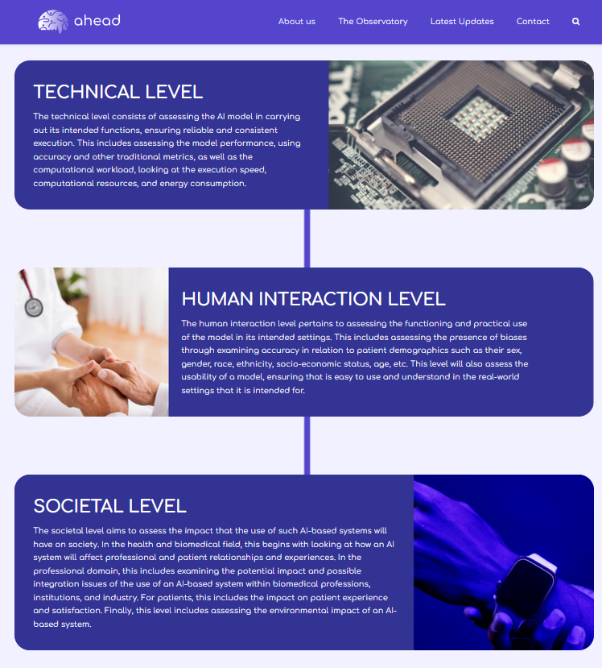
© 2025 BSC-CNS. Licensed under CC BY-NC-4.0
AI for Health: Evaluation of Applications and Databases
https://ahead-msca.eu/about-us/

Slide 30
Thank you!
© 2025 Barcelona Supercomputing Center - Centro Nacional de Supercomputación. Author: (Olivier Philippe).
Material licensed under CC BY-NC-4.0.

