Slide 1
AI Eval
Davide Cirillo
Machine Learning for Biomedical Research
Life Sciences Department
© 2025 Barcelona Supercomputing Center - Centro Nacional de Supercomputación.
Author: (XXXX). Material licensed under CC BY-NC-4.0.

Slide 2
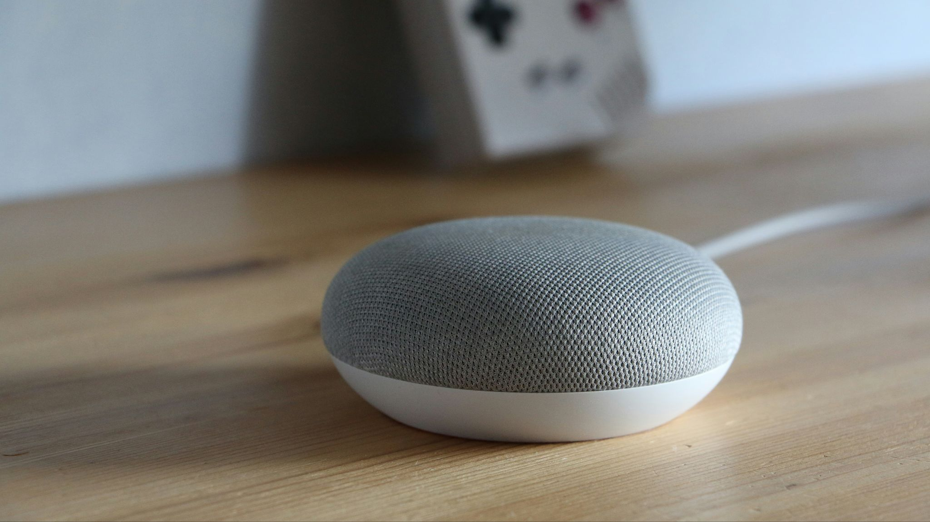



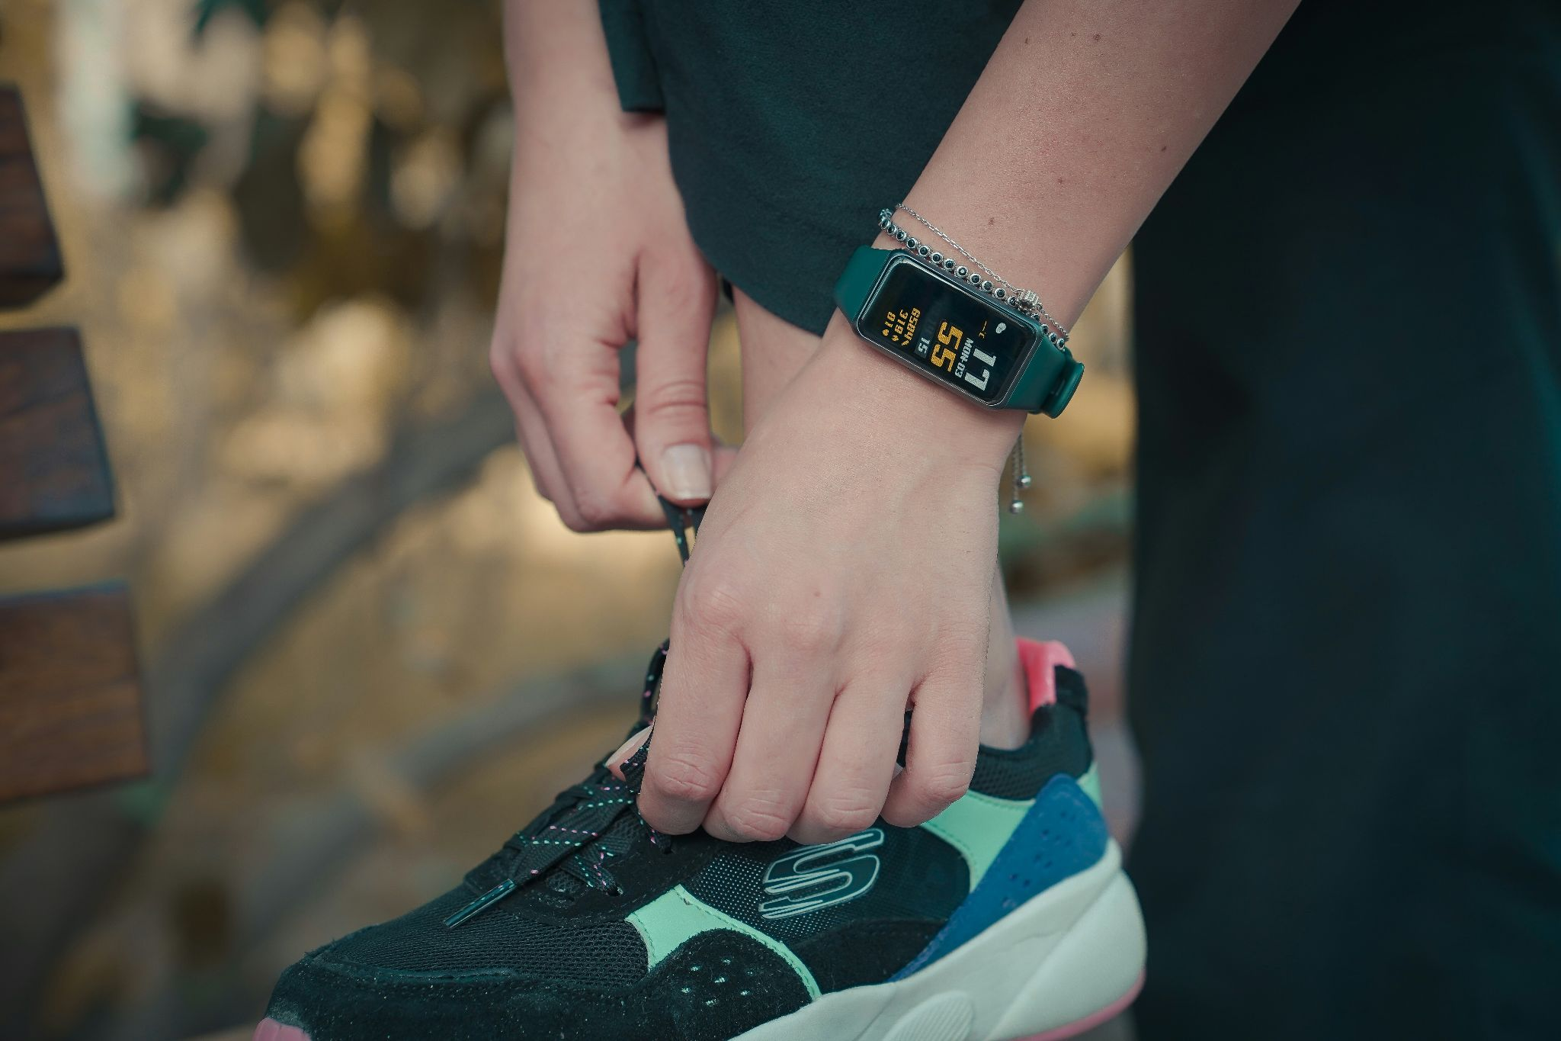


AI is everywhere
source: https://unsplash.com

Slide 3

Why AI evaluation matters?

Slide 4
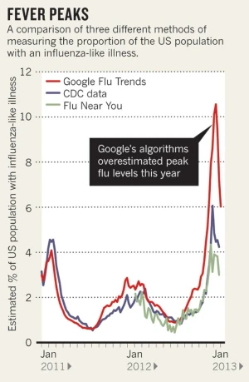

The rise and fall of Google Flu Trends (GFT)
2008: Launch, hailed as big data revolution in epidemiology
2009: Misses H1N1 (swine flu) pandemic
2011-2013: Systematically overestimates flu prevalence
2015: Quietly discontinued
Proxy problem: GFT assumed search queries reflected actual flu cases but many didn’t.
Behavior drift: Search patterns evolved (UI changes, media attention), but the model wasn’t robust to these shifts.
Spurious correlations: With millions of search terms, it picked up seasonal noise, not true flu signals.
Validation gap: Looked great on retrospective data (97% accuracy) but failed prospectively.
Butler, D. When Google got flu wrong. Nature 494, 155–156 (2013). https://doi.org/10.1038/494155a

Slide 5
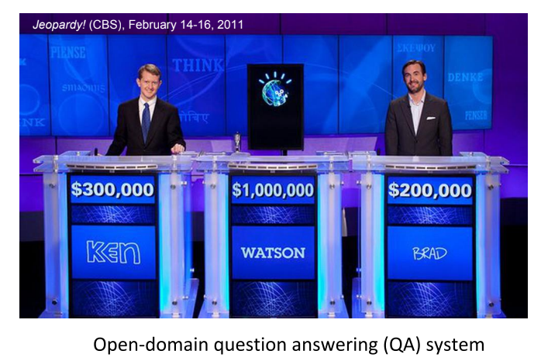
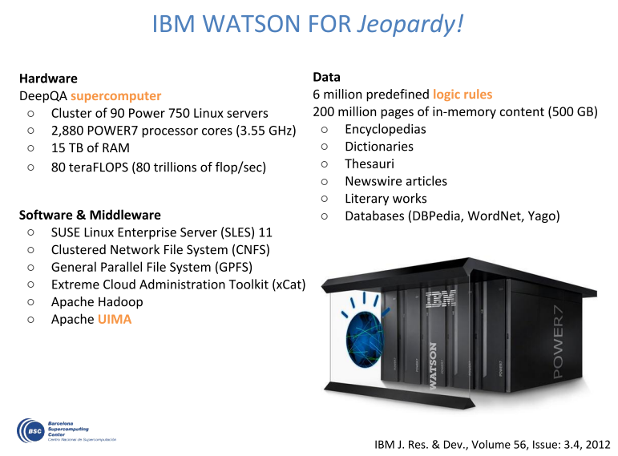
The rise and fall of IBM Watson

Slide 6
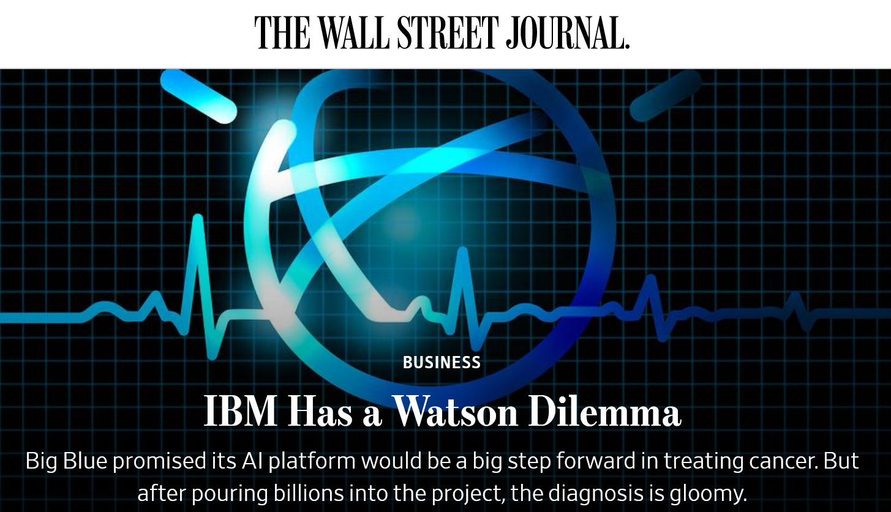
The rise and fall of IBM Watson
source: https://www.wsj.com/articles/ibm-bet-billions-that-watson-could-improve-cancer-treatment-it-hasnt-worked-1533961147

Slide 7
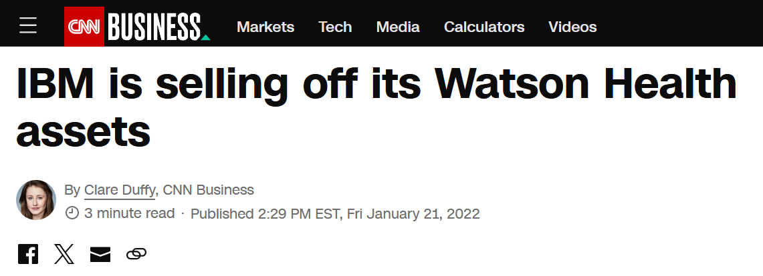
The rise and fall of IBM Watson

Slide 8
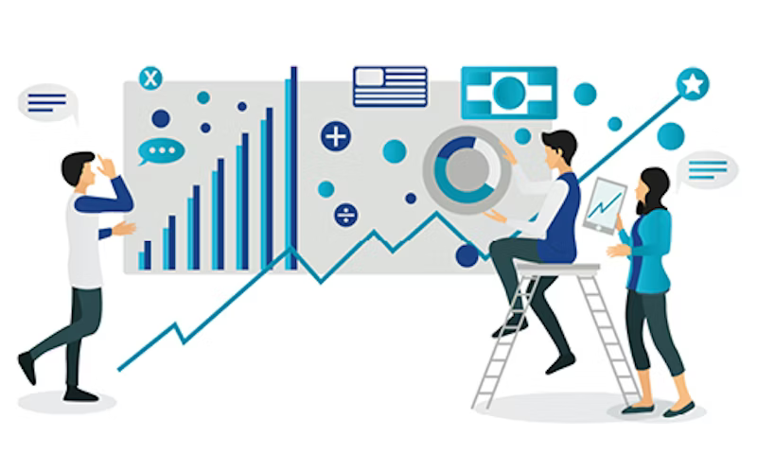
“You can’t improve
what you can’t measure.”
—Peter Drucker—

Slide 9
AI evaluation is the systematic process of assessing an AI system's performance, behavior, and properties against predefined criteria, benchmarks, or objectives.
Model level
(e.g. accuracy, error, …)
System level
(e.g. user experience, robustness …)
Societal level
(e.g. fairness, safety, …)

Slide 10

AI Eval helps to:
Ensure Model Validity
Identify Weaknesses
Build Trust
Enable Improvement

Slide 11
Types of AI evaluation

Slide 12
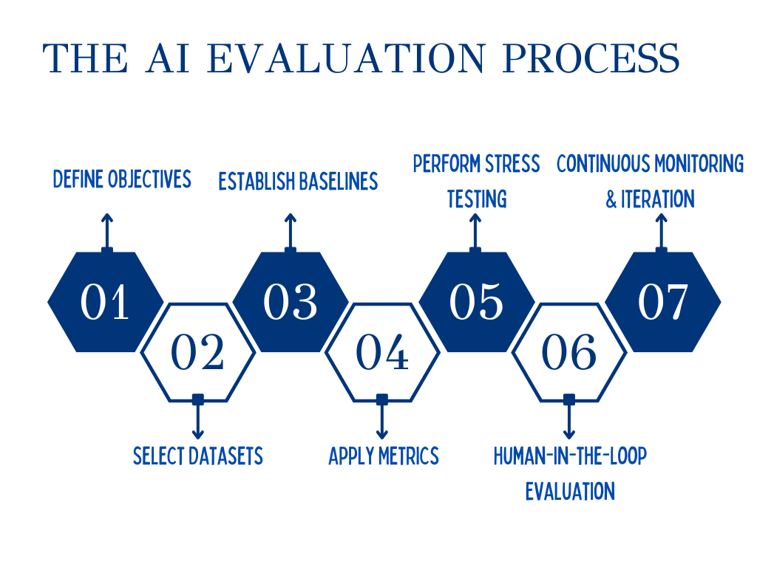

Slide 13
AI Eval Type | Typical Methods/Metrics
Pre-Deployment Evaluation | • Test-set validation • Cross-validation • Simulation testing
Post-Deployment Evaluation | • Drift detection • User feedback analysis • Audit logs
Quantitative Evaluation | • Classification: Accuracy, Precision, Recall, F1 • Regression: MAE, RMSE • Ranking: ROC-AUC, MRR, NDCG
Qualitative Evaluation | • Human review • Expert evaluation • User surveys
Ethical & Societal Evaluation | • Social impact • Data ethics • Responsible AI compliance

Slide 14
Key Metrics in Quantitative Evaluation

Slide 15
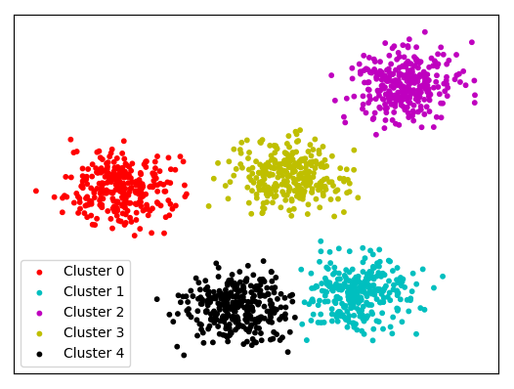
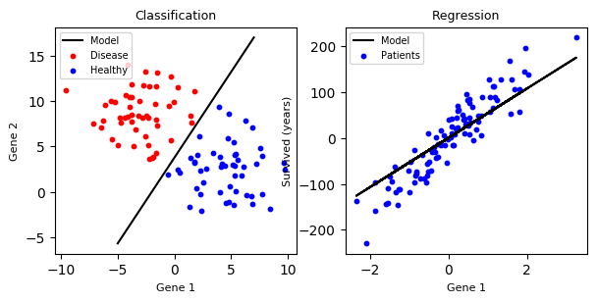
Standard discriminative learning paradigms in machine learning
Supervised Learning
Semi-supervised Learning
Self-supervised Learning
Unsupervised Learning
Reinforcement Learning

Slide 16

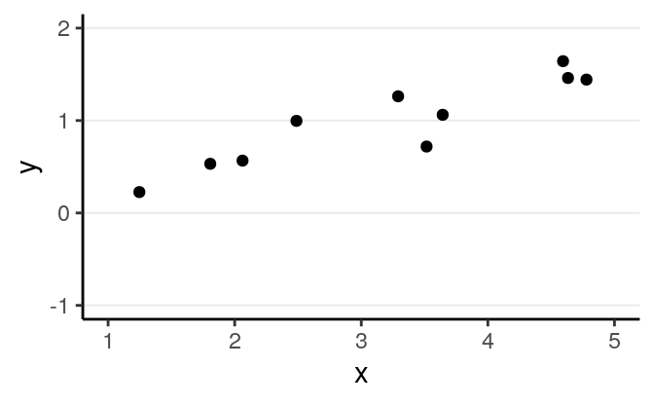
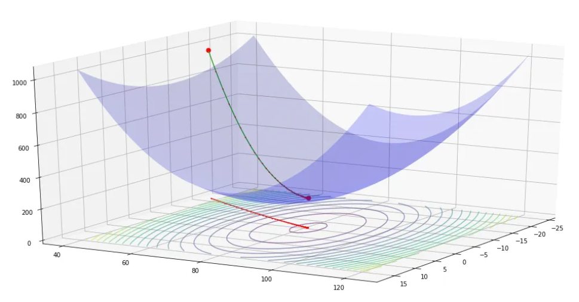

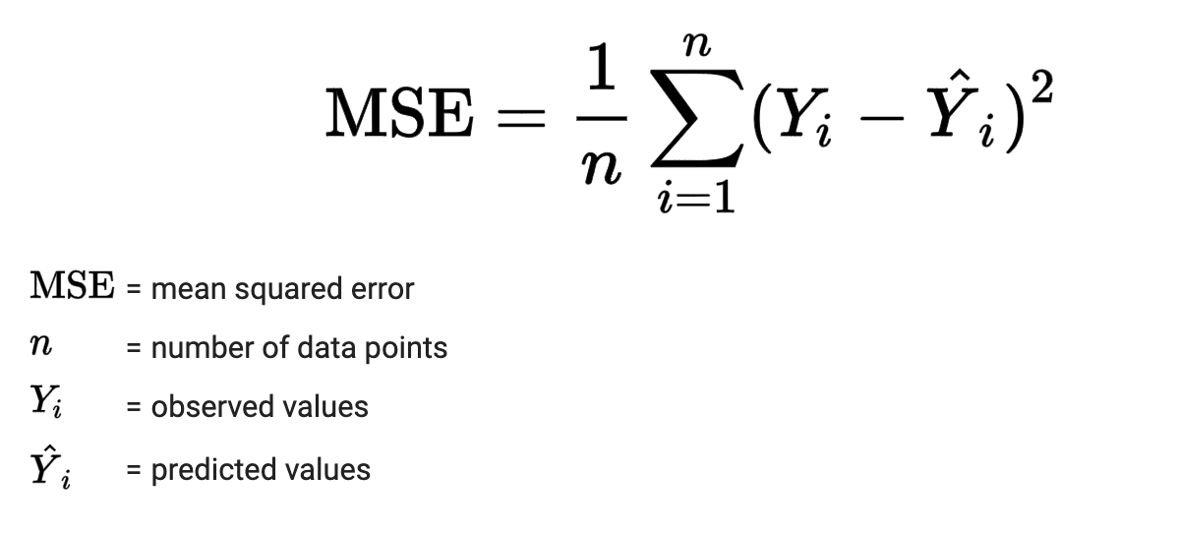
Let’s consider regression
Y = mX + b
Gradient descent
TRAINING
J (m, b)
DISEASE OUTCOME
m
b
VALIDATION
CLINICAL FEATURE

Slide 17
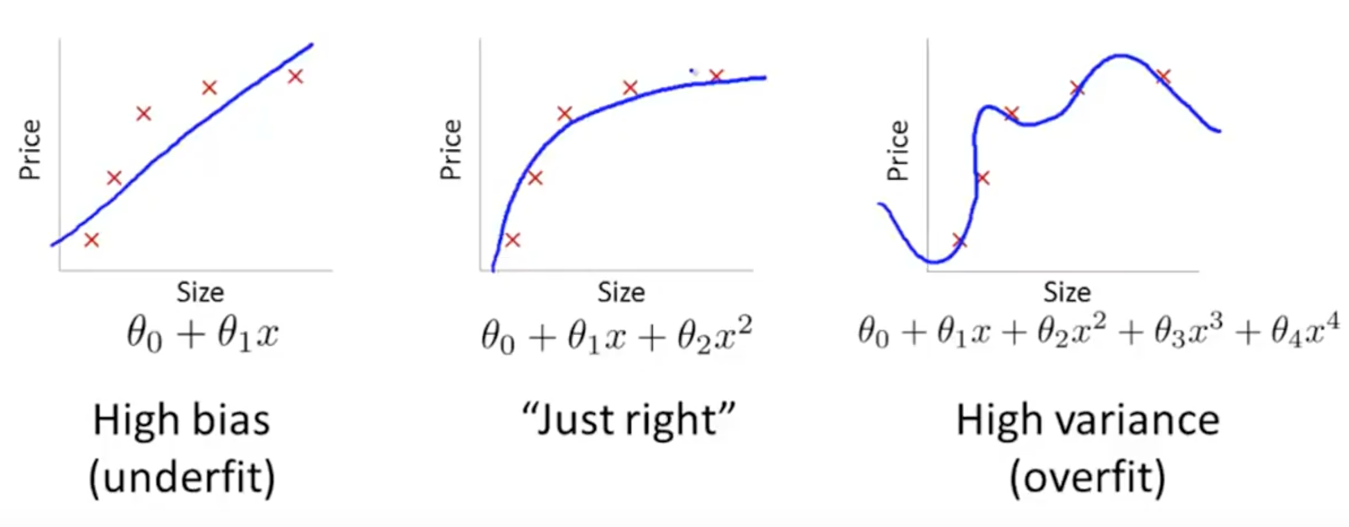
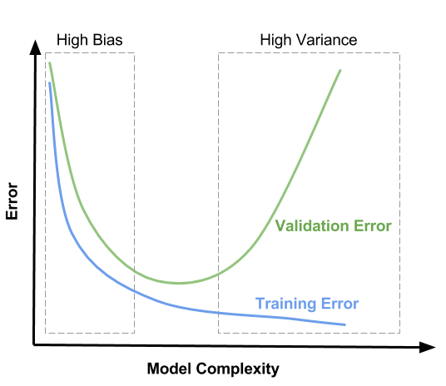
The Goldilocks rule
Disease outcome
Disease outcome
Disease outcome
Clinical feature
Clinical feature
Clinical feature

Slide 18
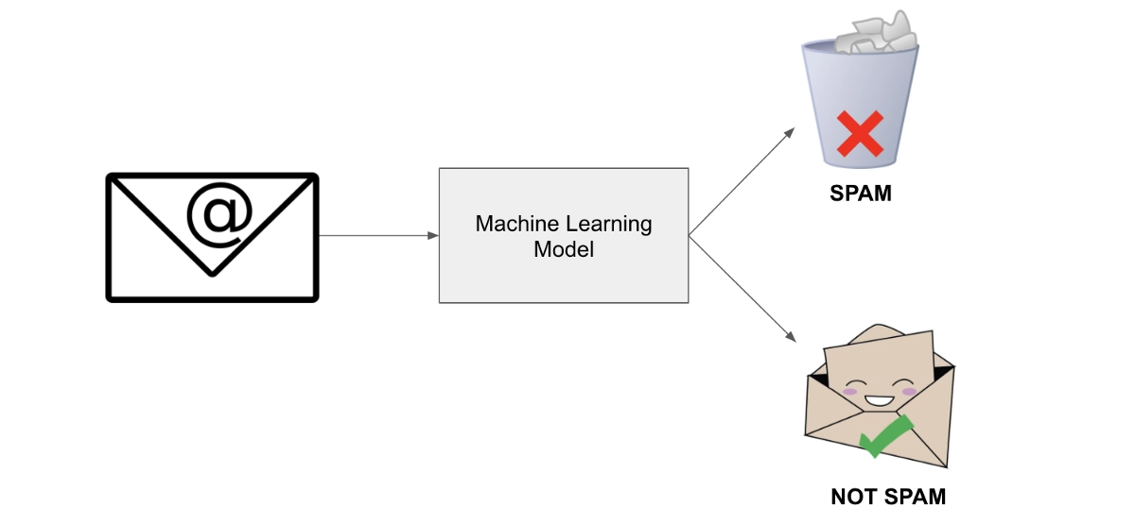
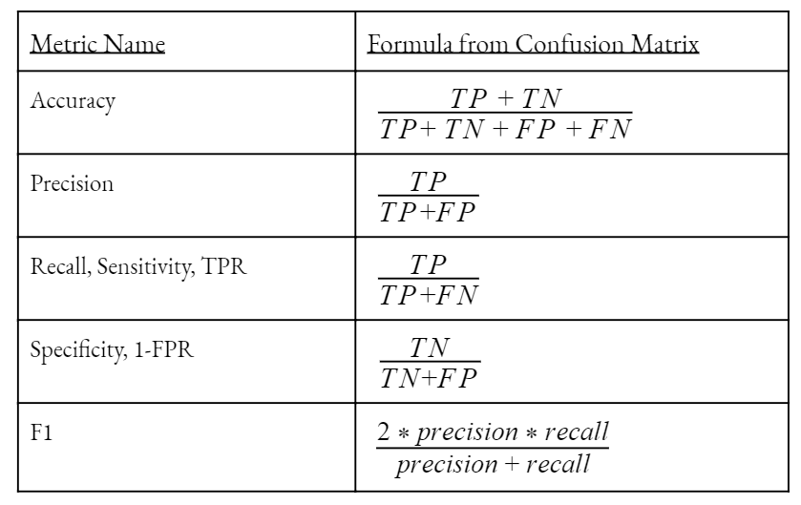
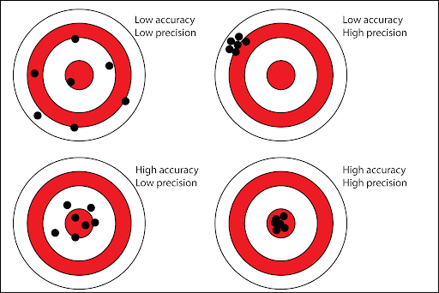
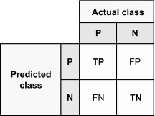
Let’s consider (binary) classification
Confusion Matrix

Slide 19
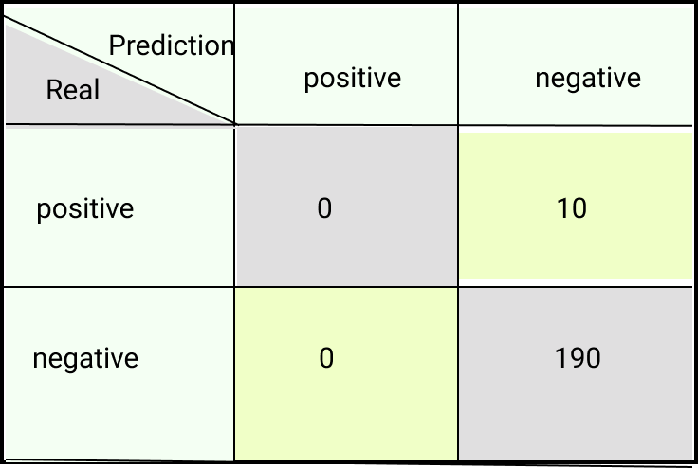
The accuracy paradox
High accuracy does not necessarily indicate good model performance,
and lower accuracy does not necessarily imply worse performance

Slide 20
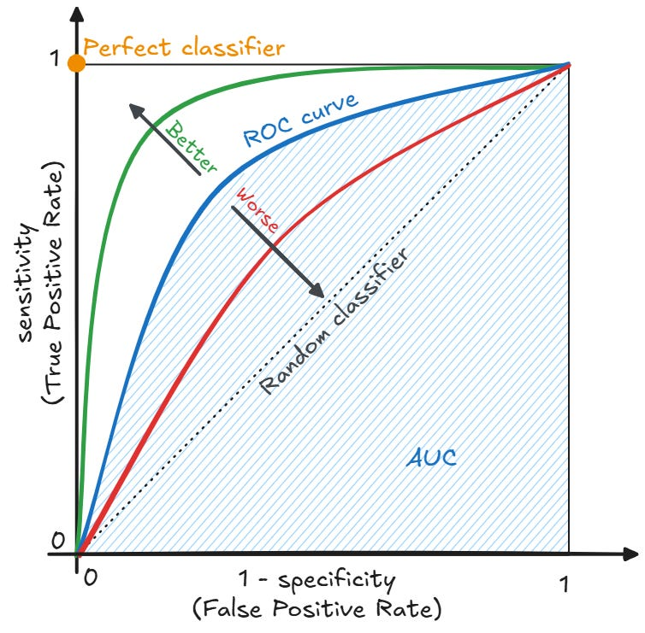
Let’s consider (binary) classification

Slide 21
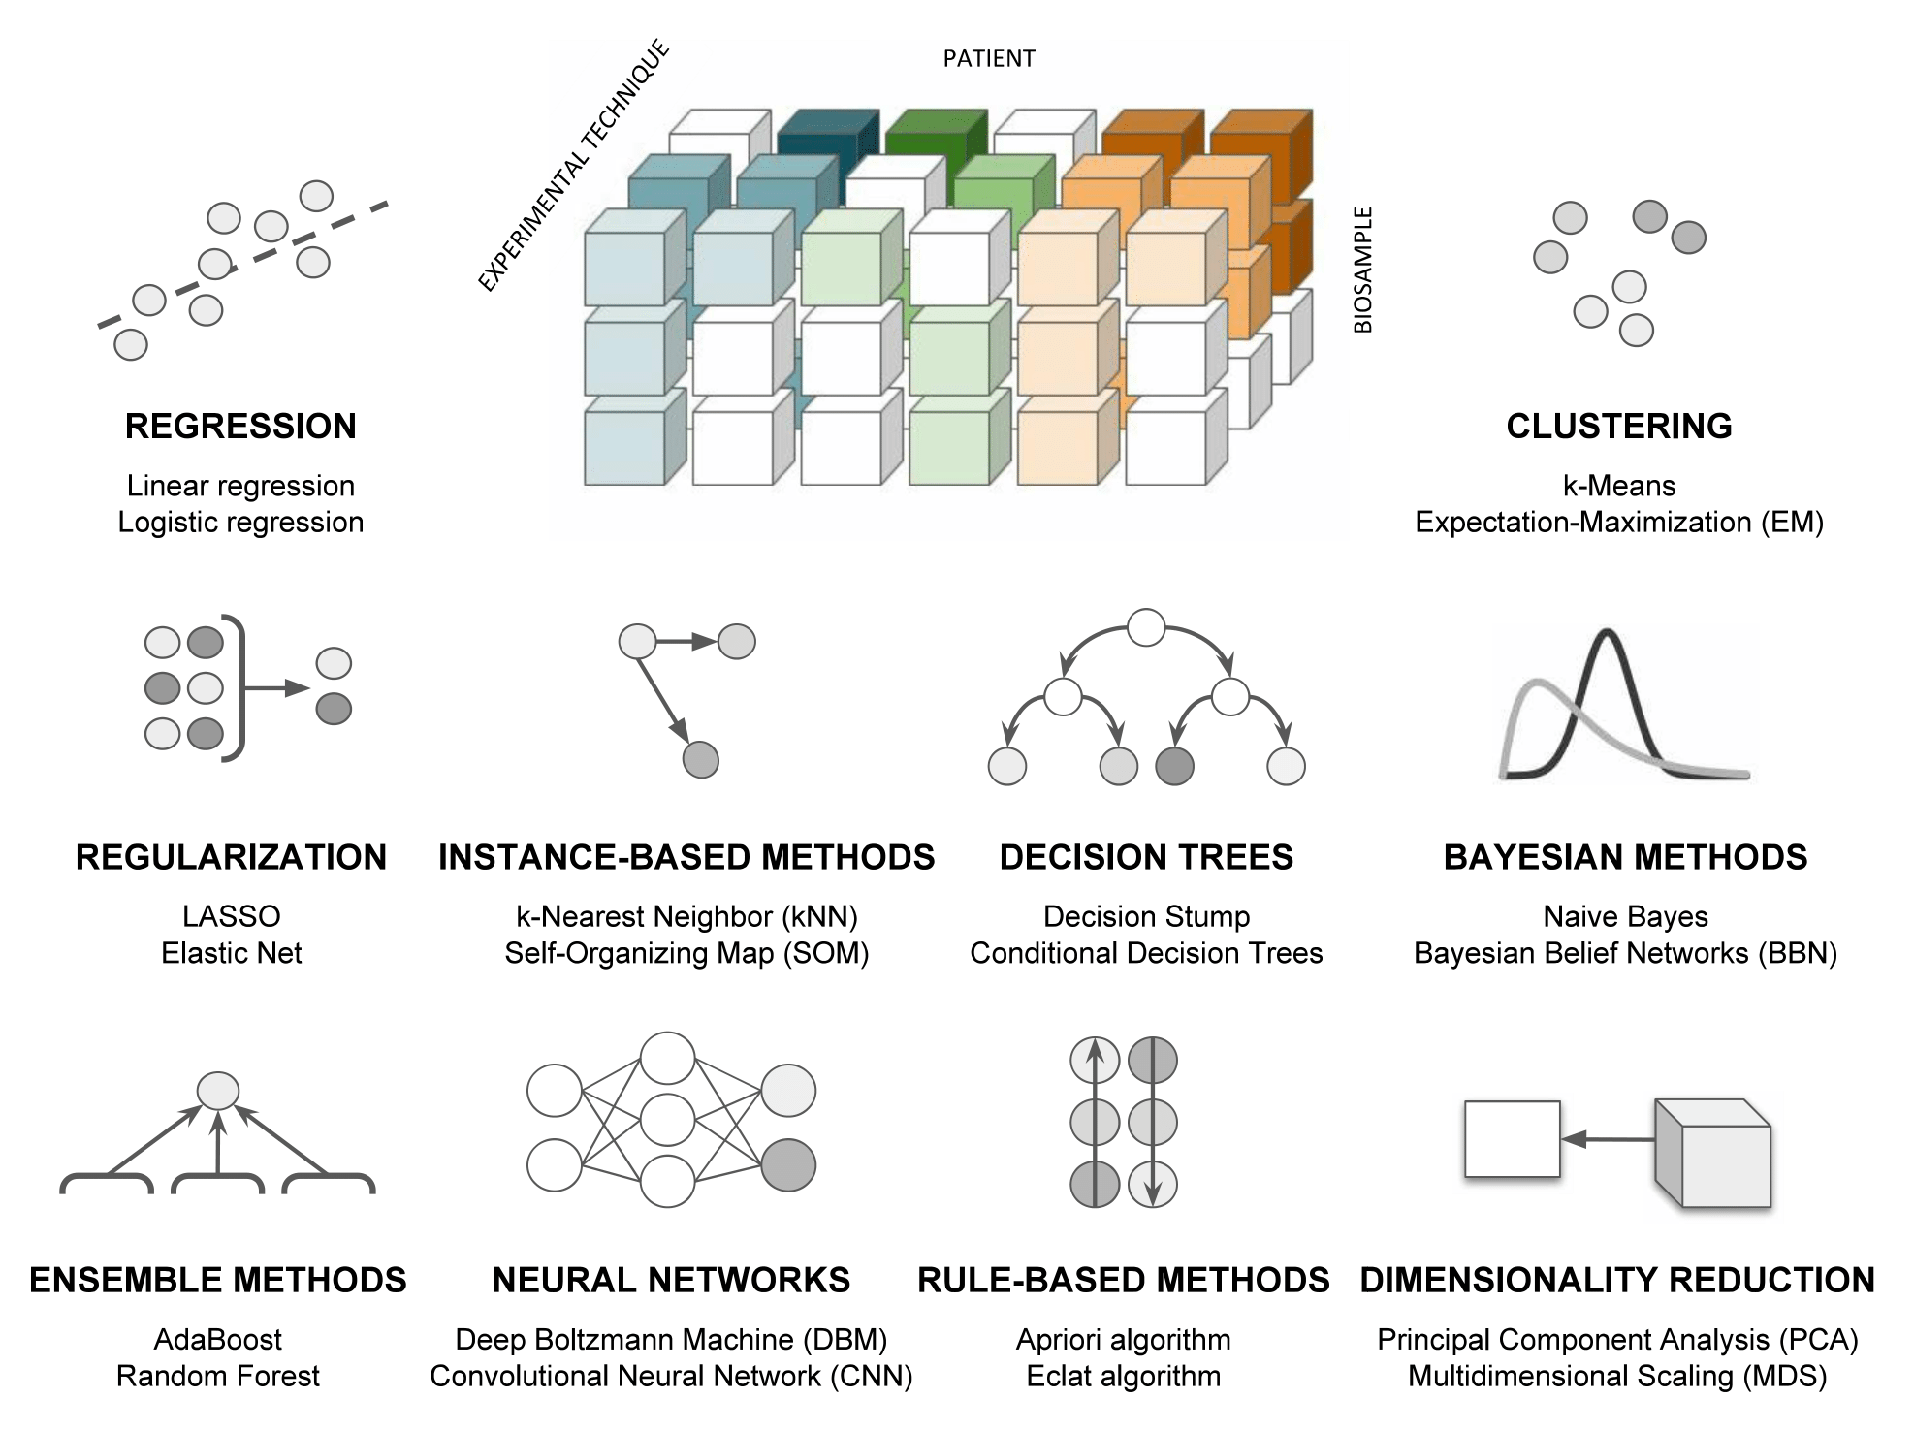

Cirillo & Valencia. Curr Opin Biotechnol. 2019

Slide 22
Key Metrics in Ethical & Societal Evaluation

Slide 23


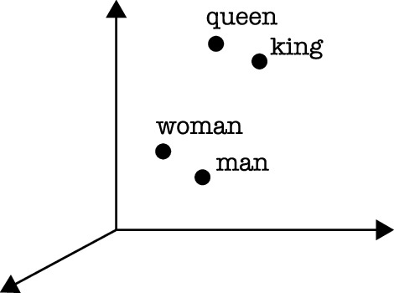

DATA
MODEL
APPLICATION
If the king is a man, then the queen is a . . .
textual data
word representations (embeddings)
semantic relationships between words

Slide 24
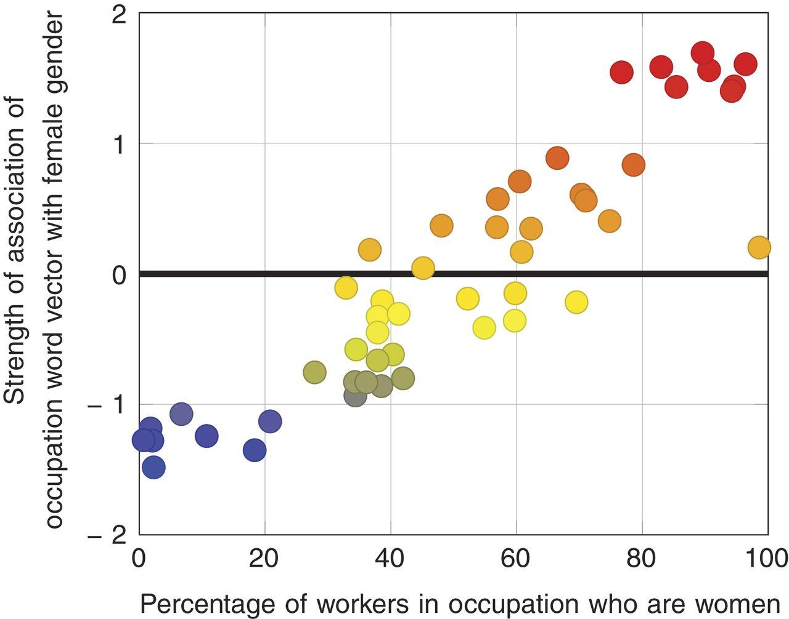
Caliskan et al. Science. 2017 doi: 10.1126/science.aal4230.

Slide 25
Two intertwined problems
DATA
social problem
(e.g., gender inequality in the workforce)
algorithmic problem
(e.g., AI reflecting gender inequality in the workforce)
APPLICATION

Slide 26
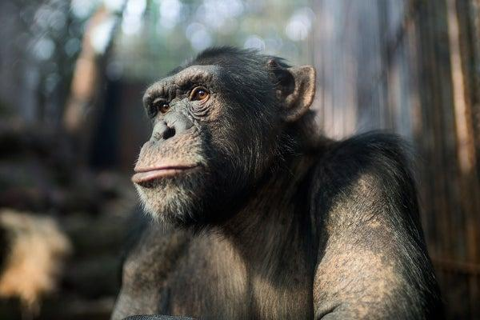
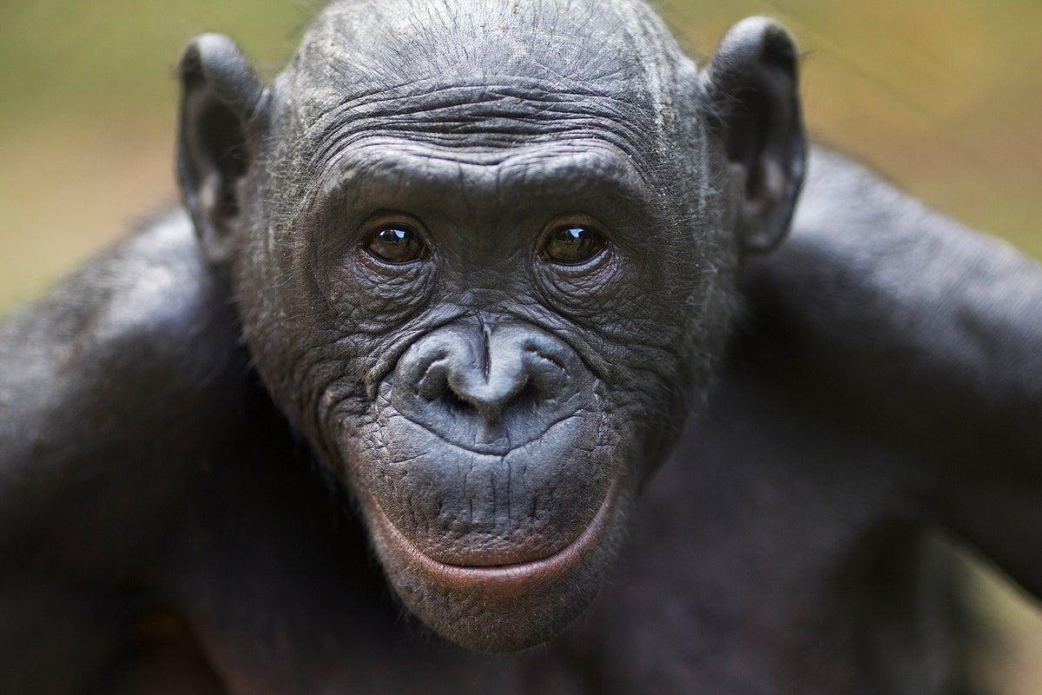
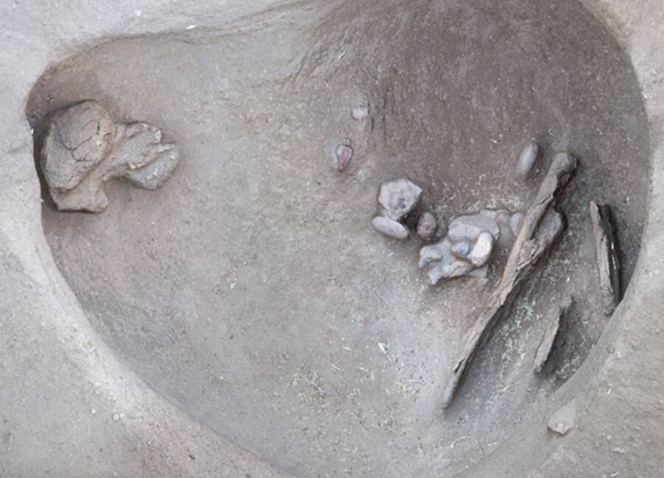


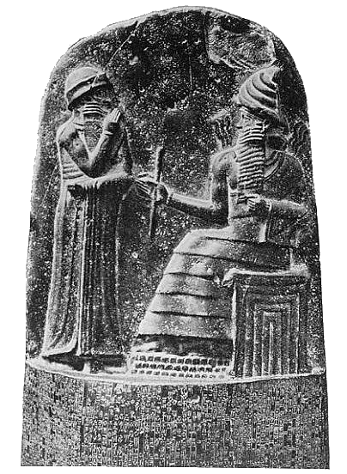
Origins of social structures: it’s complicated
Chimpanzee
Pan troglodytes
Bonobo
Pan paniscus
patriarchal structure
(male-dominated society)
matriarchal structure
(female-dominated society)
Xia Yuan/Getty Images
Anup Shah/Getty Images
Humans
Homo sapiens
Randall Haas/UC
JSTOR
Wikipedia
Wikipedia
Nomadic Hunter-Gatherers
(c. 10,000–7500 BC)
Çatalhöyük settlement
(c. 7500–5700 BC)
Minoan civilization
(c. 3100–1100 BC)
Code of Hammurabi
(c. 1755-1750 BC)
egalitarian structure
…well, at least for a while
Haas et al. Sci Adv. 2020 doi: 10.1126/sciadv.abd0310
Wright J. Anthropol. Archaeol. 2014 doi: 10.1016/j.jaa.2013.09.007
Driessen, L. Routledge, 2025 ISBN: 0415820413
May, L. Cambridge University Press, 2019 doi:10.1017/9781108670012

Slide 27
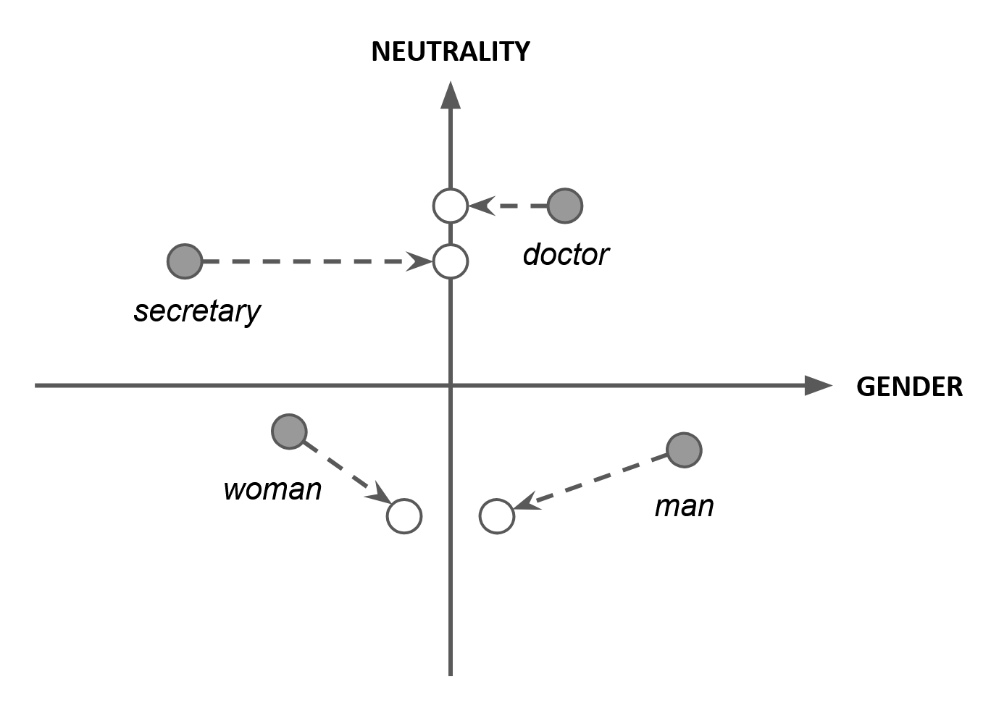
Mitigating bias could not be sufficient
Bolukbasi et al. NIPS (2016)
Cirillo et al. Elsevier (2022)

Slide 28
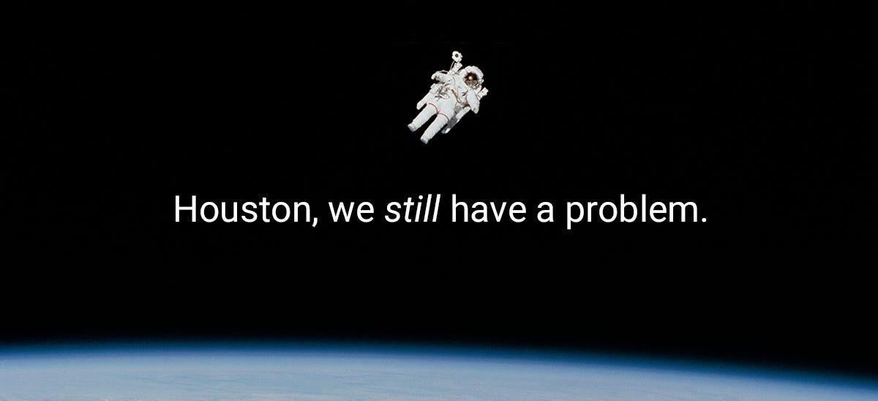
adapted from https://medium.com/@kcusnavy

Slide 29
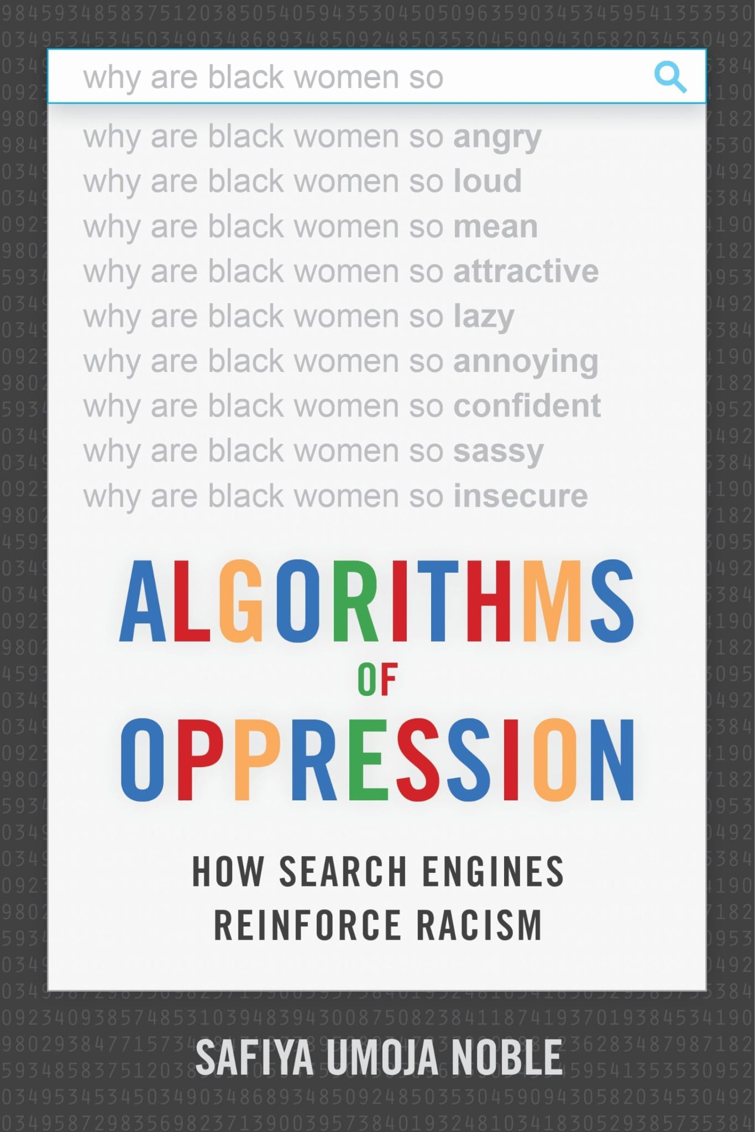
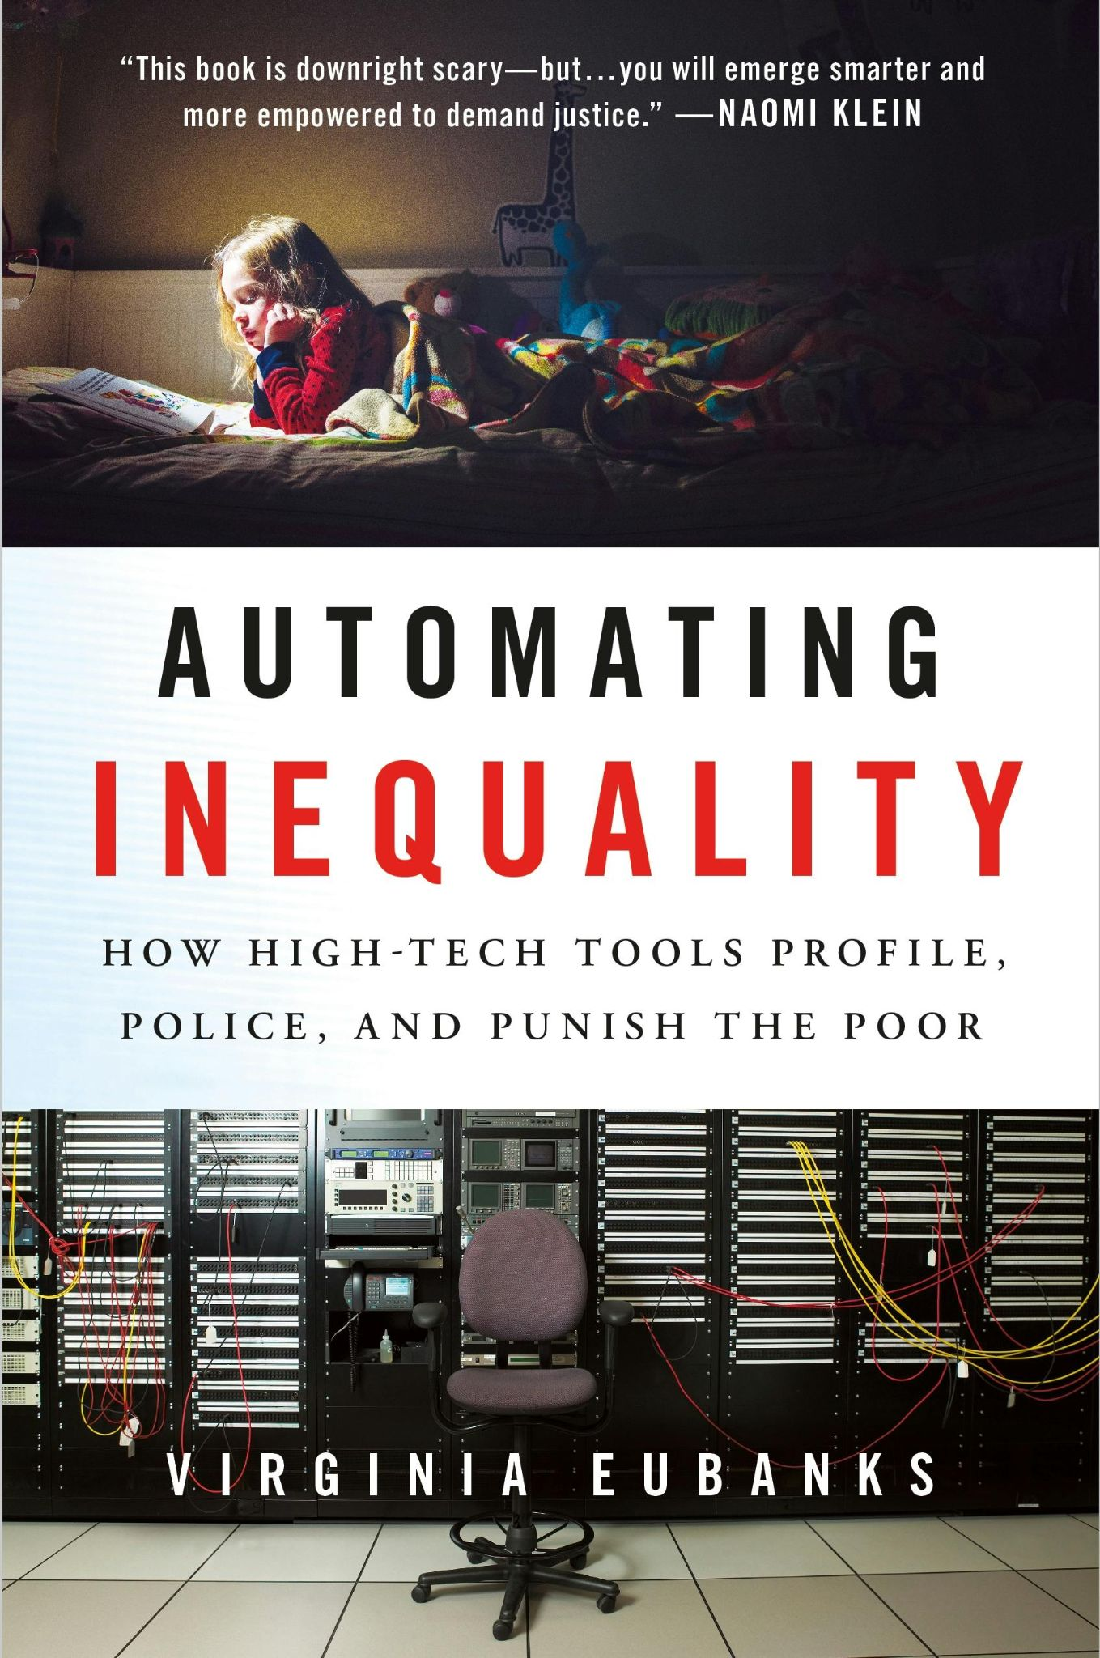
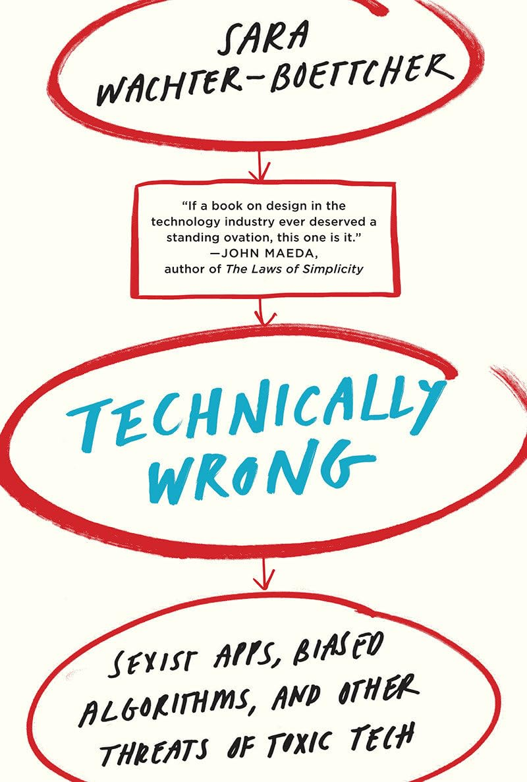


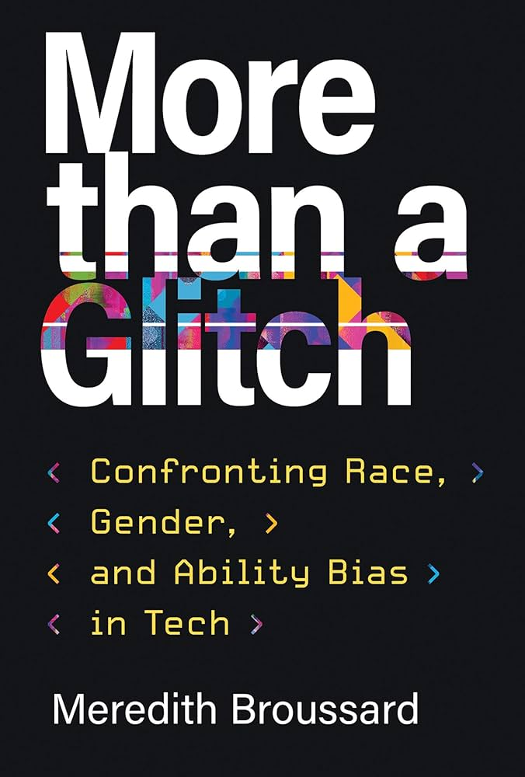
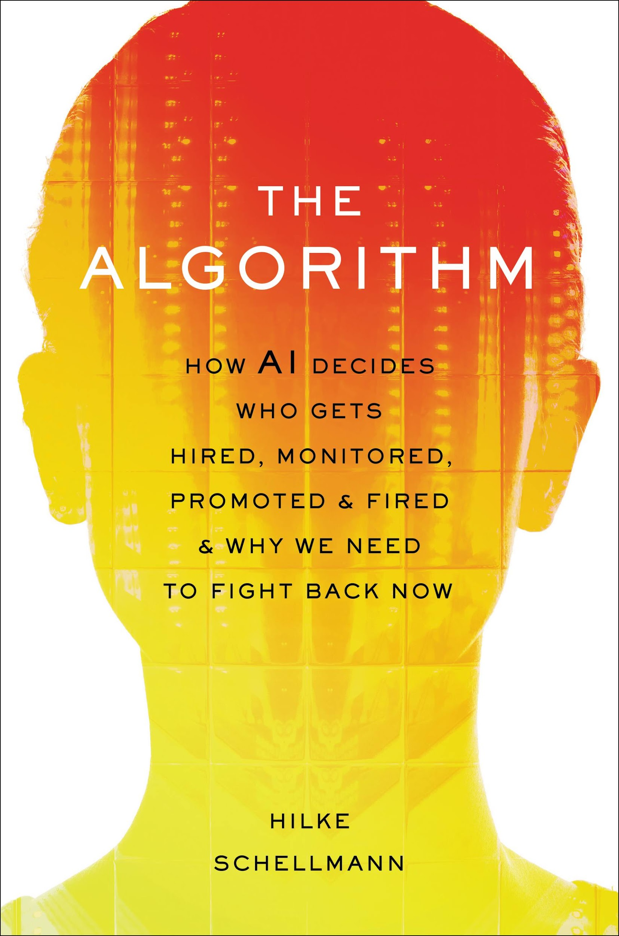
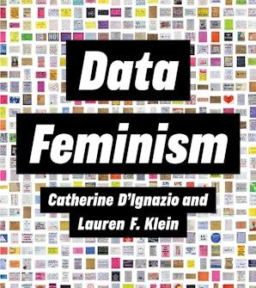

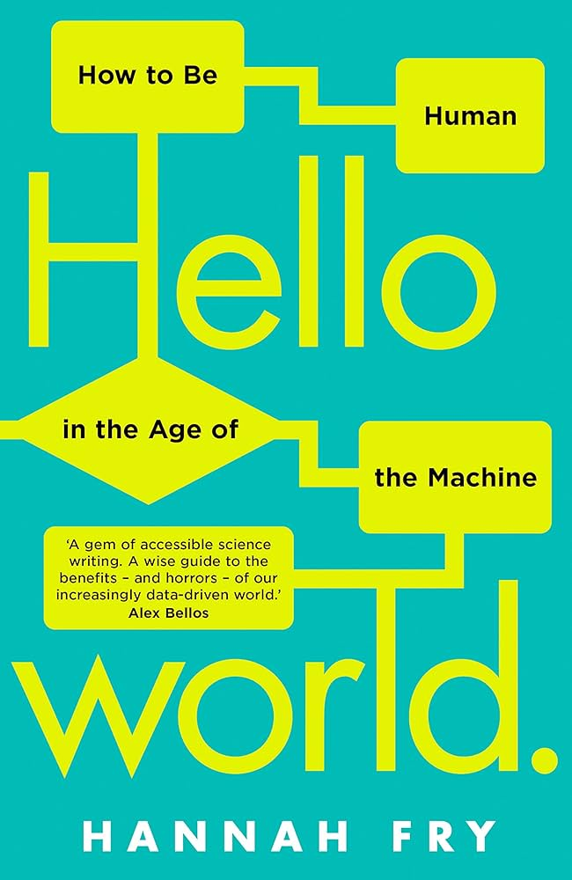
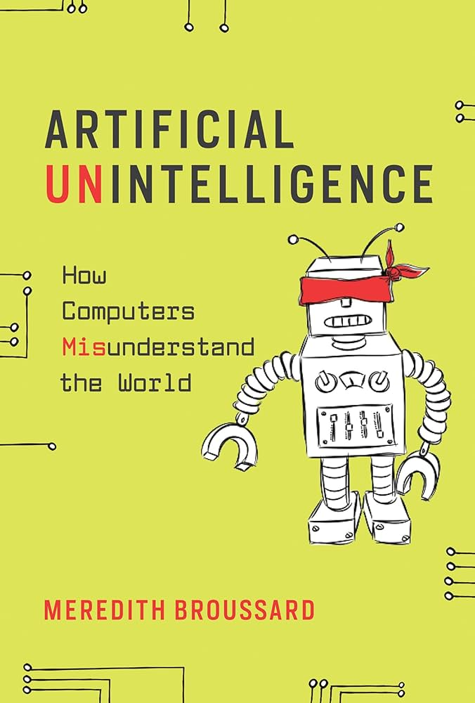
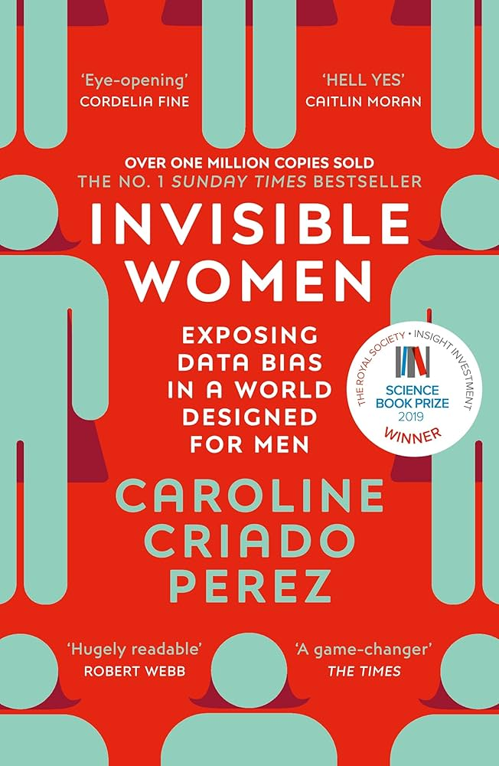
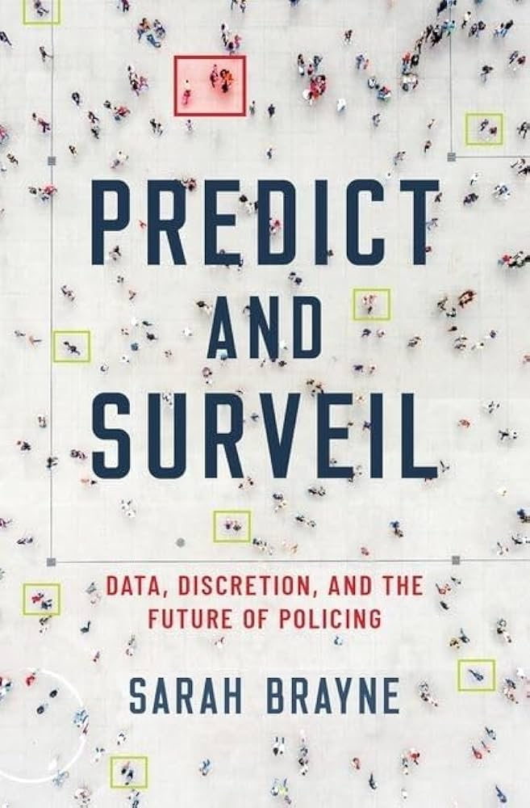


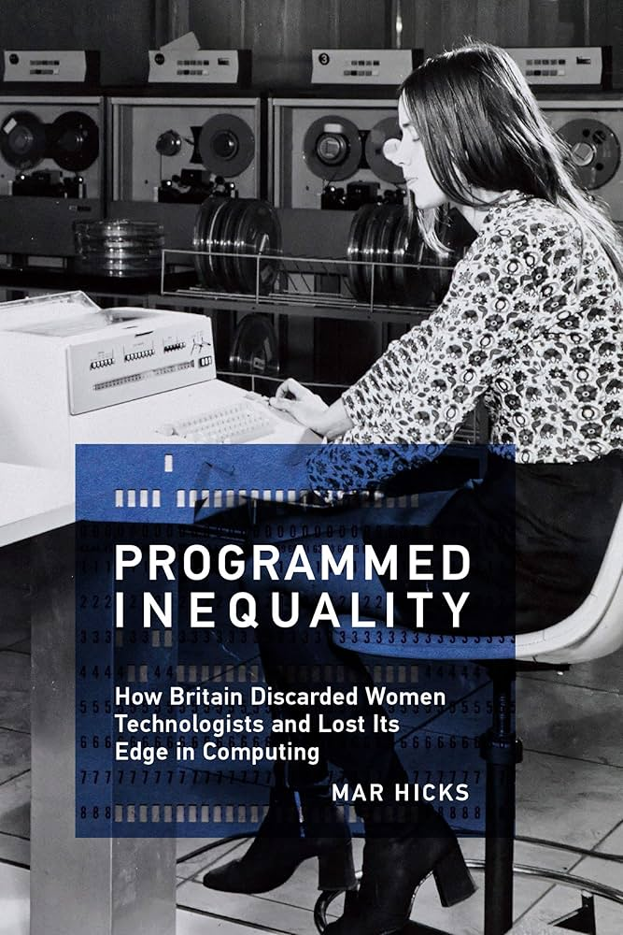
AI reflecting our own biases

Slide 30
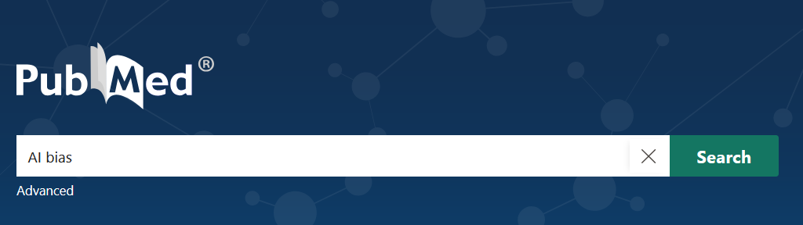
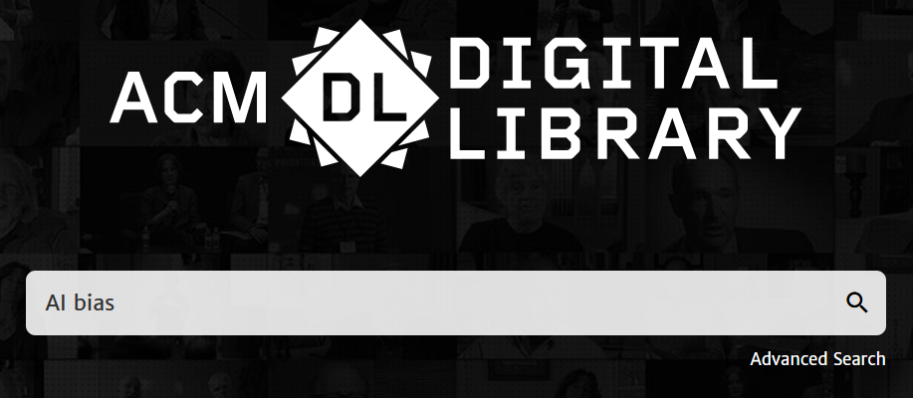


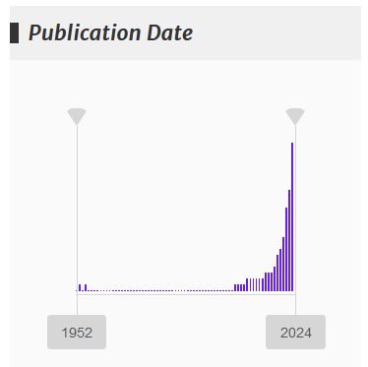
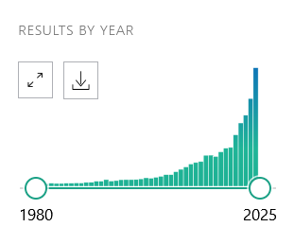
Research in AI bias
Life Sciences literature
Computer Sciences literature

Slide 31
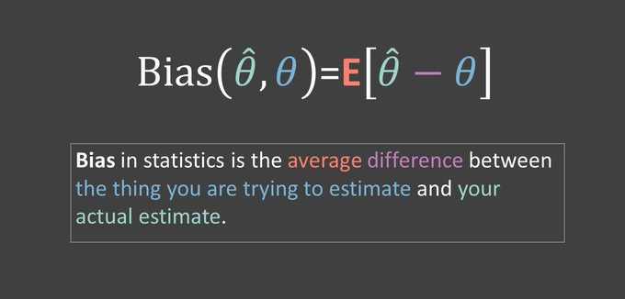

What is a bias?
@kareem_carr

Slide 32
What is a bias?
A BIAS is a systematic error made by a human (cognitive bias) or a machine (algorithmic bias)
that leads to a disadvantage for an individual or a group of people identified by personal attributes (sex, gender, age, ethnicity, etc.)

Slide 33
Real-world cases of bias in healthcare
An algorithm used by U.S. health systems underestimated the health needs of Black patients, reducing their access to high-risk care programs compared to equally sick white patients.
Obermeyer et al. Science 2019
Pulse oximeters were found to overestimate blood oxygen levels in non-White patients, potentially delaying life-saving treatment during the COVID-19 pandemic.
Sjoding et al. NEJM 2020
AI frequently underestimate risks for conditions like kidney stones and heart failure in African American patients, leading to less aggressive treatment and worse health outcomes.
Vyas et al. NEJM 2020
AI for medical imaging often rely on demographic shortcuts causing diagnostic disparities that remain even after algorithmic bias corrections when applied to real-world clinical settings.
Yang et al. Nat Med 2024
AI trained mostly on white, urban populations often fail to diagnose or prioritize treatment for Black and Latinx patients, resulting in misdiagnosis and delayed care.
Payton et al. Milbank Q. 2024

Slide 34


A recurrent pattern
DATA
PREDICTION
ALGORITHM
IMPACT
HEALTH
mortality or readmission rates
hospital performance
penalizes poor or non-White populations [1,2]
BANKING
income
credit scores
incorporates employment and salary disparities [3]
POLICING
measured crimes
targets for police intervention
increases scrutiny of some groups [4]
employment decisions or supervisory ratings
HIRING
curricula
propagates race and gender bias [5]
RETAIL
supply and demand
prices for goods at national level
penalizes poor households [6]
[1] K. E. Joynt Maddox et al., Health Serv. Res. 54, 327–336 (2019)
[2] K. E. Joynt Maddox, M. Reidhead, A. C. Qi, D. R. Nerenz, JAMA Intern. Med. 179, 769–776 (2019)
[3] S. Barocas, A. D. Selbst, Calif. Law Rev. 104, 671 (2016)
[4] K. Lum, W. Isaac, Significance 13, 14–19 (2016)
[5] I. Ajunwa, “The Paradox of Automation as Anti-Bias Intervention,” available at SSRN (2016); https://ssrn.com/abstract=2746078
[6] S. DellaVigna, M. Gentzkow, “Uniform pricing in US retail chains” (National Bureau of Economic Research, 2017)

Slide 35
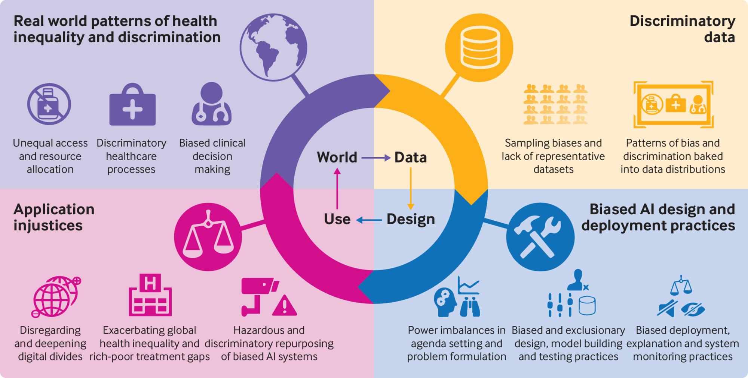
BMJ 2021;372:n304

Slide 36
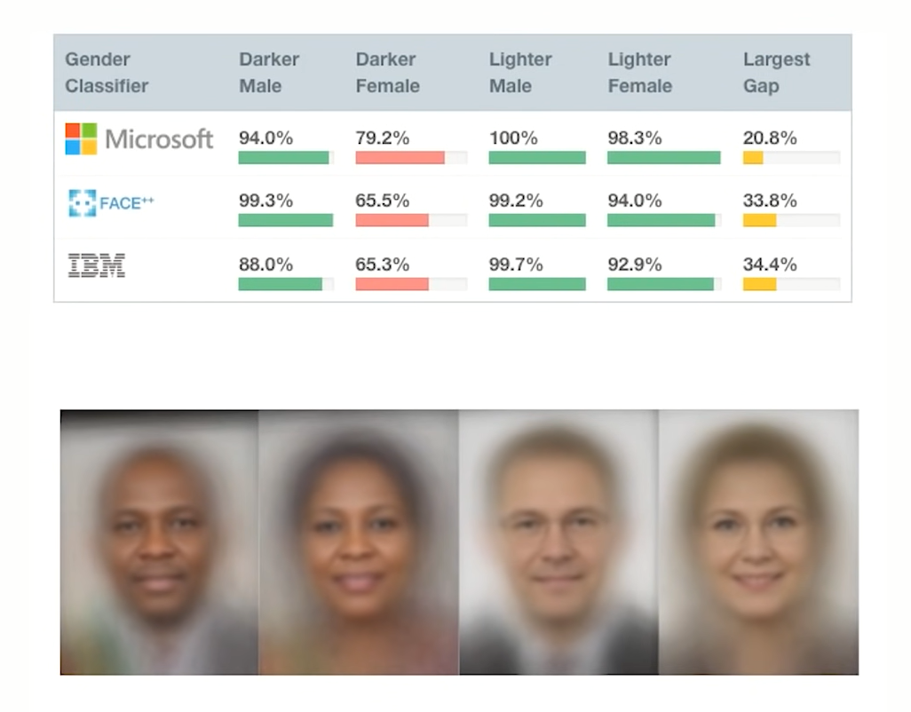
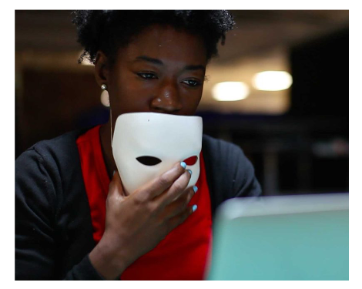
The importance of intersectionality
MIT Media Lab researcher Joy Buolamwini
source: https://gendershades.org/

Slide 37



Biases in the AI life cycle
dataset
HISTORICAL BIAS
REPRESENTATION BIAS
MEASUREMENT BIAS
world
population
AGGREGATION BIAS
model output
DEPLOYMENT BIAS
model
Data generation
benchmarks
Model building and implementation
EVALUATION BIAS
Adapted from: Surech & Guttag. EAAMO (2021)

Slide 38


Deployment bias and the digital divide
How less likely a woman is to own a mobile phone than a man
GSMA “The Mobile Gender Gap Report 2020”

Slide 39

“Bias in, bias out”
How the data has been generated, collected, processed?
What is the model actually learning?
How will the output be used in the real-world?

Slide 40
“Bias in, bias out”
How the data has been generated, collected, processed?
What is the model actually learning?
How will the output be used in the real-world?

Slide 41



Sex labels in human samples
7,036,375 total samples in 753 studies
1,249,255 total samples in 1,490 studies
Ruiz-Serra, Buslón, et al. 2024. iScience. doi:10.1016/j.isci.2024.110831

Slide 42


Ruiz-Serra, Buslón, et al. 2024. iScience. doi:10.1016/j.isci.2024.110831

Slide 43
Inaccurate data reporting can lead to bias
Systematic literature review to assess risk-of-bias (RoB)
48 studies examined (tabular, imaging, and hybrid data models)
50% demonstrated a high RoB
absent sociodemographic data
imbalance or incomplete datasets
weak algorithm design
Kumar et al. “Artificial intelligence bias in medical system designs: a systematic review.” Multimed Tools Appl (2024)

Slide 44

source: World Economic Forum. (2024). Closing the Women’s Health Gap:
A $1 Trillion Opportunity to Improve Lives and Economies.

Slide 45







Women are at higher risk than men of being prescribed drugs with toxic interactions
Blumenau
Indianapolis
Catalonia
Indianapolis
(USA)
Primary and secondary care
Primary, secondary and tertiary care
Primary care
Catalonia
(Spain)
Blumenau
(Brazil)
Sánchez-Valle et al. Prevalence and differences in the co-administration of drugs known to interact: an analysis of three distinct and large populations. BMC Med. 2024

Slide 46
“Bias in, bias out”
How the data has been generated, collected, processed?
What is the model actually learning?
How will the output be used in the real-world?

Slide 47

Black boxes

Slide 48


SHAP (Shapley Additive Explanations)

Slide 49

SHAP (Shapley Additive Explanations)
source: https://tutegomeze.medium.com/shap-shapley-additive-explanations-9a0d0e7e63d5

Slide 50

SHAP (Shapley Additive Explanations)
source: https://tutegomeze.medium.com/shap-shapley-additive-explanations-9a0d0e7e63d5

Slide 51




A practical implementation: KernelSHAP
Class | Probability
Tabby cat | 0.4271
Goldfinch | 0.0986
Egyptian cat | 0.0437
Tiger cat | 0.0162
Thimble | 0.0126
Positive and Negative contributions in the explanation of the class: Tabby cat.

Slide 52


Model explainability
source: Explaining Black-Box Machine Learning Predictions – Sameer Singh

Slide 53

Top 50 features selected by the T-Test method for the SVM model
Celeste et al. “Ethnic disparity in diagnosing asymptomatic bacterial vaginosis using machine learning”. npj Digit. Med. (2023)

Slide 54



Fairness metrics
Demographic parity
Equal opportunity
Equalized odds
4/8 = 50%
TPR = 2/4 = 50%
TPR = 2/4 = 50%
FPR = 1/4 = 25%
3/6 = 50%
TPR = 1/2 = 50%
TPR = 1/2 = 50%
FPR = 1/4 = 25%
● = healthy ● = diseased
Cirillo & Rementeria. Elsevier Academic Press 2022. ISBN: 9780128213926
Corbett-Davies et al. KDD 2017. DOI:https://doi.org/10.1145/3097983.3098095
= predicted to be diseased

Slide 55

Fairness metrics
Pareto Frontier of the Accuracy-Fairness Trade-off
source: https://lawreviewblog.uchicago.edu/2020/10/30/aa-ho-xiang/

Slide 56



Open source toolkit for bias detection and mitigation
https://aif360.res.ibm.com/data

Slide 57
“Bias in, bias out”
How the data has been generated, collected, processed?
What is the model actually learning?
How will the output be used in the real-world?

Slide 58


Slide 59




Transdisciplinary evaluation of AI models
Efficiency
Integration with other systems
Fairness
Security
Reliability
Accessibility
Environmental impact
Technical Indicators
Accessibility
Patient impact
Bias & Intersectionality
Data Security
Usability
Social norms
Traceability
Compliance
Ethical considerations
Human Interaction Indicators
Robustness
Explainability
Societal Indicators

Slide 60

AI for Health: a double-edge sword
AI can reduce inequalities by integrating factual differences
scientifically supported and medically relevant
enabling precision medicine
AI can magnify inequalities by integrating artifactual differences
systematic errors in data, models and outcomes
promoting discrimination and inequality

Slide 61
Why AI evaluation matters?

Slide 62
Thank you!
https://bioinfo4women.bsc.es/
davide.cirillo@bsc.es
© 2025 Barcelona Supercomputing Center - Centro Nacional de Supercomputación. Author: (XXXX).
Material licensed under CC BY-NC-4.0.

